Slide 1
bdbms: A Database Management System for Biological Data
Mohamed Y. Eltabakh¹
Mourad Ouzzani²
Walid G. Aref¹
¹Purdue University, Computer Science Department
²Purdue University, Cyber Center

Slide 2

Introduction
Biological data adds new challenges and requirements to DBMSs
  Community-based curation and provenance tracking
  Complex dependencies that usually involve external procedures
  Authorization that depends not only on the user’s identity but also on the content of the data
  Various data types and large amounts of data
Prediction tool
B1: Curated by user admin
B5: This gene has an unknown function
GID | GName | GSequence
JW0080 | mraW | ATGATGGAAAA…
JW0041 | fixB | ATGAACACGTT…
JW0037 | caiB | ATGGATCATCT…
JW0055 | yabP | ATGAAAGTATC…
GID | ProteinSequence
JW0080 | MMENYKHTTV…
JW0041 | MNTFSQVWVF…
JW0037 | MDHLPMPKFG…
JW0055 | MKVSVPGMPV …
B4: pseudogene
B2: possibly split by frameshift
Gene
B3: obtained from GenoBase
Protein

Slide 3
Introduction
Biological data adds new challenges and requirements to DBMSs
  Community-based curation and provenance tracking
  Complex dependencies that usually involve external procedures
  Authorization that depends not only on the user’s identity but also on the content of the data
  Various data types and large amounts of data
We propose bdbms as a prototype database engine for supporting and processing biological data
  Annotation and provenance management
  Local dependency tracking
  Content-based update authorization
  Non-traditional and novel access methods

Slide 4
Annotation Management:
Challenges
Adding annotations at various granularities (cell, tuple, column, table, or combinations)
Storing annotations
Categorizing annotations
Archiving/restoring annotations
Propagating/querying annotations
B1: Curated by user admin
B5: This gene has an unknown function
GID | GName | GSequence
JW0080 | mraW | ATGATGGAAAA…
JW0041 | fixB | ATGAACACGTT…
JW0037 | caiB | ATGGATCATCT…
JW0055 | yabP | ATGAAAGTATC…
B4: pseudogene
Gene
B3: obtained from GenoBase
B2: possibly split by frameshift

Slide 5
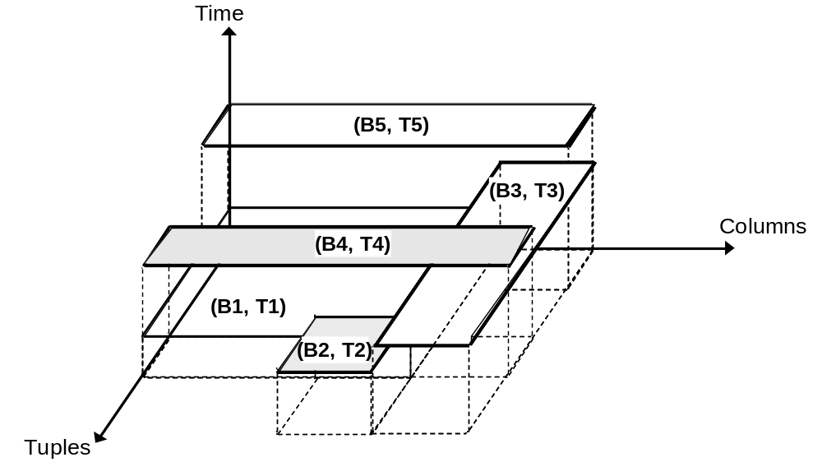
Annotation Management:
Storing and Categorizing Annotations
CREATE ANNOTATION TABLE <ann_table_name>
ON <user_table_name>
DROP ANNOTATION TABLE <ann_table_name>
ON <user_table_name>
A-SQL CREATE and DROP commands
provenance
Lab
R
public
Representing annotations at high granularities
(Groups of contiguous cells)
Each relation may have multiple
annotation tables

Slide 6
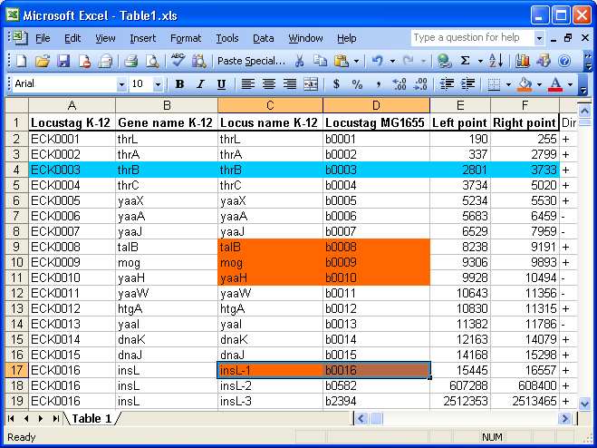
Annotation Management:
Adding and Archiving Annotations
Adding annotations to results of general SQL queries
ADD ANNOTATION
TO <annotation_table_names>
VALUE <annotation_body>
ON <SELECT_statement>
A-SQL ADD command
Visualization Interface
Archiving/restoring annotations
ARCHIVE ANNOTATION
FROM <annotation_table_names>
[BETWEEN <time1> AND <time2>]
ON <SELECT_statement>
RESTORE ANNOTATION
FROM <annotation_table_names>
[BETWEEN <time1> AND <time2>]
ON <SELECT_statement>
A-SQL ARCHIVE command
A-SQL RESTORE command

Slide 7
Annotation Management:
Propagating and Querying Annotations
A-SQL SELECT:
  Want to query data and propagate the annotation with the data
  Want to query the data by its annotation
SELECT [DISTINCT] C_{i} [PROMOTE (C_{j}, C_{k}, …)], …
FROM Relation_name [ANNOTATION (S₁, S₂, …)], …
[WHERE <data_conditions>]
[AWHERE <annotation_condition>]
[GROUP BY <data_columns>
[HAVING <data_condition>]
[AHAVING <annotation_condition>] ]
[FILTER <filter_annotation_condition>]
Copying annotations
Which annotation tables
Conditions over the annotations
Filtering the annotations over each tuple
Extended semantics for standard operators

Slide 8
Annotation Management:
Provenance Data
bdbms treats provenance as a kind of annotations
All the requirements and functionalities of annotations apply to provenance data
Additional requirements for provenance:
  Structure of provenance data is well-defined (not free text)
    Supporting XML-formatted annotations can be beneficial in structuring provenance data
  Authorization over provenance data
    Need for access control mechanism over provenance data and annotations in general

Slide 9
Local Dependency Tracking:
Challenges
Modeling dependencies
Tracking out-dated (or possibly invalid) data
Reporting and annotating out-dated data
Validating out-dated data

Slide 10
Local Dependency Tracking:
Modeling Dependencies
Extend Functional Dependencies (FDs) to Procedural Dependencies (PDs)
  Capture the characteristics and properties of the dependency
Gene.GSequence
Prediction tool P
Protein.PSequence
(1)
(Executable,
non-invertible)
Protein.PSequence
Lab experiment
Protein.PFunction
(2)
(non-executable,
non-invertible)
Lab experiment
GID | GName | GSequence
JW0080 | mraW | ATGATGGAAAA…
JW0082 | ftsI | ATGAAAGCAGC…
JW0055 | yabP | ATGAAAGTATC…
PName | GID | PSequence | PFunction
mraW | JW0080 | MMENYKHT… | Exhibitor
ftsI | JW0082 | MKAAAKTQ… | Cell wall formation
yabP | JW0055 | MKVSVPGM… | Hypothetical protein
Gene
Protein
Prediction tool P

Slide 11
Content-based Authorization
Authorizing operations based on the content of the modified data is very important (Content-based authorization)
On-demand monitoring for users’ updates over the database
Maintain a log with the update operations and their inverse operations
Administrator(s) check the log and approve/disapprove operations
  For disapproved operations, the inverse operation is executed
May need to involve local dependency tracking to invalidate some of the data items
START CONTENT APPROVAL
ON <table_name>
[COLUMNS <column_names>]
APPROVED BY <user/group>
STOP CONTENT APPROVAL
ON <table_name>
[COLUMNS <column_names>]

Slide 12
Indexing and Query Processing
Biological data contains various data formats (Sequences are dominant)
bdbms supports:
  Multi-dimensional index structures (suitable for protein 3D structures)
  Compressed index structures (suitable for large sequences)

Slide 13
Indexing and Query Processing:
Multi-dimensional Indexes
Integrating SP-GiST inside bdbms
  SP-GiST is a generic indexing framework for indexing multidimensional data (kd-tree, quadtree, …) [SSDBM01, JIIS01, ICDE04, ICDE06 ]
  Suitable for protein 3D structures and surface shape matching
PostgreSQL Engine
PostgreSQL Function Manager
SP-GiST
Quad-tree
SP-GiST
Core
SP-GiST
kd-tree

Slide 14
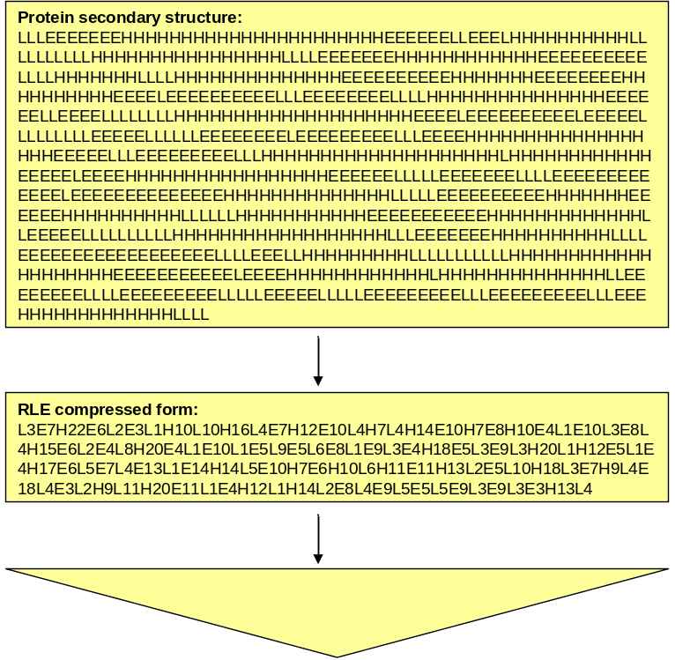
Indexing and Query Processing:
Compressed Indexes
Compressing the data improves the system performance
  Storage and I/O operations
Compressing biological sequences using Run-Length-Encoding (RLE)
SBC-tree is a novel index structure for indexing and searching RLE-compressed sequences without decompressing it
sequence
compression
indexing
compressed sequences
SBC-tree

Slide 15
Summary
Biological data add several challenges and requirements to current DBMSs
bdbms is a database management system for supporting and processing biological data
bdbms is being prototyped using PostgreSQL
Content-based update authorization
Annotation and provenance management
bdbms
Non-traditional and novel access methods
Local dependency tracking
A-SQL language

Slide 17
Annotation Management:
Example
A1: These genes are published in …
B1: Curated by user admin
A3: Involved in methyltransferase activity
B5: This gene has an unknown function
GID | GName | GSequence
JW0080 | mraW | ATGATGGAAAA…
JW0082 | ftsI | ATGAAAGCAGC…
JW0055 | yabP | ATGAAAGTATC…
JW0078 | fruR | GTGAAACTGGA…
GID | GName | GSequence
JW0080 | mraW | ATGATGGAAAA…
JW0041 | fixB | ATGAACACGTT…
JW0037 | caiB | ATGGATCATCT…
JW0055 | yabP | ATGAAAGTATC…
JW0027 | ispH | ATGCAGATCCT…
B4: pseudogene
DB1_Gene
A2: These genes were obtained from RegulonDB
DB2_Gene
B2: possibly split by frameshift
B3: obtained from GenoBase

Slide 18
Simple Storage Scheme
GID | Ann_GID | GName | Ann_GName | GSequence | Ann_GSequence
JW0080 |  | mraW |  | ATGATGGAAAA… | A3
JW0082 | A1 | ftsI | A1 | ATGAAAGCAGC…
JW0055 | A1, A2 | yabP | A1, A2 | ATGAAAGTATC… | A2
JW0078 | A2 | fruR | A2 | GTGAAACTGGA… | A2
Handling multi-granularity annotations
  Hard to perform optimizations
Example:
  A2 and B3 are repeated 6 and 5 times, respectively
DB1_Gene
GID | Ann_GID | GName | Ann_GName | GSequence | Ann_GSequence
JW0080 | B1, B5 | mraW | B1, B5 | ATGATGGAAAA… | B3, B5
JW0041 | B1 | fixB | B1 | ATGAACACGTT… | B3
JW0037 | B1, B4 | caiB | B1, B4 | ATGGATCATCT… | B3, B4
JW0055 |  | yabP | B2 | ATGAAAGTATC… | B3
JW0027 |  | ispH | B2 | ATGCAGATCCT… | B3
DB2_Gene
Every data column has a corresponding annotation column

Slide 19
Adding Annotations
Adding the annotations should be transparent to users
  How or where the annotations are stored should be transparent
Example:
  To add annotation A2
    Know where the annotations are stored (Ann_GID, Ann_GName, Ann_GSequence)
    Update these columns to add A2 to each column

Slide 20
Propagating Annotations
Key requirement is to simplify users’ queries
Without a database system support, users’ queries may become complex and user-unfriendly
Q₁: Retrieve genes that are common in DB1_Gene and DB2_Gene along with their annotations

Slide 21
Propagating Annotations:
Answering Q₁
R1(GID, GName, GSequence) =
SELECT GID, GName, GSequence
FROM DB1_Gene
INTERSECT
SELECT GID, GName, GSequence
FROM DB2_Gene
R2(GID, GName, GSequence, Ann_GID,
Ann_GName, Ann_GSequence) =
SELECT R.GID, R.GName, R.GSequence,
G.Ann_GID, G.Ann_GName,
G.Ann_GSequence
FROM R 1 R, DB1_Gene G
WHERE R.GID = G.GID
R3(GID, GName, GSequence, Ann_GID, Ann_GName, Ann_GSequence) =
SELECT R.GID, R.GName, R.GSequence, R.Ann_GID + G.Ann_GID,
R.Ann_GName + G.Ann_GName,
R.Ann_GSequence + G.Ann_GSequence
FROM R2 R, DB2_Gene G
WHERE R.GID = G.GID

Slide 22
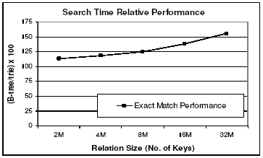
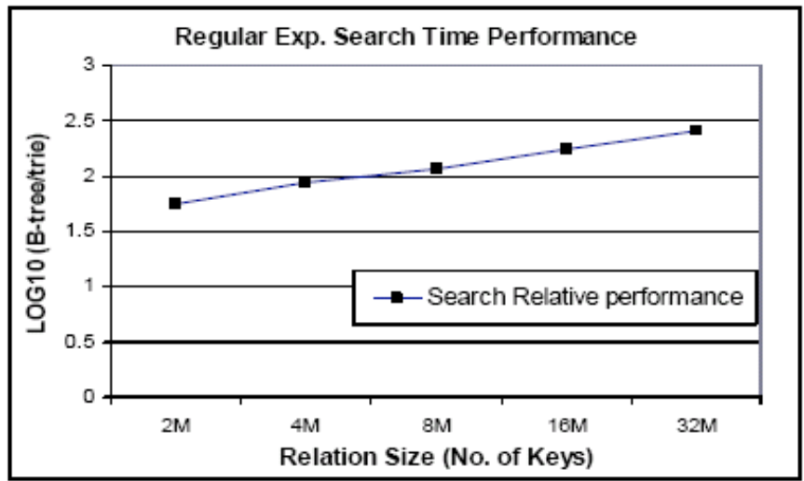
Indexing and Query Processing:
SP-GiST: trie vs. B-tree
trie is more efficient and scalable
Allow wildcard ‘?’ that replaces a single character

Slide 23
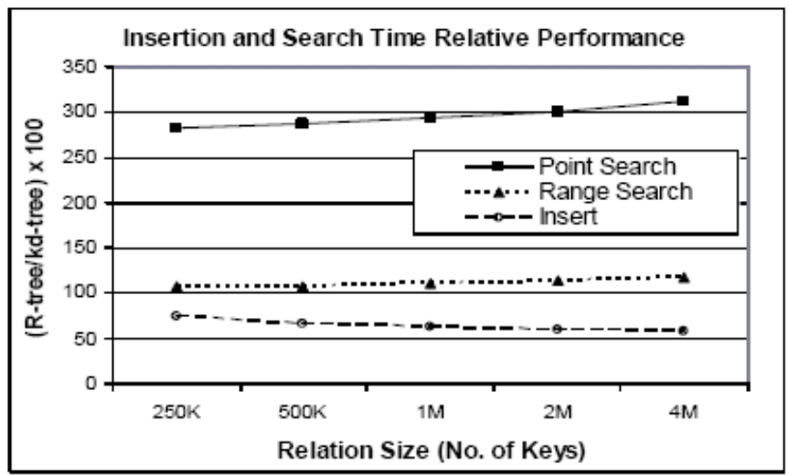
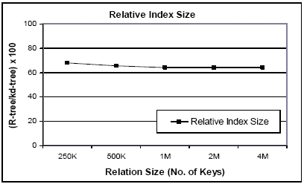
Indexing and Query Processing:
SP-GiST: kd-tree vs. R-tree
kd-tree has better search performance
R-tree has better insertion performance and less storage overhead

Slide 24
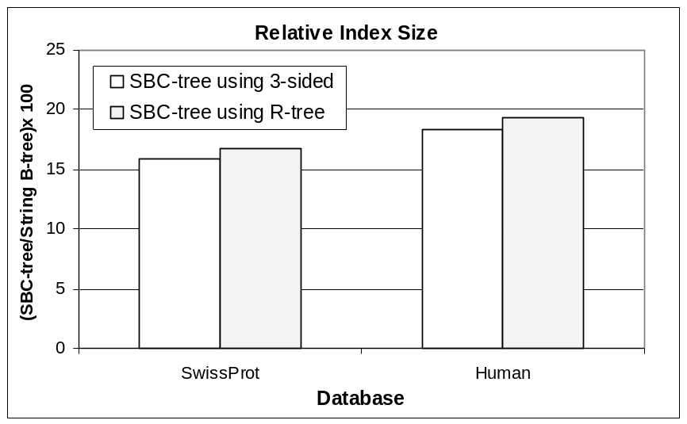
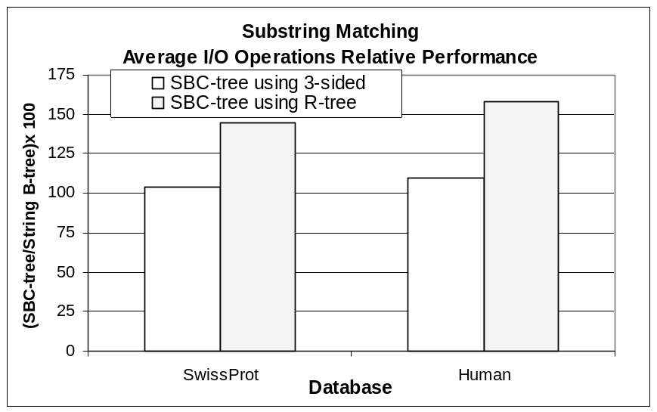
Indexing and Query Processing:
SBC-tree Performance
Achieves around 85% reduction in storage
Retains the optimal search performance

Slide 25
Annotation Management:
Propagating and Querying Annotations
A-SQL SELECT
SELECT [DISTINCT] C_{i} [PROMOTE (C_{j}, C_{k}, …)], …
FROM Relation_name [ANNOTATION (S₁, S₂, …)], …
[WHERE <data_conditions>]
[AWHERE <annotation_condition>]
[GROUP BY <data_columns>
[HAVING <data_condition>]
[AHAVING <annotation_condition>] ]
[FILTER <filter_annotation_condition>]
Copying annotations
Which annotation tables
Conditions over the annotations
Filtering the annotations over each tuple
Extended semantics for standard operators
GID | Ann_GID | GName | Ann_GName
JW0055 | A1, A2 | yabP | A1, A2
JW0078 | A2 | fruR | A2
GID | Ann_GID | GName | Ann_GName
JW0055 | B5 | yabP | B2,B5
JW0027 | B6 | ispH | B2
intersect
JW0055 | A1, A2, B5 | yabP | A1, A2, B2, B5

Slide 26
Local Dependency Tracking:
Tracking and Reporting Out-dated Data
Associate a bitmap with each table
Lab experiment
GID | GName | GSequence
JW0080 | mraW | ATGATGGAAAA…
JW0082 | ftsI | ATGAAAGCAGC…
JW0055 | yabP | ATGAAAGTATC…
PName | GID | PSequence | PFunction
mraW | JW0080 | MMENYKHT… | Exhibitor
ftsI | JW0082 | MKAAAKTQ… | Cell wall formation
yabP | JW0055 | MKVSVPGM… | Hypothetical protein
Protein
Protein-Bitmap
Gene
Protein
Prediction tool P
PName | GID | PSequence | PFunction
0 | 0 | 0 | 1
0 | 0 | 0 | 1
0 | 0 | 0 | 0
0 → Valid values
1 → Out-dated (possibly invalid) values
Protein-Bitmap

