Slide 1
Spatial Indexing and Visualizing Large Multi-dimensional Databases
I. Csabai, M. Trencséni, L. Dobos,
G. Herczegh, P. Józsa, N. Purger
Eötvös University, Budapest
T.Budavári, A. Szalay
Johns Hopkins University, Baltimore

Slide 2
Telegraph Message
FROM: Natural Scientists
TO: DB Community
URGENT!
We have lot of data, and still collecting … STOP
The data is complex … STOP
We want to do complex stuff with it … STOP
We want to interactively visualize it … STOP
Files are not good enough for us … STOP
Current DBMS are not designed for us … STOP
Please help ! … SOS!

Slide 3
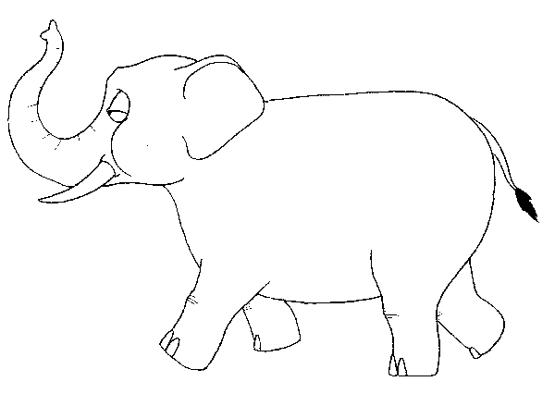
Doing Science with Elephants
E = mc²

Slide 4
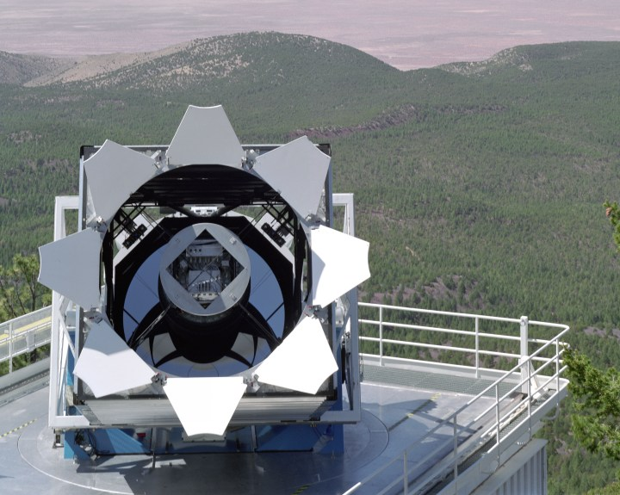
The data
120 Mpixel camera
5 years of Sloan Digital Sky
Survey data
Public archive: SkyServer
(SQL Server, A. Szalay, J. Gray)
Large: 3TB, 270M objects
Multi-dimensional: 300 parameters/object
    Index only for key values (1D) and sky coordinates (2D)
Spatial …
Upcoming surveys (Pan-Starrs, 1.4 Gpixel camera) will produce same data in 1 week

Slide 5
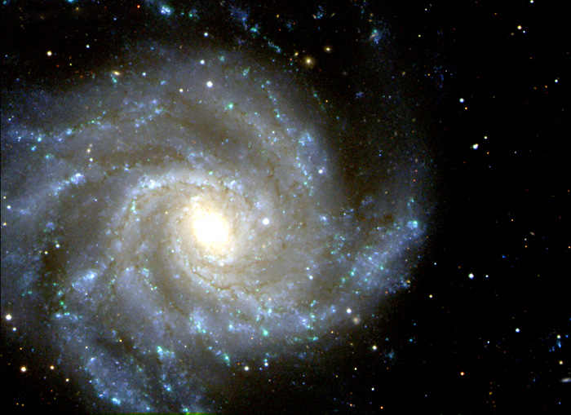
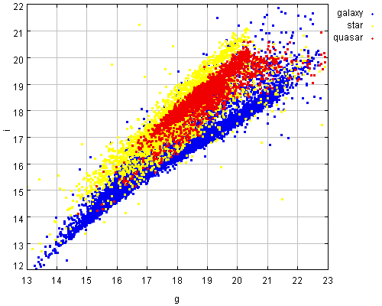
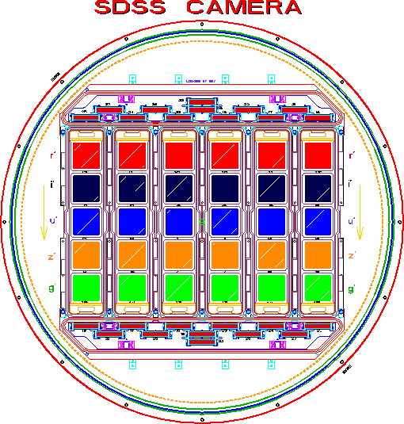

The magnitude space
270 million points
in 5+ dimensions
- Multidimensional
point data
- highly non-uniform
distribution
- outliers
u g r i z

Slide 6
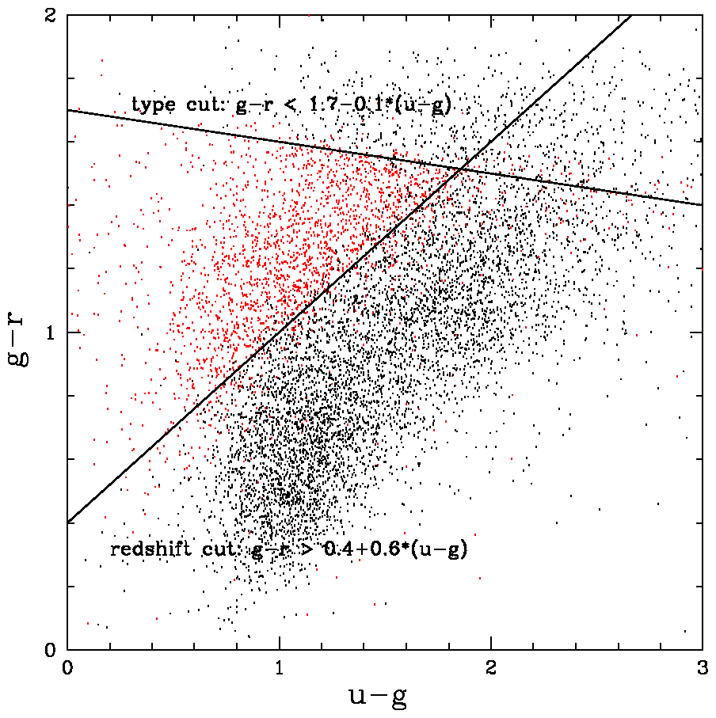
The questions astronomers ask
  petroMag_i > 17.5 and (petroMag_r > 15.5 or petroR50_r > 2) and (petroMag_r > 0 and g > 0 and r > 0 and i > 0) and ( (petroMag_r-extinction_r) < 19.2 and (petroMag_r - extinction_r < (13.1 + (7/3) * (dered_g - dered_r) + 4 * (dered_r - dered_i) - 4 * 0.18) ) and ( (dered_r - dered_i - (dered_g - dered_r)/4 - 0.18) < 0.2) and ( (dered_r - dered_i - (dered_g - dered_r)/4 - 0.18) > -0.2) and ( (petroMag_r - extinction_r + 2.5 * LOG10(2 * 3.1415 * petroR50_r * petroR50_r)) < 24.2) ) or ( (petroMag_r - extinction_r < 19.5)
  and ( (dered_r - dered_i - (dered_g - dered_r)/4 - 0.18) > (0.45 - 4 * (dered_g - dered_r)) ) and ( (dered_g - dered_r) > (1.35 + 0.25 * (dered_r - dered_i)) ) ) and ( (petroMag_r - extinction_r + 2.5 * LOG10(2 * 3.1415 * petroR50_r * petroR50_r) ) < 23.3 ) )
Star/galaxy separation
Quasar target selection
Combination of inequalities
Multi-dimensional
polyhedron query
Skyserver log; a query from the 12 million
Drop outliers, search for rare objects
Point density estimation
Find similar galaxies
K-nearest neighbor search

Slide 7
The goal
TRADITIONAL APPROACH
Flat files, Fortran, C code
+ Complex manipulation of data
- Sequential slow access
VISUALIZATION
Tools using OpenGL, DirectX
+ Fast
- Using files, some tools access
database, but not interactive
INTEGRATE
  use for astronomical data-mining
  and for fast interactive
  visualization
MULTI-DIMENSIONAL INDEXING
B-tree, R-tree, K-d tree, BSP-tree …
+ Many for low D, some for higher D
+ Fast, tuned for various problems
Implemented mostly as memory
algorithms, maybe suboptimal in
databases
SQL DATABASES
Oracle, MS SQL Server, PostgreSQL …
+ Organized, efficient data access
Hard to implement complex algorithms
Multi-dimensional support (OLAP) is
limited to categorical data

Slide 8
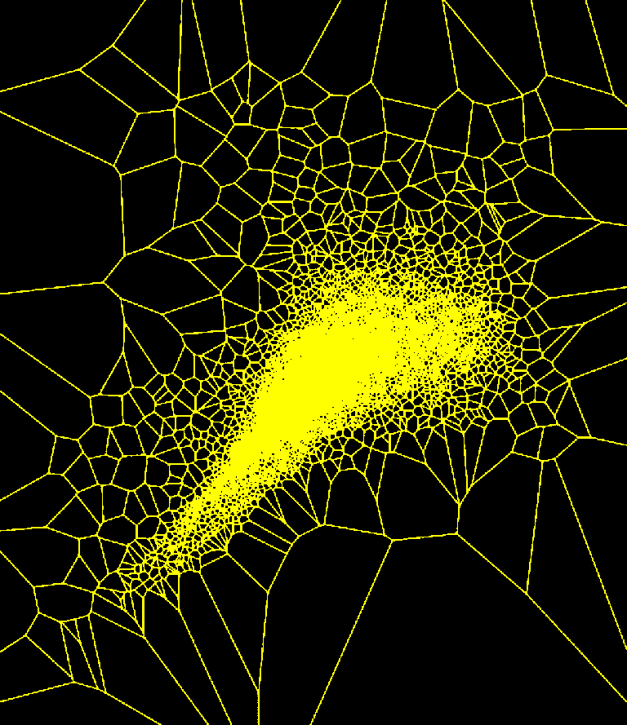
Implemented indexing techniques
MS SQL Server 2005, .NET, C#
    CLR support – run complex procedural code inside the RDBMS
Quad-tree (32-tree)
    Build (SQL 1h)
    Range search, k nearest neighbor, visualization support (SQL)
    Large query time variation in 5D with non-uniform data
Balanced k-d tree
    Build: T-SQL (12h)
    Range search, k nearest neighbor (C#)
    Local polynomial regression (C#)
Voronoi tessellation
    Limited number of random seeds
    (build: 10000 points 1h,
    insertion: 270M points 12h)
    Density estimation, NN-search
    C# wrapper for Qhull

Slide 9
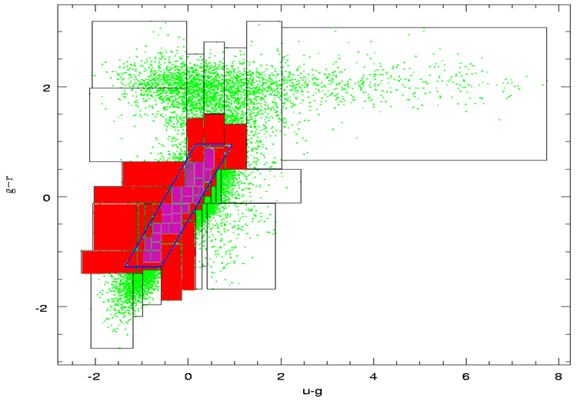
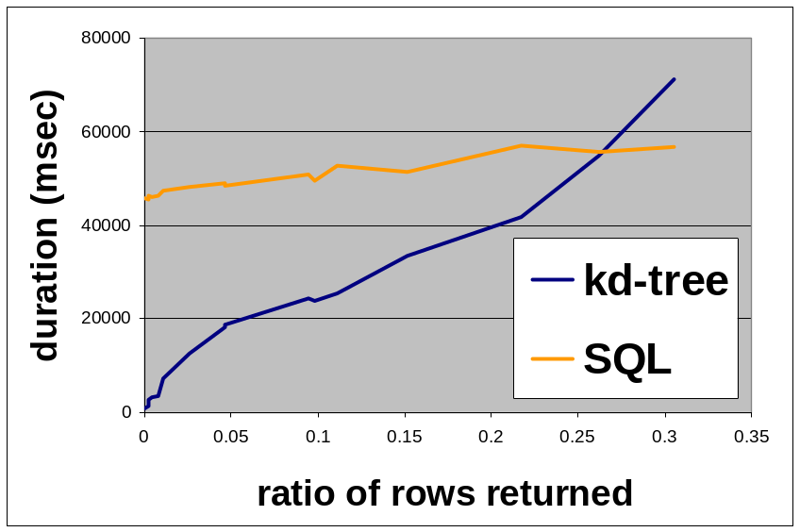
Usage: Geometric queries
First run the query against the index
Select cells those are
    fully covered
    fully outside
    intersected
Run detailed SQL only on intersected cells

Slide 10
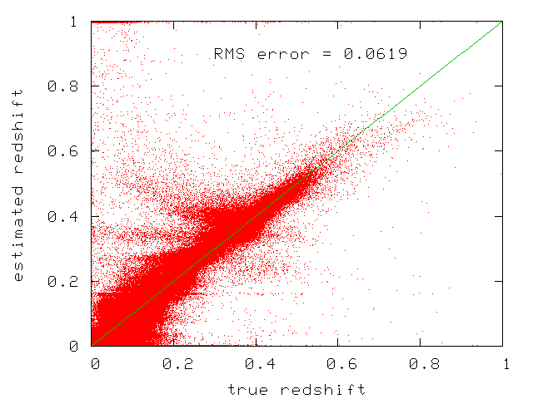
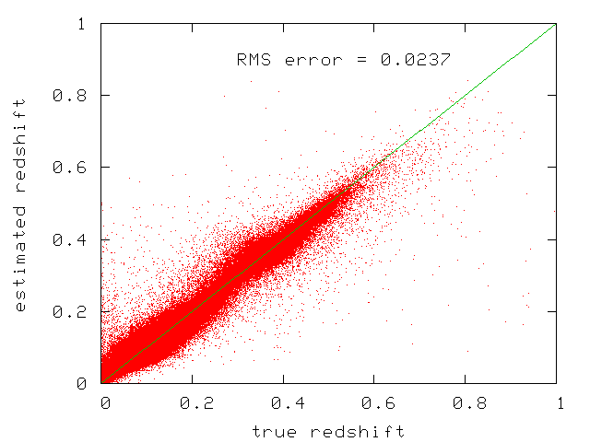
Usage: Non-parametric estimation
Template fitting
For 1M galaxies (reference set) SDSS can
measure redshift for the rest 269M (unknown set)
not
Kd-tree based nearest neighbor search
Polynomial regression implemented in C#
runs as CLR code in SQL Server
Nearest neighbor + polynomial fit
foreach (Galaxy g in UnknownSet){
neighbors = NearestNeighbors(g, ReferenceSet)
polynomCoeffs = FitPolynomial(neighbors.Colors,
neighbors.Redshift)
g.Redshift = Estimate(g.colors, polynomCoeffs)
}

Slide 11
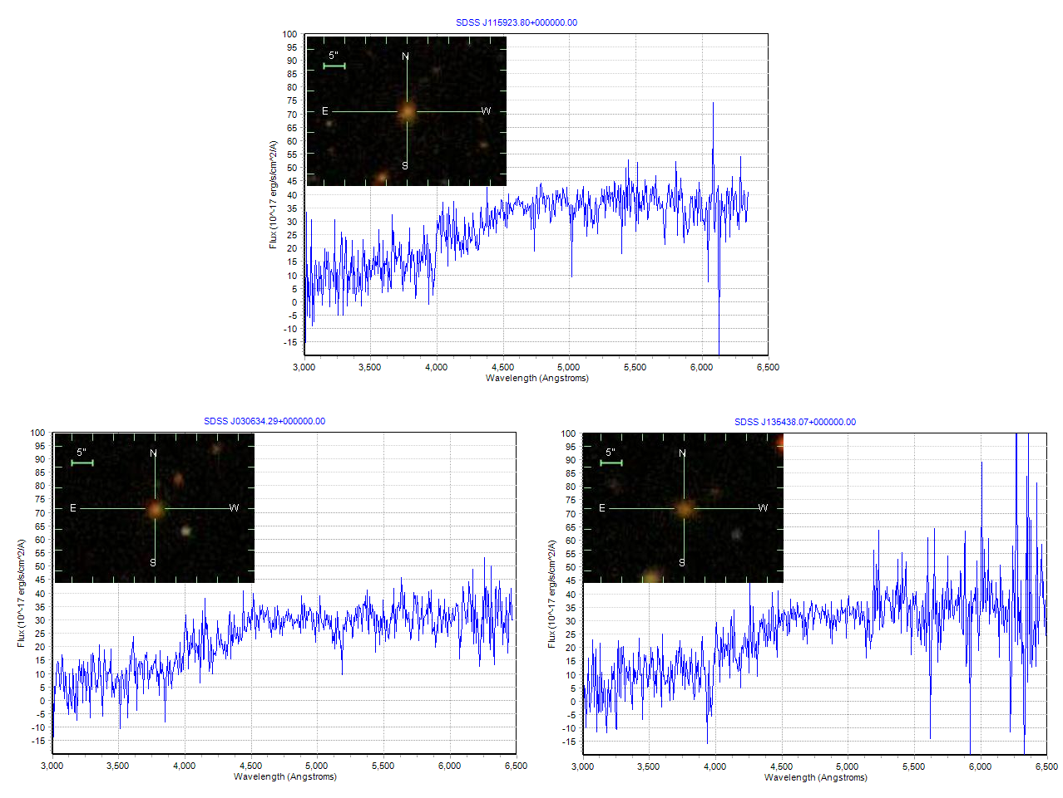
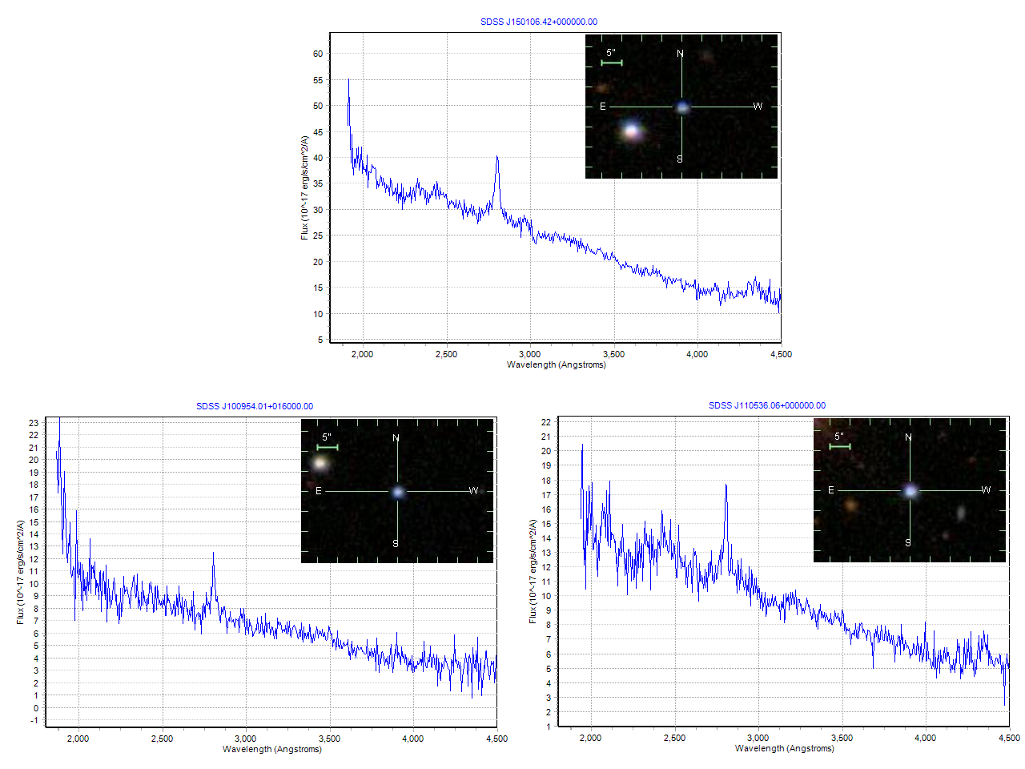
Usage: Search for similar spectra
PCA:
AMD optimized LAPACK routines
called from SQL Server
Dimension reduced from 3000 to 5
Kd-tree based nearest neighbor search
Matching with simulated spectra,
where all the physical parameters
are known would estimate age,
chemical composition, etc. of galaxies.

Slide 12
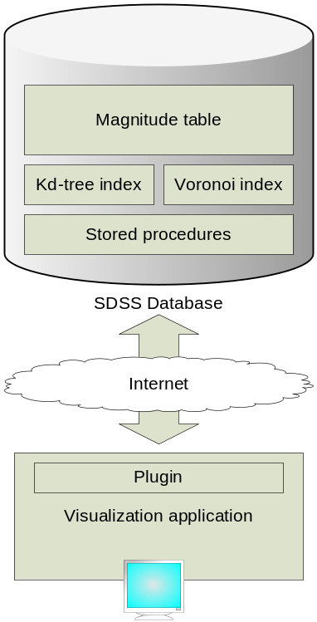
Adaptive Visualizer
  Using managed DirectX
  Visualize more data than fits into memory
  Towards graphical SQL: mouse actions are converted to queries and passed to SQL Server
    LOD, zoom in and out 270M points
    Voronoi, kd-tree visualization
    Brush select, click-connect to SkyServer
    Select nearest neighbors
    Multi-resolution density maps
    Multidim : quickly change axes
    Interact with other Virtual Observatory data

Slide 13
Visualizer Demo

Slide 14
The Tools
MS SQL Server 2005
  OODB vs. RDBMS
  SDSS SkyServer using SQL Server
  SQL Server 2005 CLR support – run complex procedural code inside the DB
  - No support for vector data
C# + native SQL
  VS.2005, rapid prototyping
  Managed DirectX
  Web Services support for Virtual Observatories

Slide 15
Why is magnitude space interesting?
3-10 DIMENSION
3-10 DIMENSION
PCA
PHYSICAL PARAMETRS
age, dust, chemical comp.
GALAXY
elliptic, spiral
LIGHT
Spectrum
1M objects
3000 DIMENSIONAL
POINT DATA
5 DIMENSIONAL
POINT DATA
MAGNITUDE SPACE
270M objects
BROADBAND FILTERS
REDSHIFT

Slide 16
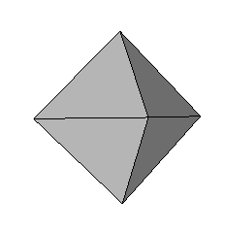
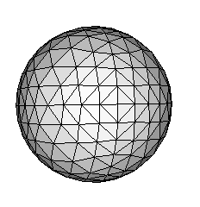
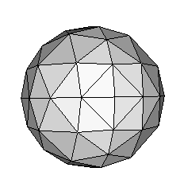
Spatial indexing
Similar to SkyServer HTM indexing
… but in 5 dimensions

Slide 17
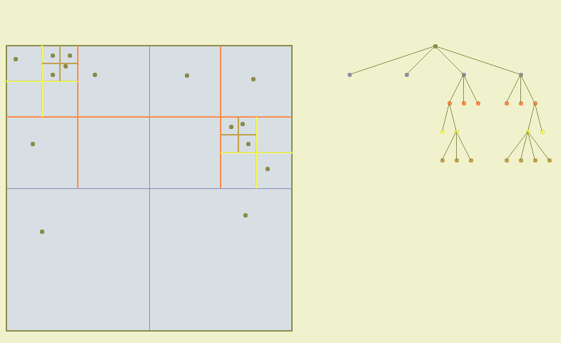
Quad-trees
32-tree in 5D
No need to store the structure
Number of nodes goes exponentially
Breaks down in high dimensions or if data is highly non-uniformly distributed

Slide 18
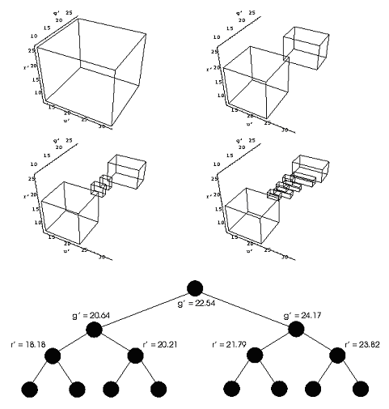
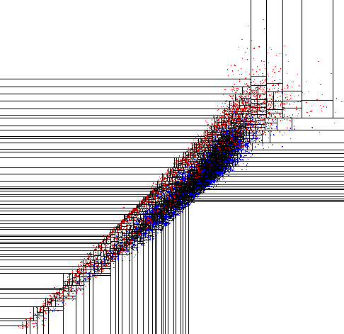
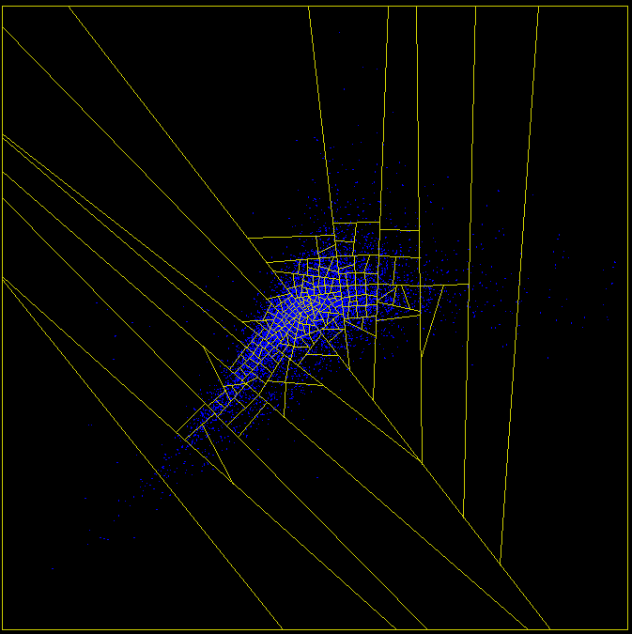
K-d trees
Only one cut in each level
Store bounding boxes

Slide 19
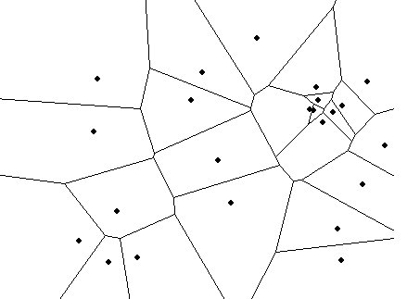
Voronoi tessellation
each point of the cell is closer
to the seed than to any other
the solution space for NN
more spherical cells, 50 neighbors,
1000 vertices
density estimation, clustering
complex code, computation
intensive in higher dimensions

Slide 20
Complex code in SQL/CLR
Spectrum Services
    Composite, continuum and line fit, convolving filters and spectra, dereddening
Non-parametric estimation
  Find k-nearest neighbors
  Polynomial fit (AMD optimized LAPACK)
    DR5: photometric redshift
    Garching DR4: ‘photometric’ D_{n}(4000), Hδ_{A}, age, mass

