Slide 1

Object-Level Vertical Search
Zaiqing Nie
Microsoft Research Asia
With Ji-Rong Wen and Wei-Ying Ma
CIDR, Jan 9, 2007
Notes:
Good morning, everyone. Today I am going to talk about object-level vertical search. It’s a joint work with Ji-Rong Wen and Wei-Ying Ma.

Slide 2
Terminology
Web Object
  A collection of (semi-) structured Web information about a real-world object
  e.g. Person, product, job, movie, restaurant, …
Object-Level Search
  Search based on Web objects
Vertical Search
  Search information in a specific domain
Notes:
At first, I will introduce some basic concepts. A Web object is a collection of structured Web information about a real-world object. Object-level Search engines allow users to search based on Web objects, and vertical search engines search information in a specific domain. I will explain this concepts using an example.

Slide 3
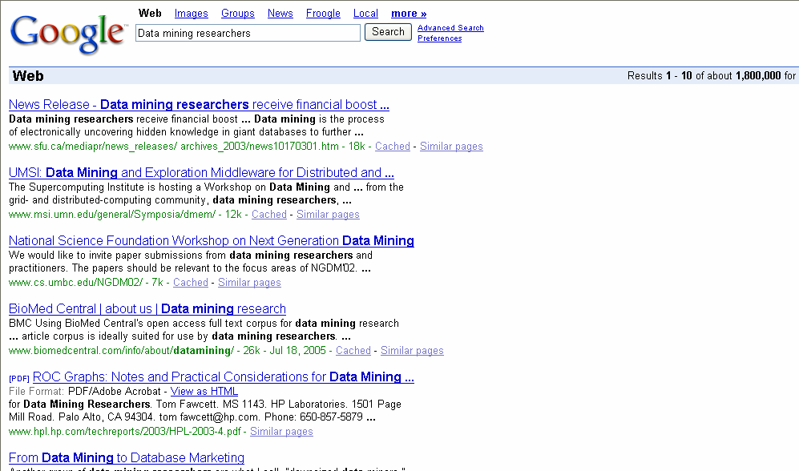
General Web Search (Google)
Notes:
Here I give an example to motivate the need for object-level search. Suppose you want to find who are the people working on data mining. If you use google, general web search engine. you can only get a list of web documents. You have to read all the documents yourself to get the list of objects.

Slide 4
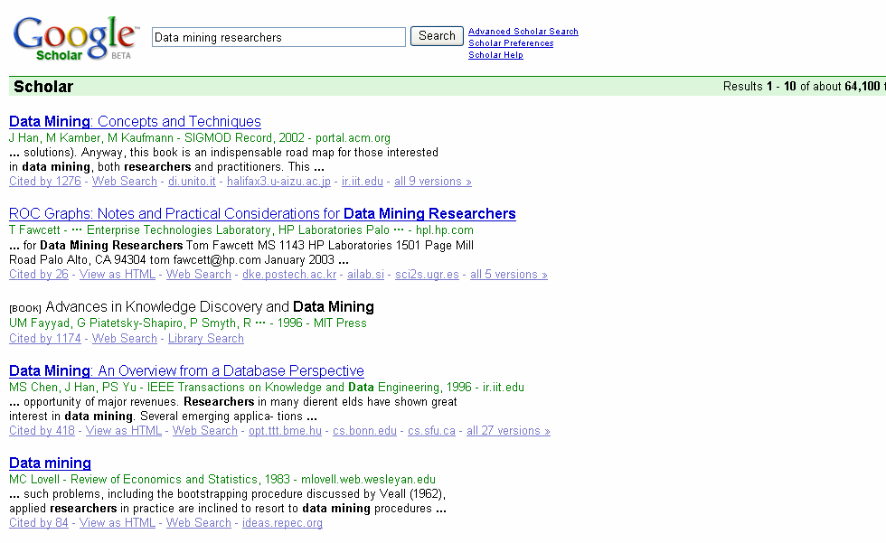
Page Level Vertical Search (Google Scholar)
Notes:
Google scholar is a vertical search engine in the academic domain. As you can see, you still can not get a list of data mining researchers.

Slide 5
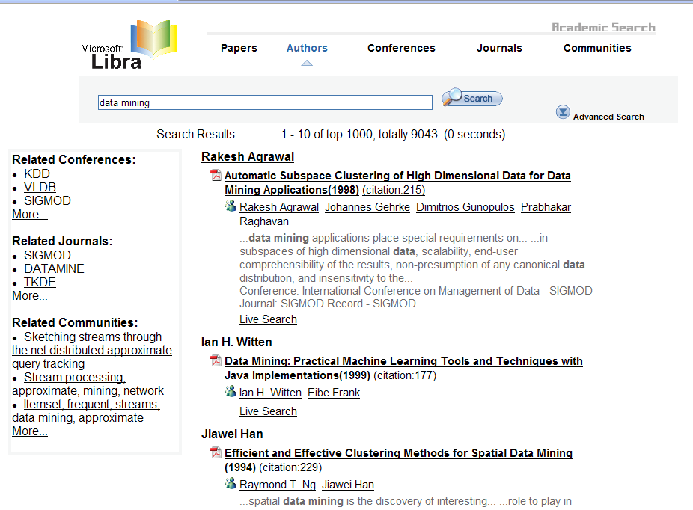
Object Level Vertical Search (http://libra.msra.cn)
Notes:
We have built Libra, an object-level academic search engine. With Libra, you can easily get a list of researchers working on data mining. I will show a live demo of Libra. Let’s say, if you want to find relevant objects about “transaction processing”. You can try Libra yourself at libra.msra.cn.

Slide 6
Architecture
Web
Object Crawling
Classification
Paper
Extractor
Author
Extractor
Conference
Extractor
Location
Extractor
Product
Extractor
Paper
Integration
Author
Integration
Conference
Integration
Location
Integration
Product
Integration
Web Objects
Scientific Web
Object Warehouse
Product Object
Warehouse
PopRank
Object Relevance
Object Community Mining
Object Categorization
Notes:
Here we show the architecture of our object-level vertical search. For every crawled webpage, we first do a classification to decide whether it contains some type of objects we are interested in. The object we are currently interested in are papers, author homepages, conference homepages, locations, product items. For example, for all the author homepages, we use a homepage extractor to automatically extract the author’s title, email, adrress, and publication list. The extracted data are integrated with existing structured data in the local database. Finally we get a high quality object warehouse. Based on these high quality data, we could do various types of analysis, such as ranking the popularity an object, ranking the relevance of an object, and object community mining.

Slide 7
Core Technologies
Web Object Extraction
  Template-independent Web Object Extraction
    A Single Extractor for Every Webpage
  Machine Learning Based Approaches (published in KDD 2006, ICDE 2006, ICML 2005)
Object Integration
  Example: Multiple Authors with the Same Name
  Web Connection
Object Ranking
  Popularity Ranking (published in WWW 2005)
  Relevance Ranking (Submitted to WWW 2007)
Notes:
To build a good object-level search engine, we need to solve the following challenging problems including web object extraction, object integration, and object ranking. We have published several papers in these fields. In puticular, we propose a template-independent method for automatically extract web objects from every webpage. We extend the conditional random fields model to do the job, and the papers are published in kdd 2006, icde 2006, and icml 2005. we also did some work on object integration, in particular name disambiguation using web connections. In our www 2005 paper, we first introduced the object-level search idea and on popularity ranking of web objects.

Slide 8
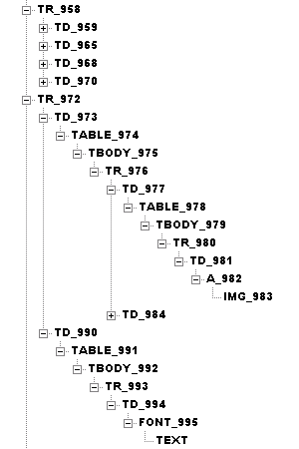
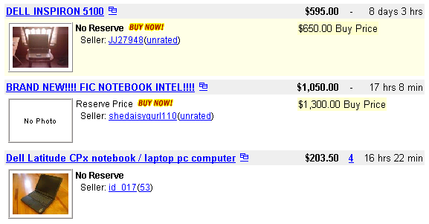
Problems with Existing Web IE Approaches

Slide 9
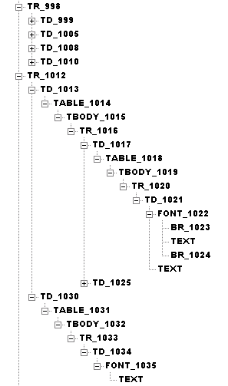
Problems with Existing Web IE Approaches

Slide 10
Problems with Existing Web IE Approaches

Slide 11
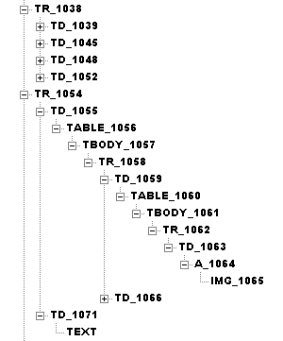
Problems with Existing Web IE Approaches

Slide 12
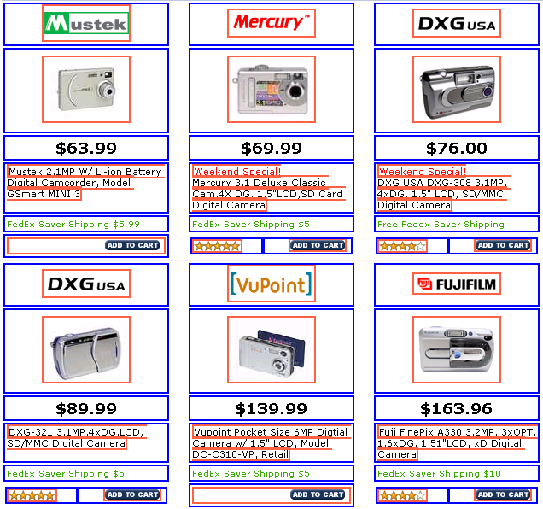
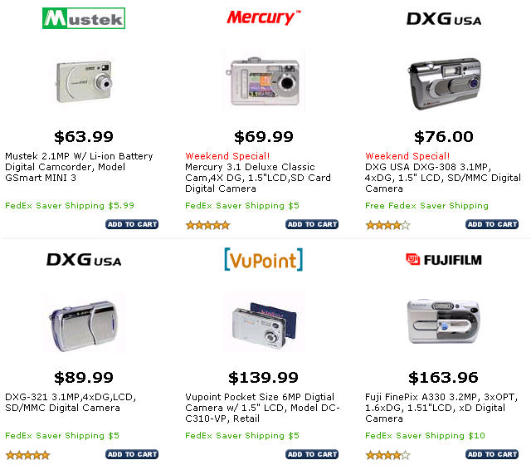
Vision-based Approach for Web Object Extraction
Visual Element Identification
Visual Element Identification
Similarity Measure & Clustering
Similarity Measure & Clustering
Record Identification & Extraction
Record Identification & Extraction
Object Blocks

Slide 13
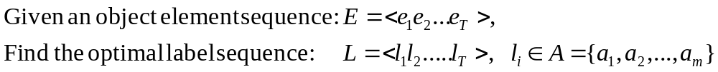
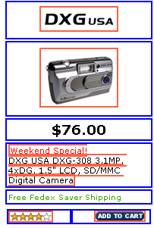
Object-level Information Extraction (IE)
The Problem
Object Block
e1
e2
e3
e4
e5
e6
Attribute
Digital Camera
Element
 | Name
 | Price
 | Description
 | Brand
 | Rating
 | Image
a1
a2
a3
a4
a5
a6

Slide 14
Sequence Patterns
product | before | researcher | before
(name, desc) | 1.000 | (name, Tel) | 1.000
(name, price) | 0.987 | (name, email) | 1.000
(image, name) | 0.941 | (name, address) | 1.000
(image, price) | 0.964 | (address, email) | 0.847
(Image, desc) | 0.977 | (address, tel) | 0.906
Product: 100 product pages (964 product blocks)
Researcher: 120 researcher’s homepages (120 homepage blocks)
Conditional Random Fields (CRFs)
  state-of-the-art for IE with strong sequence patterns
Our Approach
  2D CRFs, Hierarchical CRFs for Web Object Extraction

Slide 15
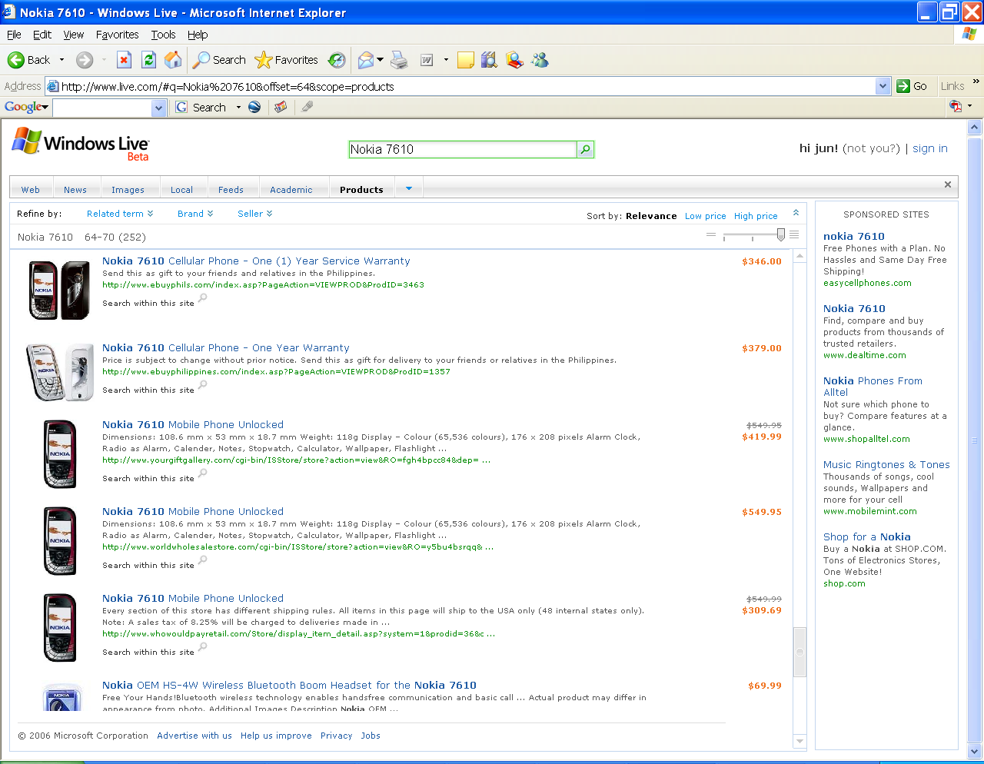
Windows Live Product Search (http://products.live.com)
All Product Information Automatically Extracted from the Web
Find products from over 100,000 online retailers, 800 million product records
Sort results by relevance, low or high price, and refine results by related terms, brand, and seller
Track down hard-to-find items
Notes:
Based on the extracted structural data, we have developed a product search engine to help users find products online available for purchase.
The key feature is that all the product information are automatically extracted from the Web.
As the data have semantics, users can sort the search results by relevance, low or high price, and can also refine the results by related terms, brands and sellers.
And now in our system, more than 100K online retailers are extracted. So the data to be extracted are highly heterogeneous, and it makes the extraction task much difficult.

Slide 16
Conclusion
An object-level vertical search model is proposed
Two Working Systems
  Libra Academic Search (http://libra.msra.cn)
  Windows Live Product Search (http://products.live.com)
More applications
  Yellow page search
  Job search
  People Search
  Movie search
  ……

