Slide 1
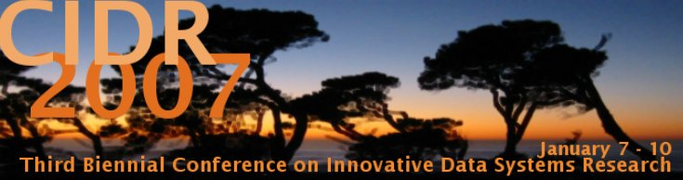
MOMA - A Mapping-based Object Matching System
Andreas Thor, Erhard Rahm
University of Leipzig, Germany
http://dbs.uni-leipzig.de

Slide 2



Motivation
Object Matching
  Identifying equal objects in (different) data sources
  Most research for relational data
Matching for ad-hoc data integration
  Dynamic information fusion
  User-oriented Web 2.0 applications
  Trade-off: Match quality vs. time (run time & set-up time)

Slide 3
MOMA Framework
MOMA = Mapping-based Object Matching
  Framework for object matching
  Extensible matcher library
Matching for ad-hoc data integration
  Generic object representation
  Instance-based mappings
Key features
  Combination of matchers / mappings
  Re-use of mappings
  Easy and flexible definition of match workflows

Slide 4
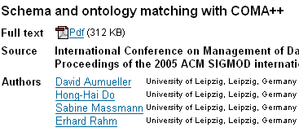

Objects and instance-based mappings
Publication@ACM
Id | 1066157.1066283
Title | Schema and ontology matching with COMA++
Source | International Conference ...
... | ...
Object
instance
Publication@ACM | Author@ACM
1066157.1066283 | P729451
1066157.1066283 | P707877
... | ...
Association-
Mapping
Same-
Mapping
Publication@ACM | Publication@DBLP | Sim
1066157.1066283 | conf/sigmod/AumuellerDMR05 | 0.9
... | ... | ...

Slide 5
MOMA Architecture
Matching = generation of a Same-Mapping
LDS_{A}
Match Workflow
Matcher 1
Mapping Combiner
A
Mapping
Cache
Matcher 2
Mapping
Operator
Selection
Same
Mapping
...
LDS_{B}
Matcher n
B
Compose,
Merge, ...
Threshold,
Best-N, ...
Matcher Library
Matcher implementation
(e.g., Attribute based)
Mapping Repository
Match Workflows

Slide 6

Match Strategies: Merge & Compose
1. Merge
map1
A1
map1
A2
Attribute-based
Matcher
map2
map2
Overcome short-
comings (e.g., recall)
2. Compose
A1
map1
A3
map2
A2
dblp
p₁
p‘‘₁
p‘₁
p₂
p‘‘₂
p‘₂
Efficient re-use of mappings
Compose result can be refined
p‘₃
p₄
p‘‘₄

Slide 7
Match Strategies: Neighborhood
B1
map2
B2
p₁
p‘₁
p₂
p‘₂
map1
map3
... p_{n}
p‘_{n} ...
dblp
A1
A2
v₁
v‘₁
Same-Mapping based on „similarity of the associated objects“
Compose and sim-value ≈ #compose paths
Generic matcher:
Source- & mapping-
independent
Re-use of existing
mappings
PROCEDURE nhMatch ($Asso1, $Same2, $Asso3)
$Temp := compose ($Asso1, $Same2, Min, Average);
$Result:= compose ($Temp, $Asso3, Min, Relative);
RETURN $Result;
END
Very good results for 1:N relationship (e.g., Venue-Publication)
Restriction of matching space for N:1 (Publication-Venue) and
N:M (Author-Publication)

Slide 8
Summary & Future Work
MOMA-Framework
  Combination of matchers / mappings
  Re-use of mappings
  Flexible definition of match workflows
Prototype implementation based on iFuice
  Evaluation for bibliographic domain
Dynamic information fusion for Web 2.0
  Re-use enables collaborative approach
  Flexible workflows allow quick set-up of data integration services → mash-up service

