Slide 1
XClean in Action
Melanie Weis, HPI Potsdam, Germany
Ioana Manolescu, INRIA Futurs, France
CIDR 2007

Slide 2
What is XClean?
  XClean is an XML data cleaning system.
  Types of errors that require data cleaning:
    Typos
    Different data formats (e.g., date, abbreviations, language)
    Missing data
    Contradictory data
    Duplicates

Slide 3
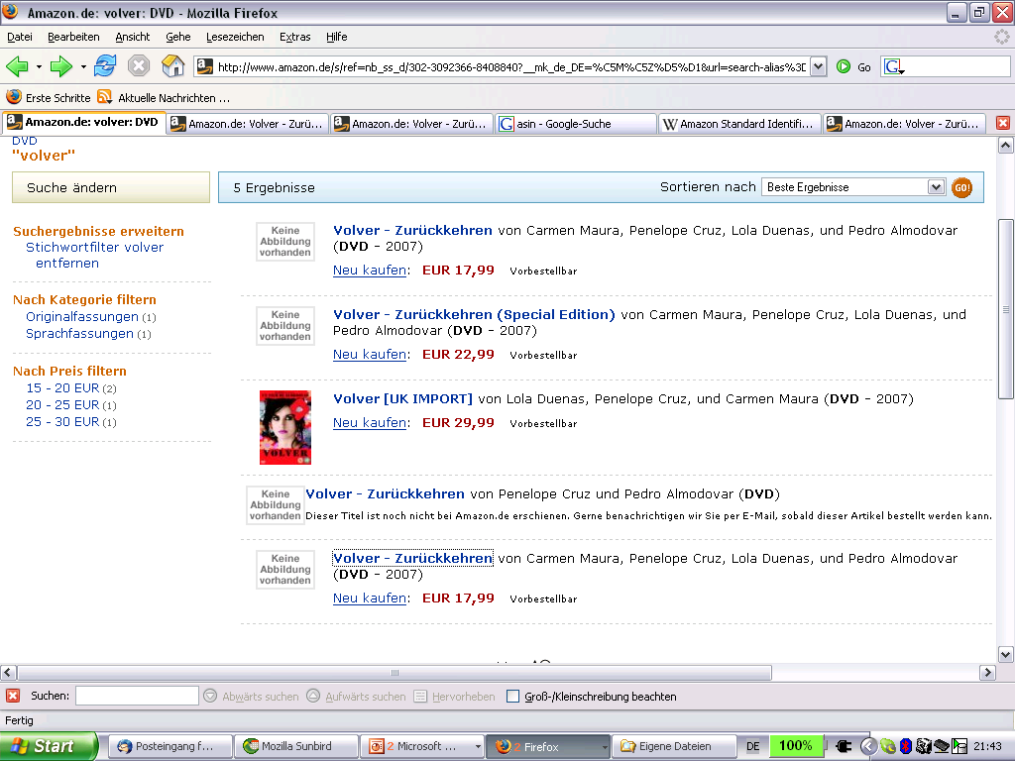
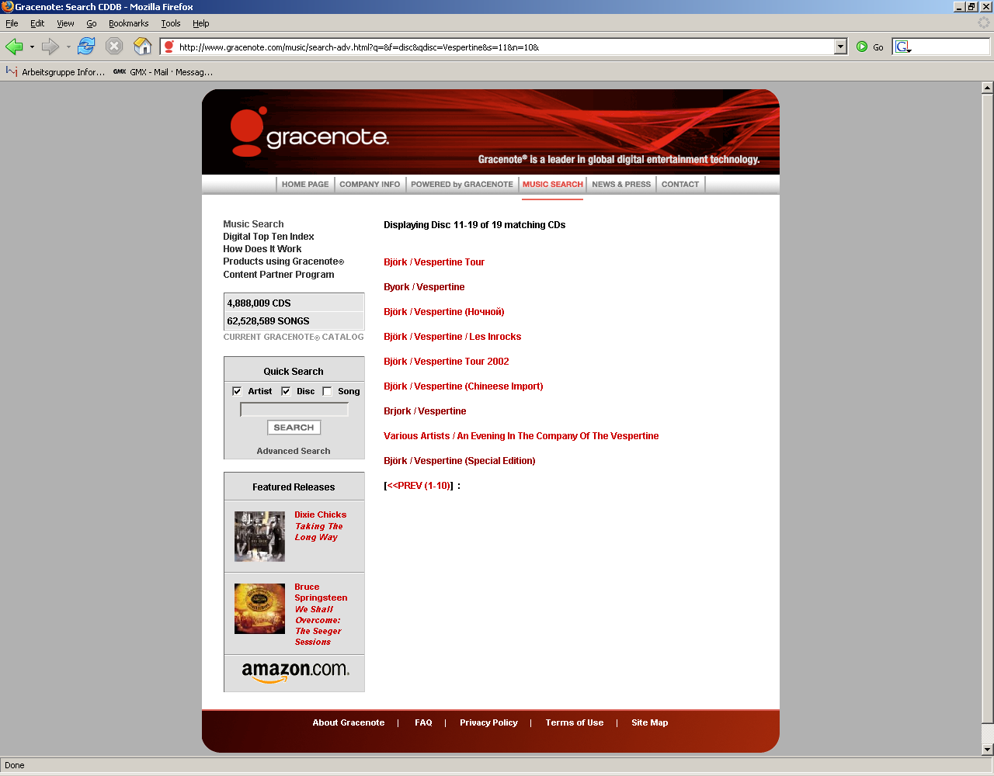
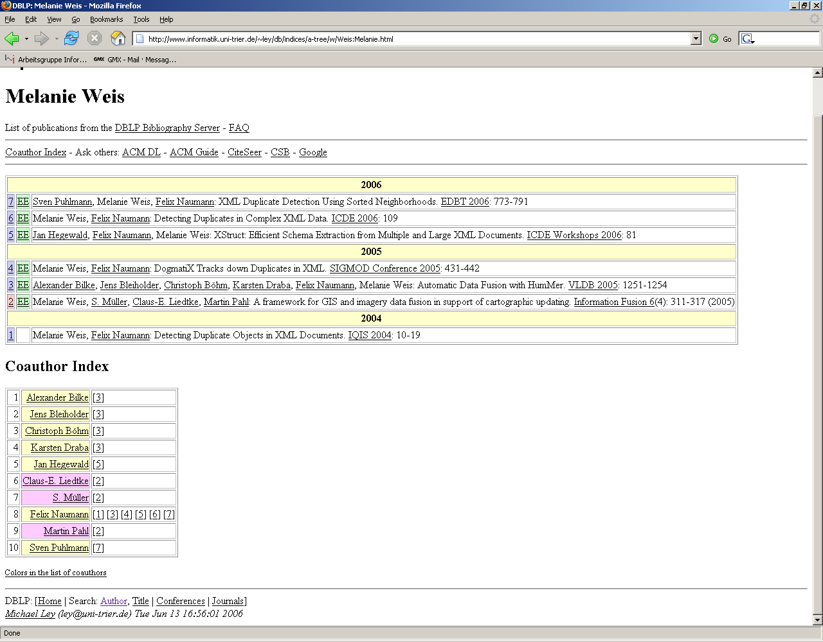
Where do we find Duplicates?
False Duplicate

Slide 4


How do we get rid of dirty data?
  Clear methodology
  (Clearly defined processing stages that combine)
  Possibility to reuse (parts of)
  a solution
  Quick fix (get glasses)
  Start over again next year
  (get new, expensive glasses)
No!
Yes!
Notes:
Have a sharp look at the data, do something, and start over again next year
Not have to change the whole system, how things connect to each other

Slide 5

Data Cleaning with XClean
Set of clearly defined cleaning operators.
XClean/PL
Declarative
Modular
Readable
XQuery
Clean
XML
data
Dirty
XML
data
XQuery Processor

Slide 6
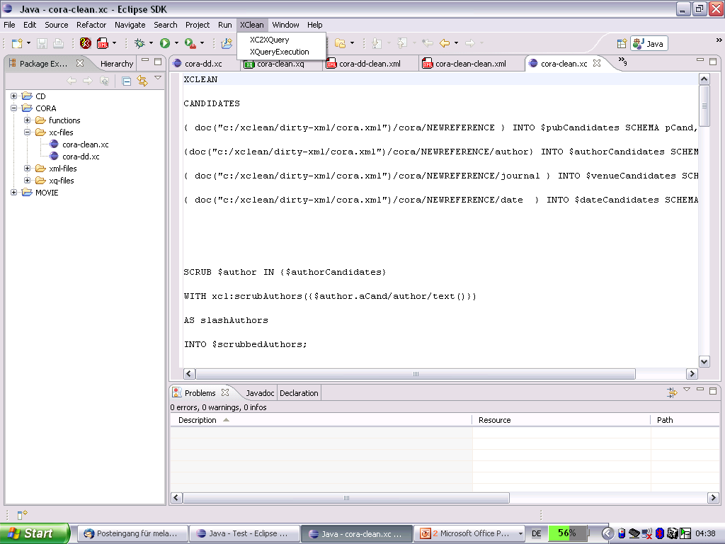
Come see the demo!
  XClean Java plugin
  Supports
    Writing XClean/PL
    Compiling XClean/PL
    to XQuery
    Executing XQuery to
    obtain clean data

