Slide 1
QUIC: Handling Query Imprecision &
Data Incompleteness in Autonomous Databases
Subbarao Kambhampati (Arizona State University)
Garrett Wolf (Arizona State University)
Yi Chen (Arizona State University)
Hemal Khatri (Microsoft)
Bhaumik Chokshi (Arizona State University)
Jianchun Fan (Amazon)
Ullas Nambiar (IBM Research, India)

Slide 2

Challenges in Querying Autonomous Databases
Imprecise Queries
User’s needs are not clearly defined hence:
Queries may be too general
Queries may be too specific
Incomplete Data
Databases are often populated by:
Lay users entering data
Automated extraction
Relevance Function
Density Function
General Solution: “Expected Relevance Ranking”
Challenge: Automated & Non-intrusive assessment of Relevance and Density functions
However, how can we retrieve similar/
incomplete tuples in the first place?
Once the similar/incomplete tuples have been
retrieved, why should users believe them?
Challenge: Rewriting a user’s query to retrieve highly relevant Similar/ Incomplete tuples
Challenge: Provide explanations for the uncertain answers in order to gain the user’s trust
Notes:
On the web there exists many autonomous databases which users access via form-based interfaces. When querying these autonomous databases, often users do not clearly define what it is they are looking for.
Users may specify queries which are overly general (e.g. A user may ask the query Q:(Model=Civic) when what they really want is a “Civic” with low mileage)
Similarly, users may specify queries which are overly specific (e.g. A user may ask the query Q:(Model=Civic) when what they really want is a reliable Japanese car in which case, an “Accord” or “Corolla” may suit their needs)
Therefore, in addition to returning the tuples which exactly satisfy the user’s query constraints, we would also like to return tuples with values which are similar to the original query constraints.
In addition to posing imprecise queries, another concern is that the data provided by the autonomous databases may be incomplete due to the methods used to populate them.
Many autonomous databases are populated by lay web users entering in data through forms (e.g. a user trying to sell their car may enter the “Model” as “Civic” omit the “Make” assuming it is obvious)
Similarly, many autonomous databases are populated using automated extraction techniques (e.g. often these extraction techniques are not able to extract all the desired information especially when dealing with free-form text as in Craigslist.com)
Therefore, in addition to returning the tuples which exactly satisfy the user’s query constraints, we would also like to return tuples which have “null/missing” values on the constrained attributes but are highly likely to be relevant to the user.
Thus, we would like to rewrite the user’s original query in order to retrieve such similar and incomplete tuples. However, rather than randomly sending the rewritten queries to the autonomous database, we rather issue them intelligently such that the tuples they return are likely to highly relevant to the user (in addition to keeping the network/processing costs manageable).
A general solution to this problem is a model we call “Expected Relevance Ranking (ERR)” which ranks in order of the expected relevance to the user. Here the ERR model can be defined in terms of Relevance and Density functions.
*** CHALLENGE 1 ***
This model brings forth our first challenge, namely, how do we automatically and non-intrusively assess the relevance and density functions?
Once the ranking model has been established, we must go back and consider how should the query rewriting work in the first place?
*** CHALLENGE 2 ***
How can we rewrite the user’s original query to bring back both similar and incomplete tuples?
After we figure out how to rewrite the users query and rank the queries/tuples in order of their expected relevance to the user, we come across a final challenge.
*** CHALLENGE ***
Given that we are showing the user tuples which do not exactly satisfy the constraints of their query, how can we explain the results in order to gain the user’s trust?
on challenges on querying autonomous db, as you are about to leave the slide--that handling autonomous db naturally brings together challenges that cross the traditional IR and DB boundaries.

Slide 3
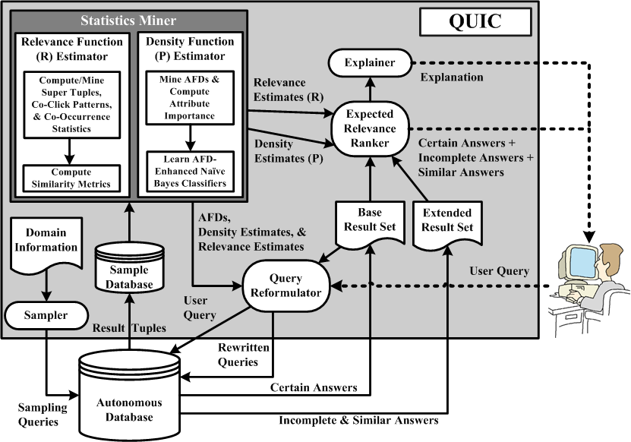

Slide 4
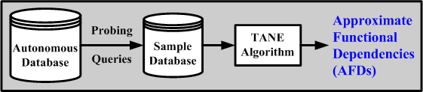
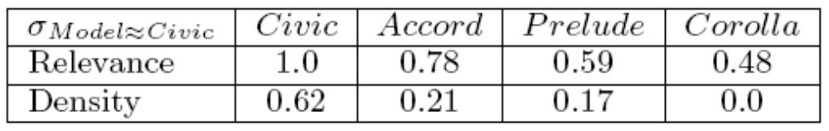
Expected Relevance Ranking Model
Problem:
How to automatically and non-intrusively assess the Relevance & Density functions?
AFDs play a role in:
  Attribute Importance
  Feature Selection
  Query Rewriting
Estimating Relevance (R):
Learn relevance for user population as
a whole in terms of value similarity
Sum of weighted similarity for each constrained attribute
  Content Based Similarity
  (Mined from probed sample using SuperTuples)
  Co-click Based Similarity
  (Yahoo Autos recommendations)
  Co-occurrence Based Similarity (GoogleSets)
Estimating Density (P):
Learn density for each attribute
independent of the other attributes
AFDs used for feature selection
  AFD-Enhanced NBC Classifiers
Notes:
right after the yellow problem statement--that there is a lot of work in AI and machine learning communities directed at density and relevance estimation, and our challenge is to adapt the right ones for autonomous db.
In order to automatically and non-intrusively assess the relevance and density functions, we start of by obaining a sample of the database and mining attribute correlations from the sample.
Given the autonomous database, we first issue probing queries the results of which are used to build a sample. Next, we feed the sample (in our case we used a sample 10% of the original database size) to the TANE algorithm which is used to discover Approximate Functional Dependencies (AFDs). For example, we may learn an AFD {Make, Body Style ~~> Model}. So it may be that given a Honda which is a Coupe, the Model is likely to be Civic with some confidence.
These AFDs play an important role in the QUIC system. They are used for computing the attribute importance which is in turn used in the relevance calculation. They are used as a feature selection tool when building classifiers for the density calculation. Finally, they are used for query rewriting which we will see later on.
Estimating Relevance:
In QUIC we learn relevance in terms of the entire user population rather than learning it for each individual user. Moreover, where relevance can be defined in terms of many metrics, we have taken relevance to equal similarity between attribute values. We experimented with three forms of similarity metrics, namely content-based similarity which forms super tuples (Ullas’s prior work) and then computes the Jaccard similarity between the supertuples using bag semantics. The second type of similarity is co-click based similarity in which we mined the collaborative recommendations from a car website (Yahoo Autos). Here given a webpage for a car, the page often contained 1-3 other recommended cars that were highly viewed by users who also viewed the current page. Using these recommendations, we constructed a undirected graph in which multiple links between two nodes (where nodes represent attribute values) are aggregated into a single link whose weight is equal to the total number of links between the nodes (prior to aggregation). We then used a modified version of Dijkstra’s shortest path algorithm where the shortest path is taken as the product of each link weight along the path between two nodes. Here the link weights are made to between 0 and 1 so that the product decreases as more paths are taken. Similarly, we mined co-occurrence statistics using GoogleSets for which we created a similar graph between attribute values. Here we used the same modified version of the shortest path algorithm to compute the similarity between two attribute values.
Estimating Density:
In QUIC we make the assumption that attribute values are missing independent of the other attributes. Using this assumption, we learn NBC classifiers for each of the attributes and use these classifiers to find the missing value distributions. When constructing the classifiers, we use the AFD’s determining set attributes for feature selection. For example, if we had an AFD {Make, Body Style ~~> Model} and we wanted to find the distribution on Model, we would restrict the features used in the classifier to just Make and Body Style as opposed to the entire set of attributes.
This table shows an example of what the relevance and density measurements might look like.
*** Explain density

Slide 5
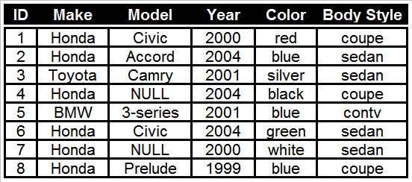
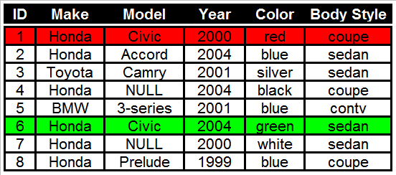
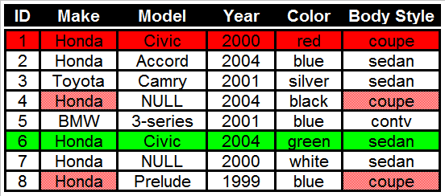
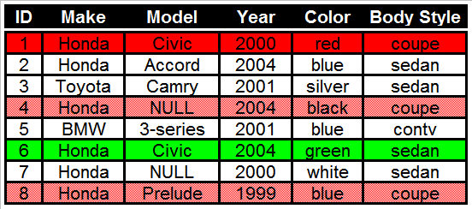
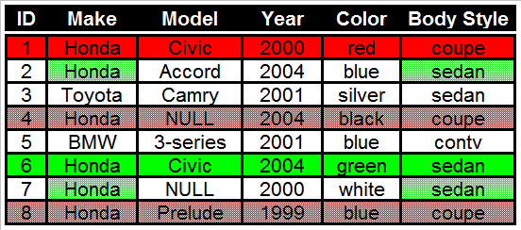
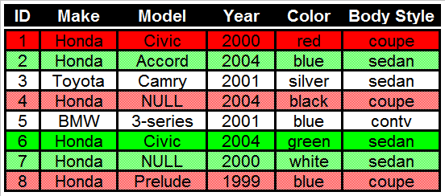
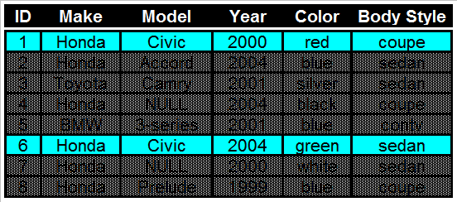
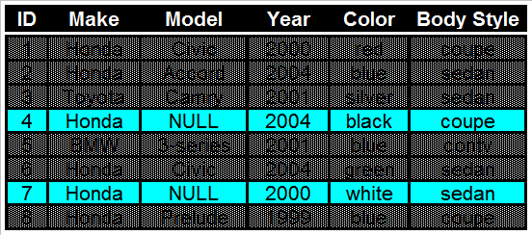
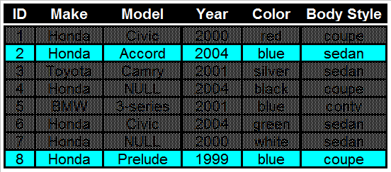
Retrieving Relevant Answers via Query Rewriting
Problem:
How to rewrite a query to retrieve answers which are highly relevant to the user?
Given a query Q:(Model=Civic) retrieve all the relevant tuples
Retrieve certain answers namely tuples t₁ and t₆
Given an AFD, rewrite the query using the determining set attributes in order to retrieve possible answers
  Q₁’: Make=Honda Λ Body Style=coupe
  Q₂’: Make=Honda Λ Body Style=sedan
Thus we retrieve:
Certain Answers
Incomplete Answers
Similar Answers

Slide 6
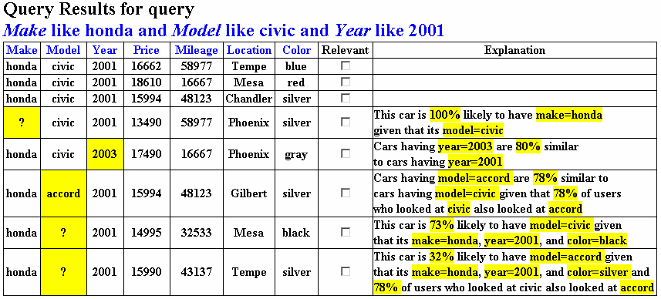
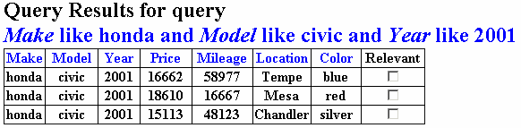
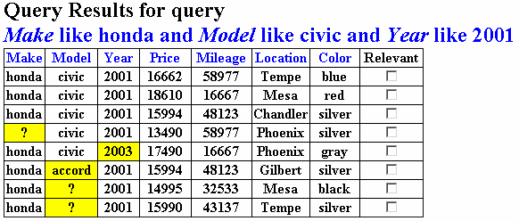
Explaining Results to Users
Problem:
How to gain users trust when showing them similar/incomplete tuples?
_{View Live QUIC Demo}
Notes:
In traditional databases, we only show the users the certain tuples and hence the user has no reason to doubt the results presented to them. However, when we begin to consider imprecise queries and incomplete data, the user may be hesitant to fully trust the answers which they are shown. Therefore, in order to gain the user’s trust, QUIC must provide explanations to the user outlining the reasoning behind each answer it provides.
Here is a snapshot which depicts some of the explanations provided by QUIC. These explanations are based are derived from the AFDs, relevance scores, and density calculations. For incomplete tuples, the values of the determining set attributes are used to justify the prediction along with the probability that the missing value is in fact the value the user was looking for. For similar tuples, the user is provided with an explanation which states how similar the tuple’s value is to the query’s constrained value. In addition, when co-click/co-occurrence statistics are available, the user is shown how many people who viewed “Car A” also viewed “Car B”.

Slide 7

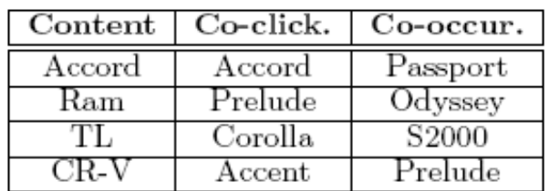
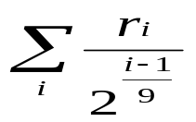
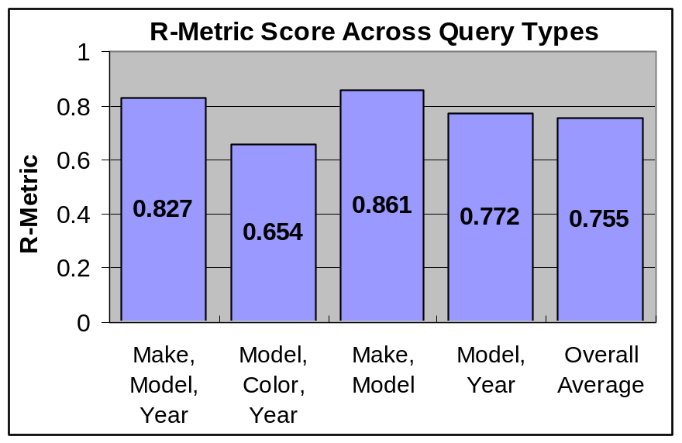
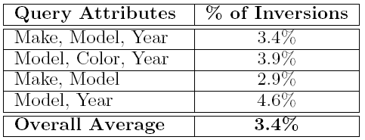
Empirical Evaluation
2 User Studies (10 users, data extracted from Yahoo Autos)
Similarity Metric User Study:
Each user shown 30 lists
Asked which list is most similar
Users found Co-click to be the most similar to their personal relevance function
Ranking Order User Study:
14 queries & ranked lists of uncertain tuples
Asked to mark the Relevant tuples
R-Metric used to determine ranking quality
Query Rewriting Evaluation:
Measure inversions between rank of query and actual rank of tuples
By ranking the queries, we are able to (with relatively good accuracy) retrieve tuples in order of their relevance to the user

Slide 8
Conclusion
QUIC is able to handle both imprecise queries and incomplete data over autonomous databases
By an automatic and non-intrusive assessment of relevance and density functions, QUIC is able to rank tuples in order of their expected relevance to the user
By rewriting the original user query, QUIC is able to efficiently retrieve both similar and incomplete answers to a query
By providing users with a explanation as to why they are being shown answers which do not exactly match the query constraints, QUIC is able to gain the user’s trust
http://styx.dhcp.asu.edu:8080/QUICWeb

