Slide 1

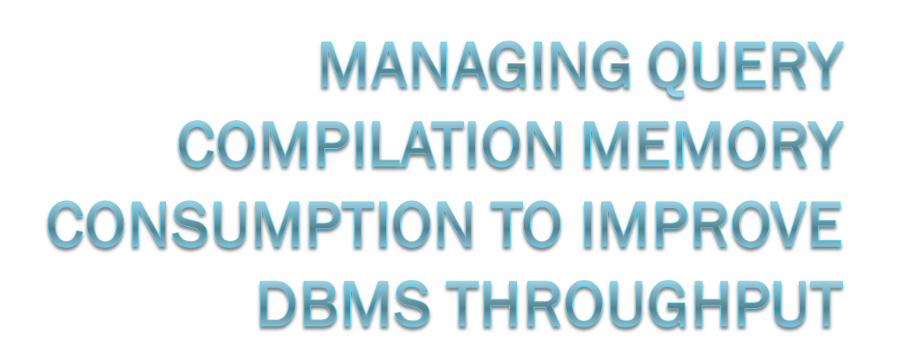
Boris Baryshnikov, Cipri Clinciu,
Conor Cunningham, Leo Giakoumakis, Slava Oks, Stefano Stefani
Notes:
Microsoft Corporation
One Microsoft Way
Redmond, WA 98052 USA
{borisb,ciprianc,leogia,slavao,stefanis}@microsoft.com

Slide 2
Outline
Problem statement and scope
Elements of the solution
  Memory broker
  Query compilation throttling
    Solution overview
    Desired behavior and example
Experimental results on SQL Server 2005
  Throughput and reliability
Questions
Notes:
Memory Broker only briefly, for context setting

Slide 3
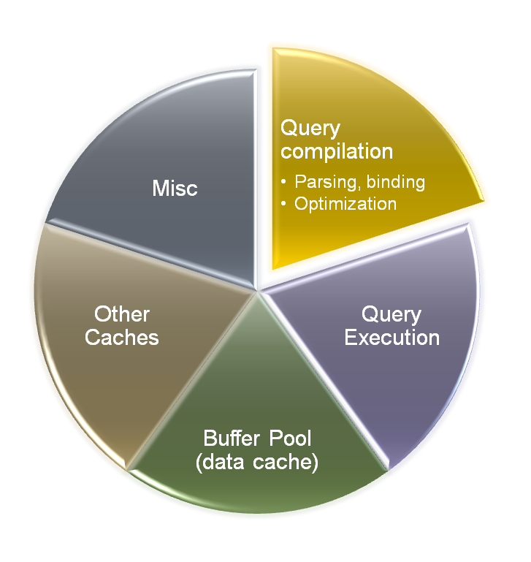
Problem statement
Memory trade-offs in a modern DB engine
  Memory is limited; platform architectural limitations
  More components
  Component specific memory consumption patterns
  Workload dependent memory consumption and cross-component interactions
How to design for system throughput?
Focus on compile-intensive ad-hoc workloads
  Query compilation throttling

Slide 4
Memory Broker
Central memory arbitration mechanism
Monitors, identifies trends and predicts component memory usage
Notifies components about their memory targets
  Components can grow or shrink, releasing “low value” memory
Better dynamic memory distribution in the DB engine
Query Compilation is one such component

Slide 5
Query Compilation
Several medium/large compile intensive queries or many smaller queries can be a significant memory toll
  Decreased throughput
  Wasted memory and time (aborts/time-outs)
How to respond to memory pressure?
Solution: adjust the rate of concurrent compilations

Slide 6
Query Compilation Throttling
Set of monitors
  Progressively increasing size
  Sequentially acquired as memory use grows
  Number of concurrent compilations decreases for larger monitors
Blocked compilations wait
  Larger monitors have larger timeouts
  Blocking is specific to memory usage → handles differing optimization techniques
Tuned to achieve balance between OOM errors vs. throttle-induced timeouts for a variety of workloads
Notes:
Memory use roughly grows with compilation time, throttling compilations restricts the overall memory usage.
Blocked compilations wait. If blocked for too long, its transaction is aborted with a “timeout” error.
The blocking is tied to the amount of memory allocated by the task and not to specific points during the query compilation.
This handles differing optimization techniques and remains stable over multiple releases.
Properly tuned, achieves a balance between out-of-memory errors and throttle-induced timeouts for a variety of workloads.
Our approach gives preference to compilations that have made the most progress.

Slide 7
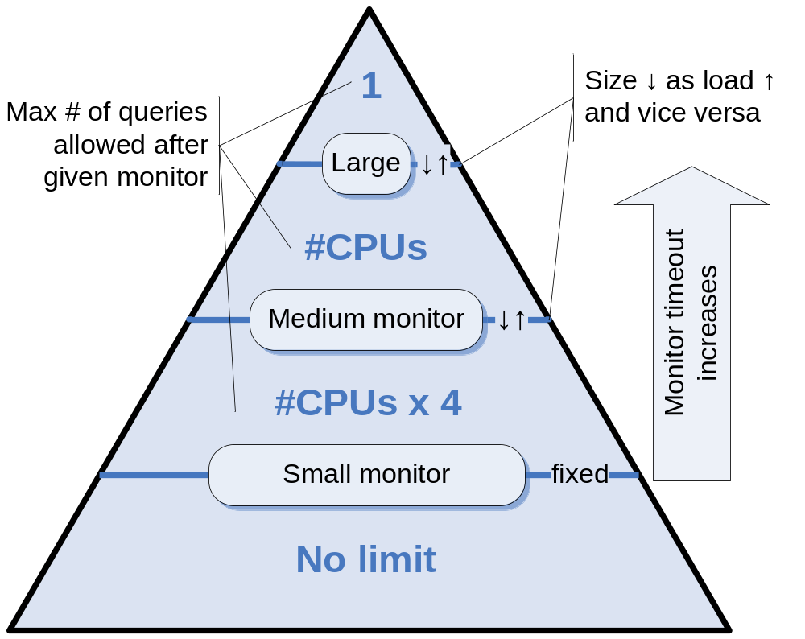
Throttling: Memory Monitors
Notes:
Based on experimental analysis (balance of flexibility and overhead) we introduce three monitors to throttle the compilation rate.
Query compilations that consume less memory than the first monitor threshold proceed unblocked. The first threshold is platform dependent and chosen to allow small diagnostic queries to proceed without acquisition of the first (small) monitor.
The first (small) monitor allows four concurrent compilations per CPU. Typically, most OLTP-class queries would fall into this category.
The second (medium) monitor is required for larger queries, allowing one per CPU. Many TPC-H queries would be in this category.
The final governs the largest queries and allows only one at a time to proceed. This class of query uses a sizable fraction of total available memory on the system. The largest memory-consuming queries are serialized to avoid starvation of other subcomponents.
Monitors contain progressively higher memory thresholds and progressively lower limits on the number of allowed concurrent compilations.
The monitors are acquired sequentially by a compilation as memory usage increases and are released in reverse order if use decreases or at the end.

Slide 8
Memory Monitors : Details
ThSize = [target]*F/[# of Q’s below Th]
Notes:
Extensions:
Medium and large thresholds are dynamic. This helps adapt to the varying nature of customer workloads.
Allows to react to reported “target” memory consumption level for the query subcomponent. This allows the query sub-system to throttle compilation memory more aggressively when other subcomponents are heavily using memory, making the system responsive to memory pressure.
The thresholds are computed attempting to divide the overall query compilation target memory across the categories identified by the monitors. For example, the medium monitor threshold is computed as [target] * F / S, where F and S are respectively the fraction of the target allotted to and the current number of small query compilations. In other words, small queries together can consume up the F fraction of the target, after which the top memory consumers are forced to upgrade to the medium category.
The values of the F fractions were identified with a long process of tuning and experimentation against several actual workloads.
If the system will likely run out of memory before an individual compilation completes we can return the best plan from the set of already explored plans instead of simply returning out-of-memory errors.
This is reserved only for very expensive queries that consume a relatively large fraction of total available memory during compilation.

Slide 9
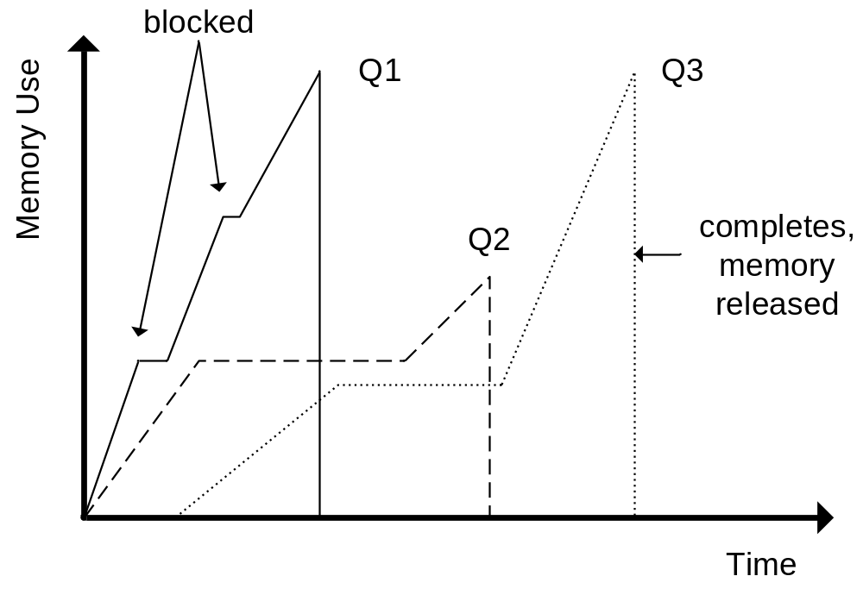
Throttling: Example
There are more queries not shown on the graph
Notes:
In this example, Q1 and Q2 start compiling at approximately the same time. However, Q1 consumes memory at a faster rate than Q2. This could occur if the query was larger, the tables contained more complex schemas, or perhaps that thread of control received more time to execute. Q1 then blocks at the first monitor, as denoted by the first flat portion of the graph of Q1’s memory use. This occurred because other queries (not shown in the example) were consuming enough resources to induce throttling. Once enough memory is available, Q1 continues, blocks again at the next monitor, eventually is allowed to continue, and finally finishes compilation. At the end of compilation, memory used in the process is freed and the query plan is ready for execution. Q2 executes in a similar manner. It waits much longer to acquire the first monitor (meaning that the system is under more memory pressure or that other compilations are concurrently executing and using memory). Q2 finishes and frees memory, but it did not require as much memory as Q1 to compile. In this example, Q3 is actually blocked by Q2 and only proceeds once Q2 is finished and releases its resources.
From the perspective of the subcomponent author, the only perceptible difference in this process from a traditional, unblocked system is that the thread sometimes receives less time for its work. The individual thread scheduling choices are made by the system based on global goals that effectively prioritize earlier over later compiles when making scheduling (and thus allocation) decisions.

Slide 10
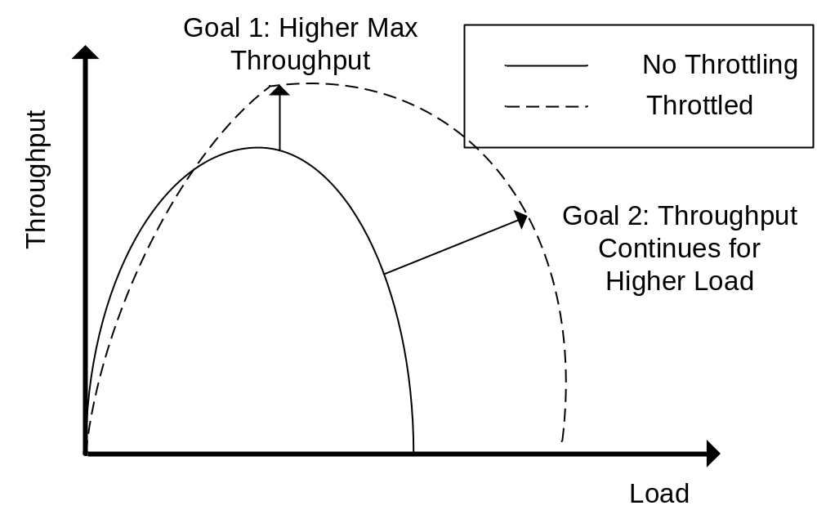
Throttling: Desired Behavior
Notes:
The intended goals of this approach are to improve maximum throughput and to enable that throughput to work for larger client loads on the system.
Since memory is a scarce resource, preserving some fraction of it for use by the database page buffer pool and query execution allows these components to more efficiently perform their functions.
Blocking some queries can reduce the need for other subcomponents to return memory from caches if many large, concurrent compilations occur.
This can spread memory use over time instead of requiring other subcomponents to release memory.

Slide 11
Results
Goal: measure throughput and reliability at and beyond [given] hardware capabilities
  Optimal load: 30 simultaneous clients
  Extreme load: 35, 40 clients
  Real life DSS workload, ~0.5 Tb
“Average” query:
  15-20 joins with aggregates
  10-90 sec for compile
  30-600 sec for execution
Throughput = # of successful queries per unit of time
Reliability = % of successful query completions in a given load
Notes:
The SALES benchmark uses a somewhat typical data warehouse schema, meaning that it has a large fact table and a number of smaller dimension tables. The largest fact table from the database contains over 400 million rows. An “average” query in this benchmark contains between 15 and 20 joins and computes aggregate(s) on the join results. As a comparison, TPC-H queries contain between 0 and 8 joins with similar numbers of indexes per table. The data mart in our experiments contains a snapshot of the data from the customer’s application and is 524 GB in size.
We execute the SALES benchmark using a custom load generator which simulates a number of concurrent database users who submit queries to the database server. For these experiments, we use a server with 8 Intel Xeon (32-bit) 700 MHz x86-based processors and 4GB of main memory. The server is using 8 SCSI-II 72GB disks configured in as a single RAID-0 drive array on a 2-channel, 160 MB/channel Ultra3/Ultra2 SCSI controller. The software on the machine is Microsoft Windows 2003 Enterprise Edition SP 1 and Microsoft SQL Server 2005. This system is a typical medium server installation and should reasonably reflect the hardware on which scaling problems are currently being seen in DBMS installations today.
Queries in this benchmark generally compile for 10-90 seconds and execute for 30 seconds to 10 minutes. In each subcomponent, these queries consume nontrivial amounts of memory to compile and execute. They also access large fractions of the database and thus put pressure on the database page buffer pool. Therefore, these subcomponents are actively competing for memory during the execution of this benchmark. Failed queries are retried up to 15 times by the client application to mimic the customer behavior. The probability that a query will be aborted due to memory shortages is high, and the cost of each failure is also high (as the work will be retried). This places a high value on biasing resource use towards those operations likely to succeed on the first attempt.

Slide 12
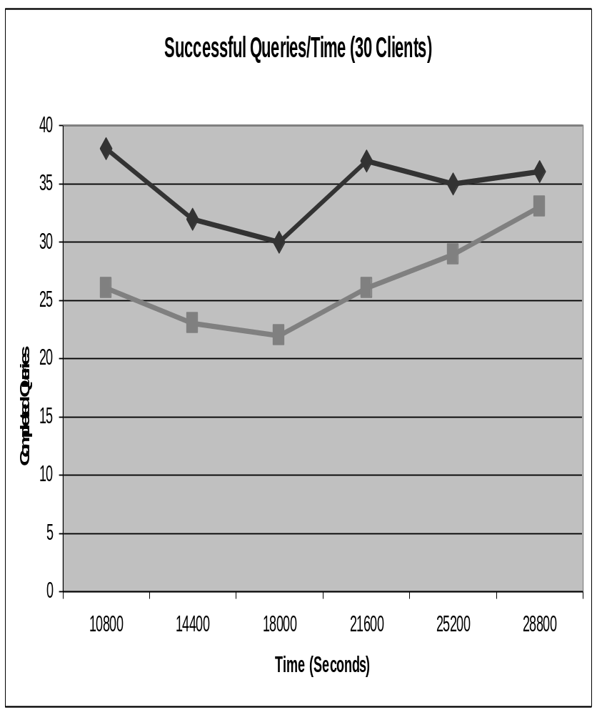
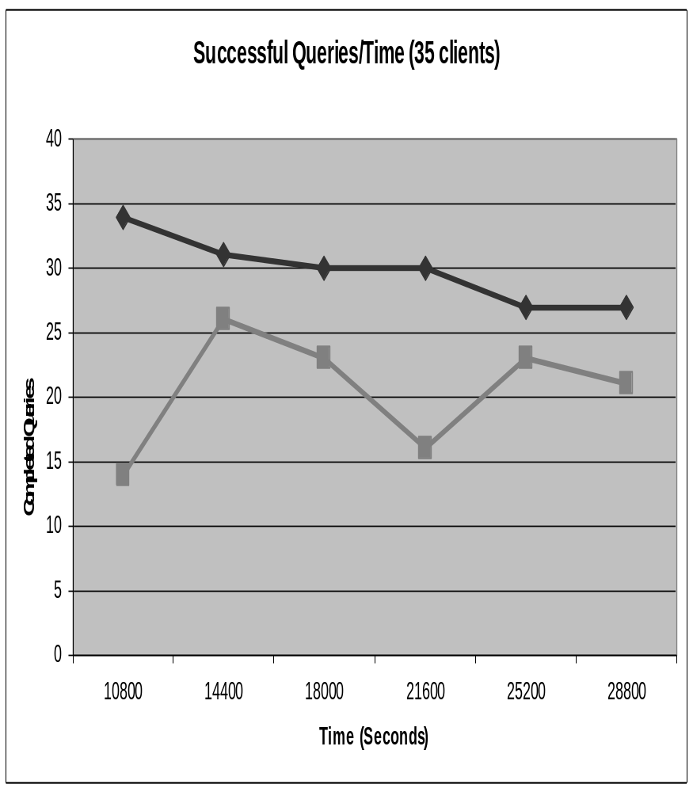

Throughput 30/35 clients
Notes:
For each graph, the darker line with diamond points represents the results when throttling was enabled. The lighter line with square points represents the non-throttled data. The points represent the number of successful query completions since the last point in time.
Throttling improves overall throughput by approximately 35% for the 30 client case, allowing a sustained completion of 30-40 queries per time slice in the benchmark. Un-throttled compilations in this benchmark will consume most available memory on the machine and starve query execution memory and the buffer pool.
Throttling also helps the 35 and 40 client cases. The throughput is lower in each of these cases when compared to the 30 client case. However, throttling still improves throughput for a given number of clients for each of these client loads.

Slide 13
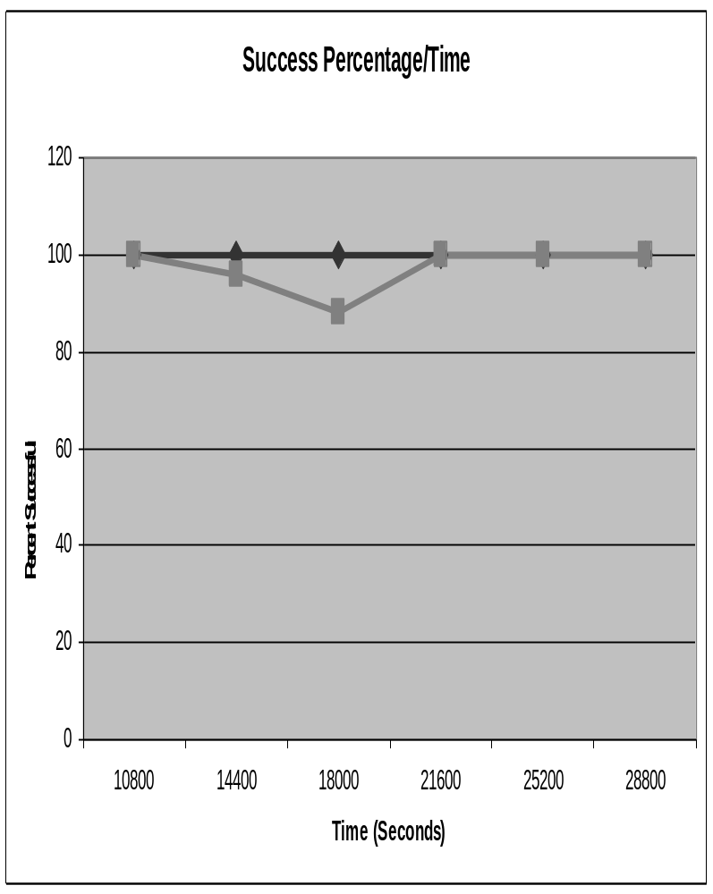
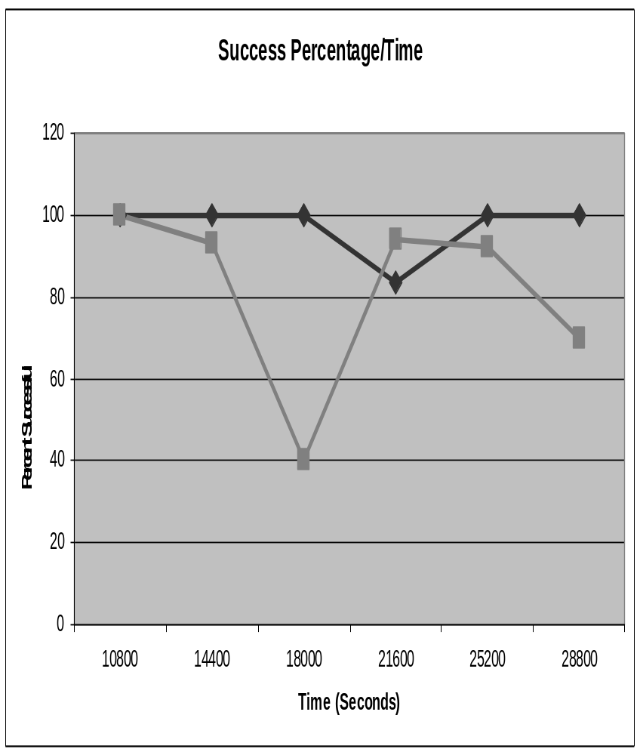
Reliability 30/35 clients
Notes:
We also measured the percentage of successful query attempts in the system. This is a metric of the probability of any given query compilation/execution attempt will succeed. Retries are counted as separate submissions in this approach.
The 30 client run demonstrates that both versions complete almost all operations without error once the system has reached a steady state. The non-throttled version has an occasional but infrequent error, and this shows that 30 clients represents the limit for the non-throttled approach on this hardware configuration.
As additional clients are added to the system, the stress on the system is increased and the probability of any individual query failing also increases (either in compilation or execution). The percentage of failures starts to increase as the system aborts operations to free memory.
The system also starts to behave less reliably once we increase the load substantially. Over time, the system may abort no queries or most queries as it tries to service the requests. However, throttling does improve the odds that a query is completed successfully, even under more extreme memory loads.

Slide 14
Summary
Three-level gateway system to throttle rate of compilations
Benefits for compile-intensive workloads
  Improves throughput for regular operations
  Gains retained even over extreme loads
Implemented in SQL Server 2005

Slide 15

Questions

