Slide 1
Rethinking Choices for
Multi-dimensional Point Indexing
You Jung Kim and Jignesh M. Patel
University of Michigan

Slide 2
Outline
Motivation
Index structures
Experimental evaluation
Conclusion

Slide 3
Motivation
Need for multi-dimensional point indexing in low to medium dimensional space
  Inherent nature of problems
  Use of dimensionality reduction techniques, e.g. PCA
Examples
  Spectral/image search (in feature space)
  Similarity search in sequence and structure databases
  Subsequence matching in time-series databases
Frequent choice: R*-tree
Is this the Right Choice?
Notes:
Multi-dimensional point indexing has played an important roles in modern database applications.
And many of those application actually require handling a point data especially in low to medium dimensional space.
One reason can be, it is just an inherent nature of the problem. Another reason is because of the curse of dimensionality, it is still difficult to index high dimensional data in an efficient way. As a way of handling this problem, people have applied a dimensionality reduction technique to transform the high-dimensional dataset into a low or medium dataset.
A few examples of such application includes x, y, and z.
One thing in common in those applications is that they all rely on R* - tree indexing multi-dimensional data sets which have less than 8 dimensional.
At this point, we ask this question, is the R*-tree a right choice for indexing low-to medium -dimensional point data?
In our work, we challenge this popular choice of the R*-tree and investigate other alternative indexing structures for the multi-dimenisionl point indexing problem.

Slide 4
Index Structures
R* tree
Quadtree
Pyramid-Technique
Data Partition
Balanced/Disjoint Space Partition
Unbalanced/Disjoint Space Partition
Balanced Tree
Unbalanced Tree
Balanced Tree

Slide 5
Packed Quadtree
Regular Quadtree
Packed Quadtree
Reduced disk footprint for the index
Clustering sibling nodes
Notes:
The quadtree is a main memory index structure and it is challenging to find an efficient mapping of the quadtree nodes to disk pages. The naïve method of mapping each quadree node to a disk page is very inefficeint. However, it is easy to design more efficient packing strategies.
The quadtree is a main memory index structure and it is challenging to find an efficient mapping of the quadtree nodes to disk pages.
The naïve method is to map a node into a single disk page. However, it can be very inefficient, wasting a significant portion of disk pages. So we used an easy and efficient mapping strategy.

Slide 6
Experimental Setup
Three indices and a file scan in SHORE
Synthetic and real datasets
  Uniformly distributed point data
  MAPS Catalog data
Query workload
  Random and skewed queries following the underlying data distribution
Notes:
Sequential file scan serves as a baseline
The reason we use a small buffer pool is to see the effect of I/O clearly.
Forest cover : forest cover type
MAPS : photometric and astrometric information extracted from the Palomar Observatory Sky survey

Slide 7
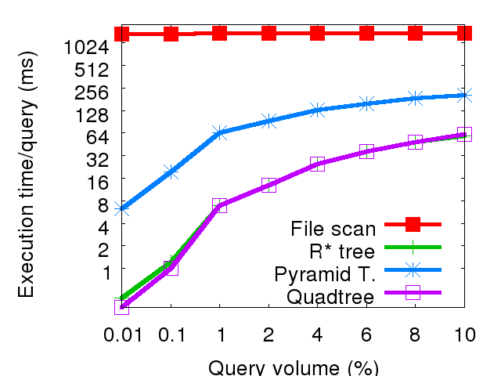
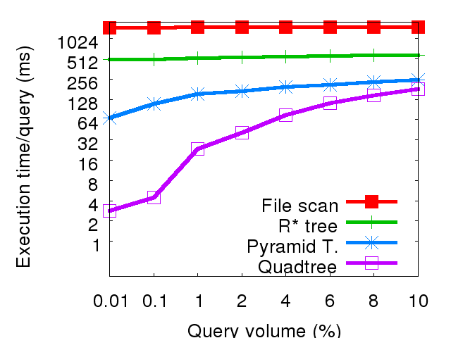
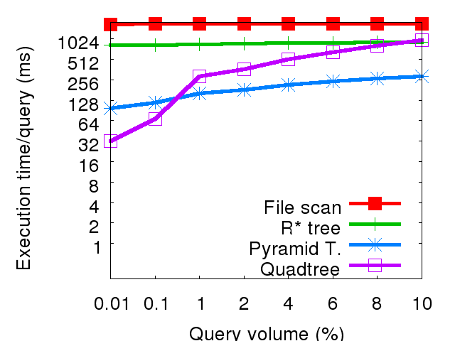
Experiments with uniform data
Total execution time for varying data dimensionality
Uniform-2D
Uniform-4D
Uniform-8D
Notes:
R*-tree
High overlap amongst MBRs with increasing dimensionality
Increased multiple path traversals
Pyramid-Technique
Due to unblanaced split strategy
Efficient for large window queries and higher dimension data
Inefficient for small window queries and lower dimensional data
Quadtree
Due to blanaced split strategy
Inefficient for large window queries and higher dimension data
Efficient for small window queries and lower dimensional data

Slide 8
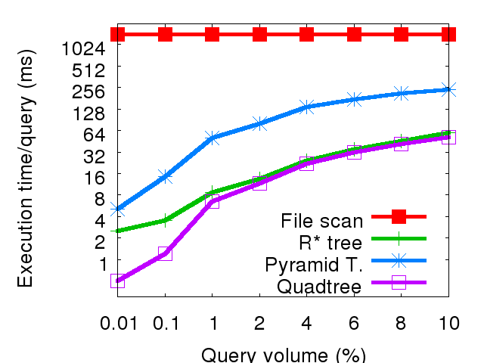
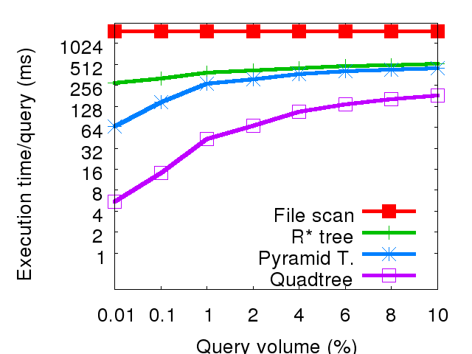
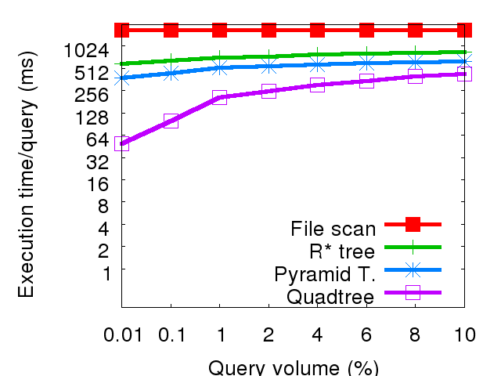
Experiments with skewed data
Total execution time for varying data dimensionality
MAPS-2D
MAPS-4D
MAPS-8D
Notes:
With 4 dimensional data sets, Quadtree outperforms the Pyramid-Technique by 2-12 times
With 8 dimensional data sets, Quadtree outperforms the Pyramid-Technique by 2-7 times

Slide 9
Analysis with skewed data
The (relative) poor performance of R*-tree
  High overlap amongst MBRs
  Skewed data points are spread under several non-leaf nodes
The (relative) poor performance of Pyramid-Technique
  The unbalanced space split is adversarial for skewed data

Slide 10
Quadtree
Uses the buffer pool very efficiently
Better spatial locality with skewed queries
R*-tree
Quadtree

Slide 11
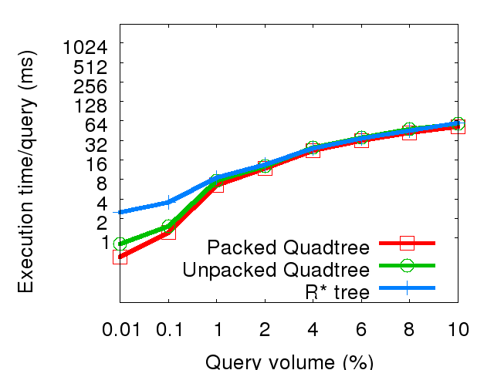
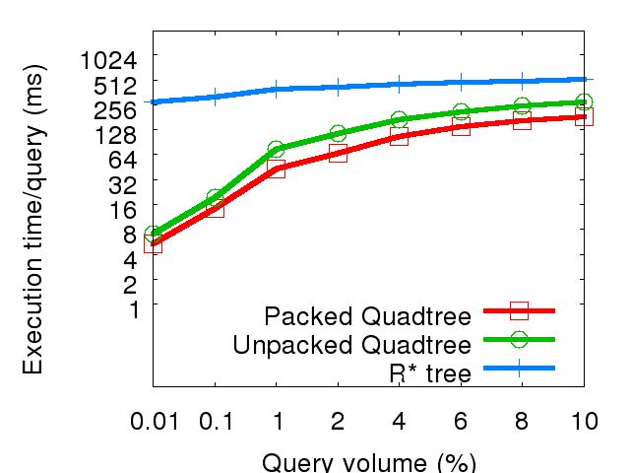
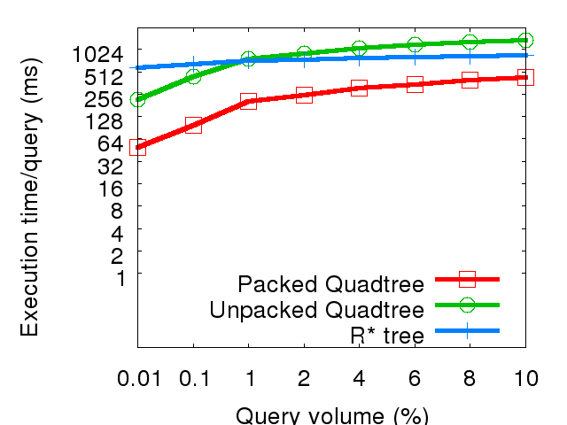
Effect of packing in Quadtree
Total execution time of packed and unpacked Quadtree
MAPS-2D
MAPS-4D
MAPS-8D

Slide 12
Conclusion
Quadtree outperforms R*-tree and Pyramid-Technique, especially for skewed (real) datasets
Efficiency of the Quadtree comes from
  Packing technique
  Regular and disjoint partitioning
  Better spatial locality and an efficient use of buffer
Analytical cost model agrees with experimental results
  i.e. our claims are not due to implementation differences, or dataset peculiarities
Notes:
As part of our work, we have also developed detailed analytical
cost models for the three indices and conducted analytical
performance evaluation of the indices. Our analytical
results are in agreement with the empirical results that we
have show here and provide additional insights into the behavior
of the indices (and validations that the claims that
we make in this paper are not due to implementation differences
or dataset peculiarities).

Slide 13
Questions?

