Slide 1
Column Stores For Wide and Sparse Data
Daniel Abadi *
MIT
*Graduating this year and seeking a job
Notes:
1

Slide 2
Row- vs. Column-Stores
Row Store
Column Store
Last Name | First Name | E-mail | Phone # | Street Address
Last Name
First
Name
E-mail
Phone #
Street
Address
Easy to add a new record
More data value locality
Might waste time reading in unnecessary data
Inserts and SELECT * might require multiple seeks

Slide 3
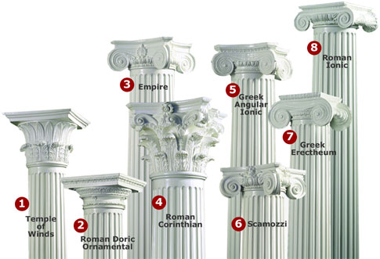
Column-Store Applications
Data Warehousing / DSS / OLAP
Customer-relationship management
IR (demo yesterday)
But that’s not enough !!!

Slide 4
Two Observations
Column-stores are good for:
  Wide Data (many columns)
  Sparse Data

Slide 5
Column-Stores For Wide Data
Column Store
One block is 10 values

Slide 6
Row-Store For Wide Data

Slide 7
Column-Stores for Sparse Data
Can use a column-specific NULL compression algorithm dependent on column sparsity

Slide 8
Storage Option for Sparse Data
NULL
Data Stored On Disk
7
NULL
StartPos
EndPos
#Vals
3
4
Header
1
11
5
NULL
Non-NULL Values
NULL
7
3
4
8
8
1
1
Non-NULL Positions
NULL
01011001100
NULL

Slide 9
Wide, Sparse Applications
Semantic Web
GEM-Style Schemas
XML (in paper)

Slide 10
Semantic Web/RDF Data
Semantic Web goal is to enable integration an sharing of data across different applications and organizations
Resource Description Framework (RDF) is data model
Typically stored in triples format

Slide 11
Semantic Web/RDF Data
Subject | Property | Object
David | rdf:type | grad student
David | Age | 26
Rachel | rdf:type | post-doc
David | Year | 3rd
Rachel | Office | 925
Rachel | Age | 29

Slide 12
Semantic Web/RDF Data
Subject | rdf:type | Age | Year | Office
David | student | 26 | 3rd | NULL
Rachel | post-doc | 29 | NULL | 925
More columns results in fewer joins
More columns results in more NULLs

Slide 13
Databases with GEM-style schemas
GEM
  Extension of the relational model to include:
    generalized attributes
    set-valued attributes
    sparse attributes
  in same conceptual schema entity (tuple)
Often results in wide, sparse schemas

Slide 14
Conclusion and Questions
Column-stores’ ability to handle wide, sparse tables opens many doors
Questions:
  Is schema design constrained by performance considerations of row-stores?
  Is physical data independence a myth?

Slide 15
Back-up Slides

Slide 16
Storing XML Data in Relational DBMS
Usually:
  XML elements can be relations
  XML attributes are table columns
  Parent/child and sibling order information also table columns
  Path expressions require a join
With column-store:
  Can use inlining where descendent elements can be included in the same element relation

Slide 17
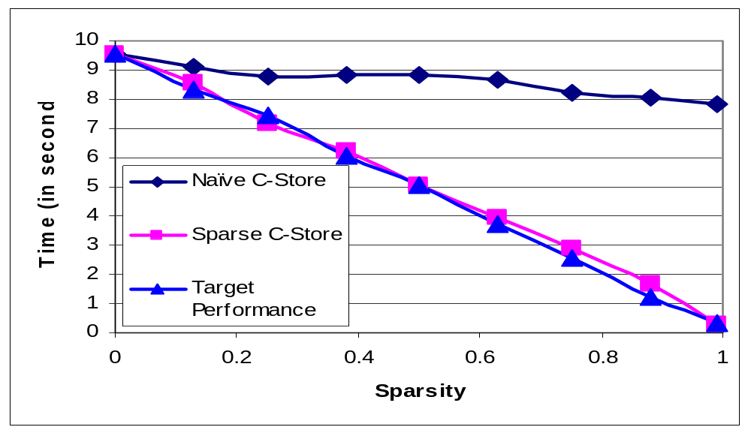
C-Store Performance on Sparse Data

Slide 18
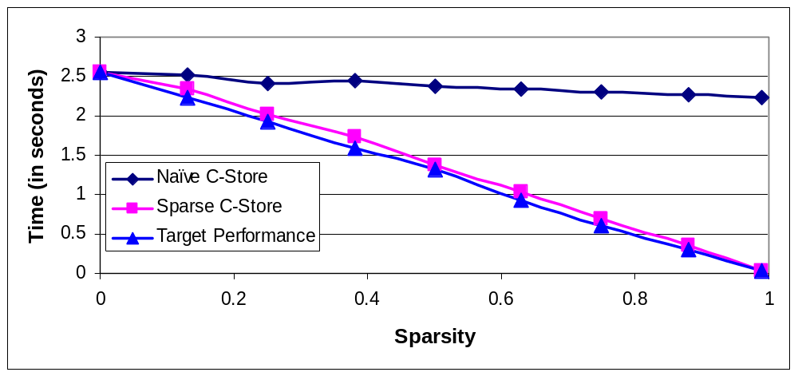
C-Store Sparse CPU Performance

Slide 19
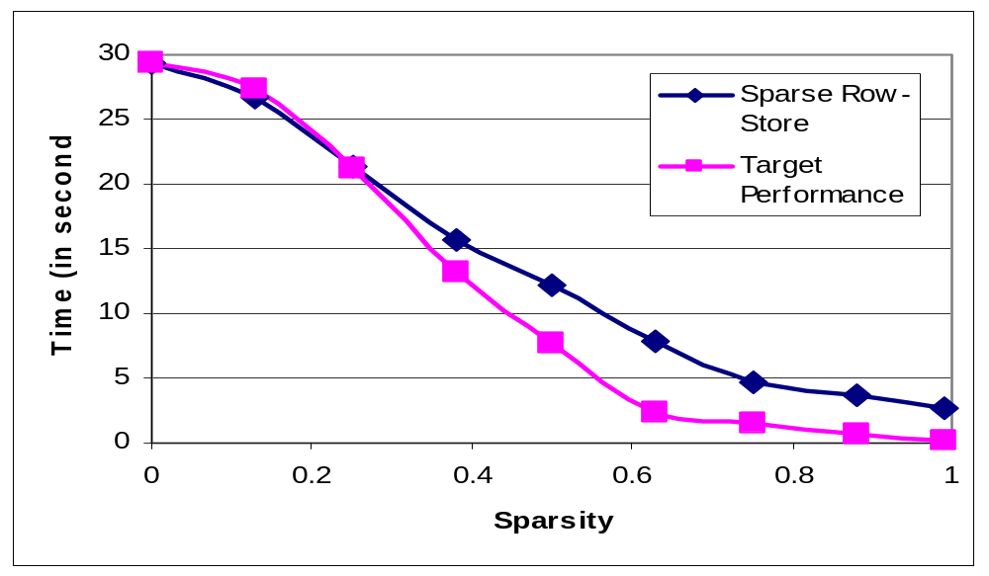
Row Store Performance on Sparse Data

Slide 20
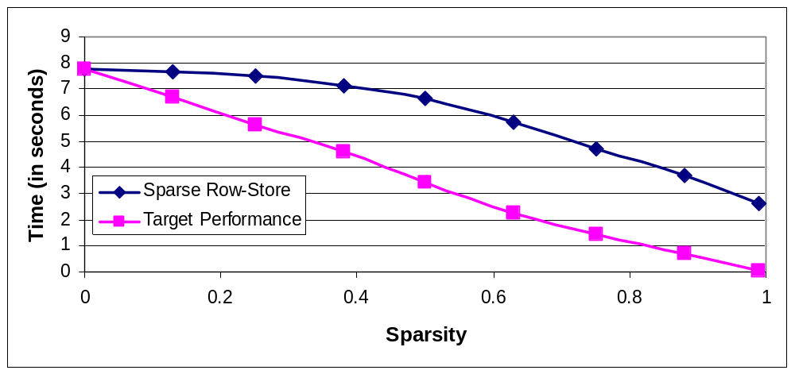
Row Store Sparse CPU Performance

Slide 21
Storage for Very Sparse Data
NULL
Data Stored On Disk
7
NULL
StartPos
EndPos
#Vals
NULL
4
Header
1
11
3
NULL
Non-NULL Values
NULL
7
4
1
NULL
Non-NULL Positions
2
5
9
1
NULL
NULL

Slide 22
Storage for Dense Data
7
Data Stored On Disk
7
StartPos
EndPos
#Vals
3
2
Header
1
11
9
4
Non-NULL Values
NULL
7
7
3
NULL
2
4
9
9
1
9
8
1
Non-NULL Positions
1
5
7
9
11
8

