Slide 1
Architecture for Modular Data Centers
James Hamilton
2007/01/08
JamesRH@microsoft.com
http://research.microsoft.com/~jamesrh/

Slide 2
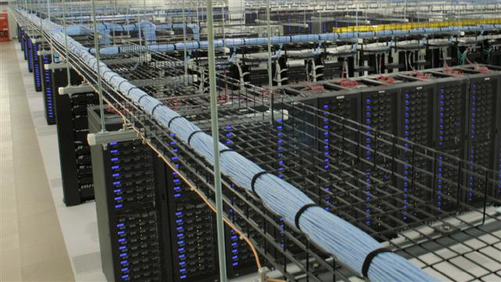
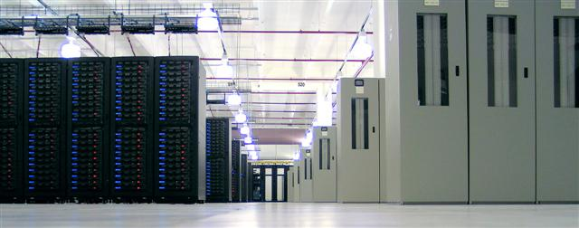
Commodity Data Center Growth
Software as a Service
  Services w/o value-add going off premise
    Payroll, security, etc. all went years ago
  Substantial economies of scale
    Services at 10^5+ systems under mgmt rather than ~10^2
  IT outsourcing also centralizing compute centers
Commercial High Performance Computing
  Leverage falling costs of H/W in deep data analysis
  Better understand customers, optimize supply chain, …
Consumer Services
  Google estimated at ½ million systems in 30 data centers
Basic observation:
  No single system can reliably reach 5 9’s (need redundant H/W with resultant S/W complexity)
  With S/W redundancy, most economic H/W solution is large numbers of commodity systems
January 8, 2006

Slide 3
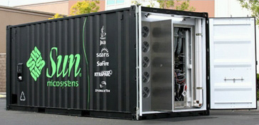
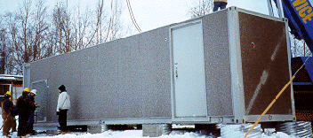
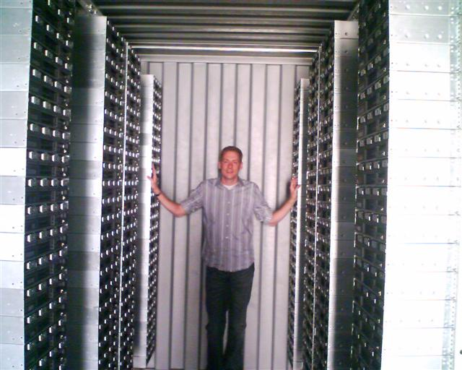
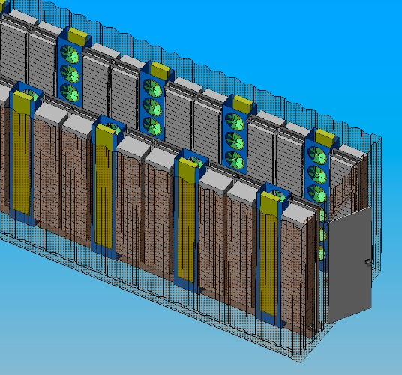
A Funny Thing Happened on the way to CIDR…
Nortel Steel Enclosure
Containerized telecom equipment
Sun Black Box (242 systems in 20’)
Rackable Systems (1,152 Systems in 40’)
Rackable Systems Container Cooling Model
January 8, 2006

Slide 4
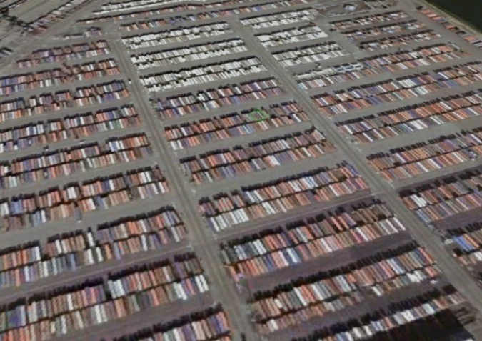
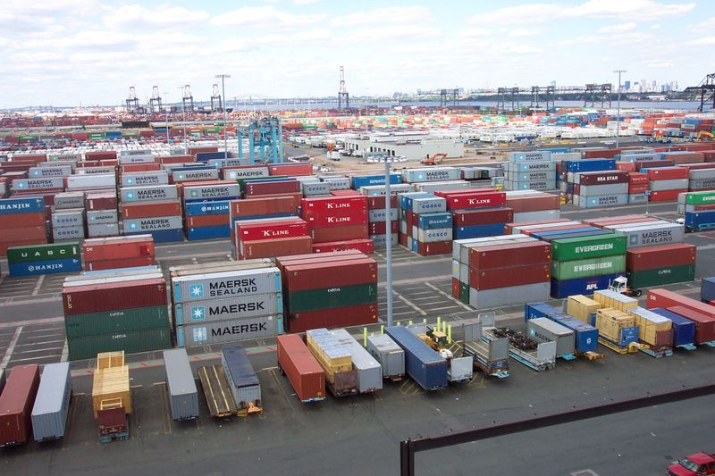
Shipping Container as Data Center Module
Data Center Module
  Contains network gear, compute, storage, & cooling
  Just plug in power, network, & cooling water
Increased cooling efficiency
  Variable water & air flow
  Better air flow management (higher delta-T)
  80% air handling power reductions (Rackable Systems)
Bring your own building
  Just central networking, power, cooling, & admin center
  Grow beyond existing facilities
  Can be stacked 3 to 5 high
  Less regulatory issues (e.g. no building permit)
  Avoids (for now) building floor space taxes
Meet seasonal load requirements
Single customs clearance on import
Single FCC compliance certification
January 8, 2006

Slide 5
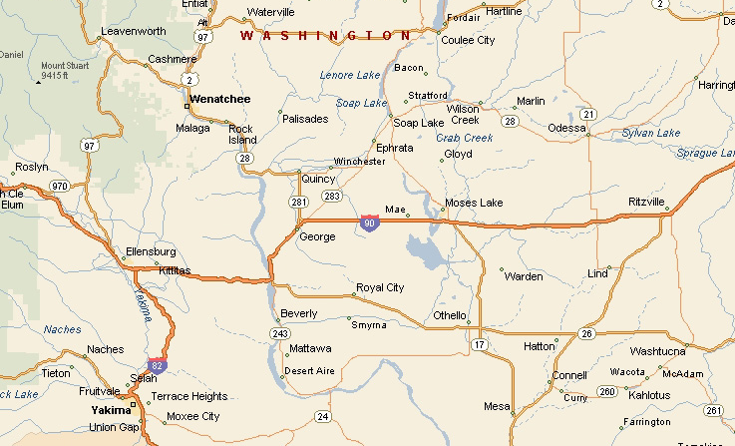
DC Location Flexibility & Portability
Dynamic data center
  Inexpensive intermodal transit anywhere in world
  Move data center to cheap power & networking
  Install capacity where needed
  Conventional Data centers cost upwards of $150M & take 24+ months to design & build
  USA PATRIOT act concerns and other national interests can require local data centers
Build out a massively distributed data center fabric
  Install satellite data centers near consumers
January 8, 2006

Slide 6
Manufacturing & H/W Admin. Savings
Factory racking, stacking & packing much more efficient
  Robotics and/or inexpensive labor
Avoid layers of packaging
  Systems->packing box->pallet->container
  Materials cost and wastage and labor at customer site
Data Center power & cooling expensive consulting contracts
  Data centers are still custom crafted rather than pre-fab units
  Move skill set to module manufacturer who designs power & cooling once
  Installation design to meet module power, network, & cooling specs
More space efficient
  Power densities in excess of 750 W/sq ft
  Rooftop or parking lot installation acceptable
Service-Free
  H/W admin contracts can exceed 25% of systems cost
  Sufficient redundancy that it just degrades over time
    At end of service, return for remanufacture & recycling
  20% to 50% of systems outages caused by Admin error (A. Brown & D. Patterson)
January 8, 2006

Slide 7

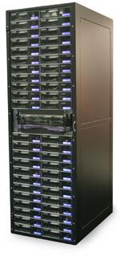
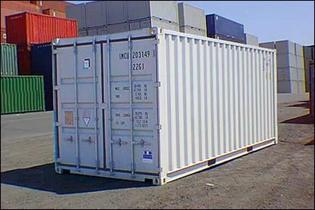
Unit of Data Center Growth
One at a time:
  1 system
  Racking & networking: 14 hrs ($1,330)
Rack at a time:
  ~40 systems
  Install & networking: .75 hrs ($60)
Container at a time:
  ~1,000 systems
  No packaging to remove
  No floor space required
  Power, network, & cooling only
Weatherproof & easy to transport
Data center construction takes 24+ months
  Both new build & DC expansion require regulatory approval
January 8, 2006

Slide 8
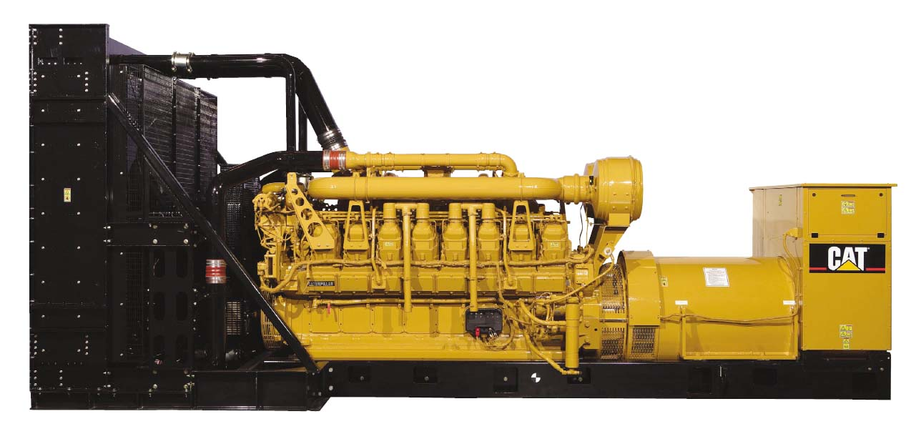
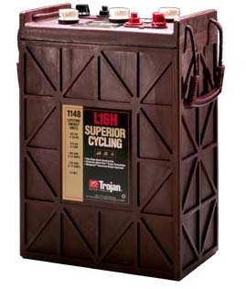
Systems & Power Density
Estimating DC power density hard
  Power is 40% of DC costs
  Shell is roughly15% of DC cost
  Cheaper to waste floor than power
    Typically 100 to 200 W/sq ft
    Rarely as high as 350 to 600 W/sq ft
  Modular DC eliminates the shell/power trade-off
    Add modules until power is absorbed
    Data Center shell is roughly 10% of total DC cost
Over 20% of entire DC costs is in power redundancy
  Batteries able to supply 13 megawatt for 12 min
  N+2 generation (11 x 2.5 megawatt)
  More smaller, cheaper data centers
Eliminate redundant power & bulk of shell costs
January 8, 2006

Slide 9
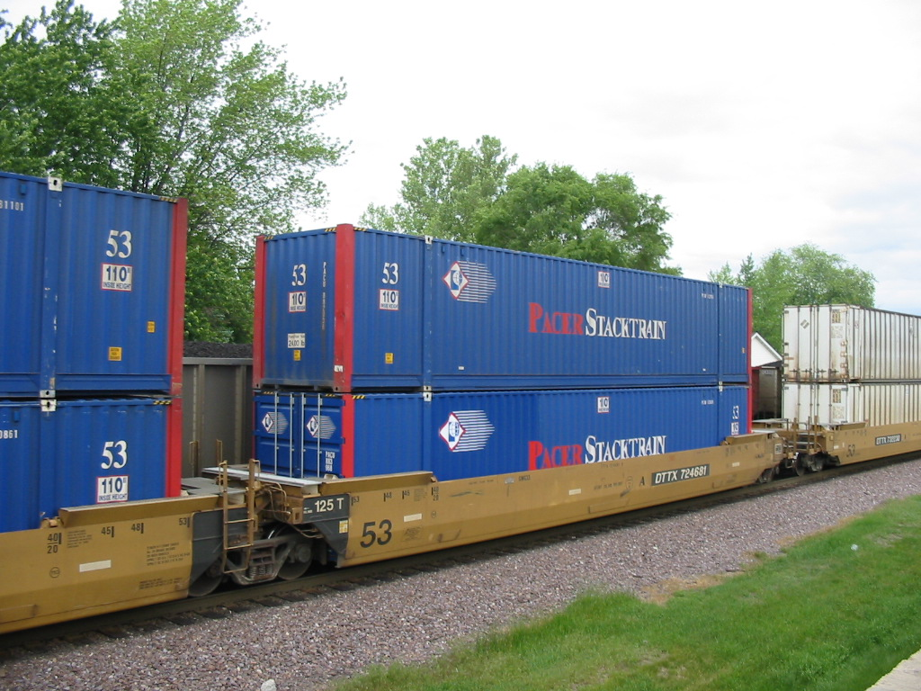
Where do you Want to Compute Today?
Slides posted to: http://research.microsoft.com/~jamesrh/
January 8, 2006

