Slide 1
Beyond Just Data Privacy
  Bobji Mungamuru
  Hector Garcia-Molina
  Christopher Olston
  Subhasish Mitra

Slide 2
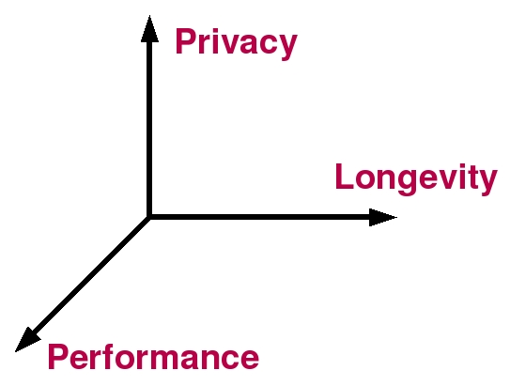
Competing Objectives

Slide 3
Overview
Configurations
  A neat way to capture these trade-offs
Search machinery
  How to find good configurations

Slide 4
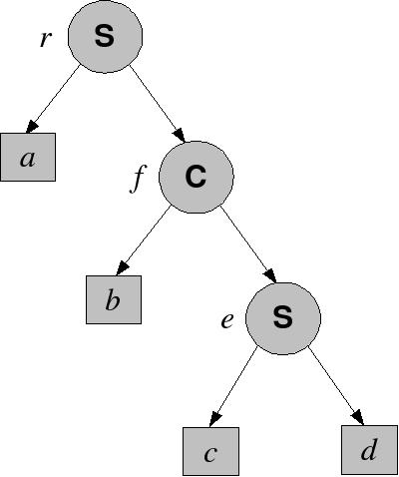
Configurations
S = split
C = copy

Slide 5
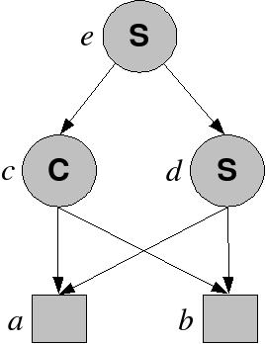
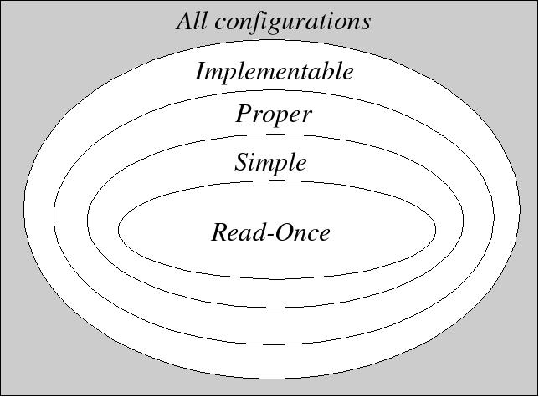
Configurations

Slide 6
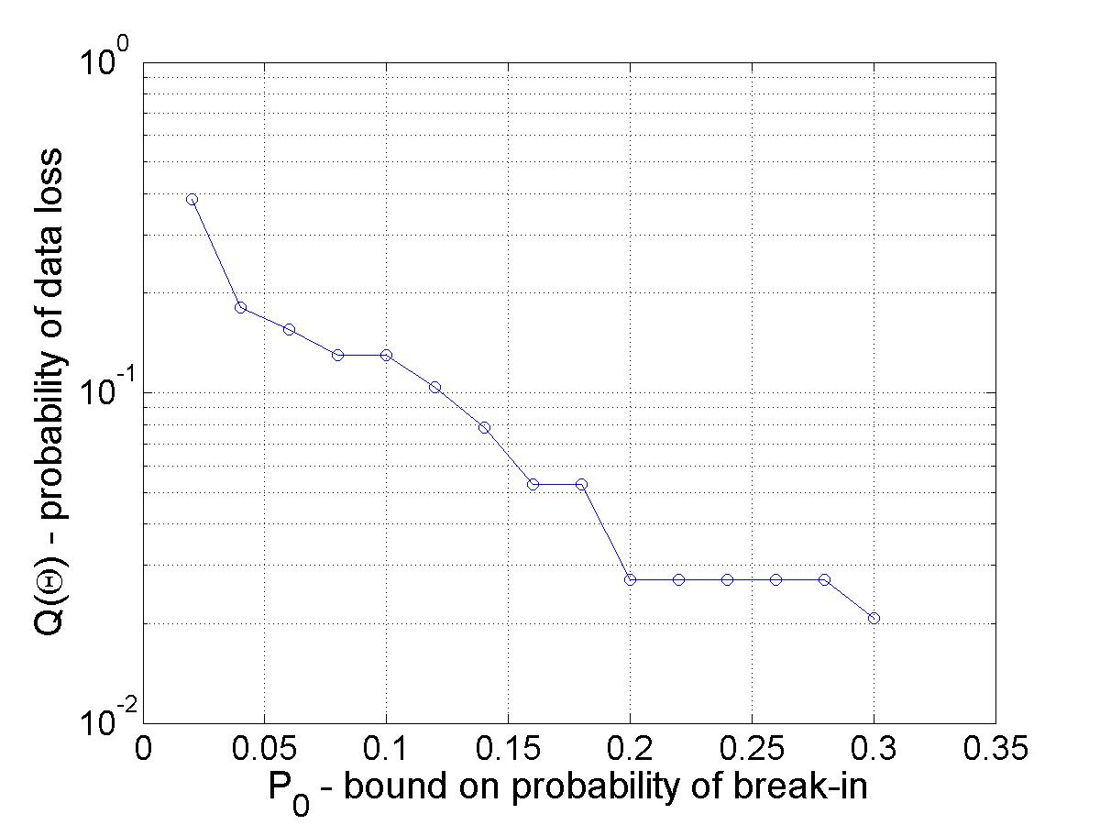
Search Machinery
^{More Longevity}
^{More Privacy}

Slide 7
Contributions
Metrics to evaluate a configuration
Algorithm for searching for good configurations
Avoiding configurations that don't “make sense”
Future work – performance

Slide 8
Summary
Google: bobji

Slide 10
So What?
Summary: given N servers with known failure characteristics, minimize data loss risk subject to an upper bound on break-in risk
Applications
  Measure effectiveness of existing systems
  Damage assessment
  Security breach probability functions

Slide 11
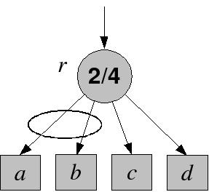
Related Work
Data preservation
Data privacy
Survivable storage @ CMU
StorageSS @ NCSA
Generalization: secret sharing

Slide 12
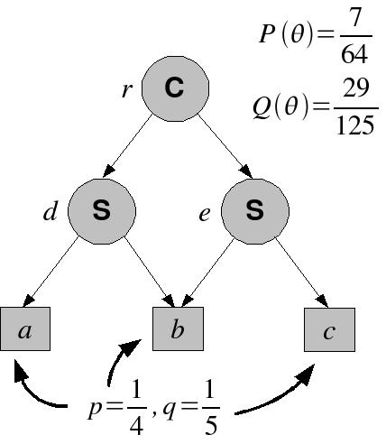
Metrics
Probability of
break-ins, P(Ө)
Probability of
data loss, Q(Ө)

Slide 13
Metrics
Depth (3)
Class (read-once)
Terminals (4)
Non-terminals (3)
Allow groups (e.g., {a,b})
Deny groups (e.g., {c,d})

Slide 14
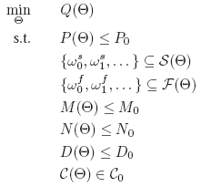
Optimization
maximize longevity, given a lower bound on privacy

Slide 15
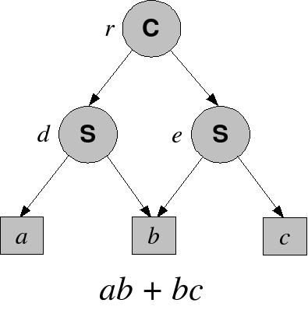
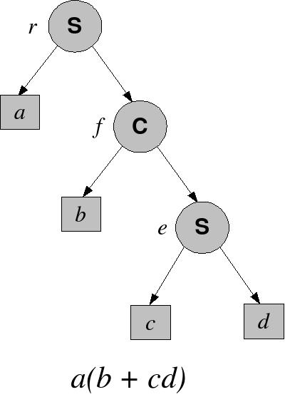
Optimization
Configurations are isomorphic with the set of factored monotone Boolean formulas

Slide 16
Optimization
Solution strategy:
  Step 1: Find the best monotone DNF formula, F*
  Step 2: Find the best factorization of F*
Step 1 is finding a separating hyperplane in {0,1}^{n}
Step 2 is well-studied in digital design literature

