Slide 1
Community Systems:
The World Online
Raghu Ramakrishnan
VP and Research Fellow
Yahoo! Research

Slide 2
The Evolution of the Web
“You” on the Web (and the cover of Time!)
  Social networking
  UGC: Blogging, tagging, talking, sharing

Slide 3
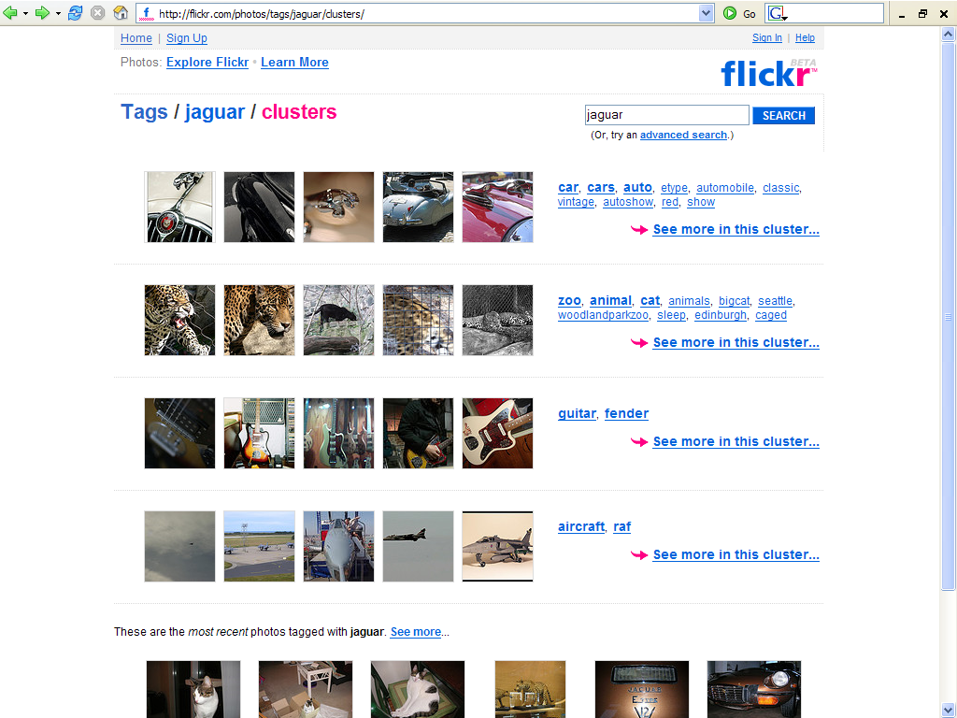

Slide 4
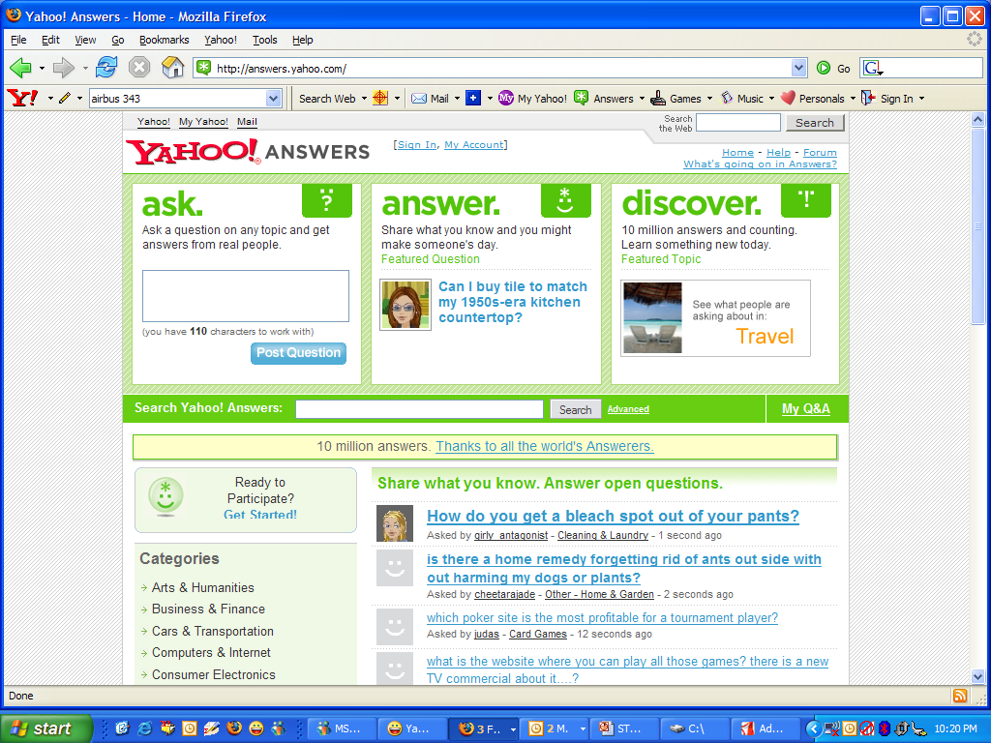

Slide 5
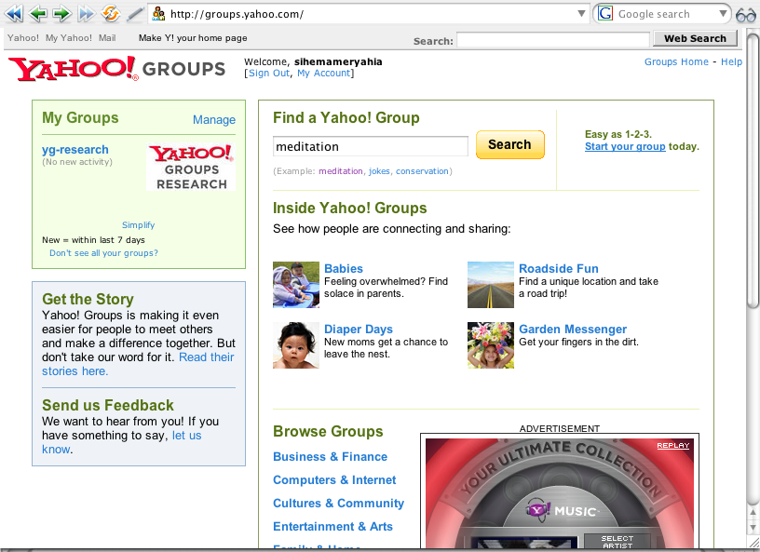

Slide 6
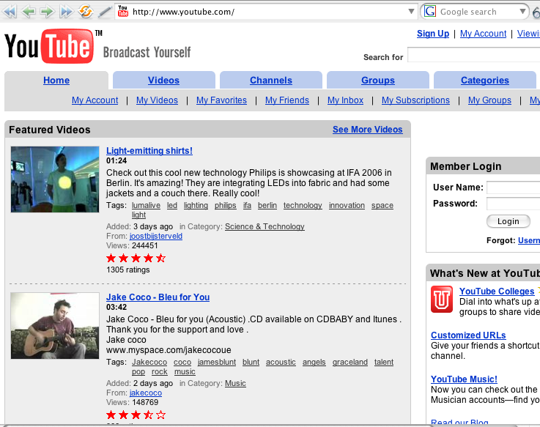

Slide 7
The Evolution of the Web
“You” on the Web (and the cover of Time!)
  Social networking
  UGC: Blogging, tagging, talking, sharing
Increasing use of structure by search engines

Slide 8
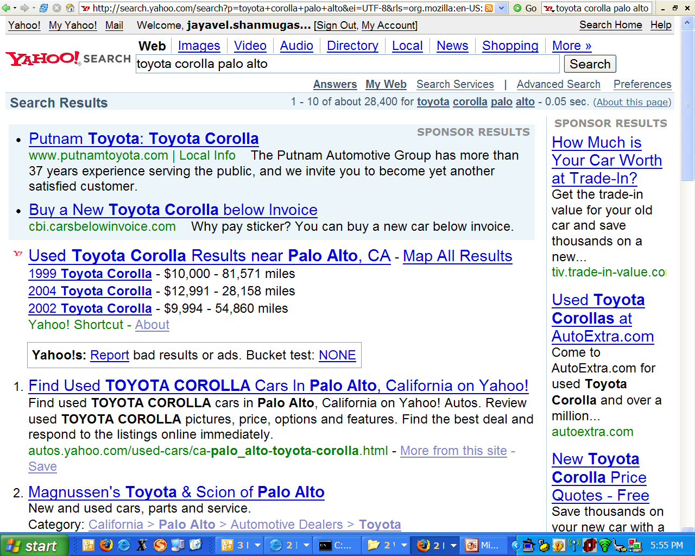
Y! Shortcuts

Slide 9
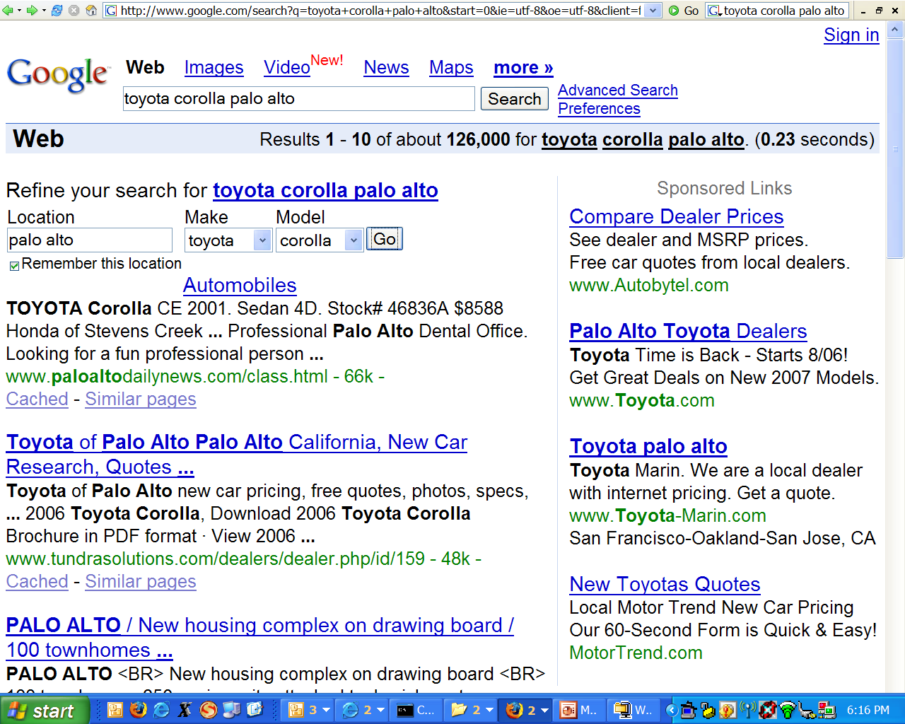
Google Base

Slide 10
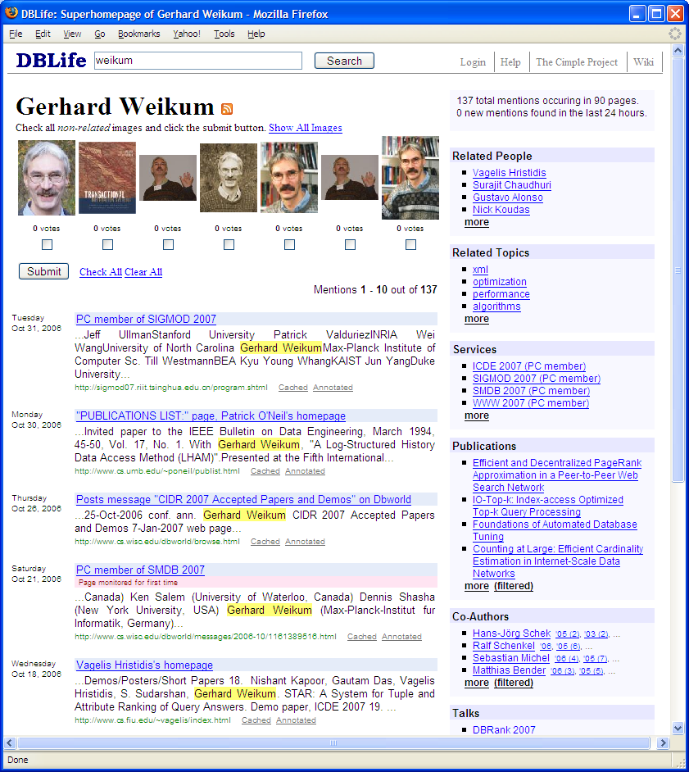
DBLife
Integrated information about a (focused) real-world community
Collaboratively built and maintained by the community
Semantic web, bottom-up

Slide 11
The Web: A Universal Bus
People to people
  Social networks
People to apps/data
  Email
Apps to Apps/data
  Web services, mash-ups

Slide 12



A User’s View of the Web
The Web: A very distributed, heterogeneous repository of tools, data, and people
A user’s perspective, or “Web View”:
Data
You Want
People
Who Matter
Functionality
Find, Use, Share, Expand, Interact

Slide 13
Grand Challenge
How to maintain and leverage structured, integrated views of web content
  Web meets DB … and neither is ready!
    Interpreting and integrating information
      Result pages that combine information from many sites
    Scalable serving of data/relationships
      Multi-tenancy, QoS, auto-admin, performance
  Beyond search—web as app-delivery channel
    Data-driven services, not DBMS software
    Desktop Web-top

Slide 14
Outline
Community Systems research at Yahoo!
Social Search
  Tagging (del.icio.us, Flickr, MyWeb)
  Knowledge sharing (Y! Answers)
Structure
  Community Information Management (CIM)
Web as app-delivery channel
  Mail and beyond

Slide 15
Community Systems Group
@ Yahoo! Research
Raghu Ramakrishnan
Sihem Amer-Yahia
Philip Bohannon
Brian Cooper
Cameron Marlow
Dan Meredith
Chris Olston
Ben Reed
Jai Shanmugasundaram
Utkarsh Srivastava
Andrew Tomkins

Slide 16
What We Do
Science of social search: Use shared interactions to
  Improve ranking of web-search results
  Enable focused content creation
  Go beyond content search to people search
Foundations of online communities:
  Powering community building and operation
  Understanding community interactions

Slide 17
Social Search
Improve web search by
  Learning from shared community interactions, and leveraging community interactions to create and refine content
    Enhance and amplify user interactions
  Expanding search results to include sources of information (e.g., experts, sub-communities of shared interest)
Reputation, Quality, Trust, Privacy

Slide 18
Web Data Platforms
Powering Web applications
  A fundamentally new goal: Self-tuning platforms to support stylized database services and applications on a planet-wide scale
    Challenges: Performance, Federation, Reliability, Maintainability, Application-level customizability, Security, Varied data types & multimedia content, extracting and exploiting structure from web content …
Understanding online communities
  Exploratory analysis over massive data sets
    Challenges: Analyze shared, evolving social networks of users, content, and interactions to learn models of individual preferences and characteristics; community structure and dynamics; and to develop robust frameworks for evolution of authority and trust
User
Tags

Slide 19
Two Key Subsystems
Serving system
  Takes queries and returns results
Content system
  Gathers input of various kinds (including crawling)
  Generates the data sets used by serving system
Both highly parallel
Goal: scaleup. Hardware increments support larger loads.
Serving
System
Data
sets
Users
Logs
Content
System
Data updates
Web sites
Goal: speedup. Hardware increments speed computations.
(Courtesy: Raymie Stata)

Slide 20
Social Search
Is the Turing test always the right question?

Slide 21
Brief History of Web Search
Early keyword-based engines
  WebCrawler, Altavista, Excite, Infoseek, Inktomi, Lycos, ca. 1995-1997
  Used document content and anchor text for ranking results
1998+: Google introduces citation-style link-based ranking
Where will the next big leap in search come from?
(Courtesy: Prabhakar Raghavan)

Slide 22
Social Search
Putting people into the picture:
  Share with others:
    What: Labels, links, opinions, content
    With whom: Selected groups, everyone
    How: Tagging, forms, APIs, collaboration
    Every user can be a Publisher/Ranker/Influencer!
      “Anchor text” from people who read, not write, pages
  Respond to others
    People as the result of a search!

Slide 23
Four Types of Communities
Social Networks
Communication &
Expression
Facebook, MySpace
Enthusiasts / Affinity
Hobbies & Interests
Fantasy Sports, Custom Autos
360/Groups
Music
Knowledge Collectives
Find answers & acquire knowledge
Wikipedia, MyWeb, Flickr, Answers, CIM
Marketplaces
Trusted transactions
eBay, Craigslist
Social Search

Slide 25
The Power of Social Media
Flickr – community phenomenon
Millions of users share and tag each others’ photographs (why???)
The wisdom of the crowds can be used to search
The principle is not new – anchor text used in “standard” search
(Courtesy: Prabhakar Raghavan)

Slide 26
Anchor text
When indexing a document D, include anchor text from links pointing to D.
Armonk, NY-based computer
giant IBM announced today
www.ibm.com
Big Blue today announced
record profits for the quarter
Joe’s computer hardware links
Compaq
HP
IBM
(Courtesy: Prabhakar Raghavan)

Slide 27
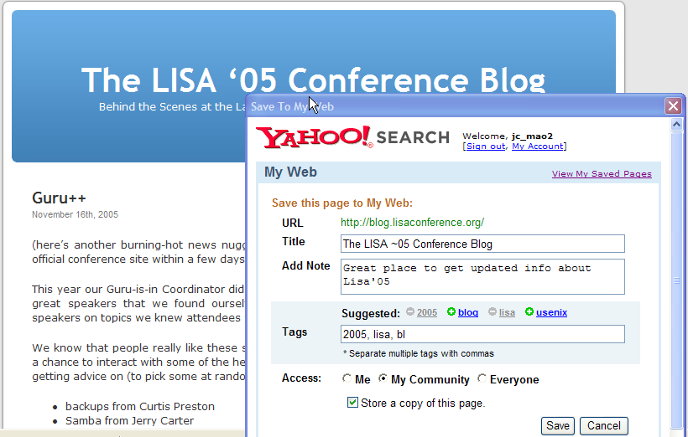
Save / Tag Pages You Like
Enter your note for personal recall and sharing purpose
You can save / tag pages you like into My Web from toolbar / bookmarklet / save buttons
You can pick tags from the suggested tags based on collaborative tagging technology
Type-ahead based on the tags you have used
You can specify a sharing mode
You can save a cache copy of the page content
(Courtesy: Raymie Stata)
Notes:
One of the tools provided by My Web 2.0 is for saving pages into My Web. For example, if you want to save the LISA 2005 page into My Web, you can use the Yahoo toolbar, or a bookmark-let to do that. It will allow you to add addition, tags, and set access control.

Slide 28
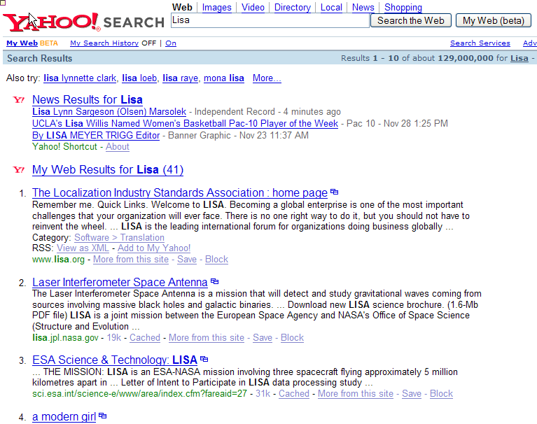
Web Search Results for “Lisa”
Latest news results for “Lisa”. Mostly about people because Lisa is a popular name
41 results from My Web!
Web search results are very diversified, covering pages about organizations, projects, people, events, etc.
Notes:
When I search for “LISA” using the search the web button, this is what I get. At the top, there are some news results. The next is a link point to 41 matches from documents that are saved in MyWeb. The rest is just the regular web search results. As you can see, they are pretty diversified, because term LISA can have many different meanings.

Slide 29
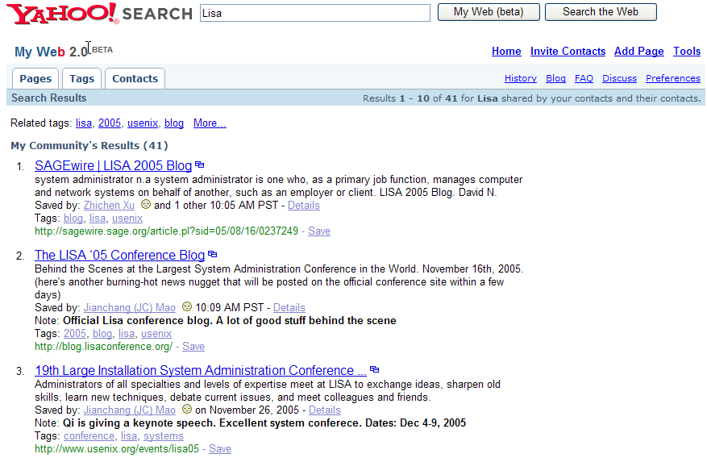
My Web 2.0 Search Results for “Lisa”
Excellent set of search results from my community because a couple of people in my community are interested in Usenix Lisa-related topics
Notes:
This is what I get if I hit the search My Web button. The results are dramatically better, as each of the hits are all about the USENIX LISA conference. The magic here is because friends in my community are co-workers who are interested in this this conference, and have saved and tagged documents about this conference. It’s the community’s bias that lead to much more relevant results for me, as I share the same bias.
However, if I were to hit the “My Web” button for the query LISA, this results all the matches that are relevant to this conference. This is because users in my community are mostly from the technology segment, and there are many who have saved and tagged documents about the LISA conference. Therefore, relative to me as a user, given my bias, this set of search results is much more relevance than a general web search result would have provided.

Slide 30
Searching Yahoo! Groups
User
Over 7M groups!
Group Search
Subscribers
User Query
(Courtesy: Sihem Amer-Yahia)

Slide 31
What is a Relevant Group?
A group whose content is relevant to the query keywords.
A group to which many of my buddies belong.
A group where many of my buddies post messages.
A group with some of my preferred characteristics: traffic, membership.
(Courtesy: Sihem Amer-Yahia)

Slide 32
Search Within a Group
Messages in a group stored in one mbox file distributed across 20 machines. Each mbox is at most 2MB. Large groups have 1000 messages and large messages are 2KB.
Search on:
  Message: author (name, email address, Y! alias, YID), body, subject, is-spam, is-special-notice, is-topic
  Thread: returned if its first message is on the input topic
Messages returned sorted by date.
(Courtesy: Sihem Amer-Yahia)

Slide 33
Some Challenges in Social Search
How do we use annotations for better search?
How do we cope with spam?
Ratings? Reputation? Trust?
What are the incentive mechanisms?
  Luis von Ahn (CMU): The ESP Game

Slide 34
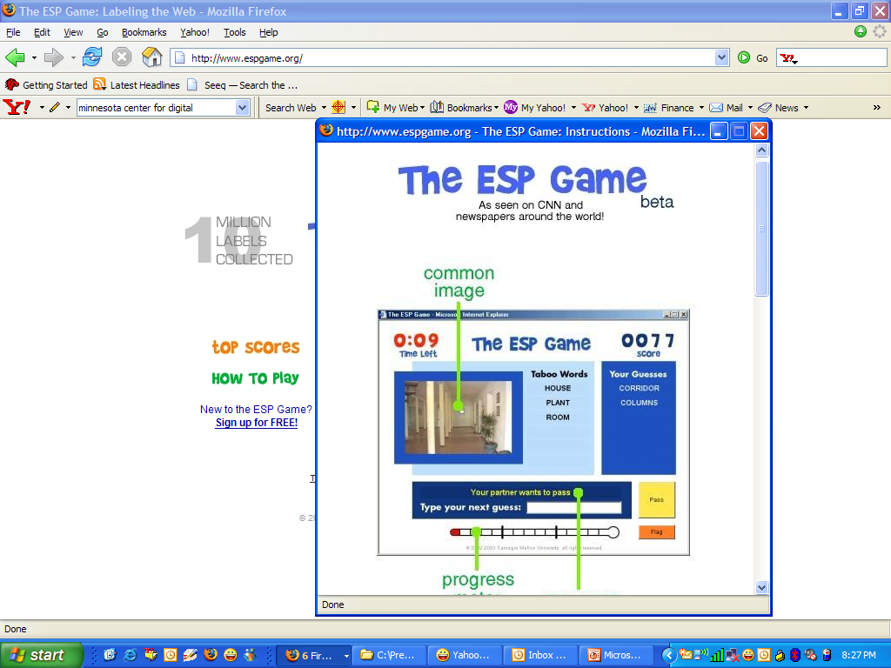

Slide 35
DB-Style Access Control
My Web 2.0 sharing modes (set by users, per-object)
  Private: only to myself
  Shared: with my friends
  Public: everyone
Access control
  Users only can view documents they have permission to
Visibility control
  Users may want to scope a search, e.g., friends-of-friends
Filtering search results
  Only show objects in the result set
    that the user has permissions to access
    in the search scope
(Courtesy: Raymie Stata)
Notes:
QL (talking points)
One problem that’s core to social search, is the access control and visibility control. For the Yahoo My Web 2.0, there are three basic sharing modes. Private, shared, which gives permission for users on my friends list to view the content, and pubic. The access permission is set by the owner at per object level. The access control problem is to ensure that users only get to see documents that they have permission to.
Visibility control is on the flip side. It allows the users to scope a search. For example, the user can select search across my friends, or my friends of friends.
The central problem boils down to filtering of search results, either based on access permission, or based on visibility scope.
The user can set sharing mode at each item level. The access control problem is to ensure that the users get to access only the objects that they have granted permissions. For visibility control, it’s the flip side of the problem, in that users would like to control the scope of a query, for example, only search for documents saved by 1st degree of friends, or friends-of-friends etc. Therefore the heart of the computation problem is filtering, so that we will ony show objects in a result that the user has permission to access, or falls within the scope specified by the user.
=================
Now I am going to switch gear to talk about two key algorithms that are essential in social search. The first one is for efficient access control, and the second one for mashup public search results with various community micro-content on various applications.
Let’s talk about ACL filtering first. My Web supports 3 sharing modes: Private - accessible only to myself; Shared – share with my friends; and Public: accessible to everyone. Users can set sharing mode at per object (saved page) level. Note that every saved page is a separate object. A URL can be saved for sharing with friends by one user, and saved as private by another user.
My Web honors users’ sharing settings. My Web users can only access saved pages that are accessible to them.
There is another aspect of ACL filtering. That is visibility control. A user may want to scope a search to only her community data that are accessible to her.
So our filtering task needs to cover these two aspects. Only show objects in the result set that the user has permissions to access and in the search scope.

Slide 36
Question-Answering Communities
A New Kind of Search Result: People, and What They Know

Slide 38
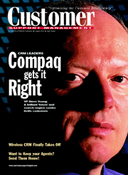

TECH SUPPORT AT COMPAQ
“In newsgroups, conversations disappear and you have to ask the same question over and over again. The thing that makes the real difference is the ability for customers to collaborate and have information be persistent. That’s how we found QUIQ. It’s exactly the philosophy we’re looking for.”
“Tech support people can’t keep up with generating content and are not experts on how to effectively utilize the product … Mass Collaboration is the next step in Customer Service.”
– Steve Young, VP of Customer Care, Compaq

Slide 39
HOW IT WORKS
QUESTION
Customer
QUESTION
KNOWLEDGE
KNOWLEDGE
BASE
SELF SERVICE
BASE
SELF SERVICE
Answer added to
power self service
Answer added to
power self service
-
Partner Experts
-
ANSWER
-
Customer Champions
-
Employees
Support
Agent

Slide 40
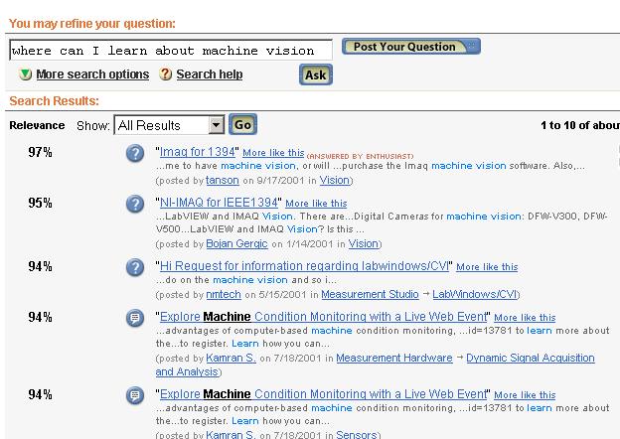
SELF-SERVICE

Slide 41
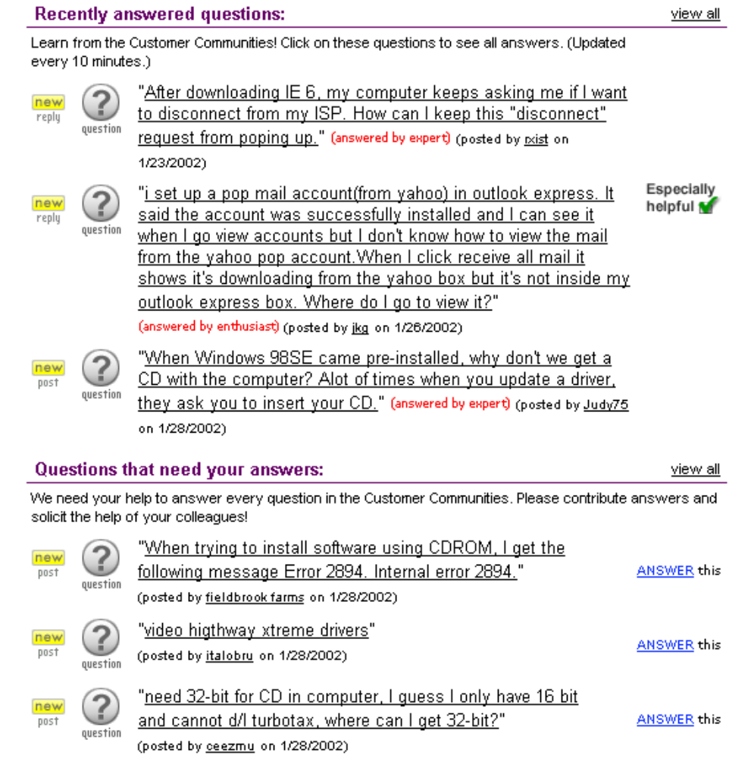
PARTICIPATION

Slide 42
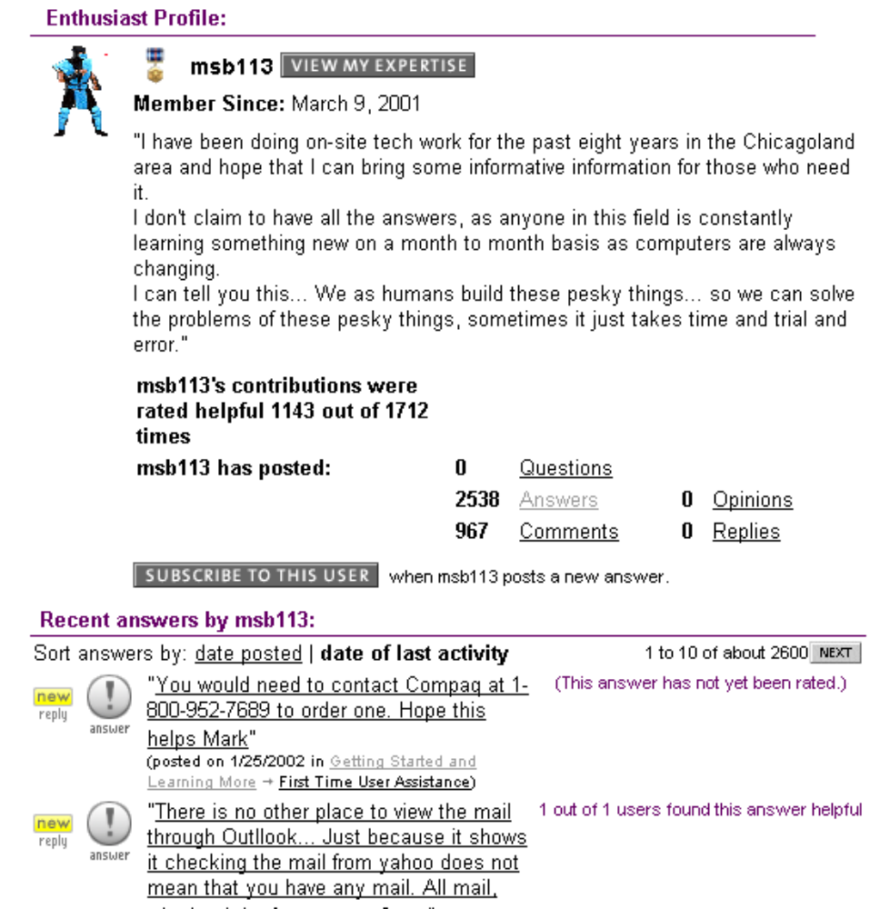
REPUTATION

Slide 43






RATINGS, QUALITY
mrduque has indicated
that this issue is resolved.
2 out of 3 users found this answer helpful
Rate this insight:

Slide 44
TIMELY ANSWERS
77% of answers provided within 24h
6,845
No effort to answer each question
No added experts
No monetary incentives for enthusiasts
86% (4,328)
74% answered
77% (3,862)
65% (3,247)
40% (2,057)
Answers
provided
in 3h
Answers
provided
in 12h
Answers
provided
in 24h
Answers
provided
in 48h
Questions

Slide 45
POWER OF KNOWLEDGE CREATION
SUPPORT
SHIELD 1
SHIELD 2
Knowledge
Creation
~80%
Self-Service *)
Customer
Mass Collaboration ^{*)}
5-10 %
Support Incidents
Agent Cases
*) Averages from QUIQ implementations

Slide 46

MASS CONTRIBUTION
Users who on average provide only 2 answers provide 50% of all answers
Answers
100 %
(6,718)
Contributed by mass of users
50 %
(3,329)
Top users
Contributing
Users
7 % (120)
93 % (1,503)

Slide 47
COMMUNITY STRUCTURE
COMPAQ
APPLE
?
SUPERVISORS
ENTHUSIASTS
MICROSOFT
ESCALATION
COMMUNITY
EDITORS
EXPERTS
AGENTS
ROLES vs. GROUPS

Slide 48
Structure on the Web

Slide 49



Make Me a Match!
USER – AD
USER - CONTENT
CONTENT - AD

Slide 50
Tradition
Keyword search: seafood san francisco
Buy San Francisco Seafood at Amazon
San Francisco Seafood Cookbook

Slide 51
Structure
“seafood san francisco”
Category: restaurant
Location: San Francisco
Reserve a table for two tonight at SF’s best Sushi Bar and get a free sake, compliments of OpenTable!
Category: restaurant Location: San Francisco
Alamo Square Seafood Grill - (415) 440-2828
803 Fillmore St, San Francisco, CA - 0.93mi - map
Category: restaurant Location: San Francisco

Slide 52
Finding Structure
“seafood san francisco”
Category: restaurant
Location: San Francisco
CLASSIFIERS
(e.g., SVM)
Can apply ML to extract structure from user context (query, session, …), content (web pages), and ads
Alternative: We can elicit structure from users in a variety of ways

Slide 53
Better Search via IE
(Information Extraction)
Extract, then exploit, structured data from raw text:
For years, Microsoft Corporation CEO Bill Gates was against open source. But today he appears to have changed his mind. "We can be open source. We love the concept of shared source," said Bill Veghte, a Microsoft VP. "That's a super-important shift for us in terms of code access.“
Richard Stallman, founder of the Free Software Foundation, countered saying…
Select Name
From PEOPLE
Where Organization = ‘Microsoft’
PEOPLE
Name Title Organization
Bill Gates CEO Microsoft
Bill Veghte VP Microsoft
Richard Stallman Founder Free Soft..
Bill Gates
Bill Veghte
(from Cohen’s IE tutorial, 2003)

Slide 54
Community Information Management

Slide 55
Community Information Management (CIM)
Many real-life communities have a Web presence
  Database researchers, movie fans, stock traders
Each community = many data sources + people
Members want to query and track at a semantic level:
  Any interesting connection between researchers X and Y?
  List all courses that cite this paper
  Find all citations of this paper in the past one week on the Web
  What is new in the past 24 hours in the database community?
  Which faculty candidates are interviewing this year, where?

Slide 56
The DBLife Portal
Faculty: AnHai Doan & Raghu Ramakrishnan
Students: P. DeRose, W. Shen, F. Chen, R. McCann, Y. Lee, M. Sayyadian
Prototype system up and running since early 2005
Plan to release a public version of the system in Spring 2007
1164 sources, crawled daily, 11000+ pages / day
160+ MB, 121400+ people mentions, 5600+ persons
See DE overview article, CIDR 2007 demo

Slide 57
DBLife
Integrated information about a (focused) real-world community
Collaboratively built and maintained by the community
Semantic web, bottom-up

Slide 58
1. Focused Data Retrieval
Identify relevant data sources
  Websites in each category identified by portal-builder
  Allow users to add sources
  Learn to identify/suggest sources
Crawl to dowload and archive data once a day

Slide 59
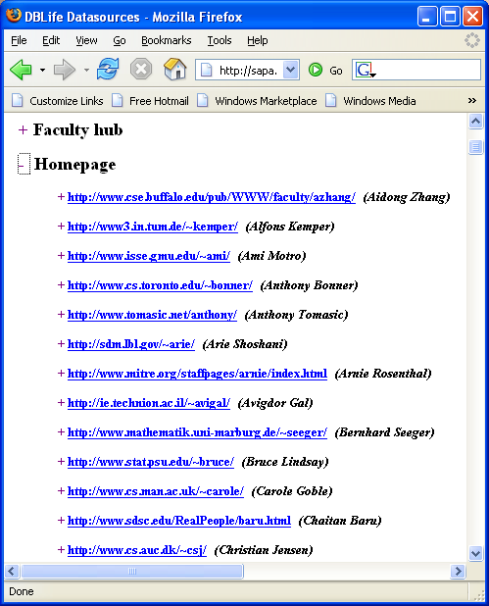
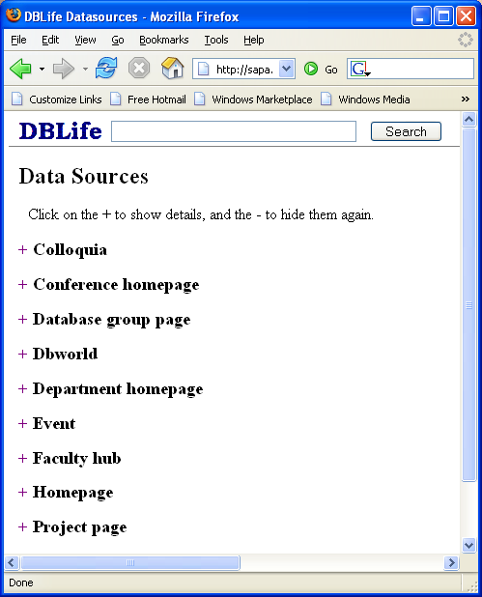
Prototype System: DBLife
Integrate data of the DB research community
1164 data sources
Crawled daily, 11000+ pages = 160+ MB / day

Slide 60
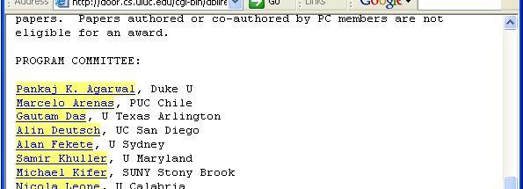
2. Semantic Data Enrichment
Given a page, find mentions of entities: researchers, conferences, papers, talks, etc.
  A mention is a span of text referring to an entity
Many sophisticated techniques are known
  Must exploit domain knowledge to do a better job
We find about 114,400 mentions per day

Slide 61
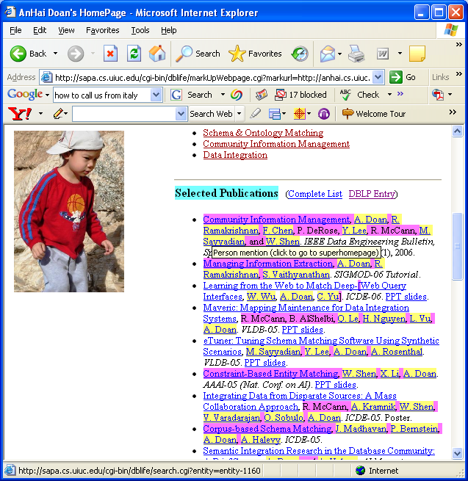
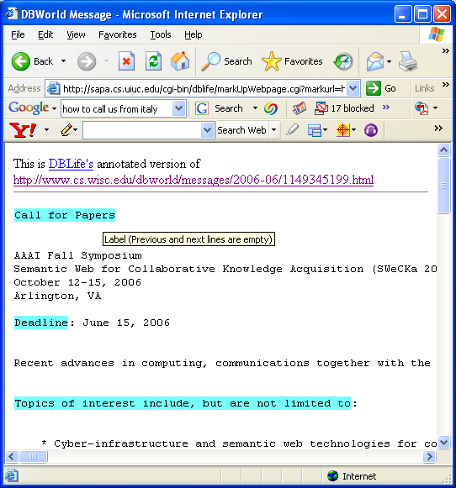
Data Extraction

Slide 62
3. Entity and Relationship Discovery
Given a set of mentions, infer the real-world entities
Fundamental challenge: Determine if two mentions refer to same entity
  “John Smith” = “J. Smith”?
  “Dave Jones” = “David Jones”?
Infer meta-data about entities and their relationships
  Researchers: Contact information, institution, research interests, year of graduation, publication list
  Publications: Topic, year, journal/conference, other publications citing it, authors
  Conferences: Location, date, acceptance rate, number of tracks, organizers, PC

Slide 63
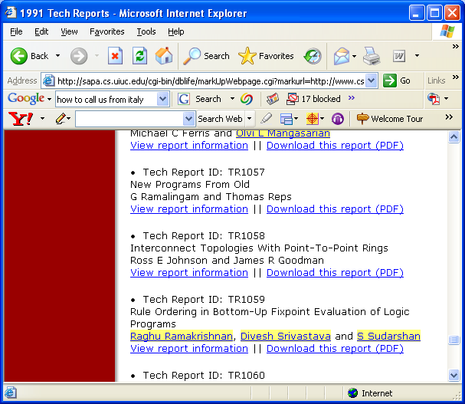
Data Integration
Raghu Ramakrishnan
co-authors = A. Doan, Divesh Srivastava, ...

Slide 64
Entity Resolution (Mention Disambiguation / Matching)
… contact Ashish Gupta
at UW-Madison …
(Ashish Gupta, UW-Madison)
Same Gupta?
… A. K. Gupta, agupta@cs.wisc.edu ...
(A. K. Gupta, agupta@cs.wisc.edu)
(Ashish K. Gupta, UW-Madison, agupta@cs.wisc.edu)
Text is inherently ambiguous; must disambiguate and merge extracted data

Slide 65
Resulting ER Graph
“Proactive Re-optimization
write
write
Shivnath Babu
coauthor
write
Pedro Bizarro
coauthor
advise
David DeWitt
advise
coauthor
Jennifer Widom
PC-member
PC-Chair
SIGMOD 2005

Slide 66
Structure-Related Challenges
Extraction
  Domain-level vs. site-level
  Compositional, customizable approach to extraction planning
    Cannot afford to implement extraction afresh in each application!
Maintenance of extracted information
  Managing information Extraction
  Mass Collaboration—community-based maintenance
Exploitation
  Search/query over extracted structures
  Detect interesting events and changes

Slide 67
Complications in Extraction and Disambiguation

Slide 68
Overview
Multi-step, user-guided workflows
  In practice, developed iteratively
  Each step must deal with uncertainty / errors of previous steps
Integrating multiple data sources
  Extractors and workflows tuned for one source may not work well for another source
  Cannot tune extraction manually for a large number of data sources
Incorporating background knowledge
  E.g., dictionaries, properties of data sources, such as reliability/structure/patterns of change
Challenges in continuous extraction, i.e., monitoring
  Reconciling prior results, avoiding repeated work, tracking real-world changes by analyzing changes in extracted data

Slide 69
Workflows in Extraction Phase
Example: extract Person’s contact PhoneNumber
I will be out Thursday, but back on Friday. Sarah can be reached at 202-466-9160. Thanks for your help. Christi 37007.
Sarah’s number is 202-466-9160
A possible workflow
Hand-coded: If a person-name is followed by “can be reached at”, then followed by a phone-number
➔
output a mention of the contact relationship
contact relationship
annotator
person-name
annotator
phone-number
annotator
I will be out Thursday, but back on Friday. Sarah can be reached at 202-466-9160. Thanks for your help. Christi 37007.

Slide 70
Workflows in Entity Resolution
Workflows also arise in the matching phase
As an example, we will consider two different matching strategies used to resolve entities extracted from collections of user home pages and from the DBLP citation website
  The key idea in this example is that a more liberal matcher can be used in a simple setting (user home pages) and the extracted information can then guide a more conservative matcher in a more confusing setting (DBLP pages)

Slide 71
Example: Entity Resolution Workflow
d₁: Gravano’s Homepage
d₂: Columbia DB Group Page
d₃: DBLP
L. Gravano, K. Ross.
Text Databases. SIGMOD 03
L. Gravano, J. Sanz.
Packet Routing. SPAA 91
Members
L. Gravano K. Ross J. Zhou
L. Gravano, J. Zhou.
Text Retrieval. VLDB 04
Luis Gravano, Kenneth Ross. Digital Libraries. SIGMOD 04
Luis Gravano, Jingren Zhou.
Fuzzy Matching. VLDB 01
Luis Gravano, Jorge Sanz.
Packet Routing. SPAA 91
d₄: Chen Li’s Homepage
Chen Li, Anthony Tung.
Entity Matching. KDD 03
Chen Li, Chris Brown. Interfaces. HCI 99
C. Li.
Machine Learning. AAAI 04
C. Li, A. Tung.
Entity Matching. KDD 03
s₁
union
s₀ matcher: Two mentions match
if they share the same name.
s₀
d₃
s₀
union
d₄
s₁ matcher: Two mentions match if they
share the same name and at least
one co-author name.
d₁
d₂

Slide 72
Intuition Behind This Workflow
Since homepages are often unambiguous, we first match home pages using the simple matcher s0. This allows us to collect co-authors for Luis Gravano and Chen Li.
s₁
union
s₀
d₃
s₀
So when we finally match with tuples in
DBLP, which is more ambiguous, we
already have more evidence in the form of co-authors, and
can use the more conservative matcher s1.
union
d₄
d₁
d₂

Slide 73
Entity Resolution With Background Knowledge
… contact Ashish Gupta
at UW-Madison …
(Ashish Gupta, UW-Madison)
Entity/Link DB
Same Gupta?
A. K. Gupta agupta@cs.wisc.edu
D. Koch koch@cs.uiuc.edu
(A. K. Gupta, agupta@cs.wisc.edu)
cs.wisc.edu UW-Madison
cs.uiuc.edu U. of Illinois
Database of previously resolved entities/links
Some other kinds of background knowledge:
  “Trusted” sources (e.g., DBLP, DBworld) with known characteristics (e.g., format, update frequency)

Slide 74
Continuous Entity Resolution
What if Entity/Link database is continuously updated to reflect changes in the real world? (E.g., Web crawls of user home pages)
Can use the fact that few pages are new (or have changed) between updates. Challenges:
    How much belief in existing entities and links?
    Efficient organization and indexing
      Where there is no meaningful change, recognize this and minimize repeated work

Slide 75
Continuous ER and Event Detection
The real world might have changed!
  And we need to detect this by analyzing changes in extracted information
Yahoo!
Research
Affiliated-with
Raghu Ramakrishnan
University of
Wisconsin
Gives-tutorial
SIGMOD-06
Affiliated-with
Raghu Ramakrishnan
Gives-tutorial
SIGMOD-06

Slide 76
Complications in Understanding and Using Extracted Data

Slide 77
Overview
Answering queries over extracted data, adjusting for extraction uncertainty and errors in a principled way
Maintaining provenance of extracted data and generating understandable user-level explanations
Mass Collaboration: Incorporating user feedback to refine extraction/disambiguation
  Want to correct specific mistake a user points out, and ensure that this is not “lost” in future passes of continuous monitoring scenarios
  Want to generalize source of mistake and catch other similar errors (e.g., if Amer-Yahia pointed out error in extracted version of last name, and we recognize it is because of incorrect handling of hyphenation, we want to automatically apply the fix to all hyphenated last names)

Slide 78
Real-life IE: What Makes Extracted Information Hard to Use/Understand
The extraction process is riddled with errors
  How should these errors be represented?
  Individual annotators are black-boxes with an internal probability model and typically output only the probabilities. While composing annotators how should their combined uncertainty be modeled?
Lots of work
  Fuhr-Rollecke; Imielinski-Lipski; ProbView; Halpern; …
  Recent: See March 2006 Data Engineering bulletin for special issue on probabilistic data management (includes Green-Tannen survey)
  Tutorials: Dalvi-Suciu Sigmod 05, Halpern PODS 06

Slide 79
Real-life IE: What Makes Extracted Information Hard to Use/Understand
Users want to “drill down” on extracted data
  We need to be able to explain the basis for an extracted piece of information when users “drill down”.
  Many proof-tree based explanation systems built in deductive DB / LP /AI communities (Coral, LDL, EKS-V1, XSB, McGuinness, …)
  Studied in context of provenance of integrated data (Buneman et al.; Stanford warehouse lineage, and more recently Trio)
Concisely explaining complex extractions (e.g., using statistical models, workflows, and reflecting uncertainty) is hard
  And especially useful because users are likely to drill down when they are surprised or confused by extracted data (e.g., due to errors, uncertainty).

Slide 80
Provenance, Explanations
System extracted
“Gupta, D” as a
person name
A. Gupta, D. Smith, Text mining, SIGMOD-06
Incorrect. But why?
System extracted “Gupta, D”
using these rules:
(R1) David Gupta is a person name
(R2) If “first-name last-name” is a
person name, then “last-name, f” is
also a person name.
Knowing this, system builder
can potentially improve
extraction accuracy.
One way to do that:
(S1) Detect a list of items
(S2) If A straddles two items in a list ➔ A is not a person name

Slide 81
Provenance and Collaboration
Provenance/lineage/explanation becomes even more important if we want to leverage user feedback to improve the quality of extraction over time.
  Maintaining an extracted “view” on a collection of documents over time is very costly; getting feedback from users can help
  In fact, distributing the maintenance task across a large group of users may be the best approach

Slide 82
Mass Collaboration
We want to leverage user feedback to improve the quality of extraction over time.
  Maintaining an extracted “view” on a collection of documents over time is very costly; getting feedback from users can help
  In fact, distributing the maintenance task across a large group of users may be the best approach

Slide 83
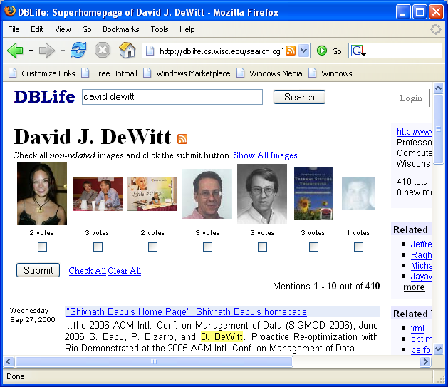
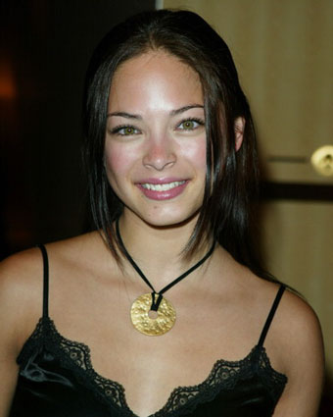
Mass Collaboration: A Simplified Example
Not David!
Picture is removed if enough users vote “no”.

Slide 84
Mass Collaboration Meets Spam
Jeffrey F. Naughton swears that this is David J. DeWitt

Slide 85
Incorporating Feedback
A. Gupta, D. Smith, Text mining, SIGMOD-06
User says this is wrong
System extracted “Gupta, D” as a person name
System extracted “Gupta, D”
using rules:
(R1) David Gupta is a person name
(R2) If “first-name last-name” is a
person name, then “last-name, f” is
also a person name.
Knowing this, system can potentially improve extraction accuracy.
Discover corrective rules such as S1—S2
Find and fix other incorrect applications of R1 and R2
A general framework for incorporating feedback?

Slide 86
Collaborative Editing
Users should be able to
  Correct/add to the imported data
  E.g., User imports a paper, system provides bib item
Challenges
  Incentives, reputation
  Handling malicious/spam users
  Ownership model
    My home page vs. a citation that appears on it
  Reconciliation
    Extracted vs. manual input
    Conflicting input from different users

Slide 87
Web as Delivery Channel
Email … and More

Slide 88
A Yahoo! Mail Example
No. 1 web mail service in the world
    Based on ComScore & Media Metrix
  More than 227 million global users
  Billions of inbound messages per day
  Petabytes of data
Search is a key for future growth
  Basic search across header/body/attachments
  Global support (21 languages)
(Courtesy: Raymie Stata)
Notes:
QL (talking points)
A good example of a large scale personal search product is Yahoo mail.
Yahoo Mail is the number one web mail srevice in the world, based on ComScore & MediaMetirx report. It has more than 227 million users on a global basis. It has billions of incoming messages per day, and it manages petabytes of user data.
Search has become very important for the future growth of web mail, as the mailbox size increase from several Megabytes to Gigabytes. As the users store more and more messages, they need better search capabilities to manage larger mailbox.
. Show an example of personal search on a huge scale. This is easily the largest search applications we have seen so far in terms of the sheer volume of content that’s available for search.
. Need to mention that because of the ever-increasing mailbox size, it’s increasingly important to provide strong search capabilities. Can even mention in passing about we have observed increasing search activities as the mailbox increases and people accumulated more stuff in their inbox.
Raymie (comments)
Transition from the previous slide, Yahoo Mail is personal locker in action.

Slide 89
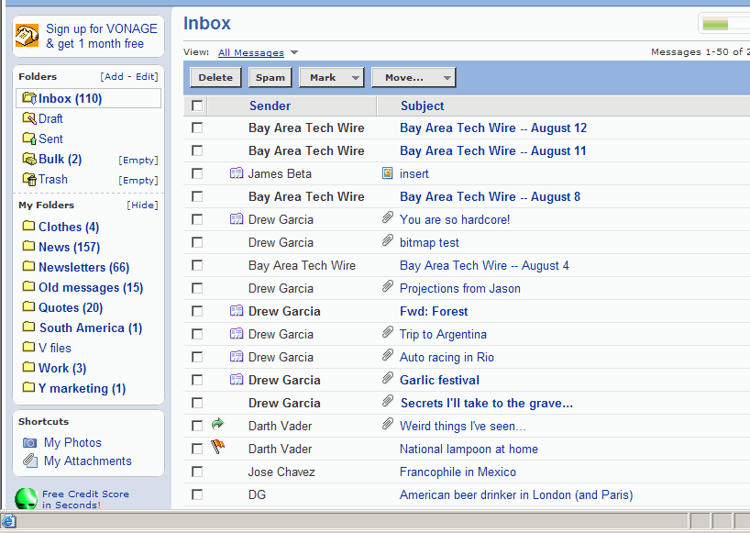
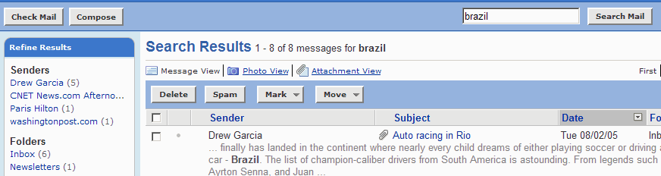
Search Views
User can
change “View” of current results set when searching
1
Shows
all Photos and Attachments in Mailbox
2
(Courtesy: Raymie Stata)
For Presentation Only – Final UI TBD
Notes:
QL (talking points)
At the top of the page, there are two additional views. The default is the message view. The second, is the photo view, and this is because photo is the most frequently attached objects in web mail. The third is the attachment view.
Just talk about views via the two yellow stickers
Raymie (comments)
My Photos views etc. illustrating the benefit for personal locker, having all personal content in one abstraction.

Slide 90
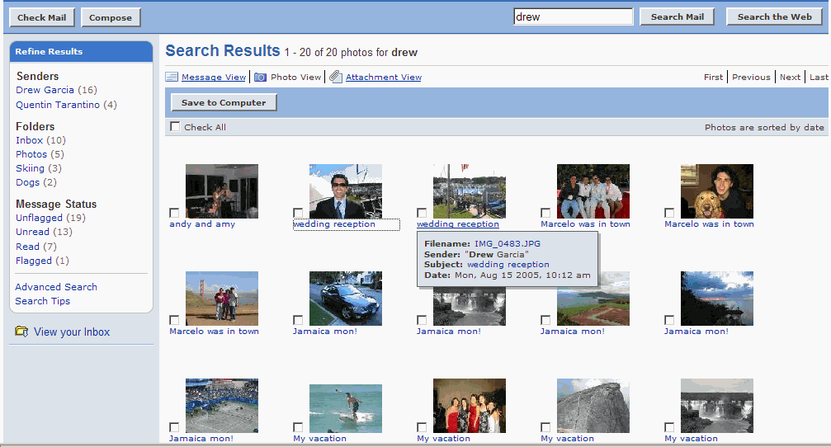
Search Views: Photo View
Refinement
Options still apply to Photo View
5
Photo View turns the user’s mailbox into a Photo album
1
Ability to quickly
save one or multiple photos to the desktop
4
Clicking photo thumbnails takes user to high resolution photo
2
Hovering
over subject provides additional information: filename, sender,
date, etc.)
3
(Courtesy: Raymie Stata)
For Presentation Only – Final UI TBD
Notes:
QL (talking points)
If you click on the photo view, this is what you will get. It turns your mailbox into a photo alum, and you can do photo management from here. On the left hand side, the refinement options are still available to further drill down the search result.
Use example of 4 and 2 as example FIND->USE

Slide 91
The Net
The Web is scientifically young
It is intellectually diverse
  The social element
  The technology
The science must capture economic, legal and sociological reality
And the Web is going well beyond search …
  Delivery channel for a broad class of apps
  We’re on the cusp of a new generation of Web/DB technology … exciting times!

Slide 92
Thank you.
Questions?
ramakris@yahoo-inc.com
http://research.yahoo.com

