Slide 1
Web-scale Data Integration:
You can only afford to Pay As You Go
Jayant Madhavan
Google Inc.
Shawn Jeffery, Shirley Cohen, Luna Dong, David Ko, Cong Yu, and Alon Halevy
Notes:
Good morning everybody! Its nice to see so many brave souls sticking around on the last day of the conference!
I am going to talk today about web-scale data integration. This is joint work with Shan Jeffery, Shirley Cohen, Luna Dong, David Ko, Cong Yu, and Alon Halevy.

Slide 2
Structured Data on the Web
WWW is getting more structured
  Deep Web: content behind HTML forms
  Flickr, Google Coop, Del.icio.us: annotation schemes
  Google Base: structured data portals
How best can web-search handle structured data?
  How can we search over structured data sources?
  Can being structure-aware enhance web-search?
Notes:
The WWW today is no longer just a collection of free text or unstructured. There is a lot of structured data on the web – a fact the multiple speakers have alluded to.
First, there is a Deep Web, a term that refers to data that typically resides in structured databases hidden behind HTML forms.
Second, there portals like Flickr, Google Coop, and Delicious that let users “annotate” pages or urls with tags that might be relevant to them. This is in fact one of the growing sources of structured data that has resulted from community portals.
Then, there are portals like Google Base that enable users to upload structured data or tuples describing items that own, want to sell, buy or just brag about.
There are other types of sources and in the coming years, the amount of structured data and structured data sources will no doubt increase.
This presents one of the biggest challenge for web-search in the future – how can web-search gracefully handle such numerous sources of structured data.
Questions of interest include how we can search over all the structured data and how can structure-awareness enhance search experience.
In this paper, we try to address the general question: how can we build systems that will gracefully provide integrated search over large numbers of structured sources. I will talk about how and why traditional data integration architectures fail and briefly describe the principles and components that should underlie such web-scale data integration systems.

Slide 3
Typical Data Integration Solution
Mediated Schema
Setting up integration systems
  Design a mediated schema
  Create semantic mappings
Answering queries
  Reformulate query over mediated schema into queries over data sources
  Retrieve results from data sources and combine results
Does not generalize well on a web-scale
  Nature of structured data – quantity, heterogeneity, user queries
Semantic Mappings
Different Structured Data Sources
Notes:
Lets start by looking at a typical data integration architecture that has been proposed by the database community as a means of integrating data from multiple structured data sources typically within a single domain.
We start with different structured data sources each with potentially a different schema. A mediated schema is designed that models the important entities and properties in the data sources. Semantic mappings are created from the mediated schema to the schemas of the data sources. At query answering time, user queries posed over the mediated schema are reformulated into queries over each of the individual data source, the results retrieved and maybe combined, and then presented to the user.
Different variation of this model have been successfully adopted in many commercial portals and even vertical search engines.
However, it does not generalize well on a web-scale! The reason for this is the nature of structured data and data sources. We look at some of these reasons shortly and based on them devise the principles for a new architecture.

Slide 4
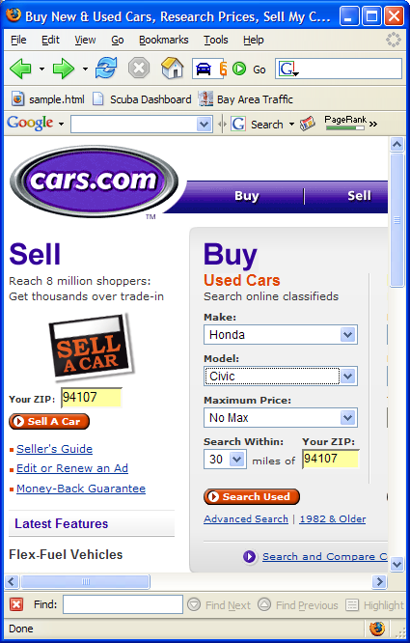
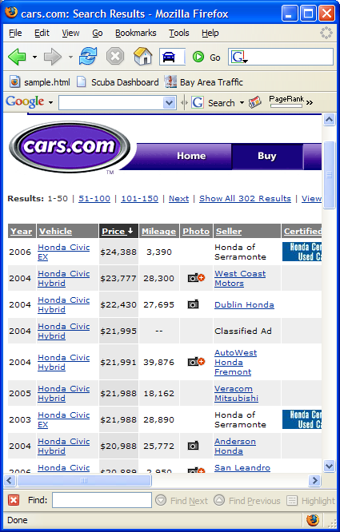
Deep Web
Data that lies in backend databases that are only accessible through HTML forms
Big gap in the coverage of search engines
Extent estimate in the paper
  Maybe millions or even tens of millions of data sources covering numerous domains
Notes:
Lets look as the Deep Web. As most people in this audience might know, this term is used to refer to data lies hidden behind HTML forms typically in backend databases.
Here’s one such example, cars.com has a search form that when submitted has a result page that we say lies on the deep web.
The deep web represents a big gap in the coverage of current search engines because it is not always possible for a search engine crawler to automatically fill out these webforms.
In the paper, as our first contribution we present an estimate of the extent of the Deep Web. I won’t be going into our results, but suffiseth to say that there might be millions or even tens of millions of deep web sites containing data over a large number of domains.

Slide 5

Deep Web Integration
Data Integration Solution
  Build data integration systems with deep web sources
  Reformulate user queries at search-time
  Build data integration for every domain of interest
Impractical for web search!
  Cannot query sources too often
  Precise content description required
  Too many domains of interest?
Mediated Schema
Semantic Mappings
1
Different Deep Web Sites
Notes:
Suppose, we try to apply our typical data integration solution to the deep web.
Data Integration systems could be built by mapping deep web sources to well-designed mediated schemas.
Since, the data sources cover many domains, possibly multiple mediated schemas can be designed, and a data integration system set up per domain

Slide 6
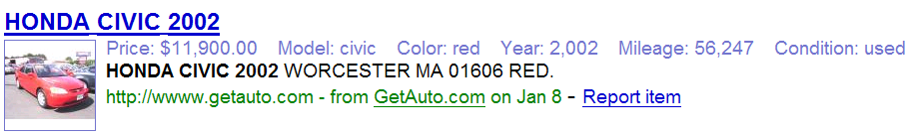
Google Base
Semi-structured data uploaded to Google
Structure-awareness enhances search in Google Base
Demonstrates large scale heterogeneity
  Large number of item types (more than 10,000)
  Vehicles, Jobs, …, High Performance Car Parts, Marine Engine Parts

Slide 7
Web-scale Heterogeneity
Data on the web is about everything!
Typical Data Integration solution impractical
  Too many domains of interest
  No clear separation of domains
  Mediated schema design is infeasible!
2

Slide 8
Web Search Queries and Users
Web Queries are typically keyword queries
Data integration solutions assume structured queries
Web users do not typically care if results are structured or unstructured
User attention restricted to small number of portals (~1)
3

Slide 9
PAYGO Architecture
There can be many, potentially ill-defined, domains
Mediated Schema → Schema Clusters
Precise mappings cannot be created to all data sources
Exact Mappings → Approximate Mappings
Users prefer keyword queries to structured queries
Query Reformulation → Query Routing
Data sources are diverse and mappings approximate
Exact Answers → Heterogeneous Result Ranking
Uncertainty everywhere !

Slide 10
Pay As You Go in PAYGO
Integration is a continuous process
  Apriori integration impossible
  Understanding of mappings/sources/ranking/etc. evolves over time
Mechanisms to facilitate evolution over time
  Automatic schema clustering and matching
  Implicit use of user feedback, e.g., from result clicks
  Result variations to elicit disambiguating user feedback
Queries always answered with best effort
  “Pay” more by correcting/creating semantic mappings

Slide 11
Query Routing Example
“honda civic 2007 review”
make model year attribute
vehicle
vehicle (mk:honda, md:civic, yr:2007, review:?)
car-reviews-by-year.com > car-reviews.com
> car-prices.com
Keyword Analysis
Domain Selection
Query Construction
Source Selection
Result Ranking

Slide 12
Conclusion
Web-scale Data Integration Challenge
  Integrate large numbers of heterogeneous data sources that span many ill-defined domains
  Support keyword queries with seamless integration of results from diverse sources
PAYGO Architecture
  Models uncertainty in mappings, results, and ranking
  Evolves with time, but best effort at all times

