Slide 1
Cayuga: A General Purpose Event Monitoring System
Mirek Riedewald
Joint work with Alan Demers, Johannes Gehrke, Biswanath Panda, Varun Sharma (IIT Delhi), Walker White
Special Acknowledgement: Mingsheng Hong
Cornell Database Group

Slide 2
Complex Event Processing
“…we focus on the concept of events because we believe that it is the key underlying factor that will enable certain revolutionary improvements in business processes and application systems during the next five years.“
--- Gartner 2003
http://www.complexevents.com
  BEA, Coral8, IBM, Oracle, StreamBase, TIBCO, etc.
Active research field

Slide 3
Applications
Monitoring large computing systems, networks
  Detect failures and security threats
  Compliance with Service Level Agreements
Automated stock trading
Business Activity Monitoring, Business Process Management
  Supply chain management with RFID tags
  Monitoring of industrial processes
Expressive publish-subscribe (pub/sub) over RSS feeds, blogs

Slide 4
Cayuga
Real-time processing of event streams
Expressive query language
  Filter, project, aggregate, join (correlate) events from multiple streams
  Fully composable operators with formal semantics
Ongoing deployments: CTC machine monitoring, automated stock analysis, RSS feed monitoring
Distinguishing feature: Effective multi-query optimization
  Throughput of tens of thousands of events per second for hundreds of thousands of active queries (depends on query complexity and similarity, of course…)

Slide 5
Cayuga Query Language
Motivated by regular expressions
  Added selection, aggregates, correlation
  “Optimized” for event processing, MQO
SELECT Name, MaxPrice, MinPrice, Price AS FinalPrice
FROM
FILTER{DUR > 10min}(
(SELECT Name, Price_1 AS MaxPrice, Price AS MinPrice
FROM FILTER{Volume > 10000}(Stock))
FOLD{$2.Name = $.Name, $2.Price < $.Price}
Stock)
NEXT{$2.Name = $1.Name AND $2.Price > 1.05*$1.MinPrice}
Stock

Slide 6
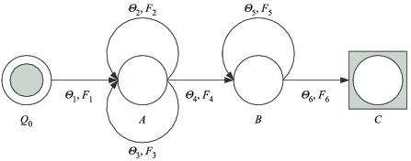
Cayuga Automata
SELECT Name, MaxPrice, MinPrice, Price AS FinalPrice
FROM
FILTER{DUR > 10min}(
(SELECT Name, Price_1 AS MaxPrice, Price AS MinPrice
FROM FILTER{Volume > 10000}(Stock))
FOLD{$2.Name = $.Name, $2.Price < $.Price}
Stock)
NEXT{$2.Name = $1.Name AND $2.Price > 1.05*$1.MinPrice}
Stock

Slide 7
Cayuga Automata
SELECT Name, MaxPrice, MinPrice, Price AS FinalPrice
FROM
FILTER{DUR > 10min}(
(SELECT Name, Price_1 AS MaxPrice, Price AS MinPrice
FROM FILTER{Volume > 10000}(Stock))
FOLD{$2.Name = $.Name, $2.Price < $.Price}
Stock)
NEXT{$2.Name = $1.Name AND $2.Price > 1.05*$1.MinPrice}
Stock

Slide 8
Cayuga Automata
SELECT Name, MaxPrice, MinPrice, Price AS FinalPrice
FROM
FILTER{DUR > 10min}(
(SELECT Name, Price_1 AS MaxPrice, Price AS MinPrice
FROM FILTER{Volume > 10000}(Stock))
FOLD{$2.Name = $.Name, $2.Price < $.Price}
Stock)
NEXT{$2.Name = $1.Name AND $2.Price > 1.05*$1.MinPrice}
Stock

Slide 9
Cayuga Automata
SELECT Name, MaxPrice, MinPrice, Price AS FinalPrice
FROM
FILTER{DUR > 10min}(
(SELECT Name, Price_1 AS MaxPrice, Price AS MinPrice
FROM FILTER{Volume > 10000}(Stock))
FOLD{$2.Name = $.Name, $2.Price < $.Price}
Stock)
NEXT{$2.Name = $1.Name AND $2.Price > 1.05*$1.MinPrice}
Stock

Slide 10
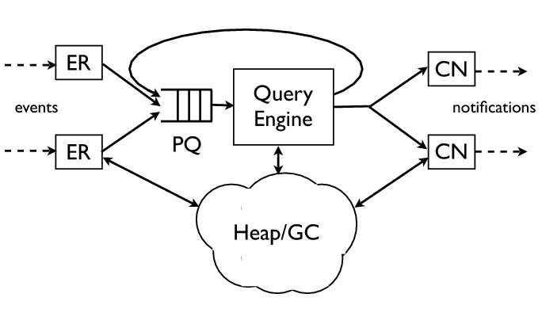
Cayuga Implementation
General challenge: Efficiently match stream of input events with large set of active automata instances based on the corresponding edge predicates
Matching cost
Synchronization cost
Memory management cost

Slide 11
Memory Management
Scalar data stored in automaton instance
Complex data, e.g., strings
  Avoid redundant copies
  Reclaim space when not referenced
  Reference counting?
    High de-allocation cost for irrelevant events
    Overhead for reference count maintenance
    Synchronization cost (or object duplication)
  Can we do better?

Slide 12
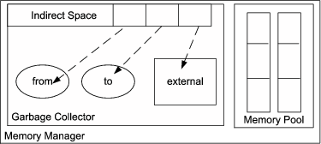
Cayuga Garbage Collector
Bi-modal distribution of object life-time
  Most instances die early, some stay around for long, few are “in the middle”
  Generational GC approach
    First generation: Copying GC
    Survivors promoted to
    non-copying GC
Why a copying GC?
  Free object allocation (increment limit pointer)
  Collection cost linear in size of life data (independent of reclaimed data size)
  Good if most objects die before next GC execution
Handle-based design
  Avoids update of client reference variables when object is copied

Slide 13
Cayuga Garbage Collector
Non-copying GC (“external” heap region)
  GC cost linear in reclaimed space size
Root finding, concurrency
  Root = program variable with
  reference to heap object
  Prevent updates from interfering
  with GC execution
    Avoid stopping of all other threads
Solution: Explicit GC calls at “GC-safe” points
  Invoked by engine thread between event processing rounds
  Stylized API for other threads that also access the heap
    Allocate in external region when GC active
  No GC call as side-effect of allocation request
    Allocate in external region when “from” region full

Slide 14
Other Design Decisions
Set-at-a-time predicate processing
  Join event stream with automaton instance set, indexing
Fast predicate evaluation
  Byte-code interpreter
Intermediate language for automata
  Compile query to automaton (optimizing compiler)
Feed automaton output into input event queue for resubscription
  Challenge: simultaneous events
  No separate engines for other resubscription levels
  Processing in rounds, install new instances at end of round (pending instance lists)

Slide 15
Conclusions
Novel design decisions for complex event processing systems
  Expressive general-purpose language: easy to express event patterns, amenable to efficient multi-query optimization
  Specialized memory manager
Can be extended to support fragment of XQuery
Next step: distributed event processing

