Slide 1
Creating a database-driven application
is almost as expensive as ever:
Time and money required not falling much
Development
Long and problematic cycles of
owner – consultant communication
Requirements
Specification
Development
Test, Evaluate
Realize Misunderstanding
(Start again)

Slide 2
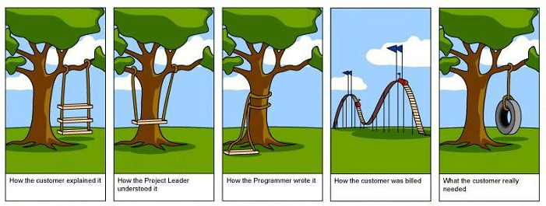

Slide 3
Which is a pity since…
Hardware Costs
Connectivity
Talking heads (eg, Anderson):
Think future hardware is free

Slide 4
How to dramatically reduce time and cost?
The lesson of Excel & Powerpoint
Do-It-Yourself

Slide 5
What happened to the
Do-It-Yourself database application?
Our community pioneered a quantum leap (SQL)
many interesting “partial” ideas (QBE)
and then almost stopped…

Slide 6
What can we do about that?

