Slide 1
“the free coffee is over”
stavros
harizopoulos
HP Labs

Slide 2
disclaimer:
the views of the author do not necessarily
represent the views of H-P.

Slide 3
(useful) axiom:
you will always find your
PhD advisor in front you.

Slide 4
Idea the DB World is Least Ready for

Slide 5
Idea the DB World is Least Ready for
forget performance!

Slide 6
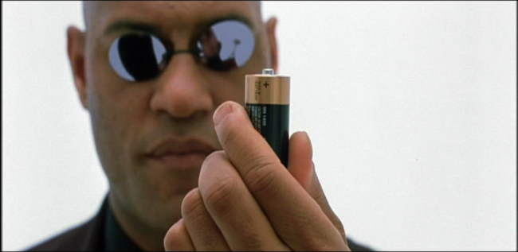
Idea the DB World is Least Ready for
forget performance!

Slide 7
from performance to energy efficiency (or performance per watt)

Slide 8

from performance to energy efficiency (or performance per watt)
“that’s easy”
get me low-power hardware
provision for power
turn off what you don’t use

Slide 9
suppose we were back in 1979
everything was the same..
..except that all computations were instant

Slide 10
suppose we were back in 1979
everything was the same..
..except that all computations were instant
suddenly, coffee is no longer free.
how do we improve performance?

Slide 11
suppose we were back in 1979
everything was the same..
..except that all computations were instant
suddenly, coffee is no longer free.
how do we improve performance?
get me high-performance hardware
provision for performance
use every resource
“that’s easy”

Slide 12
effective Wednesday January 7, 2009 at 9.30am
coffee will no longer be free
Energy Efficiency: The New Holy Grail of Data Management Systems Research
Stavros Harizopoulos (HP Labs)
Mehul Shah (HP Labs)
Justin Meza (UCLA)
Parthasarathy Ranganathan (HP Labs)

Slide 13
backup slides

Slide 14
from performance to energy efficiency (or performance per watt)
performance
your favorite parameter

Slide 15
from performance to energy efficiency (or performance per watt)
performance
same HW
your favorite parameter

Slide 16
from performance to energy efficiency (or performance per watt)
performance
same HW
energy
efficiency
your favorite parameter

