Slide 1
aiming at prize for
brilliant idea the world is not ready for

Slide 2


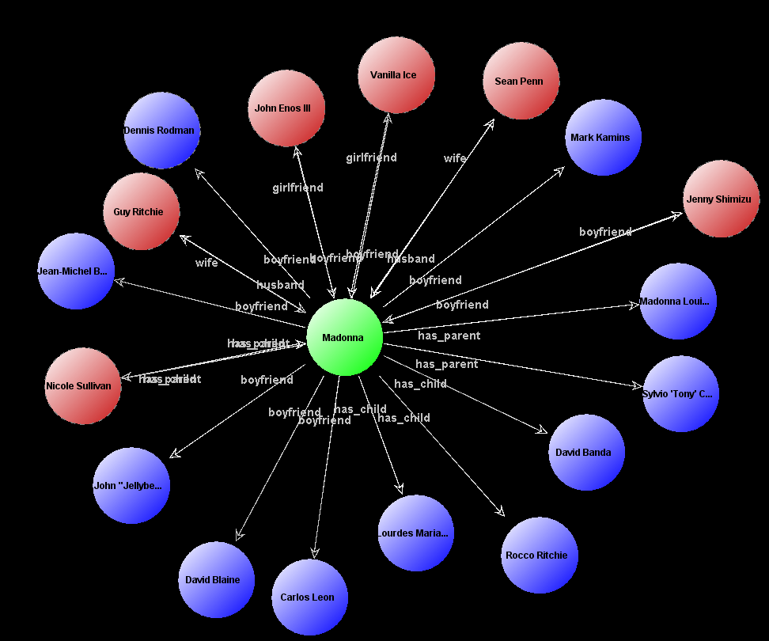
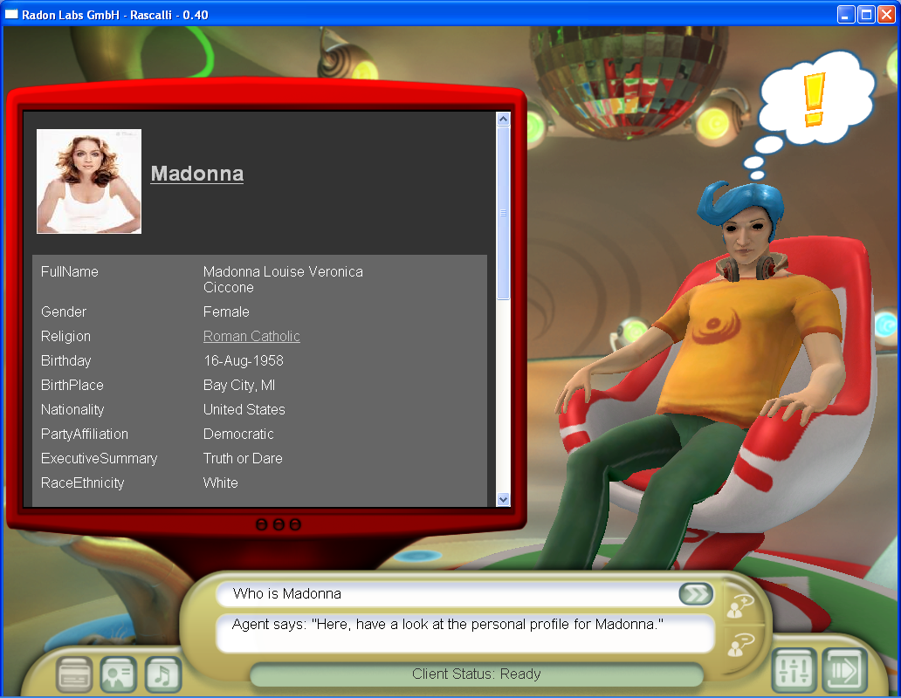

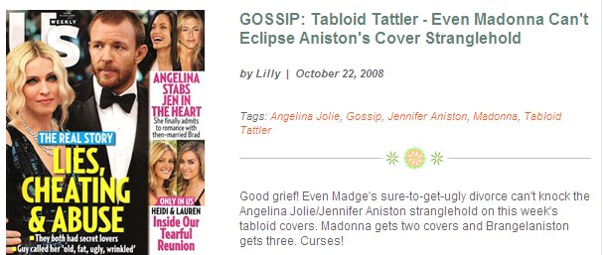
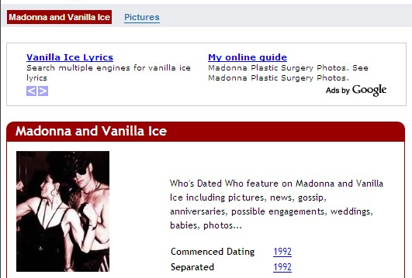
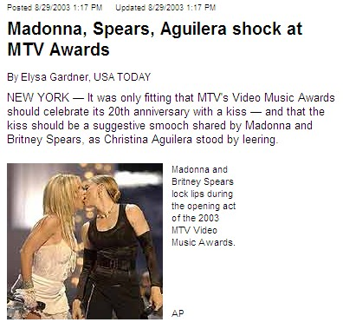
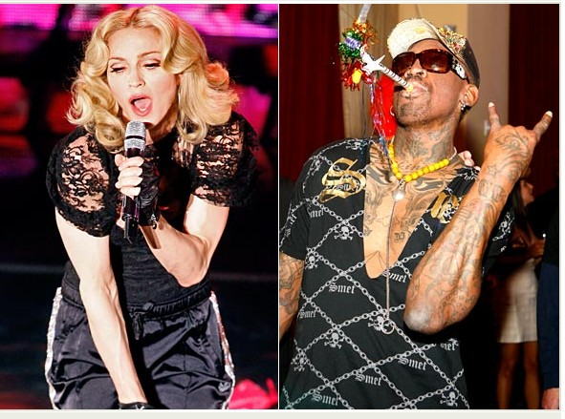
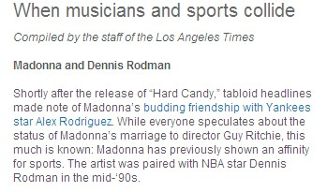
Sex http://www.ofai.at/rascalli/

Slide 3
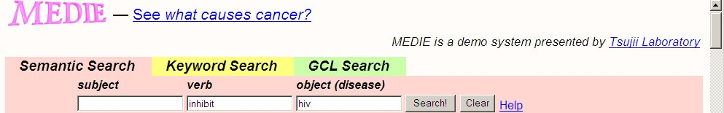
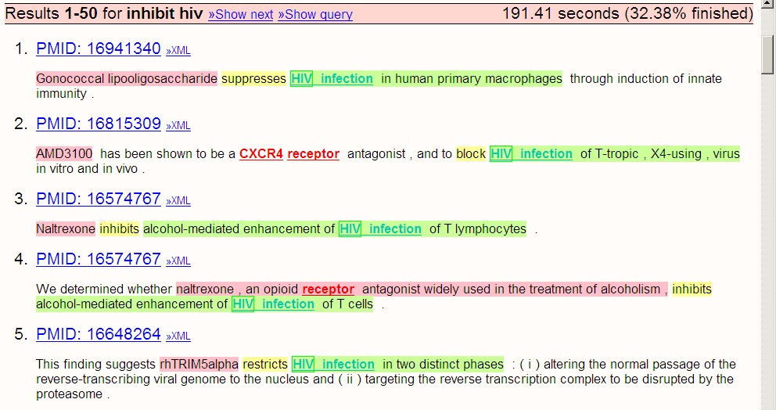
Drugs http://www-tsujii.is.s.u-tokyo.ac.jp/medie/

Slide 4
What? Who? Why?
Information Extraction (Text2Record) & Fact Gathering
by Rules, Patterns, Learning, Linguistics, Statistics
Cimple / DBlife (U Wisconsin)
KnowItAll / TextRunner (U Washington)
Avatar (IBM)
YAGO-NAGA (MPI)
Google, Microsoft, Yahoo, ...
...
Most new knowledge first produced in NL text
(news, blogs, scientific/business articles, dossiers, wikipedia)
Lift text-borne content into value-added „semantic DB“
(entities & relations, RDF)

Slide 5
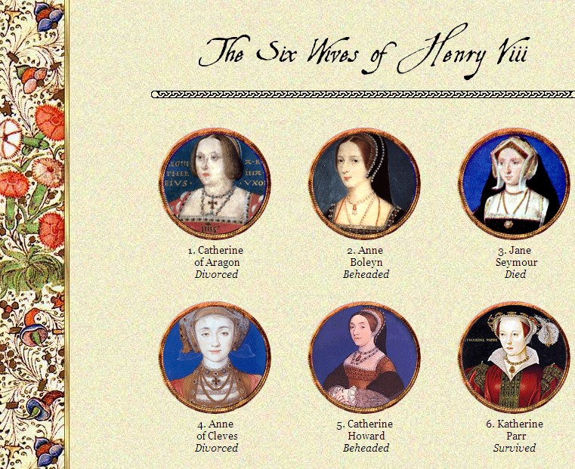
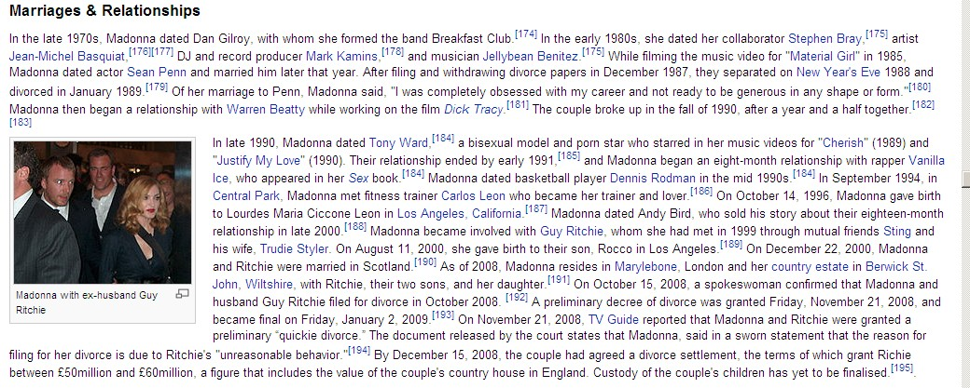
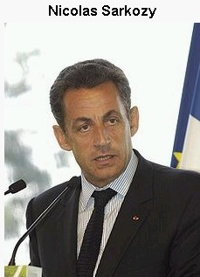
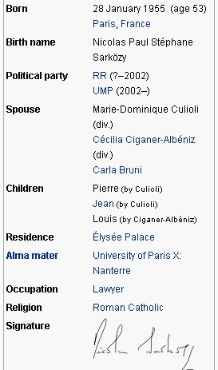
Sex: Scale Matters
Can we correctly extract all worthy facts at the
scale and rate by which news, blogs, gossips are produced ?
Benchmark Challenge:
for all people in Wikipedia (100,000‘s) gather all spouses,
incl. divorced & widowed, and corresponding time periods!
>95% accuracy, >95% coverage, in one night
redundancy of sources helps, stresses scalability even more
consistency constraints are potentially helpful:
  FD‘s: {husband, time} → wife, {wife, time} → husband
  inclusion dependencies: marriedPerson ⊆ adultPerson
  age/time/gender restrictions: birthdate + Δ < marriage < divorce

Slide 6
Databases (Know-How)
scalability and system-oriented approach
coping with trade-offs:
precision vs. recall, speed vs. quality, freshness vs. accuracy
quality boosting and efficiency gains
by consistency constraints
capturing & tracking confidence and lineage
showcase for prob DB (more tractable than general case)
killer app for RDF graph data

Slide 7
Conclusion
Information extraction (text2data)
is a major research avenue.
It‘s sexy, and should get you hooked!
DB-system know-how is vital!

