Slide 1
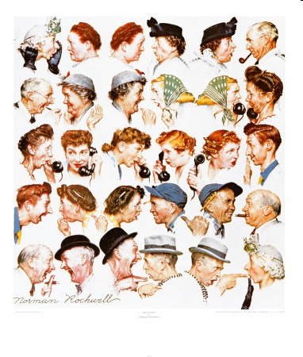
Surfing above the Influence
Amélie Marian
Rutgers University

Slide 2
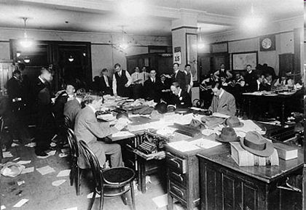



Sources of Information
The “old way”
A few trusted sources of information
(Newspapers, magazine, radio)
Accountable fact-checking
Town gossip
Now: online news, web 2.0
Not only facts: opinions, reviews, comments
Various quality levels
Difficult to identify good information sources
Established sources (e.g., newspapers)
+ highly accurate
- conservative in their reporting
Blogs and non-trusted sources
- wide variance in accuracy
+ sources of many breaking stories,
Main stream Media vs. the “undernews”

Slide 3
So much information, so little time
Several source quality parameters to consider
Trustworthiness (correct or corroborated facts and opinions)
Freshness of information
Coverage (domain)
Novelty (breaking new information)
Influence (sources are not independent)
Web sources provide useful data than can be used to assess source quality
timestamps (freshness, influence)
links and backlinks (influence, dependence)
text and topic similarity (influence, coverage, trust)
Model flow of information between sources
Identify novel sources
Look at the big picture, not a particular piece of information
Can we identify these automatically?

Slide 4




Applications
Influence graph
Categorizing news sources
High novelty, low trust: the National Enquirer
High trust, but highly influenced and low novelty: “In the papers”
Finding inter-dependence and influence between news sources
Eater.com food blog is influenced by the NY Times food reviews
Identify sources that do provide new topic coverage
Bob’s foodie blog

Slide 5
Some Research Challenges
Identifying topic relationships between sources
Text analysis, sentiment analysis (NLP)
Link analysis
Discovering influence
Related to dependency (i.e., copying)
More details by Luna tomorrow.
What is positive/negative influence and what is people reacting to the same information
Complex influence flows between more than two sources
What can we do with this?
Focus on good quality sources (not only on data)
Personalization of source recommendations
Dismiss redundant sources, or reduce their impact

