Slide 1
Chem_{X}Seer:
A Data Repository and
Digital Library for
Chemical Kinetics
Prasenjit Mitra
The Pennsylvania State University,
University Park, PA 16803
In collaboration with Y. Liu, B. Sun, C.L. Giles

Slide 2
Challenges
Formula and Name Search
Structure Search
Table Data Extraction & Search
Figure Data Extraction & Search

Slide 3
Chemical Formula and Name Search
Extraction
  Disambiguation from acronyms/abbreviations, etc., e.g., OH (hydroxyl versus Ohio)
  Functional group identification by automatic segmentation
Indexing
  Which sub-formula should we index?
  Index Pruning
Search
  Query Semantics for partial/fuzzy search of chemical formula

Slide 4
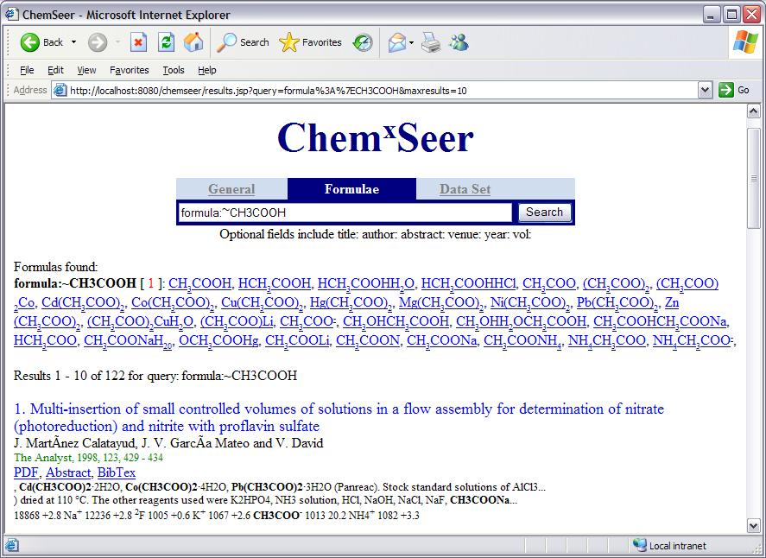
Formula/Name Search

Slide 5
TableSeer:Table Data Extraction and Search
Automatically identify tables in digital documents
  Varying formats, irregular formats
  Table Boundary detection [CIKM’08]
  Separate column header from data [JCDL’08]
    Some tables have multiple rows of column headers
    Units and other metadata extraction
Index data and metadata extracted from tables
  Metadata: captions, references to the table in the text
  Automatically identify synopsis – part of the paper discussing the table [in submission]
TableRank
  Dependent both upon table data, metadata, and document level metadata [AAAI’08]

Slide 6
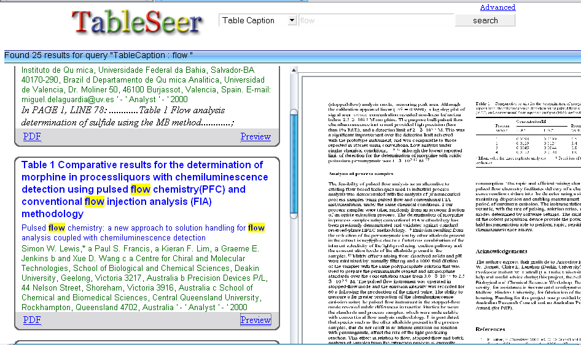
TableSeer
Beta online working design of a table search engine

Slide 7
Other Challenges
Crawl using limited resources
  Clustering-based algorithm [CIKM’07]
Extract data from figures [AAAI’08]
Chemical Structure Search [in submission]
  Graph Database
    What substructures to index?
    What is a good ranking function?

Slide 8
Future Work
Information Extraction
  From other types of figures:
    Bar graphs, pie charts, etc.
  Data Quality
    How do we assign scores representing the fidelity of the data?
      Depends upon data source
      Depends upon accuracy of our online extractors
Make Extracted Table Data Queryable
  Schema Mapping
    Columns in extracted tables to other similar columns in tables
    Automatic unit detection and normalization

Slide 9
pmitra@psu.edu
chemxseer.ist.psu.edu
archseer.ist.psu.edu [ Map Search]
=> SeerSuite [ SourceForge ]

