Slide 1

Virtualization and Databases
Ashraf Aboulnaga University of Waterloo

Slide 2
Conclusion
Virtualization: a layer of indirection between the abstract view of computing resources and their implementation
Helps in, for example, resource consolidation
Database systems will increasingly run in virtualized environments
Need to make them run more efficiently, and to take advantage of the capabilities of virtualization

Slide 3
Machine Virtualization
App 1
App 2
App 3
Operating System
Virtual Machine
Machine
CPU
CPU
Mem
Virtual Machine Monitor (VMM)
Physical Machine
CPU
CPU
Mem
Net

Slide 4
Machine Virtualization
App 1
App 2
App 3
App 4
App 5
Operating System
Operating System
Virtual Machine 1
Virtual Machine 2
CPU
CPU
Mem
CPU
Mem
Net
Virtual Machine Monitor (VMM)
Physical Machine
CPU
CPU
Mem
Net

Slide 5
Storage Virtualization
App 1
App 2
App 3
Operating System
Machine
CPU
CPU
Mem
Virtual Disk
Storage Server
Physical Storage

Slide 6
Research Directions
1- Tuning the virtualization environment in an application informed way
Pass information about the application (database system) to the virtualization layer
Use this information for configuration and tuning
What information and how to use it?
2- Using the capabilities provided by the virtualization environment to improve manageability, availability, …

Slide 7
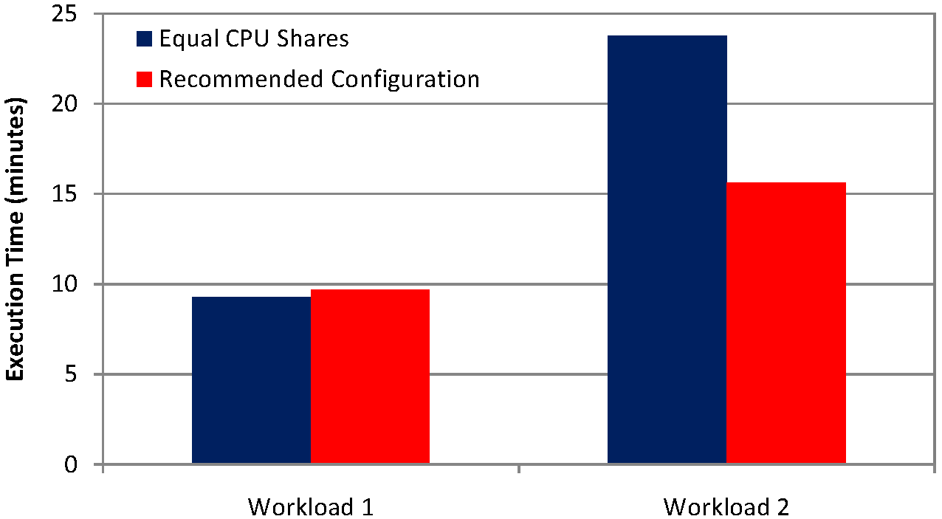
Virtual Machine Configuration
If N virtual machines running database systems share a physical server, how much of the server’s resources to give to each one?
Ask query optimizer for workload costs

Slide 8
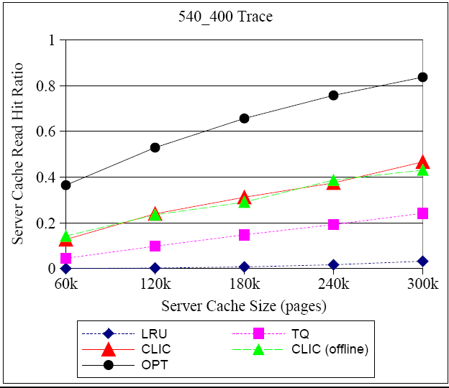
Caching in Storage Servers
Which of a database system’s I/O requests should a storage server cache?
Hints from database system to storage server

Slide 9
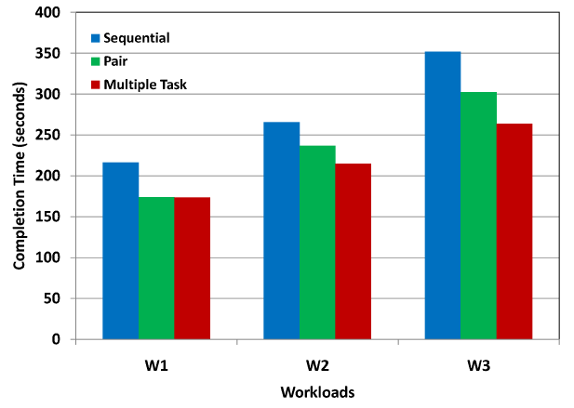
Scheduling Hadoop Tasks
Given a set of Hadoop (Map-Reduce) jobs, how to run them to minimize execution time?
How many nodes for each job? Which jobs can share nodes?

