Slide 1
Normalization Is for Sissies
Pat Helland
Microsoft

Slide 2
Why Normalize?
Normalization’s Goal Is Eliminating Update Anomalies
  Can Be Changed Without “Funny Behavior”
  Each Data Item Lives in One Place
De-normalization is
OK if you aren’t going to update!
Classic problem
with de-normalization
Can’t update
Sam’s phone #
since there are
many copies
Emp #
Emp Name
Emp Phone
Mgr #
Mgr Name
Mgr Phone
47
Joe
5-1234
13
Sam
6-9876
18
Sally
3-3123
38
Harry
5-6782
91
Pete
2-1112
13
Sam
6-9876
66
Mary
5-7349
02
Betty
4-0101

Slide 3
Real Programmers Encapsulate Their Joins…
Persistent Business Objects
  Encapsulated by Logic
  Kept in SQL
  Uses Optimistic Concurrency (Low Update)
Stored as Collection of Records
  May Use Records in Many Tables
  Keys of Records Prefixed with Unique ID
    This is the Object ID
Encapsulation by Convention
Table-B
ID-X
<key1>
<record>
ID-X
<key2>
<record>
ID-X
<key3>
<record>
ID-Y
<key1>
<record>
SQL
ID-Y
<key2>
<record>
Table-A
Database-Key
ID-X
<key>
<record>
ID-Y
<key>
<record>
ID-Z
<key>
<record>
Persistent Object
ID=Y
Database-Key

Slide 4
Business Objects Dominate
Most Apps Use Independent Business Objects
  Each Object Has a Unique Key
  The Relational Version Has the Key as a Field for
  The Object Is Sucked into Memory as a Whole
  Updates Made in Memory; Changed Records Written Back
Joins Are Used to Overcome Normalization
  We Have to Put the Objects Back Together…
It Is Unusual to See Joins across Business Objects in Mainstream Application Code
  Ad-hoc Business Intelligence May Cross Business Objects

Slide 5
Accountants Don’t Use Erasers
Database Logs Are Append-Only
  The Entire State of EVERYTHING that Has Ever Happened to the Database Is Kept in the Log
  The Database Is a Caching of a Subset of the Transaction Log
Most Data Is Accrete-Only
  You Add Transactions to the End of Your Bank Account
  You Append a Purchase-Order to the Order-Log
  You Append a Change-Order, etc
Some Data Is Roll-Up Data
  Balance Calculated as Delta from Last Month’s

Slide 6
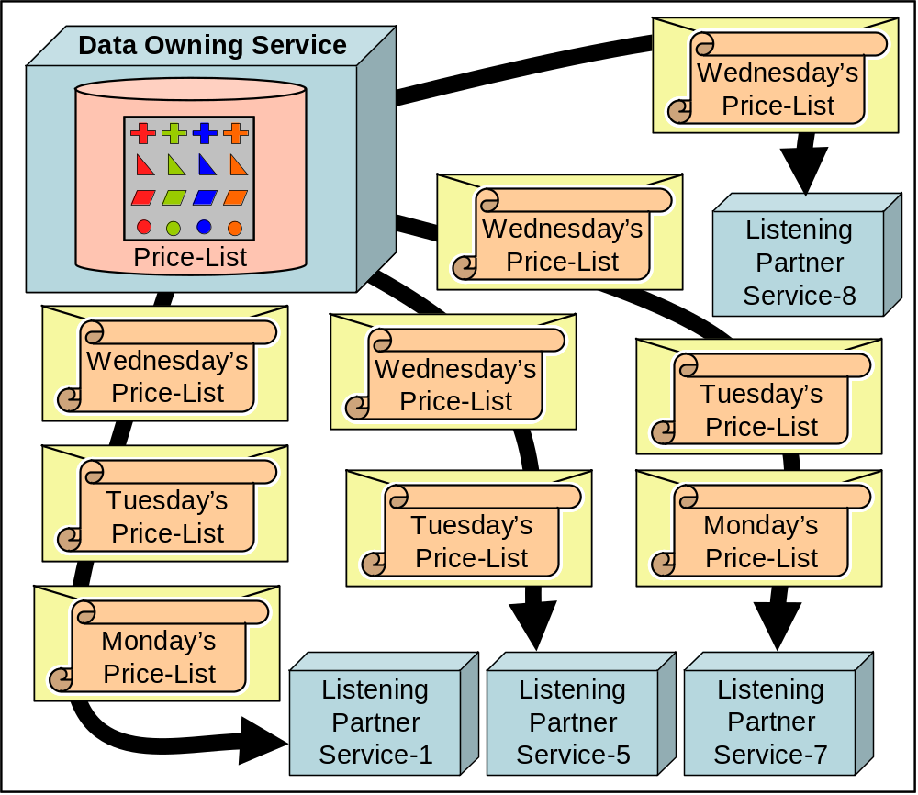
We Are Swimming in a Sea of Immutable Data

Slide 7
Think First Before You Normalize
For God’s Sake, Don’t Normalize Immutable Data
  Unless It’s to Optimize Space Utilization…

Slide 8
Culture: the Way We Do Things Around Here
People Normalize ‘Cuz their Professor Said To
  -- That’s Why We Need All Those Joins…
If All You Have Is a Database,
Everything Looks Like a Nail…

