Slide 1
SwissBox
G. Alonso, D. Kossmann, T. Roscoe
Systems Group, ETH Zurich
http://systems.ethz.ch

Slide 2
Agenda
What we are building?
Why we are building it?

Slide 3
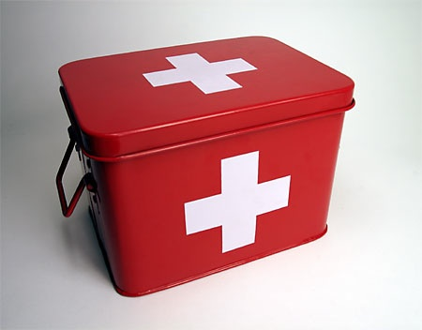
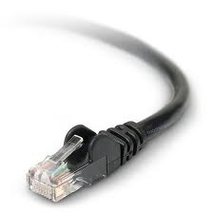
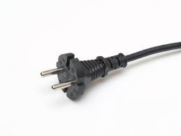
What is SwissBox?
[Forrest Gump, Hollywood 1994]

Slide 4

Inside SwissBox (Hardware)
N CPU Cores (N = 100, 1000)
X GB of main memory (X = 10xN)
NUMA
dedicate MM for each core
Network
heterogeneous (complex)
FPGAs
Some persistent storage
Disks or flash (maybe obsolete in future with PCM)
Think of (commodity) rack or a multi-core machine

Slide 5
Overview of Components

Slide 6
Shared i-disk Architecture
Client
HTTP
XML, JSON, HTML
Web Server
FCGI, ...
XML, JSON, HTML
App Server
SQL
records
DB Server
get/put
block
Storage

Slide 7
Shared i-disk Architecture
Client
Client
Client
Client
HTTP
XML, JSON, HTML
Web Server
Workload Splitter
XML, JSON, HTML
FCGI, ...
XML, JSON, HTML
DB+App
DB+App
App Server
Predicates, Light Aggr.
SQL
records
Store (e.g., S3)
Store (e.g., S3)
DB Server
Distributed Storage
get/put
block
Storage
[Brantner et al. 2008]

Slide 8
{record, {query-ids} }
results
Queries + Upd.
records
ClockScan
data partition
[Unterbrunner et al. 2009]

Slide 9
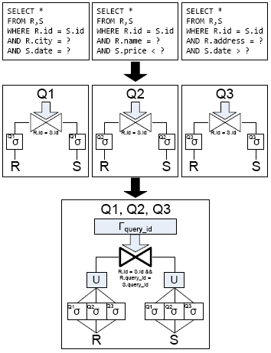
SharedDB: Joins
Mass. share Joins
same join pred.
diff. table pred
(reassemble BO)
Same idea as ClockScan
„shared join scan“
additional join predicate on „query“
[Giannikis et al. 2011]

Slide 10
Overview of Components

Slide 11
SwissBox Building Blocks
Barrelfish Multi-kernel Operating System
CPU Driver for each core (Barrelfish)
Message Passing (no shared memory!)
Designed for heterogeneous HW (e.g., NUMA)
ClockScan
Storage layer serves simple predicates + aggregates
Snapshop isolation within one partion
E-Cast Protocol
Paxos + consistent hashing
elasticity (online repartioning), SI across partions
SharedDB Operators
massively shared joins, sorts, group-bys...
custom processing (if sharing not worth it)
FPGAs
some special algos for in-network filtering / processing

Slide 12
Summary: Design Ideas
SwissBox is an Appliance
enables optimization across layers
Exploit data / query duality
index queries rather than data
optimize with knowledge of queries and data
Radically simplified data flow architecture
No indexes, one query plan for a particular workload
Merge DB and application server layers
Save cost and improve predictability
Shape the workload
Force (almost) all operations into simple access patterns (scan)
Shared i-disk architecture
Great for elasticity, fault tolerance (previous work on cloud)
Make use of capabilities of „storage layer“
Great for „inter-query“ parall. (not good for „intra-query parall.)

Slide 13
Agenda
What we are building?
Why we are building it?

Slide 14
Why are we doing this?
Because we can...
... the proof is in the pudding
Interesting research artefact
re-address OS/DB co-design
study „battle of the bottlenecks“
Hardware trends
Hardware changes faster than systems software
NUMA, main-memory, heterogeneity
Challenging workloads and requirements
Predictable performance, data freshness guarantees

Slide 15
Amadeus Workload
Passenger-Booking Database
~ 600 GB of raw data (two years of bookings)
single table, denormalized
~ 50 attributes: flight-no, name, date, ..., many flags
Query Workload
up to 4000 queries / second
latency guarantees: 2 seconds
today: only pre-canned queries allowed
Update Workload
avg. 600 updates per second (1 update per GB per sec)
peak of 12000 updates per second
data freshness guarantee: 2 seconds

Slide 16
Other Workloads
Logging Service (Amadeus, CreditSuisse)
Log entries from multiple apps and middleware
Maintenance of coarse-grained indexes (sessionId, ...)
Distributed debugging, support, auditing
Index look-ups + large scans
Twitter Times (http://www.twittertim.es)
Streams of events / microblog posts (700 / sec)
Maintain simple statistics incrementally (word counts)
Compile a personalized newspaper of posts
TPC-W style (CreditSuisse, SAP)
Complex queries + updates

Slide 17
Related Work
Appliances
SAP Trex, Netezza, Oracle Exadata, ...
New Data Processing Architectures
All the previous papers of this session
IBM Blink, MonetDB X100, AsterData, ...
Eddies, data/query dualism, StageDB, QPipes, ...
Nothing what we do is really new

Slide 18
Conclusion
Consensus on Starting Point
Great workloads, new app requirements
(predictability, elasticity, ...)
Technology moving faster than ever
(MM, multi-core, heterogeneity, cloud, ...)
Building blocks that feel right
(ClockScan, multi-kernel, ...)
No consensus (yet) on putting it together
How to compose predictability and elasticity?
„The journey is the destination“

