Slide 1
The Schema-Independent
Database UI
(a proposed holy grail and some suggestions)
Eirik Bakke and Edward Benson
CIDR 2011
Notes:
Today I’m gonna talk about a tool we need to invent, which I think would be of great value to a huge number of people and organizations around the world. And at the end I’m also gonna show you a demo of some of my own work on this enterprise.

Slide 2
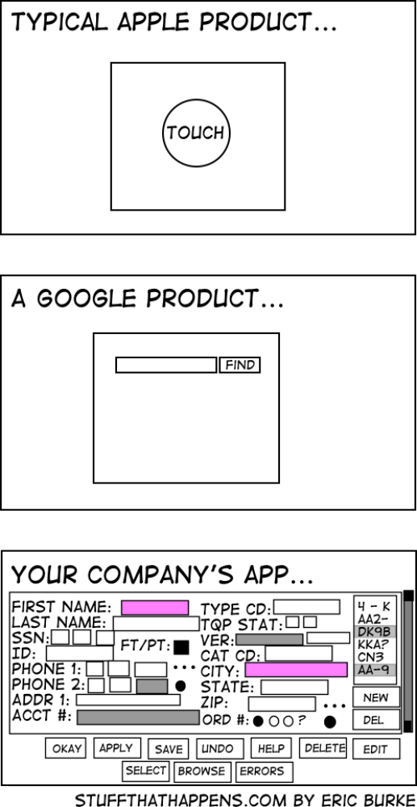
A Common Class of Business-Oriented Database Applications
Notes:
Have you seen that?

Slide 3
Notes:
So this comic is making a very clear reference to the kind of software I have in mind. But let’s use screenshots of some actual applications out there instead.

Slide 4
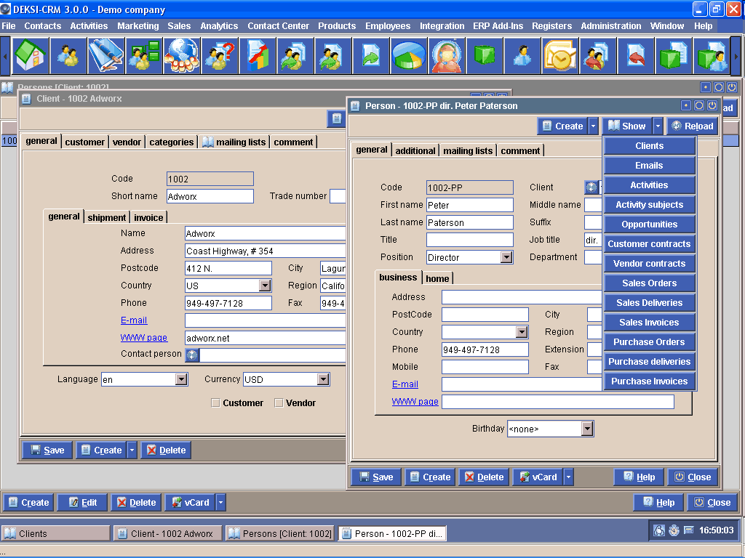
Notes:
To a large number of people, this is what a database looks like. It’s a very standard kind of user interface paradigm.

Slide 5
Record View
Notes:
This particular style of dialog box, for instance, is called a record view. It usually shows the data associated with a single entity – or, a single ”record” – in the database, and maybe some data from related items as well. Layout-wise there’s a bunch of fields laid out, there’s usually a label next to each one of them, and there are often multiple columns. And in these kinds of applications, the record view is usually the place where you edit data.

Slide 6
Record view
Notes:
So let’s put the record view down there.

Slide 7
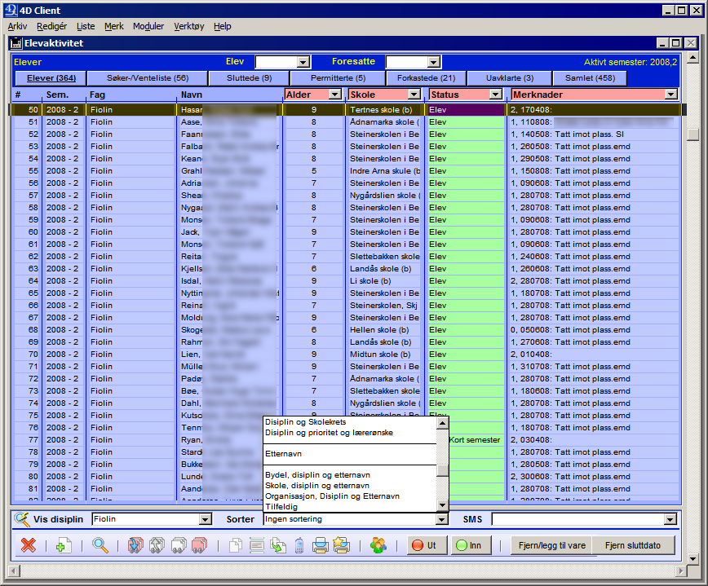
Table view
Record view
Notes:
Here’s another kind of standard screen – this is called a table view. It shows a list of items from the database, with field labels in the header on top. You might be able to sort the list, choose from a selection of columns to display, and certainly select items. Typically you can’t edit data directly here, to do that you select a single item from the table and open it in the record view. Then you can edit it in the record view.

Slide 8
Table view
Record view
Notes:
So I’ll put the table view down here.

Slide 9
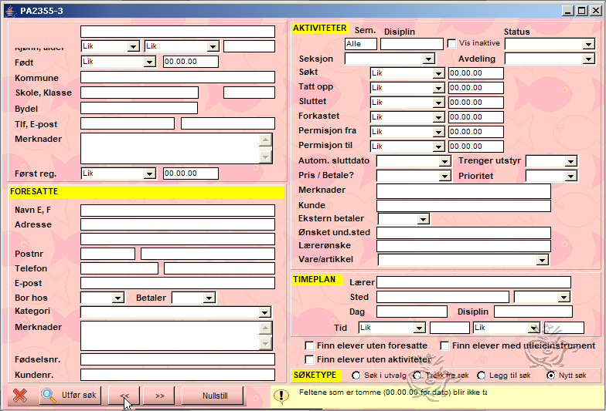
Search form
Table view
Record view
Notes:
Here’s the third classic dialog box, the search form. It’s almost like a record view except instead of entering data you’re entering search terms.

Slide 10
Search form
Table view
Record view
Notes:
After you’ve search, you end up with a table of results in the table view, and you can go and edit individual items in the record view. Just quickly, two more standard screens...

Slide 11
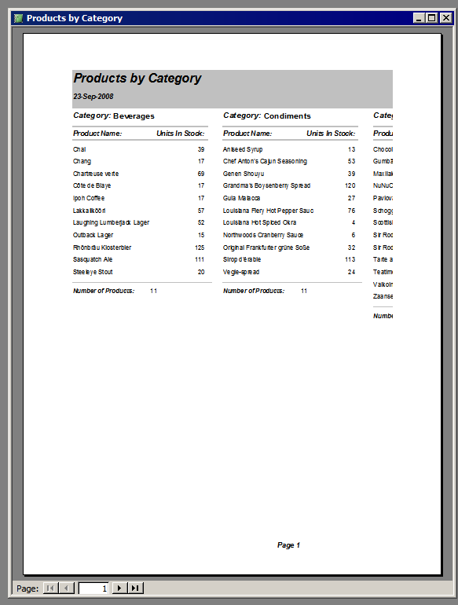
Reports
Search form
Table view
Record view
Notes:
Every business-oriented database application has gonna have some reports. A report is basically a hard-coded query that presents some of the data in the database in some specific way required by the users for some purpose. It is usually implemented by the programmer who made the entire application in the first place, so it’s not very flexible. The reason you need hard-coded reports in the first place is because the rest of the user interface isn’t powerful enough to do these kinds of queries.

Slide 12
Search form
Reports
Table view
Record view
Notes:
Every business-oriented database application has gonna have some reports. A report is basically a hard-coded query that presents some of the data in the database in some specific way required by the users for some purpose. It is usually implemented by the programmer who made the entire application in the first place, so it’s not very flexible. The reason you need hard-coded reports in the first place is because the rest of the user interface isn’t powerful enough to do these kinds of queries.

Slide 13
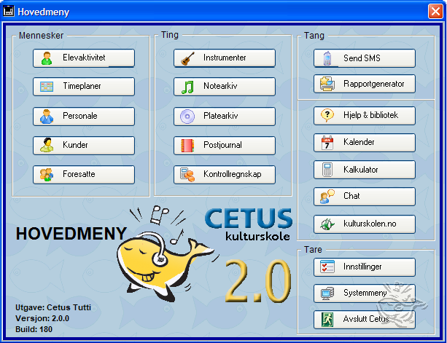
Search form
Reports
Table view
Record view
Notes:
And last, there’s what’s called a Switchboard, which is just the main menu that gets you to the various tables, reports and so on. Very often there will be one button for each of the major tables in the underlying relational database or whatever.

Slide 14
Switchboard
Search form
Reports
Table view
Record view

Slide 15
”Switchboard”-applications
Switchboard
Search form
Reports
Table view
Record view
Notes:
We might call them ”switchboard” applications, cause that’s what Microsoft Access calls them.

Slide 16
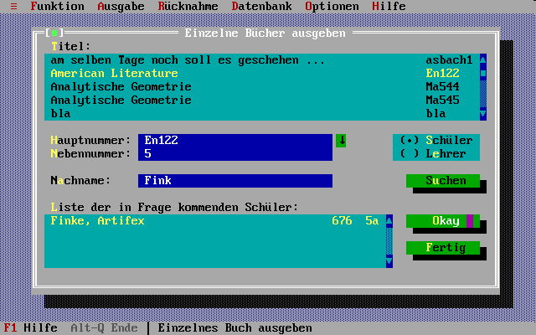
Notes:
We can see a few more of these here...

Slide 17
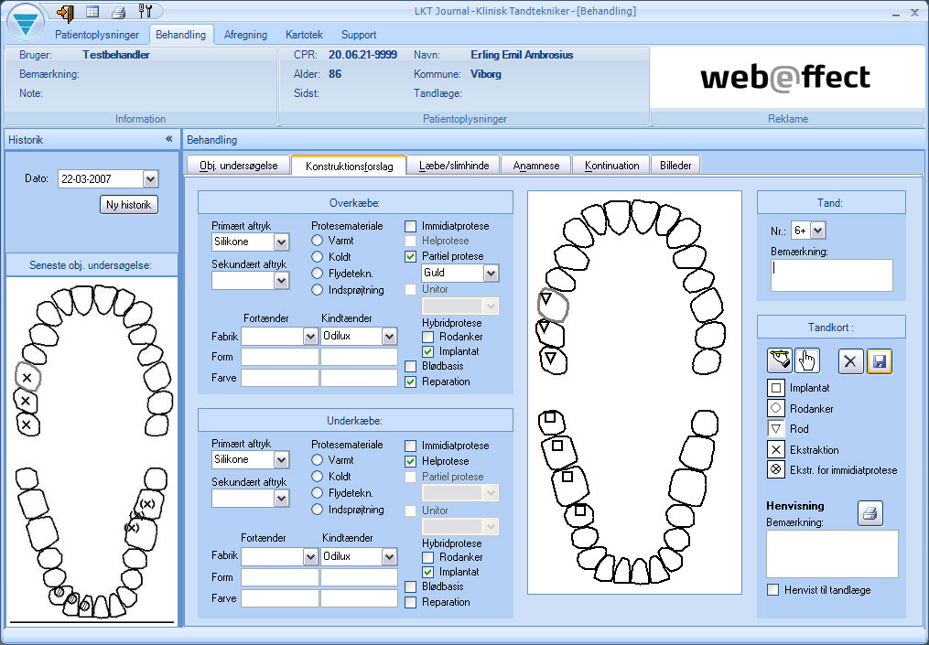
Notes:
Here’s a Danish software package for dental technitians.

Slide 18
In pop culture, too...
(From the showreel of Mark Coleran, designer of fake movie UIs)
    http://gizmodo.com/5418342/ridiculous-user-interfaces-in-film-and-the-man-who-designs-them
    1.44
    1.52
    1.59
    2.10

Slide 19
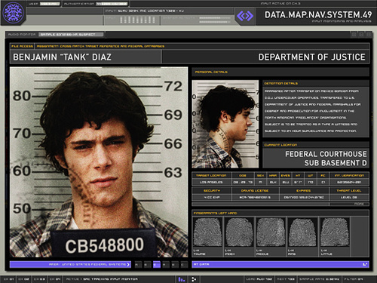
Form-Based Professional Systems in Pop Culture...
From the Showreel of Mark Coleran,
  Designer of Fake Movie UIs
http://vimeo.com/1563485
1.44 Record View
1.52 Table View
1.59 Record View
2.10 Record View
Notes:
They’ve even found their way into pop culture.

Slide 20
These applications exist chiefly
to provide a user interface
for some
highly domain-specific database schema
Notes:
So to summarize, here’s a class of applications which does very little else than provide a basic user interface to some underlying database. And the databases in question tend to be _very_ specific to their particular group of users or organizations. We’ve seen this from the examples; these systems could be used to manage a Norwegian music school, a Danish dental technitian’s office, a steel production facility in Germany, or even the FBI/CIA/NSA or whatnot as we saw in all these movies.

Slide 21
So what’s the problem?
Notes:
So anyway -- what’s the problem... other than the fact that these UIs are often very bad.

Slide 22

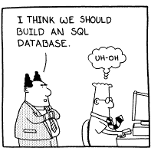

Really expensive to implement (or adopt) a new app for every new schema
support!
Notes:
Even for large organizations, the costs associated with adopting a custom-made database application is high, not because of initial development cost, but because of support and maintenance costs.

Slide 23
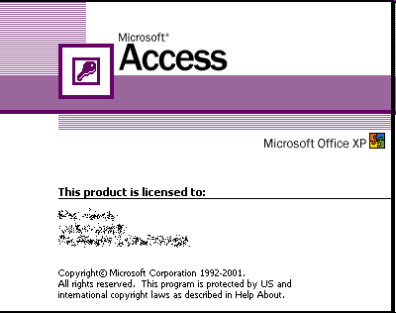
Really expensive to implement (or adopt) a new app for every new schema
support!
Notes:
Btw, thanks to Kuang Chen, first mile talk, for mentioning Microsoft Access.

Slide 24
Really expensive to implement (or adopt) a new app for every new schema
support!

Slide 25
So what can we do?
Build a better app builder
(e.g., FORWARD/App2You, AppForge, Intuit QuickBase, FileMaker Bento, RoR)
Build a universal app
(that lets you interact with any database regardless of schema)
Notes:
Mention advantage of app builders for external-facing apps.

Slide 26
Proposed Grail:
A general-purpose data manipulation tool
to replace tailor-made database UIs once and for all

Slide 27
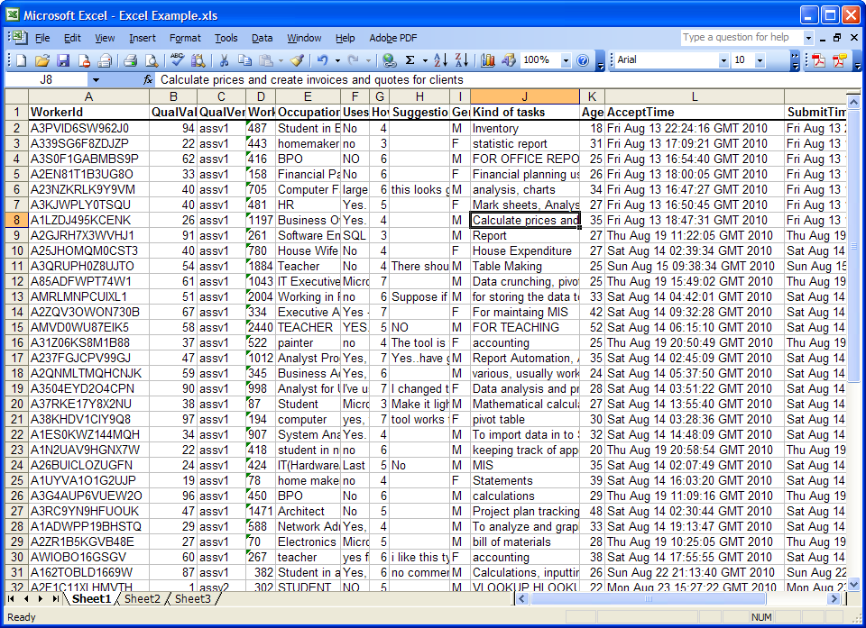
Consider this successful single table, single user ”database”
Notes:
To give you an idea of why this is even possible...

Slide 28
Consider this successful
single table, single user ”database”
Spreadsheets:
General-purpose
Extremely mature
No builder: The data is the interface
Notes:
Unfortunately, spreadsheets don’t really work for multiple tables etc.

Slide 29
Requirements for a Universal Database UI
Edit both schema and data with spreadsheet-like ease
Provide and expressive visual query language to create and dispose of complex views
Support hierarchical views and flexible layouts

Slide 30
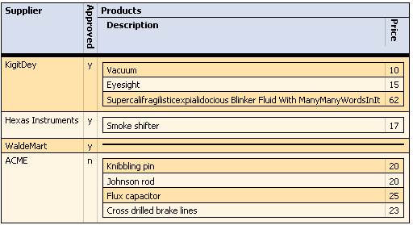
Hierarchical Views
E.g. show me “a list of papers, each paper showing its authors and its reviewers” – supported for instance by App2You, AppForge.
Intelligent layout management

Slide 31
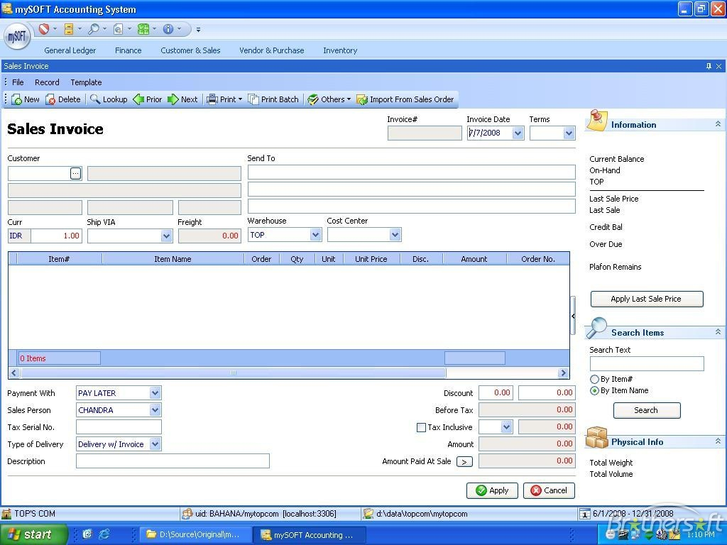
Hierarchical Views

Slide 32
Related Worksheets
Co-Developed with Paul Grogan and Yod Watanaprakornkul
demo
(To appear in CHI ’11)

Slide 33
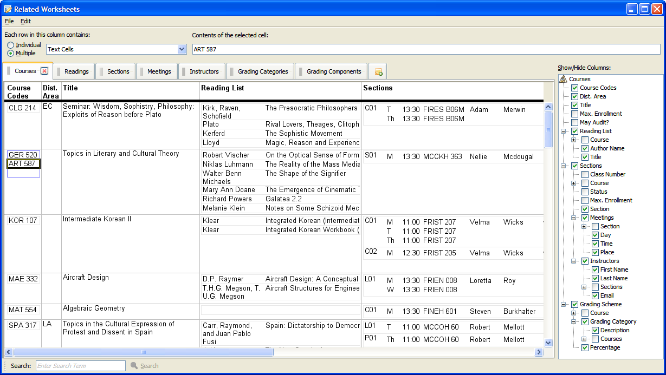
demo
(To appear in CHI ’11)

Slide 34
Underlying Schema
Courses(Course, Distribution Area, Title, Max. Enrollment, May Audit)
Readings(Course, Author Name, Title)
Sections(Class Number, Course, Status, Max. Enrollment, Section)
Meetings(Section Class Number, Day, Time, Place)
Instructors(First Name, Last Name, Email)
Grading Components(Course, Grading Category, Percentage)
Instructors-Sections(Instructor Name, Section Class Number)
Cross-Listings(Crosslisted Course Code, Primary Course Code)

Slide 35
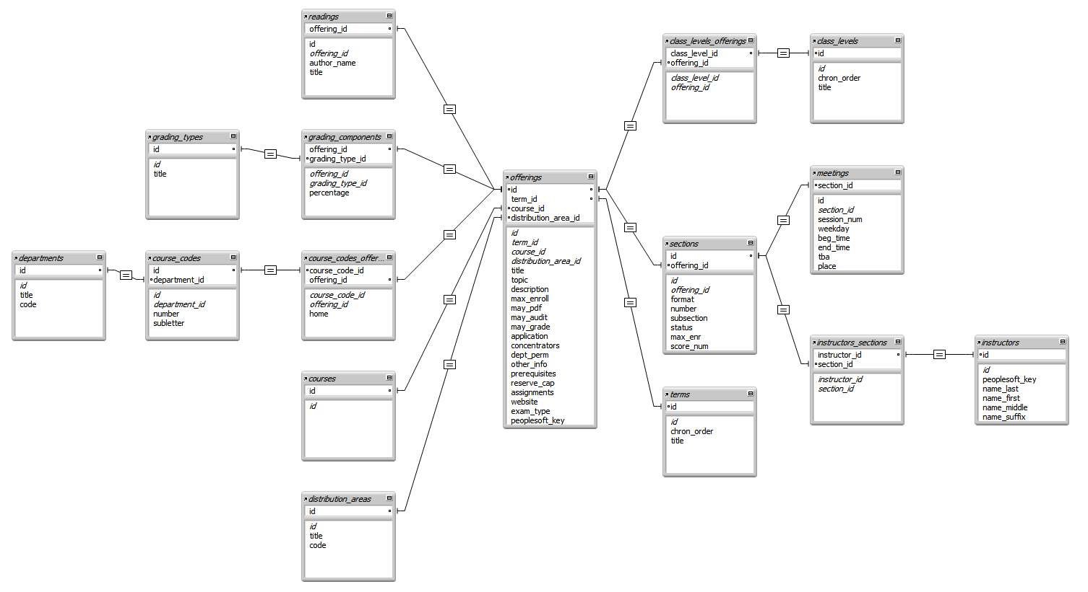
Underlying schema

Slide 36
View Query: 12 joins

Slide 37
Conclusion
A great number of small organizations could use a relational database for their own highly domain-specific schema.
Stop spending time and money writing a new app for every schema – invent a general-purpose one instead.
Convert many small vertical markets into one big horizontal market.
  Think Excel, not Access

Slide 38
Q&A

Slide 39
Backup Slides

Slide 40
An infinite supply of schemas
perfectly obscure to the world at large
but
each of great value to a limited number of
people or organizations

Slide 41
Architecture
Relational
Database
SQL
Relational Data
(Bidirectional)
Relational-to-XML
Mapping Layer
Form Query
Query Builder UI
XML
Schema
XML
Data
Automatic Layout
Manager
+ Editing UI
Formatting UI
Stylesheet
Grand Unified UI
Note: ”XML” really means ”some hierarchical data model” (nested relations is another)
Notes:
One more item which is not shown here is the infrastructure to edit the actual schemas.

Slide 42
Contrast: Spreadsheets
General-purpose data management UI, widely used for database-style tasks
Large range of streamlined facilities for interacting with any data in a grid
Sadly, spreadsheets lack features essential to any relational database UI
  Joins, managing one-to-many/many-to-many relationships
  No dynamic views
  Non-tabular views and layouts
  Need better scaling, multiuser support
Great it your database is single-table, single-user

Slide 43
Highly Domain-Specific
Database Applications
Require large development efforts
Have high training/support costs
Put developers between data and users
Seldom reach a high level of maturity
Usually just a CRUD¹ interface to some relational database
^{1 “}Create, Read, Update, Delete”

Slide 44
Related Work
General-purpose interfaces
  QBE
  VisiCalc (the spreadsheet)
  Polaris (Stolte et al. TVCG ’02)
    Visual algebra for data visualization (pivot table-based)
Application builders
  FileMaker (‘82), 4D (‘84), Microsoft Access (‘92)
  AppForge (Yang et al. PVLDB ’08)
    Includes a visual algebra for hierarchical view creation
  App2You (Kowalzcykowski et al., CIDR ’09)
    Also supports hierarchical views

Slide 45
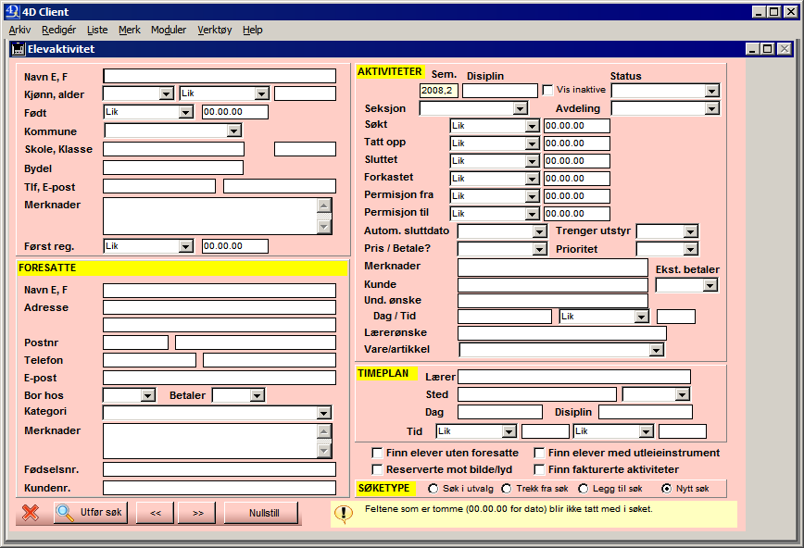
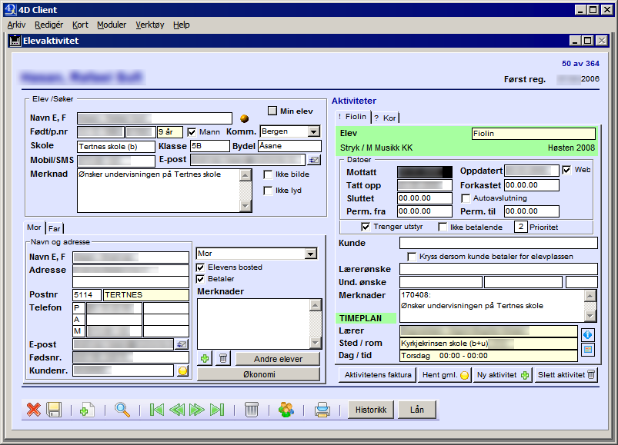

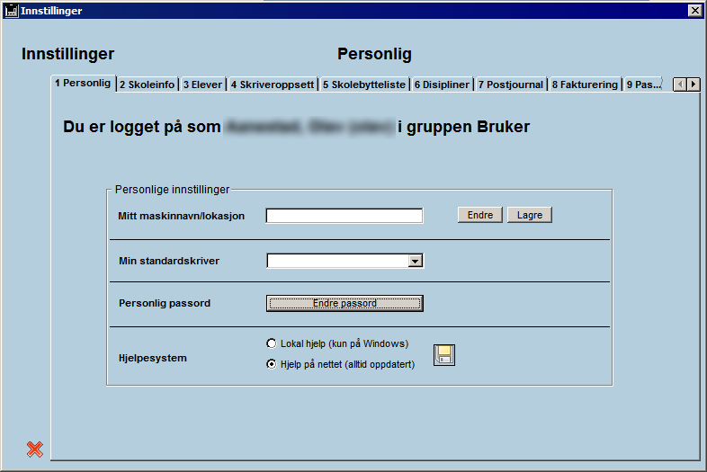
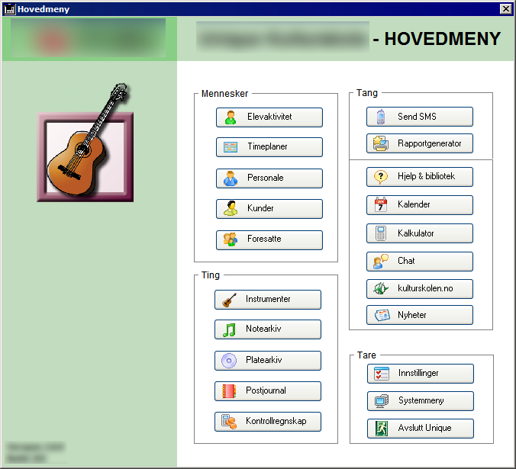

Slide 46
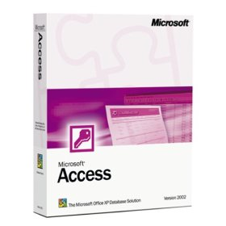
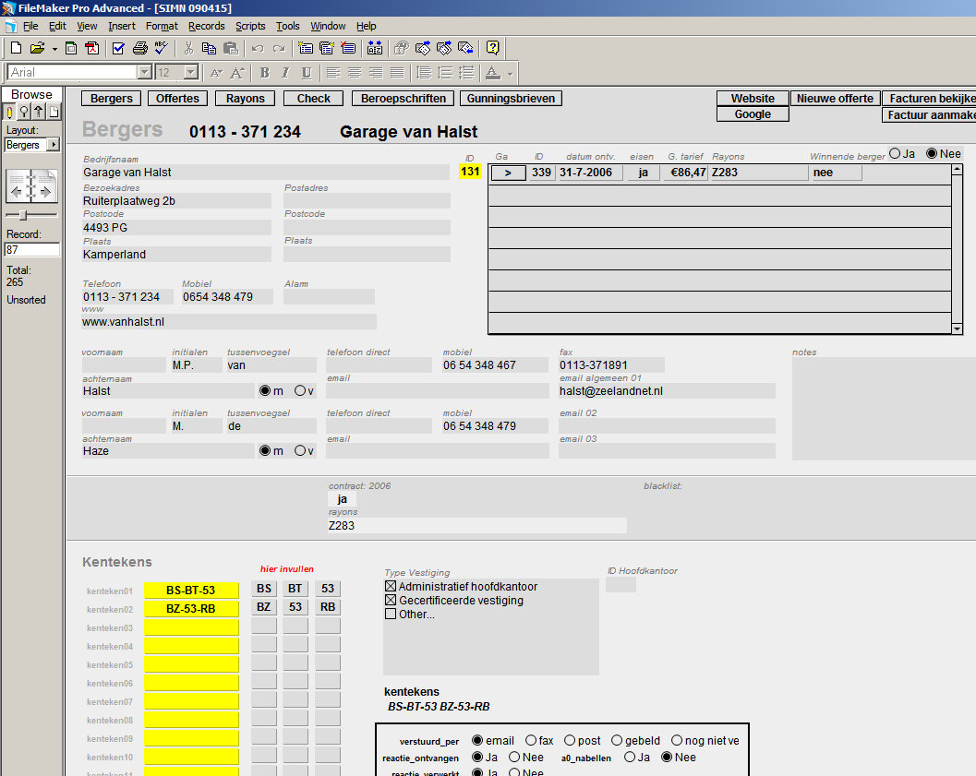
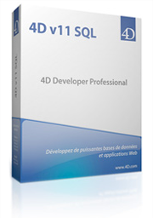

App Builders
Desktop IDEs

Slide 47
Spreadsheets vs.
Database Builders (Access et. al.)
Spreadsheets
A mature, grand unified idea for how to interact with data
Limited strategies available for presenting data.
Does not help you manage relationships between multiple tables of data
Access/FileMaker/etc.
Access to the full power of relational databases
Too technical interface
Often requires macro programming
Requires you to design and implement a new UI for every schema
Good
Bad

Slide 48
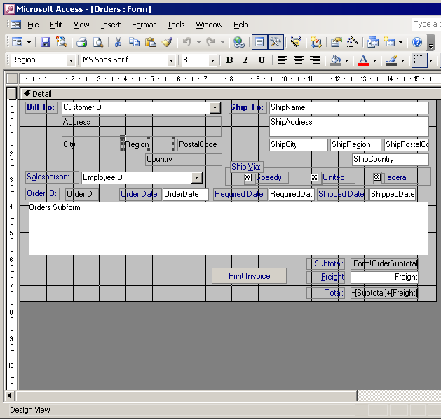
Spreadsheets vs.
Database Builders (Access et. al.)
Spreadsheets
A mature, grand unified idea for how to interact with data
Limited strategies available for presenting data.
Does not help you manage relationships between multiple tables of data
Access/FileMaker/etc.
Access to the full power of relational databases
Too technical interface
Often requires macro programming
Requires you to design and implement a new UI for every schema
Good
Bad

Slide 49
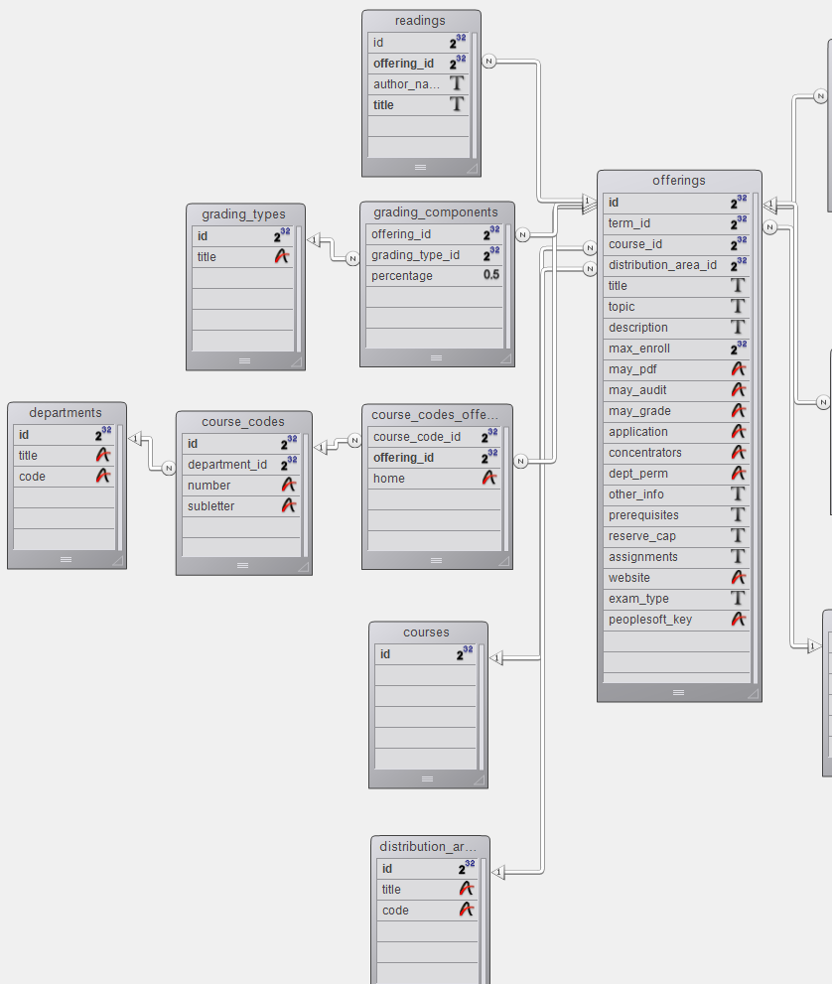
Spreadsheets vs.
Database Builders (Access et. al.)
Spreadsheets
A mature, grand unified idea for how to interact with data
Limited strategies available for presenting data.
Does not help you manage relationships between multiple tables of data
Access/FileMaker/etc.
Access to the full power of relational databases
Too technical interface
Often requires macro programming
Requires you to design and implement a new UI for every schema
Good
Bad

Slide 50
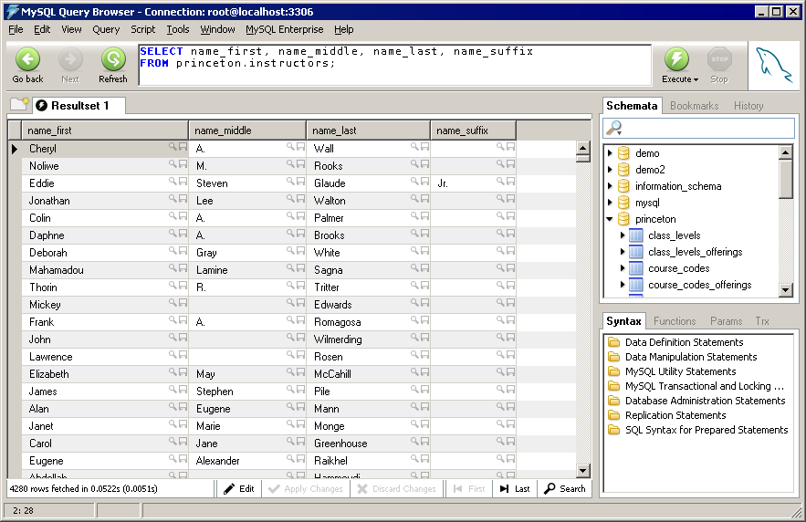
If All Your GUI Ever Needed was Tables:
Notes:
Then you’d be set... each dialog corresponds to a SQL query (or view), and you can use a standard Java component or whatever to provide all the editing facilities. Now there are other things you might like your user to be able to do without knowing SQL, like searching and doing certain customizations on the views, but that’s not the main problem. The problem is...

