Slide 1


Flash Device Support for Database Management
CIDR 2011
Philippe Bonnet, ITU
Copenhagen, Denmark
Luc Bouganim, INRIA,
Paris – Rocquencourt, France
This work is partially supported by the Danish Strategic Research Council.

Slide 2
Outline
Note: These slides are an extended version of the slides shown at CIDR 2011
Motivation
Flash device behavior
The Good, the Bad and the FTL
Minimal FTL
Bimodal FTL
Example: Hash join on Bimodal FTL
Conclusion

Slide 3
DBMS on (or using) flash devices
NAND flash performance is impressive
  Flash devices is part of the memory hierarchy
  Replace or complement hard disks
DBMS design = 3 decades of optimization based on
the (initial) hard disk behavior
Revisit the DBMS design wrt. flash device behavior?
Need to understand the behavior of flash devices

Slide 4
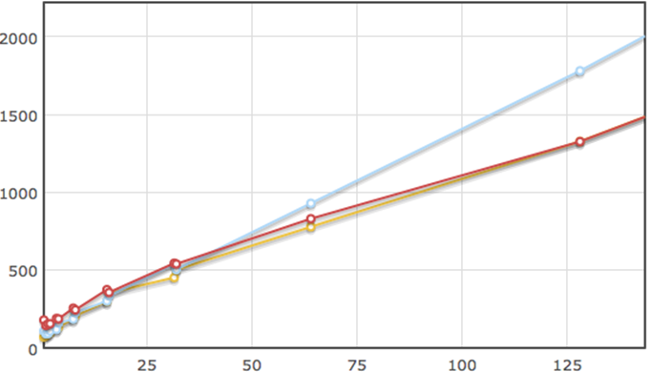

Some examples of behavior (Samsung)
SR, SW and RR have similar (good) performance
RW, not shown, are much more expensive, 10-30ms
Response
time (μs)
IO size (KB)

Slide 5
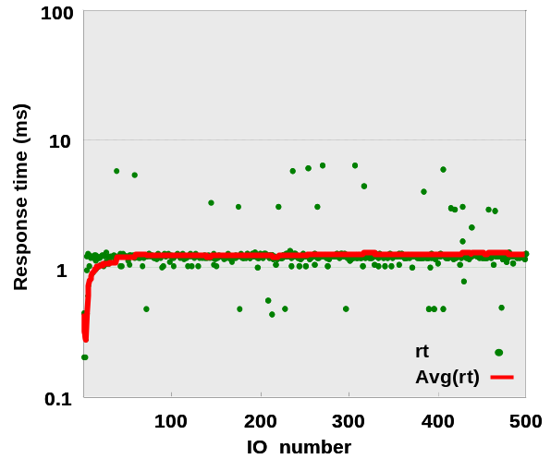
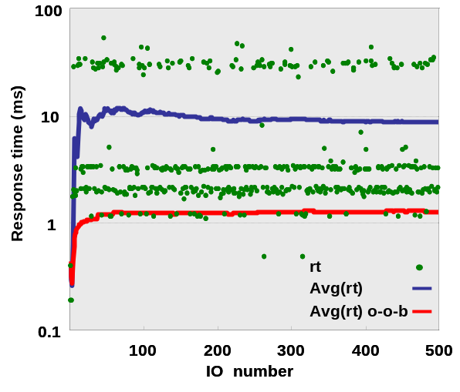
Some examples of behavior (Samsung)
Random Writes (16KB)
Out of the box
Random Writes (16 KB)
After filling the device
Average performance can vary of an order of magnitude depending on the device state

Slide 6
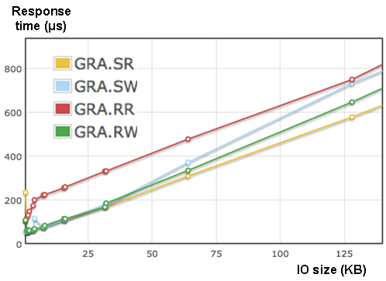
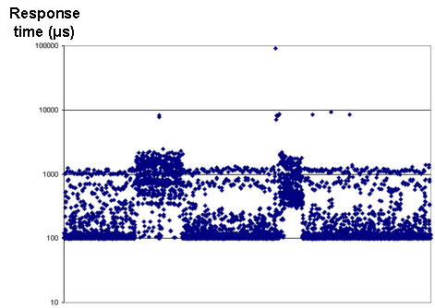
Some examples of behavior (Intel X25-E)
SR, SW and RW have similar performance.
RR are more costly!
RW (16 KB) performance varies from 100 μs to 100 ms!! (x 1000)

Slide 7
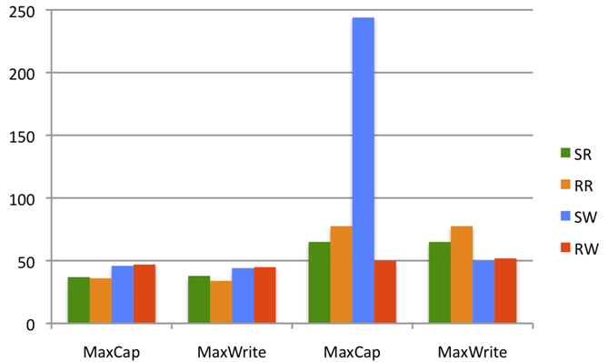
Some examples of behavior (Fusion IO)
Capacity vs Performance tradeoff
Sensitivity to device state
Response
time (μs)
IO Size = 4KB
Low level formatted
Fully written

Slide 8
Flash device behavior (1)
Understanding flash behavior [uFLIP, CIDR 2009]
  Flash devices (e.g., SSDs) do not behave as flash chips
  Flash devices performance is difficult to measure (device state)
    Need for an adequate methodology
  We proposed a wide benchmark to cover current and future devices.
  We also observed a common behavior and deduced design hints
    Not true anymore on recent devices!
Making assumptions about flash behavior
  Consider the behavior of flash chips (embedded context)
  Consider the behavior of a given device or of a class of devices

Slide 9
Flash device behavior (2)
What is actually the behavior of flash devices?
  Update in place are inefficient?
  Random writes are slower than sequential ones?
  Better not filling the whole device if we want good performance?
Behavior varies across devices and firmware updates
Should we continue running after the flash technology?
In this talk, we propose another way to include flash devices in the DBMS landscape

Slide 10


The Good
Flash devices performance is impressive!
A single flash chip offers great performance
  e.g., 40 MB/s Read, 10 MB/s Write
  Random access is as fast as sequential access
  Low energy consumption
A flash device contains many (e.g., 16, 32) flash chips and provides inter-chips parallelism
Flash devices include some (power-failure resistant) cache
  e.g., 16-32 MB of RAM

Slide 11


The Bad
Flash chips have severe constraints!
C1: Write granularity:
  Writes must be performed at flash page granularity (e.g. 4 KB)
C2: Must erase a block (e.g., 64 pages) before rewriting a page
C3: Writes must be sequential within a flash block
C4: Limited lifetime (from 10⁴ up to 10⁶ erase operations)
Write granularity: a page (4 KB)
Writes must be sequential
within the block
(64 pages)
Erase granularity: a block (256 KB)

Slide 12


And The FTL
The Flash Translation Layer (FTL) emulates a classical block device, handling flash constraints
Distribute erase across flash (wear leveling)
  Address C4 (limited lifetime)
Make out-of-place updates (using reserved flash blocks)
  Address C2 (erase before write) and C1 (writes smaller than a page→updates)
Maintain a logical to physical address mapping
  Necessary for out-of-place updates and wear leveling, address C3 (seq. writes)
A garbage collector is necessary!

Slide 13
Logical to physical mapping
Mapping table
(900 MB for a 1 TB flash)
Page Mapping:
Logical @
Physical @
Problem
Logical @
Page
Block
Page
Search for the correct page
Block Mapping:
Block
Physical @
Mapping
table
(12 MB for a 1 TB flash)
Problem
Beside these two extremes, many techniques were designed, using temporal/spatial locality, caching, detecting “hotness” of data, distinguishing RW and SW, grouping blocks, etc.
FTL is a complex piece of software, generally kept secret by flash device manufacturers

Slide 14
FTL designers vs DBMS designers goals
Flash device designers goals:
  Hide the flash device constraints (usability)
  Improve the performance for most common workloads
  Make the device auto-adaptive
  Mask design decision to protect their advantage (black box approach)
DBMS designers goals:
  Have a model for IO performance (and behavior)
    Predictable
    Clear distinction between efficient and inefficient IO patterns
  To design the storage model and query processing/optimization strategies
  Reach best performance, even at the price of higher complexity (having
  a full control on actual IOs)
These goals are conflicting!

Slide 15
Minimal FTL: Take the FTL out of equation!
FTL provides only wear leveling, using block mapping to address C4 (limited lifetime)
Pros
  Maximal performance for
    SR, RR, SW
    Semi-Random Writes
  Maximal control for the DBMS
Cons
  All complexity is handled
  by the DBMS
  All IOs must follow C1-C3
    The whole DBMS must
    be rewritten
    The flash device is
    dedicated
DBMS
Constrained Patterns only
(C1, C2, C3)
(C1) Write granularity
(C2) Erase before write
(C3) Sequential writes
within a block
(C4) Limited lifetime
Block mapping, Wear Leveling
(C4)
Minimal flash device
Flash chips

Slide 16
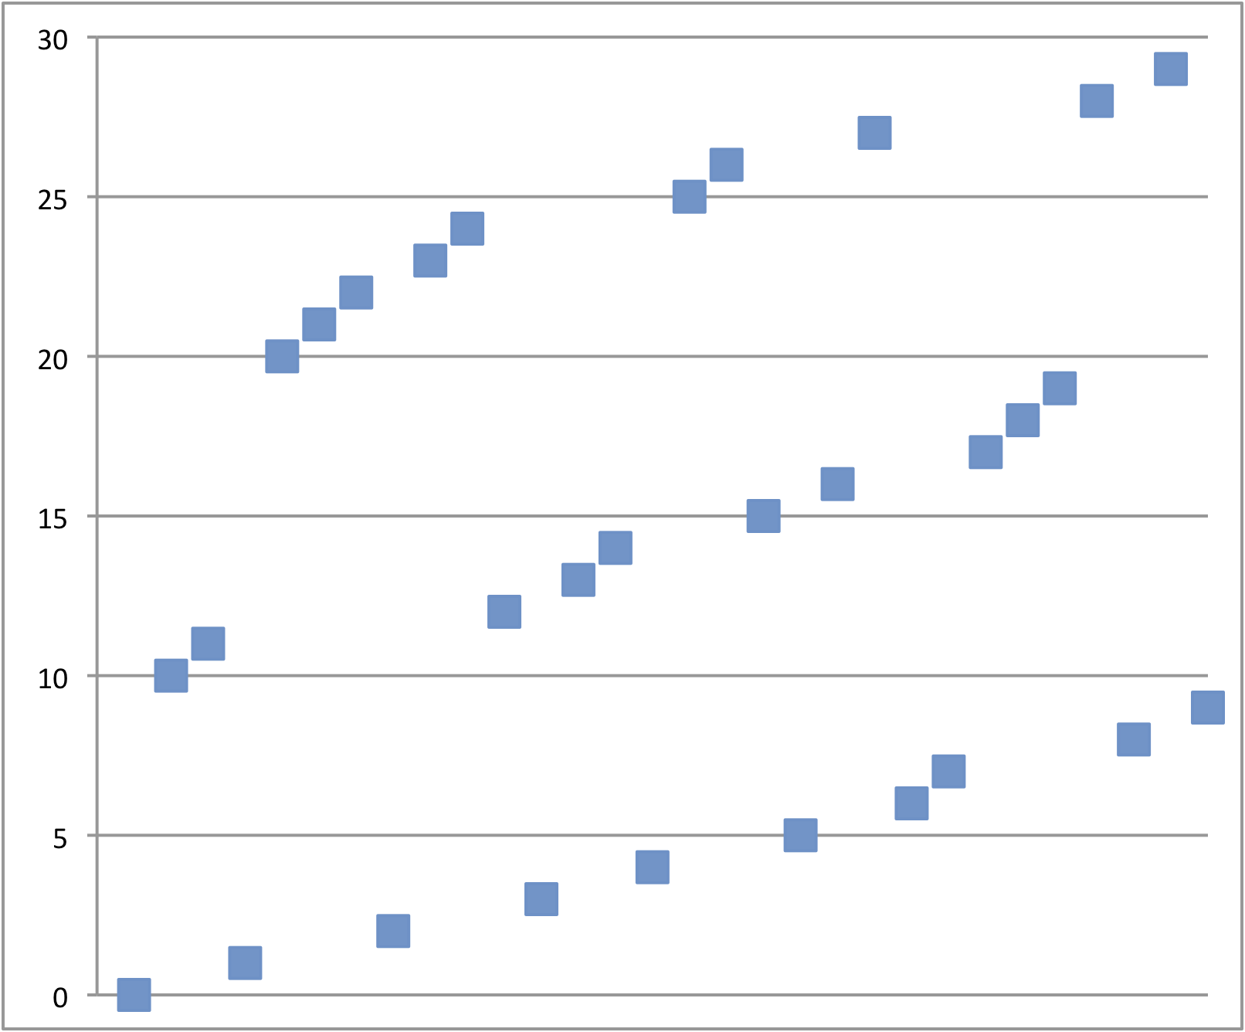
Semi-random writes (uFLIP [CIDR09])
Inter-blocks : Random
Intra-block : Sequential
Example with 3 blocks of 10 pages:
IO address
time

Slide 17
Bimodal FTL: a simple idea …
Bimodal Flash Devices:
  Provide a tunnel for those IOs that respect constraints C1-C3 ensuring maximal performance
  Manage other unconstrained IOs in best effort
  Minimize interferences between these two modes of operation
Pros
  Flexible
  Maximal performance and
  control for the DBMS for
  constrained IOs
Cons
  No behavior guarantees for
  unconstrained IOs.
DBMS
unconstrained constr. patterns
patterns (C1, C2, C3)
(C1) Write granularity
(C2) Erase before write
(C3) Sequential writes
within a block
(C4) Limited lifetime
Update mgt, Garb. Coll.
(C1, C2, C3)
Block map., Wear Leveling
(C4)
Bimodal flash device
Flash chips

Slide 18
Bimodal FTL: easy to implement
Constrained IOs lead to optimal blocks
Optimal blocks can be trivially
  mapped using a small map table in safe cache
  detected using a flag and cursor in safe cache
No interferences!
No change to the block device interface:
  Need to expose two constants: block size and page size
Page 0
Page 1
Page 2
Page 3
Page 4
Page 5
Page 0
Page 1
Page 1’
Page 1’’
Page 0’
Page 2
Flag = Optimal
Flag = Non-Optimal
CurPos=6
CurPos=6
16 MB for a 1TB device

Slide 19
Bimodal FTL: better than Minimal + FTL
Non-optimal block can become optimal (thanks to GC)
Free
(CurPos = 0)
Write at @
CurPos++
TRIM
TRIM
Write at @ ≠ CurPos
Optimal
Non optimal
Garbage collector
actions
Write at @ CurPos++
Page 0
Page 1
Page 1’
Page 1’’
Page 0’
Page 2
Page 0’
Page 1’’
Page 2
Flag = Non-Optimal
Flag = Optimal
CurPos=3
CurPos=6

Slide 20
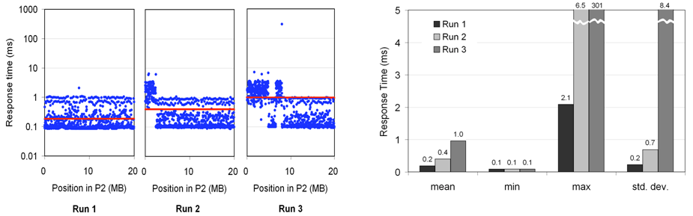
Bimodal FTL does not exist yet!
P1
P2
P3
A simple test
Device must support TRIM operation → Only recent SSDs
Results on Intel X25-M

Slide 21
Impact on DBMS Design
Using bimodal flash devices, we have a solid basis for designing efficient DBMS on flash:
What IOs should be constrained?
  i.e., what part of the DBMS should be redesigned?
How to enforce these constraints? Revisit literature:
  Solutions based on flash chip behavior enforce C1-C3 constraints
  Solutions based on existing classes of devices might not.

Slide 22
Example: Hash Join on HDD
One pass partitioning
Multi-pass partitioning (2 passes)
Tradeoff: IOSize vs Memory consumption
IOSize should be as large as possible, e.g., 256KB – 1 MB
  To minimize IO cost when writing or reading partitions
IOSize should be as small as possible
  To minimize memory consumption: One pass partitioning needs
  2 x IOSize x NbPartitions in RAM
  Insufficient memory → multi-pass → performance degrades!

Slide 23
Hash join on SSD and on bimodal SSD
With non bimodal SSDs
  No behavior guarantees but…
  Choosing IOSize = Block size (128 – 256 KB) should bring good performance
With bimodal SSDs
  Maximal performance are guaranteed (constrained patterns)
  Use semi-random writes
  IOSize can be reduced up to page size (2 – 4 KB) with no penalty
  Memory savings
  Performance improvement

Slide 24
Conclusion
Adding bimodality is necessary to support efficiently DBMS on flash devices
  DBMS designer retains control over IO performance
  DBMS leverages performance potential of flash chips
Adding bimodality to FTL does not hinder competition between flash device manufacturers, they can
  bring down the cost of constrained IO patterns (e.g., using parallelism)
  bring down the cost of unconstrained IO patterns without jeopardizing DBMS design
This study is very preliminary – many issues to explore
  More complex storage systems (e.g., RAID, ASM, etc)
  What abstraction for flash device?
    Memory abstraction (block device interface)
    Network abstraction (two systems collaborating)

Slide 25
More information
Bimodal Flash devices: P. Bonnet, L. Bouganim : Flash Device Support for Database Management. 5th Biennial Conference on Innovative Data Systems Research (CIDR), January 2010. http://www.cidrdb.org/cidr2011/Papers/CIDR11_Paper1.pdf
Benchmark: L. Bouganim, B. Jónsson, P. Bonnet. uFLIP: Understanding Flash IO Patterns, 4th Biennial Conference on Innovative Data Systems Research (CIDR), (Best paper award), January 2009 http://www-db.cs.wisc.edu/cidr/cidr2009/Paper_102.pdf
Energy consumption: M. Bjørling, P. Bonnet, L. Bouganim, Björn Þór Jónsson, uFLIP: Understanding the Energy Consumption of Flash Devices, IEEE Data Engineering Bulletin, vol. 33, n°4, December 2010.http://sites.computer.org/debull/A10dec/bonnet1.pdf
Demonstration: M. Bjørling, L. Le Folgoc, A. Mseddi, P. Bonnet, L. Bouganim, Björn Þór Jónsson, Performing Sound Flash Device Measurements: The uFLIP Experience, 29th ACM International Conference on Management of Data (ACM SIGMOD), June. 2010. http://portal.acm.org/citation.cfm?doid=1807167.1807324
  Web Sites: www.uflip.org, http://www-smis.inria.fr/~bouganim , http://www.itu.dk/people/phbo/
Authors: Luc.Bouganim@inria.fr , phbo@itu.dk

