Slide 1
Rethinking Database Algorithms for Phase Change Memory
Shimin Chen* Phillip B. Gibbons* Suman Nath⁺
*Intel Labs Pittsburgh ⁺Microsoft Research

Slide 2
Introduction
PCM is an emerging non-volatile memory technology
Samsung is producing a PCM chip for mobile handsets
Expected to become a common component in memory/storage hierarchy
Recent computer architecture and systems studies argue:
PCM will replace DRAM to be main memory
PCM-DB project: exploiting PCM for database systems
This paper: algorithm design on PCM-based main memory

Slide 3
Outline
Phase Change Memory
PCM-Friendly Algorithm Design
B⁺-Tree Index
Hash Joins
Related Work
Conclusion

Slide 4
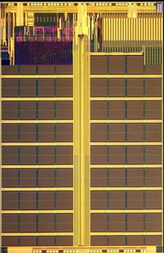
Phase Change Memory (PCM)
Byte-addressable non-volatile memory
Two states of phase change material:
Amorphous: high resistance, representing “0”
Crystalline: low resistance, representing “1”
Operations:
“RESET” to Amorphous
e.g., ~610⁰C
Current (Temperature)
“SET” to Crystalline
e.g., ~350⁰C
READ
Time

Slide 5
Comparison of Technologies
 | DRAM | PCM | NAND Flash
Page size Page read latency Page write latency Write bandwidth Erase latency | 64B 20-50ns 20-50ns ∼GB/s per die N/A | 64B ∼ 50ns ∼ 1 µs 50-100 MB/s per die N/A | 4KB ∼ 25 µs ∼ 500 µs 5-40 MB/s per die ∼ 2 ms
Endurance | ∞ | 10⁶ − 10⁸ | 10⁴ − 10⁵
Read energy Write energy Idle power | 0.8 J/GB 1.2 J/GB ∼100 mW/GB | 1 J/GB 6 J/GB ∼1 mW/GB | 1.5 J/GB [28] 17.5 J/GB [28] 1–10 mW/GB
Density | 1× | 2 − 4× | 4×
Compared to NAND Flash, PCM is byte-addressable, has orders of magnitude lower latency and higher endurance.
Sources: [Doller’09] [Lee et al. ’09] [Qureshi et al.’09]

Slide 6
Comparison of Technologies
 | DRAM | PCM | NAND Flash
Page size Page read latency Page write latency Write bandwidth Erase latency | 64B 20-50ns 20-50ns ∼GB/s per die N/A | 64B ∼ 50ns ∼ 1 µs 50-100 MB/s per die N/A | 4KB ∼ 25 µs ∼ 500 µs 5-40 MB/s per die ∼ 2 ms
Endurance | ∞ | 10⁶ − 10⁸ | 10⁴ − 10⁵
Read energy Write energy Idle power | 0.8 J/GB 1.2 J/GB ∼100 mW/GB | 1 J/GB 6 J/GB ∼1 mW/GB | 1.5 J/GB [28] 17.5 J/GB [28] 1–10 mW/GB
Density | 1× | 2 − 4× | 4×
Compared to DRAM, PCM has better density and scalability; PCM has similar read latency but longer write latency
Sources: [Doller’09] [Lee et al. ’09] [Qureshi et al.’09]

Slide 7
Relative Latencies:
Read
DRAM
PCM
NAND Flash
Hard Disk
10ns
100ns
1us
10us
100us
1ms
10ms
DRAM
PCM
NAND Flash
Hard Disk
Write

Slide 8
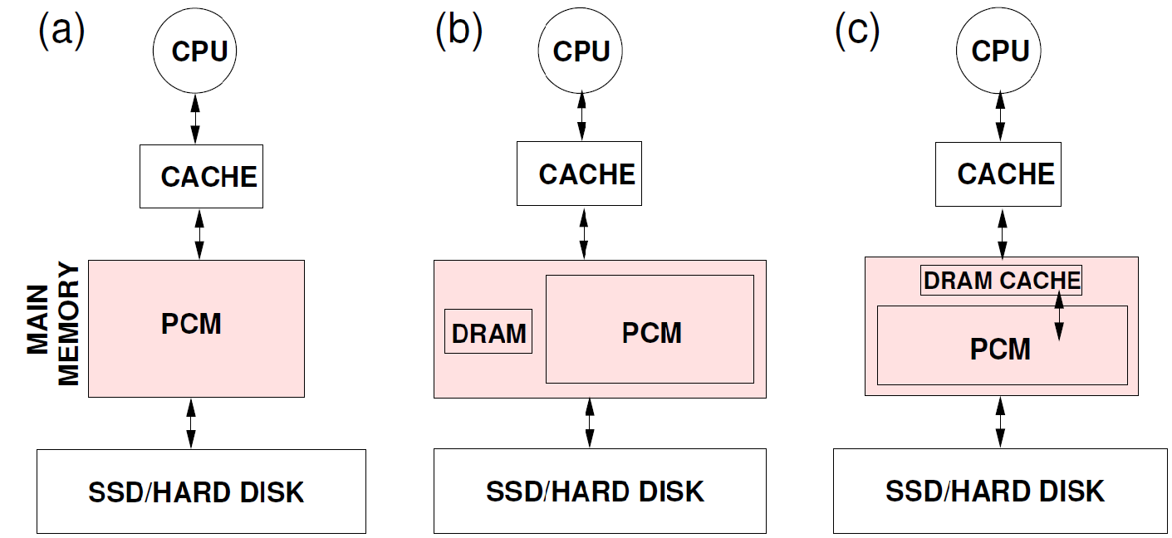
PCM-Based Main Memory Organizations
PCM is a promising candidate for main memory
Recent computer architecture and systems studies
Three alternative proposals:
[Condit et al’09] [Lee et al. ’09] [Qureshi et al.’09]
For algorithm analysis, we focus on PCM main memory, and view optional DRAM as another (transparent/explicit) cache

Slide 9
Challenge: PCM Writes
 | PCM
Page size Page read latency Page write latency Write bandwidth Erase latency | 64B ∼ 50ns ∼ 1 µs 50-100 MB/s per die N/A
Endurance | 10⁶ − 10⁸
Read energy Write energy Idle power | 1 J/GB 6 J/GB ∼1 mW/GB
Density | 2 − 4×
Limited endurance
Wear out quickly for hot spots
High energy consumption
6-10X more energy than a read
High latency & low bandwidth
SET/RESET time > READ time
PCM chip has limited instantaneous electric current level, requires multiple rounds of writes
Write operation and hardware optimization

Slide 10
PCM Write Operation
[Cho&Lee’09] [Lee et al. ’09] [Yang et al’07] [Zhou et al’09]
Baseline: several rounds of writes for a cache line
Which bits in which rounds are hard wired
Optimization: data comparison write
Goal: write only modified bits rather than entire cache line
Approach: read-compare-write
Skipping rounds with no modified bits
Rounds highlighted w/ different colors
Cache line
0
1
0
1
1
0
0
1
0
1
1
0
0
0
0
1
0
1
0
1
1
0
1
1
0
1
1
0
1
1
1
0
PCM
0
0
1
1
0
0
1
1
1
1
0
0
1
0
0
1
1
0
0
1
1
1
1
0
0
1
0
0
1
0
0
1
0
0
0
1
1

Slide 11
Outline
Phase Change Memory
PCM-Friendly Algorithm Design
B⁺-Tree Index
Hash Joins
Related Work
Conclusion

Slide 12
Algorithm Design Goals
Algorithm design in main memory
Prior design goals:
Low computation complexity
Good CPU cache performance
Power efficiency (more recently)
New goal: minimizing PCM writes
Improve endurance, save energy, reduce latency
Unlike flash, PCM word granularity

Slide 13
PCM Metrics
Algorithm parameters:
: cache misses (i.e. cache line fetches)
: cache line write backs
: words modified
We propose three analytical metrics
Total Wear (for Endurance)
Energy
Total PCM Access Latency
PCM

Slide 14
B⁺-Tree Index
Cache-friendly B⁺-Tree:
Node size: one or a few cache lines large
Problem: insertion/deletion in sorted nodes
Incurs many writes!
[Rao&Ross’00] [Chen et al’01] [Hankins et al. ’03]
Insert/delete
num
keys
5
2
4
7
8
9
pointers
Notes:
Sorted nodes are good for binary search , low instruction overhead.

Slide 15
Our Proposal: Unsorted Nodes
keys
Unsorted node
Unsorted node with bitmap
Unsorted leaf nodes, but sorted non-leaf nodes
num
5
8
2
9
4
7
pointers
bitmap
keys
1011
1010
8
2
9
4
7
pointers

Slide 16
Simulation Platform
Cycle-accurate out-of-order X86-64 simulator: PTLSim
Extended the simulator with PCM support
Parameters based on computer architecture papers
Sensitivity analysis for the parameters
Details of Write Backs in Memory Controller
PTLSim
Data Comparison Writes
PCM
PCM
PCM
PCM

Slide 17
B⁺-Tree Index
Node size 8 cache lines; 50 million entries, 75% full;
Three workloads:
Inserting 500K random keys
deleting 500K random keys
searching 500K random keys
Total wear
Energy
Execution time
Unsorted leaf schemes achieve the best performance
For insert intensive: unsorted-leaf
For insert & delete intensive: unsorted-leaf with bitmap

Slide 18
Simple Hash Join
Build hash table on smaller (build) relation
Probe hash table using larger (probe) relation
Problem: too many cache misses
Build + hash table >> CPU cache
Record size is small
Build Relation
Probe Relation
Hash Table

Slide 19
Cache Partitioning
[Shatdal et al.’94] [Boncz et al.’99] [Chen et al. ’04]
Partition both tables into cache-sized partitions
Join each pair of partitions
Problem: too many writes in partition phase!

Slide 20
Our Proposal: Virtual Partitioning
Virtual partitioning:
Join a pair of virtual partitions:
Preserve good CPU cache performance while reducing writes
Compressed Record ID Lists
Build Relation
Probe Relation
Hash Table

Slide 21
Hash Joins
50MB joins 100MB; varying record size from 20B to 100B.
Total wear
Energy
Execution time
Virtual partitioning achieves the best performance
Interestingly, cache partitioning is the worst in many cases

Slide 22
Related Work
PCM Architecture
Hardware design issues: endurance, write latency, error correction, etc.
Our focus: PCM friendly algorithm design
Byte-Addressable NVM-Based File Systems
Battery-Backed DRAM
Main Memory Database Systems & Cache Friendly Algorithms
Not considering read/write asymmetry of PCM

Slide 23
Conclusion
PCM is a promising non-volatile memory technology
Expected to replace DRAM to be future main memory
Algorithm design on PCM-based main memory
New goal: minimize PCM writes
Three analytical metrics
PCM-friendly B⁺-tree and hash joins
Experimental results show significant improvements

Slide 24
Thank you!
shimin.chen@intel.com

