Slide 1
consistency analysis in bloom a CALM and collected approach
peter alvaro, neil conway, joseph m. hellerstein, william r. marczak
uc berkeley

Slide 2
the state of things
distributed programming increasingly common
hard²
(parallelism + asynchrony + failure) × (software engineering)

Slide 3
choices
ACID
loose consistency
general correctness via theoretical foundations
read/write: serializability
coordination/consensus
app-specific correctness via design maxims
semantic assertions
custom compensation
concerns: latency, availability
concerns: hard to trust, test

Slide 4
desire: best of both worlds
theoretical foundation for correctness under loose consistency
embodiment of theory in a programming framework

Slide 5
progress
CALM consistency (maxims ⇒ theorems)
Bloom language (theorems ⇒ programming)

Slide 6
outline
motivation: language-level consistency
foundation: CALM theorem
implementation: bloom prototype
discussion: tolerating inconsistency taint

Slide 7
CALM

Slide 8
monotonicity
monotonic code
non-monotonic code
info accumulation
the more you know, the more you know
belief revision
new inputs can change your mind
e.g. aggregation, negation, state update

Slide 9
an aside
double-blind review

Slide 10
an aside
double-blind review
pocket change

Slide 11
intuition
counting requires waiting

Slide 12
intuition
counting requires waiting
waiting requires counting

Slide 13
CALM Theorem
CALM: consistency and logical monotonicity
monotonic code ⇒ eventually consistent
non-monotonic ⇒ coordinate only at non-monotonic points of order
conjectures at pods 2010
(web-search for “the declarative imperative”)
results submitted to pods 2011
Marczak, Alvaro, Hellerstein, Conway
Ameloot, Neven, Van den Bussche

Slide 14
practical implications
compiler can identify non-monotonic “points of order”
inject coordination code
or mark uncoordinated results as “tainted”
compiler can help programmer think about coordination costs
easy to do this with the right language…

Slide 15
outline
motivation: language-level consistency
foundation: CALM theorem
implementation: bloom prototype
discussion: tolerating inconsistency taint

Slide 16
bloom

Slide 17
disorderly programming
why is distributed programming hard? the von neumann legacy: obsession with order
state: ordered array
logic: ordered instructions, traversed by program counter
disorderly programming
state: unordered collections
logic: unordered set of declarative statements

Slide 18
bud: bloom under development
based in 5 years experience with Overlog
culmination: API-compliant HDFS++ implementation [Eurosys10]
i got the itch to prototype a more usable language
dsl for distributed programming, embedded in ruby
interpreter: ~2300 lines of ruby
bloom features
fully declarative semantics (based on dedalus temporal logic)
disorderly programming with pragmatics of modern language (ruby)
domain-specific code analysis

Slide 19
bloom operational model
really a metaphor for dedalus logic
each node runs independently
local clock, local data, local execution
timestepped execution loop at each node

Slide 20
bloom statements
<collection>
<accumulator>
<collection expression>

Slide 21
bloom statements
<collection>
<accumulator>
<collection expression>
<= | now
<+ | next
<- | del_next
<~ | async

Slide 22
bloom statements
<collection>
<accumulator>
<collection expression>
persistent | table
transient | scratch
networked transient | channel
scheduled transient | periodic
transient | interface
<= | now
<+ | next
<- | del_next
<~ | async

Slide 23
bloom statements
<collection>
<accumulator>
<collection expression>
persistent | table
transient | scratch
networked transient | channel
scheduled transient | periodic
transient | interface
<= | now
<+ | next
<- | del_next
<~ | async
<collection>
map, flat_map
reduce, group
join, natjoin, outerjoin
empty? include?

Slide 24
toy example: delivery
# abstract interface
module DeliveryProtocol
def state
super
interface input, :pipe_in,
[’dst’, ’src’, ’ident’], [’payload’]
interface output, :pipe_sent,
[’dst’, ’src’, ’ident’], [’payload’]
end
end

Slide 25
simple concrete implementation of the delivery protocol
module BestEffortDelivery
include DeliveryProtocol
def state
channel :pipe_chan,
['@dst', 'src', 'ident'], ['payload']
end
declare
def snd
pipe_chan <~ pipe_in
end
declare
def done
pipe_sent <= pipe_in
end
end

Slide 26
an alternative implementation: reliable delivery
module ReliableDelivery
include BestEffortDelivery
def state
super
table :pipe, ['dst', 'src', 'ident'], ['payload']
channel :ack, ['@src', 'dst', 'ident']
periodic :tock, 10
end
declare
def remember_resend
pipe <= pipe_in
pipe_chan <~ join([pipe, tock]).map{|p, t| p }
end
declare
def rcv
ack <~ pipe_chan.map {|p| [p.src, p.dst, p.ident] }
end
declare
def done
apj = join [ack, pipe], [ack.ident, pipe.ident]
pipe_sent <= apj.map {|a, p| p }
pipe <- apj.map{|a, p| p}
end
end

Slide 27
the payoff is in the paper
case study: 2 replicated shopping cart implementations
replicated key/value-store with “destructive” overwriting
“disorderly” version that accumulates/replicates user actions
demonstrates automatic consistency analysis
isolate points of order for coordination
highlights why the 2nd implementation is preferable to 1st
tolerating inconsistency (autoPat)
identify “tainted” data in a program
automatically generate scaffolding for compensation logic

Slide 28
destructive cart
module DestructiveCart
include CartProtocol
include KVSProtocol
declare
def do_action
kvget <= action_msg.map{|a| [a.reqid, a.key]}
kvput <= action_msg.map do |a|
if a.action == "A"
unless kvget_response.map{|b| b.key}.include? a.session
[a.server, a.client, a.session, a.reqid, [a.item]]
end
end
end
old_state = join [kvget_response, action_msg],
[kvget_response.key, action_msg.session]
kvput <= old_state.map do |b, a|
if a.action == "A"
[a.server, a.client, a.session, a.reqid, b.value.push(a.item)]
elsif a.action == "D"
[a.server, a.client, a.session, a.reqid, delete_one(b.value, a.item)]
end
end
end
declare
def do_checkout
kvget <= checkout_msg.map{|c| [c.reqid, c.session]}
lookup = join [kvget_response, checkout_msg],
[kvget_response.key, checkout_msg.session]
response_msg <~ lookup.map do |r, c|
[c.client, c.server, c.session, r.value]
end
end
end
full source in paper including replicated KVS

Slide 29
disorderly cart
module DisorderlyCart
include CartProtocol
include BestEffortDelivery
def state
table :cart_action, ['session', 'item', 'action', 'reqid']
table :action_cnt, ['session', 'item', 'action'], ['cnt']
scratch :status, ['server', 'client', 'session', 'item'], ['cnt']
end
declare
def do_action
cart_action <= action_msg.map do |c|
[c.session, c.item, c.action, c.reqid]
end
action_cnt <= cart_action.group(
[cart_action.session, cart_action.item, cart_action.action],
count(cart_action.reqid))
end
declare
def do_checkout
del_items = action_cnt.map{|a| a.item if a.action == "Del"}
status <= join([action_cnt, checkout_msg]).map do |a, c|
if a.action == "Add" and not del_items.include? a.item
[c.client, c.server, a.session, a.item, a.cnt]
end
end
status <= join([action_cnt, action_cnt,
checkout_msg]).map do |a1, a2, c|
if a1.session == a2.session and a1.item == a2.item and
a1.session == c.session and
a1.action == "A" and a2.action == "D"
[c.client, c.server, c.session, a1.item, a1.cnt - a2.cnt]
end
end
response_msg <~ status.group(
[status.client, status.server, status.session],
accum(status.cnt.times.map{status.item}))
end
end
full source in paper, including replication

Slide 30


conclusion
CALM theorem
what is coordination for? non-monotonicity.
pinpoint non-monotonic points of order
coordination or taint tracking
Bloom
declarative, disorderly DSL for distributed programming
bud: organic Ruby embedding
CALM analysis of monotonicity
synthesize coordination/compensation
releasing to the dev community
friends-and-family next month
public beta, Fall 2011

Slide 31
more?
http://bloom.cs.berkeley.edu
thanks to:
Microsoft Research
Yahoo! Research
IBM Research
NSF
AFOSR

Slide 32
backup

Slide 33



influence propagation…?
Technology Review TR10 2010:
“The question that we ask is simple: is the technology likely to change the world?”
Fortune Magazine 2010 Top in Tech:
“Some of our choices may surprise you.”
Twittersphere:
“Read this. Read this now.”

Slide 34
relative to LP and active DB
“Unlike earlier efforts such as Prolog, active database languages, and our own Overlog language for distributed systems [16], Bloom is purely declarative: the syntax of a program contains the full spec- ification of its semantics, and there is no need for the programmer to understand or reason about the behavior of the evaluation engine. Bloom is based on a formal temporal logic called Dedalus [3].”

Slide 35
why ruby?
“Bud uses a Ruby-flavored syntax, but this is not fundamental; we have experimented with analogous Bloom embeddings in other languages including Python, Erlang and Scala, and they look similar in structure.”

Slide 36
what about erlang?
“we did a simple Bloom prototype DSL in Erlang (which we cannot help but call “Bloomerlang”), and there is a natural correspondence between Bloom-style distributed rules and Erlang actors. However there is no requirement for Erlang programs to be written in the disorderly style of Bloom. It is not obvious that typical Erlang programs are significantly more amenable to a useful points-of-order analysis than programs written in any other functional language. For example, ordered lists are basic constructs in functional languages, and without program annotation or deeper analysis than we need to do in Bloom, any code that modifies lists would need be marked as a point of order, much like our destructive shopping cart”

Slide 37
CALM analysis for traditional languages?
We believe that Bloom’s “disorderly by default” style encourages order-independent programming, and we know that its roots in database theory helped produce a simple but useful program analysis technique. While we would be happy to see the analysis “ported” to other distributed programming environments, it may be that design patterns using Bloom-esque disorderly programming are the natural way to achieve this.

Slide 38
dependency graphs

Slide 39
dependency graphs
BestEffortDelivery
ReliableDelivery

Slide 40
2 cart implementations
destructive
disorderly

Slide 41
example analysis in paper: replicated shopping carts
“destructive” cart implements a replicated key/value store
key: session id
value: array of the items in cart
add/delete “destructively” modify the value
“disorderly” cart uses accumulation and aggregation
adds/deletes received/replicated monotonically
checkout requires counting up the adds/deletes
hence coordinate only at checkout time

Slide 42
Building on Quicksand
Campbell/Helland CIDR 2009
goal: avoid coordination entirely
maxim: memories, guesses and apologies
can we use Bloom analysis to automate/prove correctness of this?
initial ideas so far

Slide 43
from quicksand & maxims to code & proofs
“guesses”: easy to see in dependency graph
any collection downstream of an uncoordinated point of order
compiler rewrites schema to add “taint” attribute to these
and rewrites rules to carry taint bit along
“memories” at interfaces
compiler interposes table in front of any tainted output interface
“apologies”
need to determine when “memory” tuples were inconsistent
idea: wrap tainted code blocks with “background” coordination check
upon success, garbage-collect relevant “memories”
upon failure, invoke custom “apology” logic to achieve some invariant
ideally, prove that inconsistent tuples + apology logic = invariant satisfied

Slide 44

the shift
application logic
application logic
system infrastructure
system infrastructure
quicksand
theoretical foundation

Slide 45
ruby embedding
class Bud
“declare” methods for collections of Bloom statements
checked for legality, potentially optimized/rewritten
template methods for schemas and data
all the usual Ruby goodness applies
rich dynamic type system
OO inheritance, mixins (~multiple inheritance), encapsulation
functional programming comprehension syntax
libraries for everything under the sun

Slide 46
a taste of ruby
inheritance
mixins
Enumerables and code blocks
module MixMeIn
def mixi
"who do we appreciate"
end
end
class SuperDuper
def doit
"a super duper bean"
end
end
class Submarine < SuperDuper
include MixMeIn
def doit
"a yellow submarine"
end
def sing
puts "we all live in " + doit
end
def chant(nums)
out = nums.map { |n| n*2 }
puts out.inspect + " " + mixi
end
end
s = Submarine.new
s.sing ; s.chant([1,2,3,4])

Slide 47
example app: shopping cart
replicated for HA and low latency
clients associated with unique session IDs
add_item, deleted_item, checkout
challenge: guarantee eventual consistency of replicas
maxim: use commutative operations
c.f. Amazon Dynamo, Campbell/Helland “Building on Quicksand”
easier said than done!

Slide 48
abstract interfaces
module CartClientProtocol
def state
interface input, :client_action,
['server', 'session', 'reqid'], ['item', 'action']
interface input, :client_checkout,
['server', 'session', 'reqid']
interface output, :client_response,
['client', 'server', 'session'], ['contents']
end
end
module CartProtocol
def state
channel :action_msg,
['@server', 'client', 'session', 'reqid'],
['item', 'action']
channel :checkout_msg,
['@server', 'client', 'session', 'reqid']
channel :response_msg,
['@client', 'server', 'session'], ['contents']
end
end

Slide 49
simple realization
module CartClient
include CartProtocol
include CartClientProtocol
declare
def client
action_msg <~ client_action.map do |a|
[a.server, @local_addr, a.session, a.reqid, a.item, a.action]
end
checkout_msg <~ client_checkout.map do |a|
[a.server, @local_addr, a.session, a.reqid]
end
client_response <= response_msg
end
end

Slide 50
destructive cart
disconnected because we haven’t picked a kvs implementation yet

Slide 51
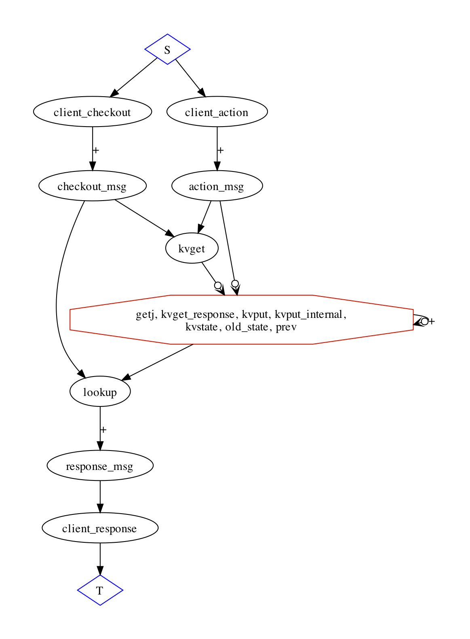
destructive cart
basic KVS interposes a point of order into the dataflow

Slide 52
abstract and concrete clients
note that concrete client is still underspecified: we haven’t supplied an implementation of the cart yet!

Slide 53
simple key/value store
module KVSProtocol
def state
super
interface input, :kvput, ['client', 'key', 'reqid'],
['value']
interface input, :kvget, ['reqid'], ['key']
interface output, :kvget_response, ['reqid'],
['key', 'value']
end
end

Slide 54
simple KVS
module BasicKVS
include KVSProtocol
def state
table :kvstate, ['key'], ['value']
end
declare
def do_put
kvstate <+ kvput.map{|p| [p.key, p.value]}
prev = join [kvstate, kvput], [kvstate.key, kvput.key]
kvstate <- prev.map{|b, p| b}
end
declare
def do_get
getj = join [kvget, kvstate],
[kvget.key, kvstate.key]
kvget_response <= getj.map do |g, t|
[g.reqid, t.key, t.value]
end
end
end
no replication
deletion on each put
gets worse with replication!

Slide 55
simple key/val store
any path through kvput crosses both a point of order and a temporal edge.
where’s the non-monotonicity?
state update in the KVS
easy syntactic check!
kvstate <- prev.map{|b, p| b}

Slide 56
simple syntax check
module BasicKVS
include KVSProtocol
def state
table :kvstate, ['key'], ['value']
end
declare
def do_put
kvstate <+ kvput.map{|p| [p.key, p.value]}
prev = join [kvstate, kvput],
[kvstate.key, kvput.key]
# dude, it's here! (<-)
kvstate <- prev.map{|b, p| b}
end
declare
def do_get
getj = join [kvget, kvstate],
[kvget.key, kvstate.key]
kvget_response <= getj.map do |g, t|
[g.reqid, t.key, t.value]
end
end
end

Slide 57
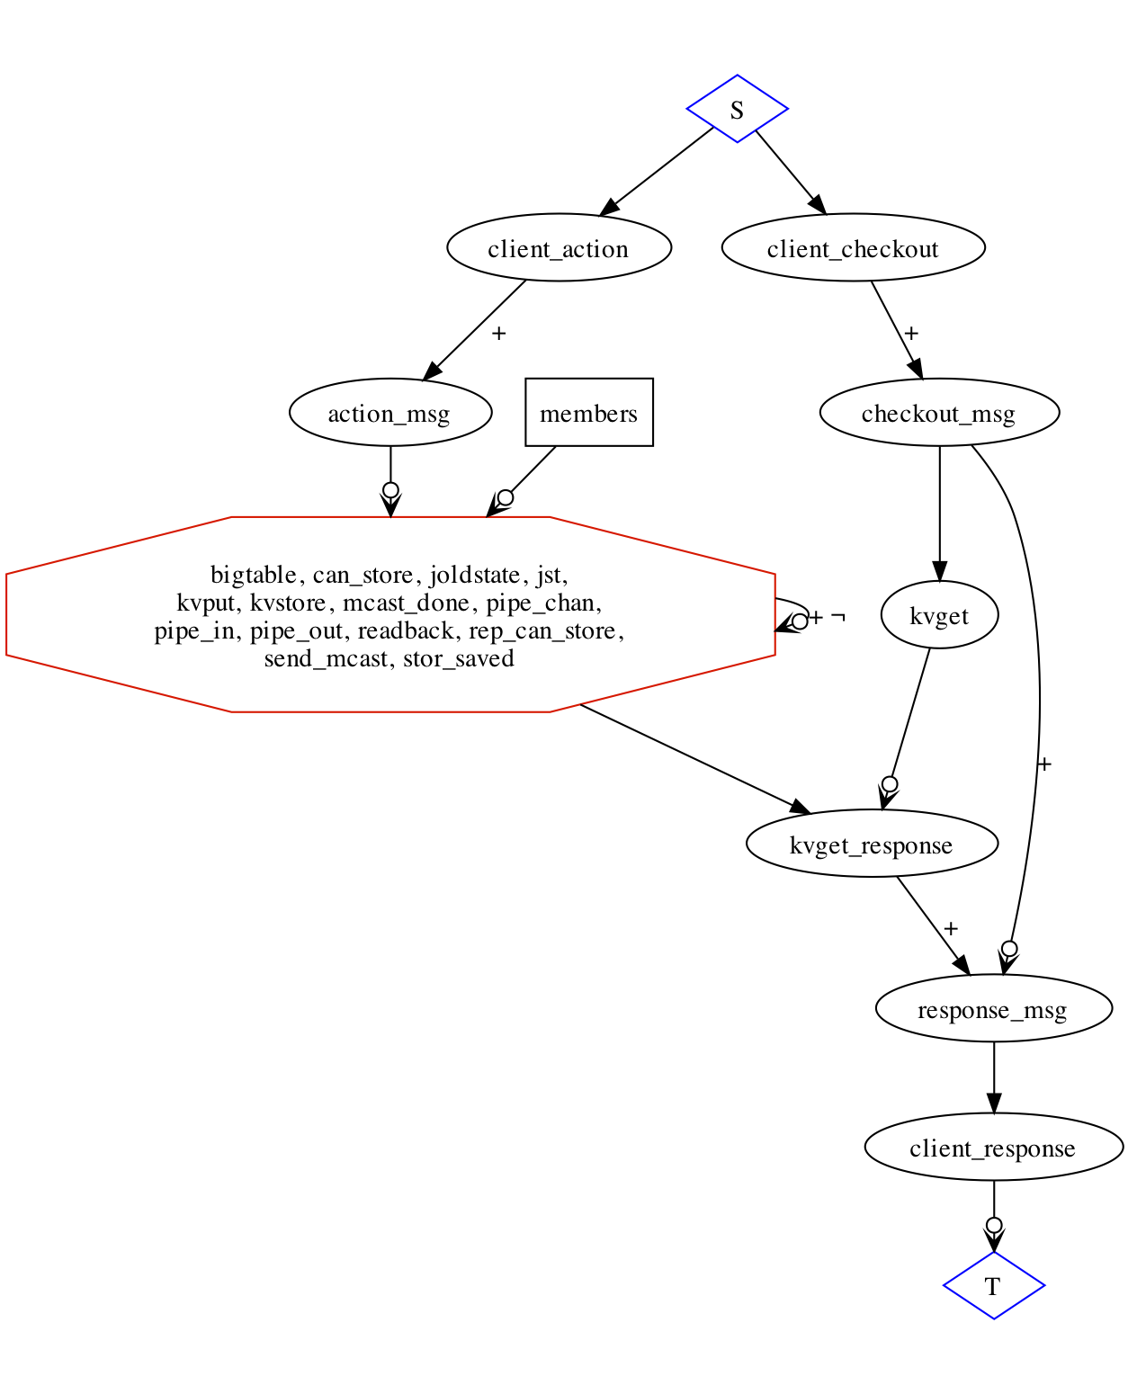
complete destructive cart
analysis: bad news
coordinate on each client action
add or delete
coordinate on each KVS replication
what if we skip coordination?
assert: actions are commutative
no way for compiler to check
and in fact it’s wrong!

Slide 58
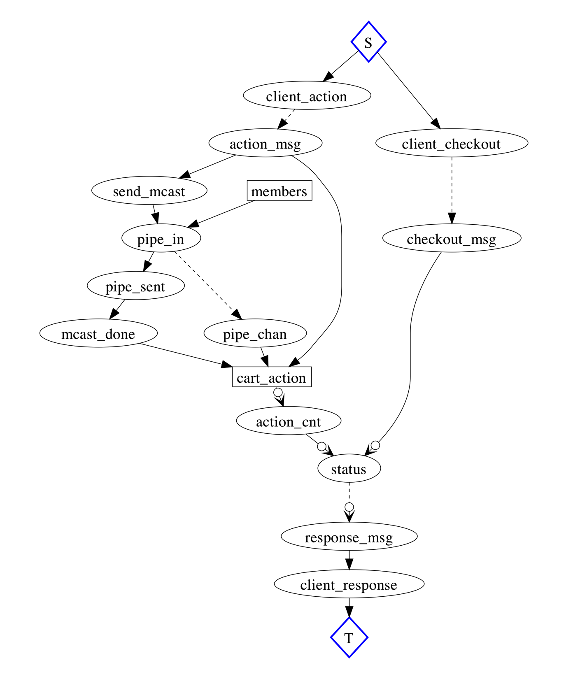
complete disorderly cart
client actions and cart replication all monotonic
point of order to handle checkout messages

Slide 59
final analysis: destructive
point of order on each client request for cart update
this was visible even with the simplest KVS
only got worse with replication
what to do?
assert that operations commute, and leave as is
informal, bug-prone, subject to error creep over time
there’s already a bug: deletes may arrive before adds at some replicas
add a round of distributed coordination for each update
e.g. 2PC or Paxos
this makes people hate ACID
best solution: a better cart abstraction!
move that point of order to a lower-frequency operation

Slide 60
simple disorderly skeleton
concrete implementation has points of order as abstraction
client updates and replication of cart state can be coordination-free
some coordination may be necessary to handle checkout messages

Slide 61
… and its composition with the client code
note points of order (circles) corresponding to aggregation

Slide 62
replication
module MulticastProtocol
def state
super
table :members, ['peer']
interface input, :send_mcast, ['ident'], ['payload']
interface output, :mcast_done, ['ident'], ['payload']
end
end
module Multicast
include MulticastProtocol
include DeliveryProtocol
include Anise
annotator :declare
declare
def snd_mcast
pipe_in <= join([send_mcast, members]).map do |s, m|
[m.peer, @addy, s.ident, s.payload]
end
end
declare
def done_mcast
# override me
mcast_done <= pipe_sent.map{|p| [p.ident, p.payload] }
end
end
We take the abstract class Multicast…

Slide 63
replication
module ReplicatedDisorderlyCart
include DisorderlyCart
include Multicast
include BestEffortDelivery
declare
def replicate
send_mcast <= action_msg.map do |a|
[a.reqid, [a.session, a.reqid, a.item, a.action]]
end
cart_action <= mcast_done.map {|m| m.payload }
cart_action <= pipe_chan.map{|c| c.payload }
end
end
… and extend the disorderly cart to use it (along with the concrete multicast implementation BestEffortDelivery)

Slide 64
final analysis: disorderly cart
concrete implementation has points of order as abstraction
client updates and replication of cart state can be coordination-free
some coordination may be necessary to handle checkout messages

