Slide 1

Provenance for Generalized
Map and Reduce Workflows
PANDA
Project
Robert Ikeda, Hyunjung Park, Jennifer Widom
Stanford University

Slide 2
Provenance
Where data came from
How it was derived, manipulated,
combined, processed, …
How it has evolved over time
Uses:
  Explanation
  Debugging and verification
  Recomputation

Slide 3
The Panda Environment
I₁
…
O
I_{n}
Data-oriented workflows
  Graph of processing nodes
  Data sets on edges
  Statically-defined; batch execution; acyclic

Slide 4
Provenance
Twitter
Posts
Movie
Sentiments
Backward tracing
  Find the input subsets that contributed to a given output element
Forward tracing
  Determine which output elements were derived from a particular input element

Slide 5
Provenance
Basic idea
  Capture provenance one node at a time
  (lazy or eager)
  Use it for backward and forward tracing
  Handle processing nodes of all types

Slide 6
Generalized Map and Reduce Workflows
R
M
M
R
M
What if every node
were a Map or Reduce function?
Provenance easier to define, capture, and exploit
than in the general case
Transparent provenance capture in Hadoop
  Doesn’t interfere with parallelism or fault-tolerance

Slide 7
Remainder of Talk
Defining Map and Reduce provenance
Recursive workflow provenance
Capturing and tracing provenance
System description and performance
Future work

Slide 8
Remainder of Talk
Defining Map and Reduce provenance
Recursive workflow provenance
Capturing and tracing provenance
System description and performance
Future work
Surprising theoretical result
Implementation details

Slide 9
Map and Reduce Provenance
Map functions
  M(I) = U_{i∈I} (M({i}))
  Provenance of o∈O is i∈I such that o∈M({i})
Reduce functions
  R(I) = U_{1≤ k ≤ n}(R(I_{k})) I₁,…,I_{n} partition I on reduce-key
  Provenance of o∈O is I_{k} ⊆ I such that o∈R(I_{k})

Slide 10
Workflow Provenance
I*₁ ⊆
I₁
R
M
E₁
…
…
o ∈ O
M
R
O
I*_{n} ⊆
I_{n}
M
E₂
Intuitive recursive definition
Desirable “replay” property
  o ∈ W(I*₁,…, I*_{n})
Usually holds, but not always

Slide 11



Replay Property Example
Twitter
Posts
M
R
R
#Movies
Per
Rating
TweetScan
Summarize
Count
Inferred
Movie Ratings
Rating
Medians
“Avatar was great”
“I hated Twilight”
“Twilight was pretty bad”
“I enjoyed Avatar”
“I loved Twilight”
“Avatar was okay”
Movie | Rating
Avatar | 8
Twilight | 0
Twilight | 2
Avatar | 7
Twilight | 7
Avatar | 4
Movie | Median
Avatar | 7
Twilight | 2
Median | #Movies
2 | 1
7 | 1

Slide 12
Replay Property Example
Twitter
Posts
M
R
R
#Movies
Per
Rating
TweetScan
Summarize
Count
Inferred
Movie Ratings
Rating
Medians
“Avatar was great”
“I hated Twilight”
“Twilight was pretty bad”
“I enjoyed Avatar”
“I loved Twilight”
“Avatar was okay”
Movie | Rating
Avatar | 8
Twilight | 0
Twilight | 2
Avatar | 7
Twilight | 7
Avatar | 4
Movie | Median
Avatar | 7
Twilight | 2
Median | #Movies
2 | 1
7 | 1

Slide 13
Replay Property Example
Twitter
Posts
M
R
R
#Movies
Per
Rating
TweetScan
Summarize
Count
Inferred
Movie Ratings
Rating
Medians
“Avatar was great”
“I hated Twilight”
“Twilight was pretty bad”
“I enjoyed Avatar
And Twilight too”
“Avatar was okay”
Movie | Rating
Avatar | 8
Twilight | 0
Twilight | 2
Avatar | 7
Twilight | 7
Avatar | 4
Movie | Median
Avatar | 7
Twilight | 2
Median | #Movies
2 | 1
7 | 1

Slide 14
Replay Property Example
Twitter
Posts
M
R
R
#Movies
Per
Rating
TweetScan
Summarize
Count
Inferred
Movie Ratings
Rating
Medians
“Avatar was great”
“I hated Twilight”
“Twilight was pretty bad”
“I enjoyed Avatar
And Twilight too”
“Avatar was okay”
Movie | Rating
Avatar | 8
Twilight | 0
Twilight | 2
Avatar | 7
Twilight | 7
Avatar | 4
Movie | Median
Avatar | 7
Twilight | 2
Median | #Movies
2 | 1
7 | 1

Slide 15
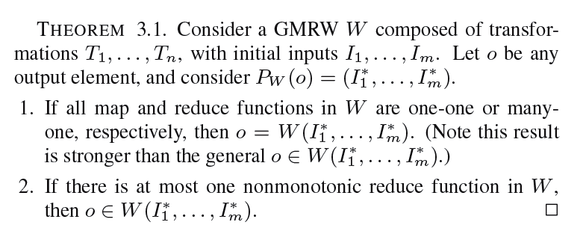
Replay Property Example
Twitter
Posts
M
R
R
#Movies
Per
Rating
TweetScan
Summarize
Count
Inferred
Movie Ratings
Rating
Medians
One-Many
Function
Nonmonotonic
Reduce
Nonmonotonic
Reduce
“Avatar was great”
“I hated Twilight”
“Twilight was pretty bad”
“I enjoyed Avatar
And Twilight too”
“Avatar was okay”
Movie | Rating
Avatar | 8
Twilight | 0
Twilight | 2
Avatar | 7
Twilight | 7
Avatar | 4
Movie | Median
Avatar | 7
Twilight | 2
Median | #Movies
2 | 1
7 | 1
7
2

Slide 16
Capturing and Tracing Provenance
Map functions
  Add the input ID to each of the output elements
Reduce functions
  Add the input reduce-key to each of the output elements
Tracing
  Straightforward recursive algorithms

Slide 17
RAMP System
Built as an extension to Hadoop
Supports MapReduce Workflows
  Each node is a MapReduce job
Provenance capture is transparent
  Retaining Hadoop’s parallel execution and fault tolerance
Users need not be aware of provenance capture
  Wrapping is automatic
  RAMP stores provenance separately from the input and output data

Slide 18
RAMP System: Provenance Capture
Hadoop components
  Record-reader
  Mapper
  Combiner (optional)
  Reducer
  Record-writer

Slide 19
RAMP System: Provenance Capture
Input
Input
_{Wrapper}
RecordReader
RecordReader
(k^{i}, v^{i})
p
(k^{i}, v^{i})
(k^{i}, 〈v^{i}, p〉)
_{Wrapper}
(k^{i}, v^{i})
Mapper
Mapper
p
(k^{m}, v^{m})
(k^{m}, v^{m})
(k^{m}, 〈v^{m}, p〉)
Map Output
Map Output

Slide 20
RAMP System: Provenance Capture
Map Output
Map Output
(k^{m}, [〈v^{m}₁, p₁〉,…, 〈v^{m}_{n}, p_{n}〉])
(k^{m}, [v^{m}₁,…,v^{m}_{n}])
_{Wrapper}
(k^{m}, [v^{m}₁,…,v^{m}_{n}])
Reducer
Reducer
(kº, vº)
(kº, vº)
(kº, 〈vº, k^{m}_{ID}〉)
_{Wrapper}
(kº, vº)
q
RecordWriter
RecordWriter
(k^{m}_{ID}, p_{j})
(q, k^{m}_{ID})
Output
Output
Provenance

Slide 21
Experiments
51 large EC2 instances (Thank you, Amazon!)
Two MapReduce “workflows”
  Wordcount
    Many-one with large fan-in
    Input sizes: 100, 300, 500 GB
  Terasort
    One-one
    Input sizes: 93, 279, 466 GB

Slide 22
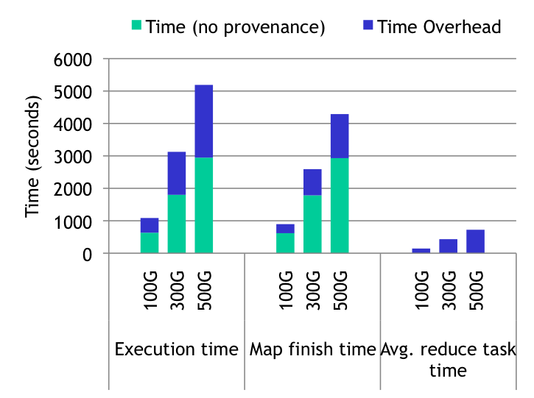
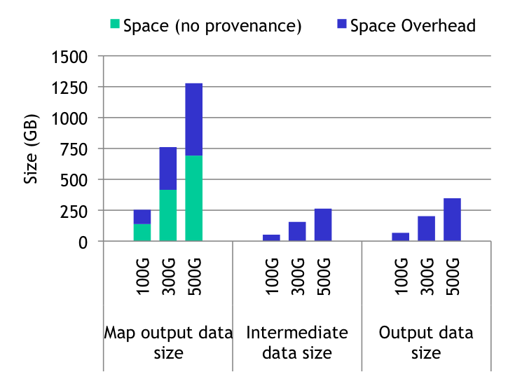
Results: Wordcount

Slide 23
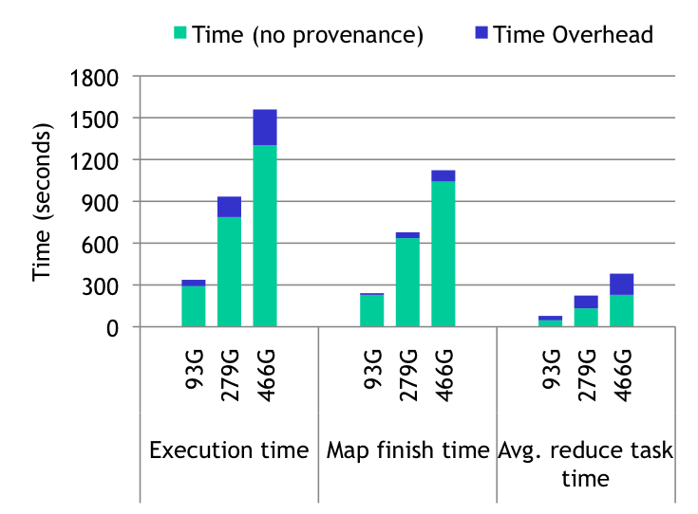
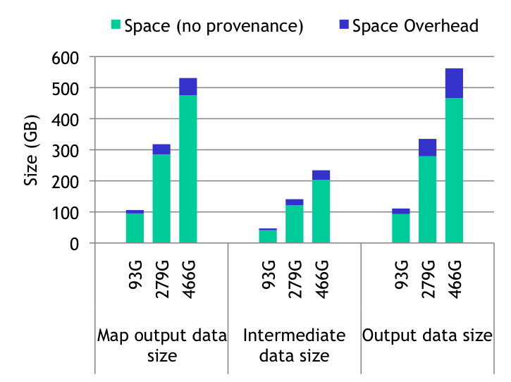
Results: Terasort

Slide 24
Summary of Results
Overhead of provenance capture
  Terasort
    20% time overhead, 21% space overhead
  Wordcount
    76% time overhead, space overhead depends directly on fan-in
Backward-tracing
  Terasort
    1.5 seconds for one element
  Wordcount
    Time directly dependent on fan-in

Slide 25
Future Work
RAMP
  Selective provenance capture
  More efficient backward and forward tracing
  Indexing
General
  Incorporating SQL processing nodes

Slide 26
PANDA
A System for Provenance and Data
“stanford panda”

