Slide 1

DBrev: Dreaming of a Database Revolution
Gjergji Kasneci, Jurgen Van Gael, Thore Graepel
Microsoft Research
Cambridge, UK

Slide 2



Uncertainty in Applications
Managing sensor data
Managing anonymized data
Information extraction
Information integration
(Approximate) Query Processing
Intelligent data management with following requirements:
Store, represent, retrieve data
Assess accuracy and confidence
Self diagnostic and calibration
+
DB & IR
Statistical ML

Slide 3
Main Issues
Provenance
Context Awareness
Ambiguity
Consistency
Retrieval & Discovery
Outrageous:
solve these problems simultaneously in integrated system…
→ DBrev

Slide 4
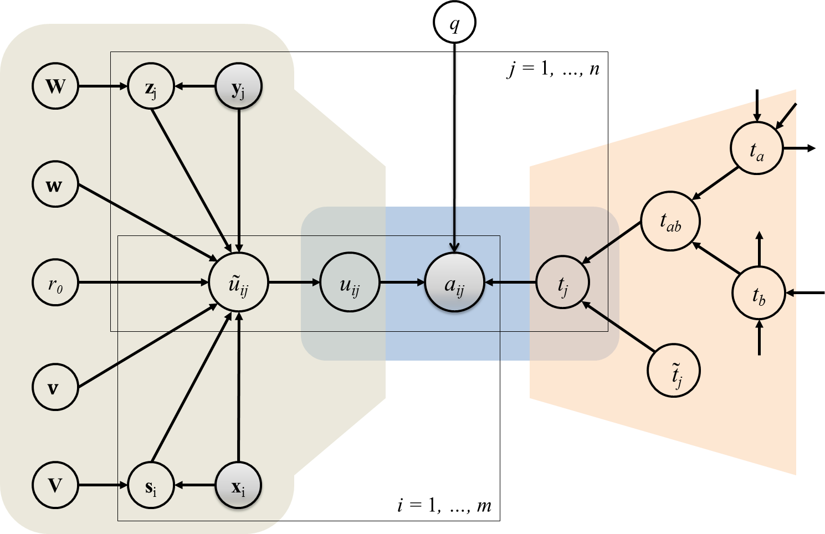
DBrev Exploits Large-Scale Graphical Model
Combine logical constraints and sources of evidence about knowledge fragments into belief
network, e.g.:
Sample Belief Network for Aggregating User Feedback and Expertise on Knowledge Fragments,
Kasneci et al.: WSDM’11

Slide 5
DBrev on Information Extraction and Integration
Data Provenance
Tracing derivation chain back to the sources
Closely related to consistency and curation
“… open problem in the presence of multiple sources” (Dalvi, Ré, Suciu: CACM’09)
Provenance through factor graphs in DBrev:

Slide 6
DBrev on Information Extraction and Integration
Data Provenance
Tracing derivation chain back to the sources
Closely related to consistency and curation
“… open problem in the presence of multiple sources” (Dalvi, Ré, Suciu: CACM’09)
Provenance through factor graphs in DBrev:
<MichaelJackson,
diedOn,
25-07-2009>
<MichaelJackson,
livesIn,
Ireland>
michaeljackson.com
f₁
f₂
f₁’
michaeljackson-
sightings.com
wikipedia.org/wiki/Michael_Jackson

Slide 7
DBrev on Information Extraction and Integration
Ambiguity & Context Awareness
Reasoning over contextual and background info, e.g. “The fruit flies like a banana.”
Problem lies at the heart of AI.
Are two recognized entities the same?
Ambiguity & Context in DBrev:

Slide 8

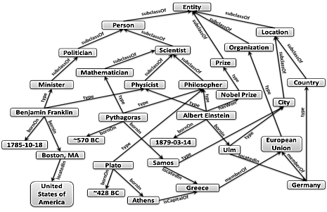

DBrev on Information Extraction and Integration
Ambiguity & Context Awareness
Reasoning over contextual and background info, e.g. “The fruit flies like a banana.”
Problem lies at the heart of AI.
Are two recognized entities the same?
Ambiguity & Context in DBrev:
Entity1
f
sameAs
f’
Statistical fingerprint
derived from the Web
Ontological description/
Semantic features
Entity
Entity2

Slide 9
DBrev on Information Extraction and Integration
Consistency
In DBs handled by universal constraints in FOL
E.g., transitive dependencies between tuples
What about more expressive logical constraints?
… can also support the lineage
Consistency in DBrev:
<A, R, B> ^ <B, R, C> ^ <R, type, Transitive> → <A, R, C>
Extracted Triple: (“x”, “r”, “y”)
refersTo(“x”, A) ^ refersTo(“y”, C) ^ canBeDeduced(A, R, C)
→ refersTo (“r”, R)

Slide 10
DBrev on Information Extraction and Integration
Consistency
In DBs handled by universal constraints in FOL
E.g., transitive dependencies between tuples
What about more expressive logical constraints?
… can also support the lineage
Consistency in DBrev:
^
^
<A, R, B> ^ <B, R, C> ^ <R, type, Transitive> → <A, R, C>
Extracted Triple: (“x”, “r”, “y”)
refersTo(“x”, A) ^ refersTo(“y”, C) ^ canBeDeduced(A, R, C)
→ refersTo (“r”, R)
v

Slide 11
DBrev on Information Extraction and Integration
Retrieval & Discovery
Search and rank knowledge
In probabilistic setting, ranking is the only meaningful search semantics (Ré, Dalvi, Suciu: VLDB’07, Weikum et al.: CACM’09).
Retrieval & Discovery in DBrev:
partnerOf
Microsoft
$x
locatedIn
US
certifiedBy
SPARQL / Conjunctive Datalog / NAGA

Slide 12
DBrev on Information Extraction and Integration
Retrieval & Discovery
Search and rank knowledge
In probabilistic setting, ranking is the only meaningful search semantics (Ré, Dalvi, Suciu: VLDB’07, Weikum et al.: CACM’09).
Approximate Matching
Entity / relationship similarity
Reasoning over relationship properties
Reasoning with temporal / spatial
constraints
Retrieval & Discovery in DBrev:
partnerOf
Microsoft
$x
locatedIn
US
User Preference
Information needs
freshness, accuracy, popularity
Interests
context, background, current interest
certifiedBy
SPARQL / Conjunctive Datalog / NAGA

Slide 13

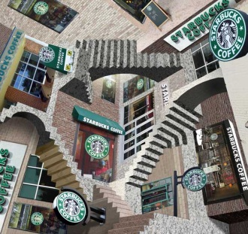

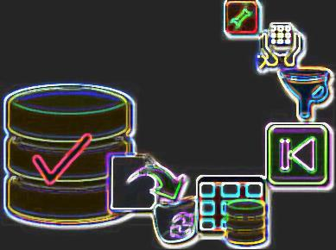

Summary
DBrev builds on large-scale factor graph to simultaneously approach:
Retrieval &
Discovery
provenance
context
ambiguity
consistency
An inspiration to combine…
+
DB & IR
Statistical ML
… for the challenges ahead.

