Slide 1
Deuteronomy: Transaction Support for Cloud Data
Justin Levandoski*
University of Minnesota
David Lomet
Microsoft Research
Mohamed Mokbel*
University of Minnesota
Kevin Zhao*
University of California San Diego
*work done while at Microsoft Research

Slide 2
Motivation
Want ACID transactions for data anywhere in cloud
Currently, cloud providers support:
Transactions for data guaranteed to exist on the same node
Eventual consistency
Currently no support for transactions “across the cloud”

Slide 3
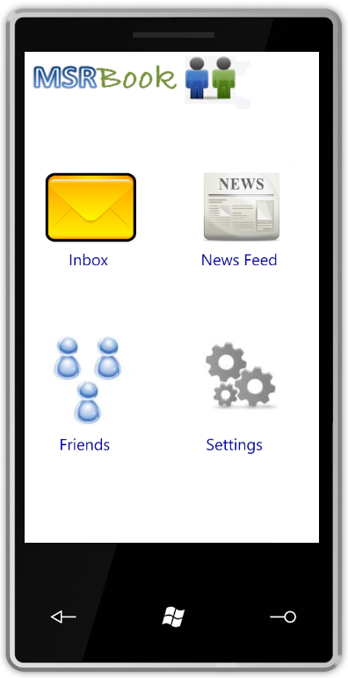

Application Motivation – Transactions Anywhere
My new mobile application
The Cloud

Slide 4
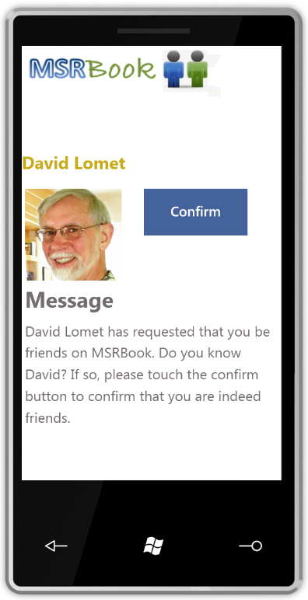
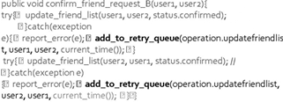
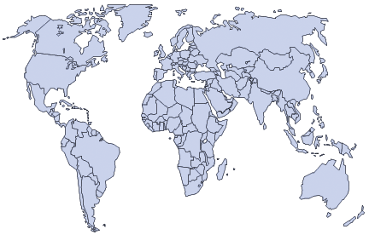

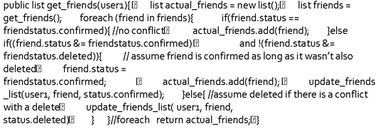
Application Motivation – Transactions Anywhere
What We Want
Begin Transaction
1. Add me to Dave’s friend list
2. Add Dave to my friend list
End Transaction
What We Have Today
Eventual consistency*
click
*Thanks to Divy Agrawal for example
Notes:
Reason current transaction support won’t work in this case: friend lists are partitioned by user, thus two users friend lists are never guaranteed to be on same node.
This is not the only application example
Shopping cart applications for any e-commerce site cannot think of using cloud storage (need transactions)-

Slide 5
Talk Outline
Application Motivation
Technical Motivation
Deuteronomy Architecture
Transaction Component Implementation
Performance
Wrap Up

Slide 6
Technical Motivation
CIDR 2009: “Unbundling Transaction Services in the Cloud” (Lomet et al)
Partition storage engine into two components
Transactional component (TC): transactional recovery and concurrency control
Data component (DC): tables, indexes, storage, and cache
DC₁
Application
TC
DC₂
CIDR 2011: “Deuteronomy: Transaction Support for Cloud Data”
Reduce number of round trips between TC and DC
Large latencies (Network overhead, context switching)
No caching at the TC

Slide 7
Technical Motivation
CIDR 2009 required logging before sending operation to DC
Drawback: requires two messages and/or double logging to perform operation (e.g., update)
TC
DC₁
1. Request before image
2. Return image
3. Log operation (generateLSN)
4. Send operation
5. Perform operation
6. Log operation success
Our new protocol logs after operation returns from DC
TC
DC₁
1. Locking (generate LSN)
2. Send operation
3. Perform operation and send back before image
4. Log operation
Must deal with LSNs out of order on log
Also required us to rethink TC/DC control protocol

Slide 8
Talk Outline
Application Motivation
Technical Motivation
Deuteronomy Architecture
Transaction Component Implementation
Performance
Wrap Up

Slide 9
Deuteronomy Architecture
Client Request
Interaction Contract
Transaction Component (TC)
Guarantee ACID Properties
No knowledge of physical data storage
Reliable messaging “At least once execution”
Idempotence “At most once execution”
Causality “If DC remembers message, TC must also”
Contract termination “Mechanism to release contract”
Logical locking and logging
Record
Operations
Control Operations
Data Component (DC)
Physical data storage
Atomic record modifications
Data could be anywhere (cloud/local)
Storage

Slide 10

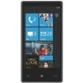

Client
Transaction Component
Session Manager
. . .
Session 1
Session 2
Session N
Log Manager
Lock Manager
Session
Table
Manager
Record
Manager
Meta-data Management
TC-DC Control Operations
TC-DC Control Operations
TC-DC Control Operations
TC-DC Control Operations
Record/ Table
Operations
Record/ Table
Operations
. . .
Record/ Table
Operations
Data Component 1
Data Component 2
Data Component N
Cloud Storage
Local Storage
Cloud Storage

Slide 11
Thread forking and pooling
Client
Transaction Component
Session Manager
Protect data structures
Block committing threads for log flush
Protect lock data from race condition.
Block threads for conflict
. . .
Session 1
Session 2
Session N
Thread aware and some thread management
Log Manager
Lock Manager
Session
Logical
locking
Logical
logging
Table
Manager
Record
Manager
Meta-data Management
Record/ Table operations
Record/ Table
Operations
Record/ Table
Operations
. . .
Record/ Table
Operations
Data Component 1
Data Component 2
Data Component N
Cloud Storage
Local Storage
Cloud Storage

Slide 12
Talk Outline
Application Motivation
Technical Motivation
Deuteronomy Architecture
Transaction Component Implementation
Performance
Wrap Up

Slide 13
Record Manager – An Insert Operation Example
Receive request and dispatch a session thread
Call to lock manager
Lock resource
Generate Log Sequence Number (LSN)
Sends LSN & operation to DC
Call to log manager
Log operation with LSN
1
Client & Session Manager
“insert record”
2
1
Log Record
Lock
Manager
Lock
Log
Manager
TC Record Manager
LSN
LSN
2
4
3
“insert record”, LSN
3
DC
4

Slide 14
Lock Manager
Deuteronomy locking hierarchy:
Support locking of range read by using partitions, not next key locking
SELECT * FROM Employees WHERE id > 10 AND id < 40 Partitions to lock [0, 30], [30, 60]
So that inserts DO NOT have to know or test the lock on next key
In charge of generating LSN before sending operation to data components
Table
Partition
Record

Slide 15
Log Manager
Different from conventional log manager in two aspects:
Need to coordinate TC’s log with DC’s cache
Write Ahead Logging: Which updates are allowed to be made stable at DC
Log truncation: Which updates must be made stable at DC
Complexity: LSNs are stored out-of-order on TC’s log, but DC only understands LSN
TC
LSN 5
LSN 4
LSN 3
LSN 2
LSN 1
DC
DC
DC
TC Physical Log
…
…
LSN 4
LSN 1
LSN 2
LSN 5
LSN 3
What can DC write to stable storage?
Log flushed
Not flushed

Slide 16
Control Operations: End-Of-Stable-Log
TC sends an LSN value eLSN from TC to all DCs
For DC:
Updates with LSN <= eLSN can be made stable.
Updates with LSN > eLSN must not be made stable and must be forgettable.
For TC: all log records with LSN <= eLSN must be flushed.
Flushed (stable)
Not flushed
Physical Log
LSN 4
LSN 1
LSN 2
LSN 6
LSN 3
LSN Vector
LSN 1
LSN 2
LSN 3
LSN 4
LSN 5
LSN 6
eLSN=2

Slide 17
The Deuteronomy Project
Built TC, DCs, test environment, and performed experiments
Different “flavors” of DCs implemented
Cloud DC
Windows Azure used as cloud storage
Collaborators: Roger Barga, Nelson Araujo, Brihadish Koushik, Shailesh Nikam
Flash DC
Storage manager from Communications and Collaboration Systems group at MSR
Collaborators: Sudipta Sengupta, Biplob Debnath, and Jin Li
TC
Cloud
DC
Flash
DC
Operation Log
Buffer Pool
Windows Azure
Flash Storage

Slide 18
Talk Outline
Application Motivation
Technical Motivation
Deuteronomy Architecture
Transaction Component Implementation
Performance
Wrap Up

Slide 19
Performance of TC
Adapted TPC-W benchmark
Controlled DC latencies from 2ms to 100ms
High latency requires high level of multithreading, which appears to impact throughput
Ideas on improving throughput
Threading mechanism
Implementation language from C# to C/C++

Slide 20
Conclusion
Application & Technical Motivations
Overview of project, teams, and development
Architecture of our multithreaded TC
A new TC:DC interface protocol to suit the cloud scenario
Experiments that show good performance and the impact of cloud latency on performance

