Slide 1
Cloud Resource Orchestration: A Data-Centric Approach
Yun Mao
AT&T Labs - Research
1/12/2011, CIDR
Joint work with Changbin Liu (UPenn),
Kobus Van der Merwe, Mary Fernandez

Slide 2

Cloud in 1991

Slide 3
Cloud in 2001
The Internet

Slide 4
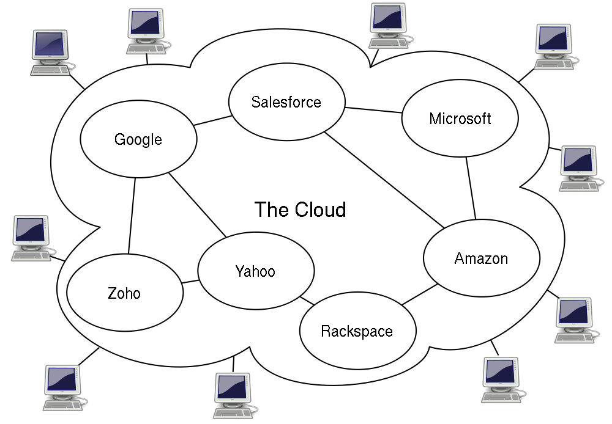
Cloud in 2011
Source: wikipedia
“Cloud computing”
{Infrastructure | Platform | Software} As A Service

Slide 5
Cloud: The Networking Play
Emerging Service Trend:
Virtual Private Cloud [HotCloud 2009]
Cloud Bursting [Eurosys 2009, LANMAN 2010]
Follow The Sun [LANMAN 2010]
…

Slide 6
Follow the sun: wide-area migration
San Francisco Data Center
Chicago Data Center
VM
Server
Server
West Coast
East Coast

Slide 7
Follow the sun: wide-area migration
San Francisco Data Center
Chicago Data Center
VM
Server
Server
West Coast
East Coast

Slide 8
Follow the sun: wide-area migration
San Francisco Data Center
Chicago Data Center
VM
Server
Server
West Coast
East Coast

Slide 9
Follow the sun: wide-area migration
San Francisco Data Center
Chicago Data Center
VM
Server
Server
West Coast
East Coast

Slide 10
What’s New: A Management Perspective “Behind the Scene”
Wide diversity of resources:
Compute (VMs), Storage, Networks, etc.
All with different APIs
Scale
Amazon EC2: ~40,000 servers [cloudscaling.com]
Increasing dynamics
Customers: fast resource acquire and release …
Providers: load balancing, power consumption reduction…
Far more dynamic than VPN and CDN services
Notes:
pay-on-the-go model, short-term usage, (e.g. vm create, reboot, migration)
Example of own experience with machine reboot

Slide 11
Wanted: Cloud Orchestration Platform
Reason about network-wide properties
Enforce engineering and operations policies
Deal with unexpected errors
Misconfigurations, transient network disconnections, power outage, volatile hardware...
Provide high concurrency without race condition
Existing solutions:
Mostly adhoc management script + human intervention
Prohibitively expensive in dynamic environment

Slide 12
Yesterday once more?
Database
Cloud Orchestration
Manage data stored on disks
Query processing
Atomic transactions
Consistency on integrity constraints
Isolation provides concurrency control
Manage data “stored” in
physical devices (configuration,
control state, etc)
Global reasoning
Handle unexpected errors
Policy enforcement
Concurrent orchestration

Slide 13
“This time it’s different.”
Cloud resources are not disks
Side effect
Be careful on replication and caching
Volatile
Crash / malfunction
Out-of-band channel
Costly to execute
Can we still build a transactional cloud orchestration platform?

Slide 14
Data-centric Management Framework (DMF)
queries
operations
transaction manager
query processor
DMF
stored procedures
global logical model
constraints
logical
layer
actions
weak
consistency
views
global physical model
physical
layer
actions
resource model
resource model
resource model
network devices
storage devices
compute devices

Slide 15
Data Model
class LRoot(dmf.LogicalModel):
vmRoot = dmf.One(LVmRoot)
storageRoot = dmf.One(LStorageRoot)
…
class LStorageRoot(dmf.LogicalModel):
hosts = dmf.Many(LStorageHost)
…
class LStorageHost(dmf.LogicalModel):
hostname = dmf.Attribute(str)
resources = dmf.Many(LStorageRes)
…
class LStorageRes(dmf.LogicalModel):
name = dmf.Attribute(str)
resRole = dmf.Attribute(StorageResRole)
…
semi-structured/tree model handles heterogeneity of resources well

Slide 16
Domain-Specific Language
Views: materialized queries
Constraints: policies
Actions
atomic operation
Implement on both logical and physical layers
Also declare undo action
Stored procedure
Transactions of queries + actions + procs

Slide 17
Code Sample
class LRoot(dmf.LogicalModel):
…
@dmf.constraint
def vmAlwaysOnPrimary(self):
return [("VM %s not running on Primary Storage", vm.name)
for host in self.vmRoot.hosts
for vm in host.domains
if self.storageRoot.hosts[host].resources[vm.storageRes].resRole
!= StorageResRole.Primary
]
…
@dmf.proc
def migrate(root, vmName, srcHost, destHost):
resName = root.vmRoot.hosts[srcHost].domains[vmName].storageRes
srcRes = root.storageRoot.hosts[srcHost].resources[resName]
destRes = root.storageRoot.hosts[destHost].resources[resName]
destRes.setResRole(StorageResRole.Primary)
root.vmRoot.migrate(vmName, srcHost, destHost)
srcRes.setResRole(StorageResRole.Secondary)
constraint
queries
3 actions in the transaction

Slide 18
Orchestration as Transactions
Logical layer: in-memory states of physical resources
vm2
storage2
vm2
storage2
Logical
Physical
Perform logical layer simulation before actual physical layer deployment
Enforce policy constraints to prevent misconfiguration before physical resources being tampered

Slide 19

Transaction: VM live migration
0. Check DRBD status
0. Check VM existence
Dst DRBD=> Primary
Migrate VM
Src => Secondary
Logical
PHY
Host_1
Host_2
DRBD storage
DRBD storage
VM
Primary
Secondary
Primary
Secondary

Slide 20
Rollback after errors occurred at physical layer
0. Check DRBD status
0. Check VM existence
Dst DRBD=> Primary
Migrate VM
Src => Secondary
Logical
PHY
Host_1
Host_2
DRBD storage
DRBD storage
VM
Secondary
Primary
Primary
Secondary
Automatic rollback through undo functions as if nothing happens.

Slide 21
Consistency
Strong consistency inside the logical layer
Before and after a transaction, constraints are always satisfied
Weak consistency cross layers
Best cases: start with same states, perform the same transaction, two layers end up with the same states. But…
Errors could occur during physical undo phase
Transient network disconnection
Physical state could be volatile
Host machines reboot
Out-of-band operations

Slide 22
Reconcile Cross-layer Inconsistency
Logical-only transaction (reload)
Accept physical layer, reload states into logical layer
use cases: e.g. new hardware
Physical-only transaction (repair)
Deny physical layer, repair physical layer to make it consistent with logical layer
Automatic with minimum human intervention
Use cases:
Transient network disconnection
VMs crash
Host machines reboot

Slide 23
Implementation
Framework prototype
Implementation in Python
Embedded query and constraint language
Resources modeling:
Entirely manual:
libvirt over Xen as compute
DRBD as storage: text config files + command-line interface
Semi-automatic:
Juniper router with XML schema
Manual: views, constraints on protocol dependency
Services:
Follow-the-sun migration cross data centers (Demo Available!!)

Slide 24
Summary
Resource Orchestration ≈ Data Management on Configuration and Control State
DMF: a framework for rapidly building reliable cloud services
(Semi-)structured data models
Transaction for orchestration
Ongoing work
Concurrency control
Decentralized architecture
Application of a lot database techniques
More services, large scale deployment

Slide 25
backup

Slide 26
Follow the sun: wide-area migration
Host_1
(San Francisco)
Server VM
Host_2
(Chicago)
Provisioning
VM
Storage
Network: VPLS VPN, default route
Migration
Step 1: migrate VM (simplified)
Step 2: update route
Decommissioning
VPLS
Router 1
Router 2
Internet

Slide 27
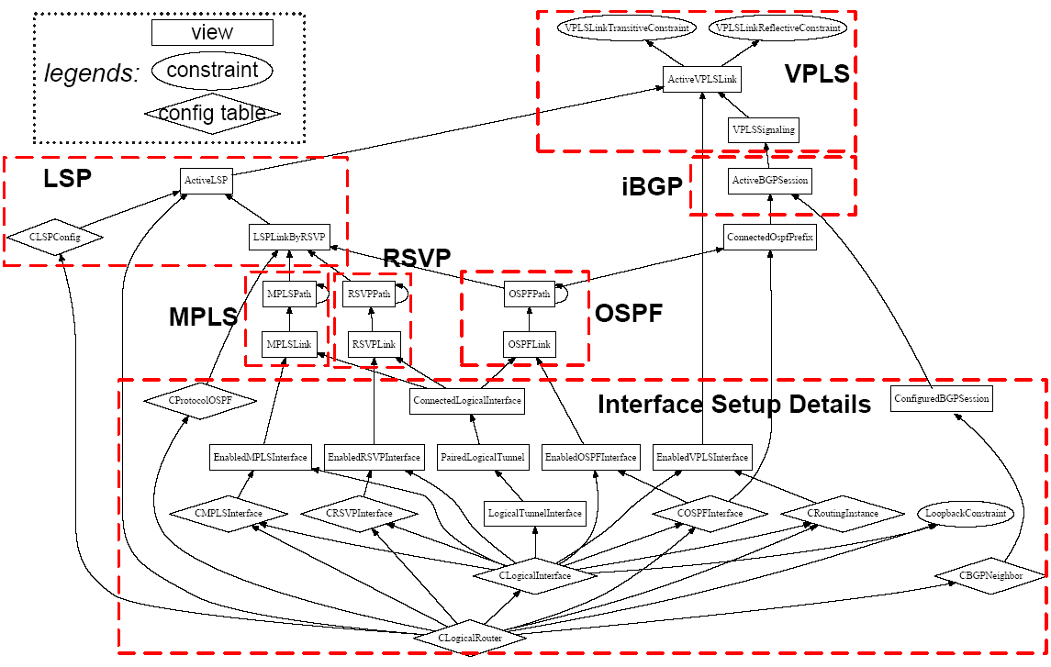
Provisioning VPLS: configuration dependency graph
Laboriously put together from reading manuals
Relatively small set of queries can concisely capture network wide rules and protocol dependencies + be used in systematic manner

Slide 28
Game Server Live Migration
Host_1
(San Francisco)
Server VM
Host_2
(Chicago)
Router 1
Router 2
A big detour!
Internet
Client
(West coast)
Client
(East coast)

Slide 29
Rollback: Game Server Live Migration
Host_1
(San Francisco)
Server VM
Host_2
(Chicago)
Router 1
Router 2
A big detour!
Internet
Client
(West coast)

