Slide 1
The FORWARD
SQL-Based Declarative Framework
for Ajax Applications
Yupeng Fu
Kian Win Ong
Kevin Zhao
Yannis Papakonstantinou
Michalis Petropoulos

Slide 2
Vast Majority of Web Applications: Issue simple SQL commands, reflect new state on browser
Browser
Submit
Web Application
App server data
in main memory
INSERT
Session
Objects
UPDATE
SELECT
Session
Objects
Session
Objects
DELETE
Database

Slide 3
The Paradox
Most web applications are fundamentally simple;
yet their development requires large amounts of code, both server-side* and client-side (JavaScript)
* Java, PHP, C#, Ruby etc.

Slide 4
Where is the extraneous code expended?
Low-level code addressing frictions
of the web application architectures
pre-2005: Pure server-side programming
Plumbing code addressing language heterogeneities
post-2005: Ajax (also Flash, Silverlight)
Data coordination code between Ajax page
and server state (main memory + database)

Slide 5
Pre-2005: Pure server-side programming: Tedious code to integrate across three languages and computation hosts
Code with JDBC/SQL calls to combine database and application-server data
HTML
DOM
Code to combine database and application server data into HTML
Browser
Application Server
Action
Page Computation
Request
Parameters
Java
Java
In MVC-coded applications of UCSD’s Web App programming class projects
60 lines of plumbing code for each line of SQL and 2 lines of control flow
INSERT INTO reviews …
SELECT *
FROM proposals…
SELECT *
FROM reviews …
Session
Objects
Session
Objects
Session
Objects
Database Server
Database
5

Slide 6
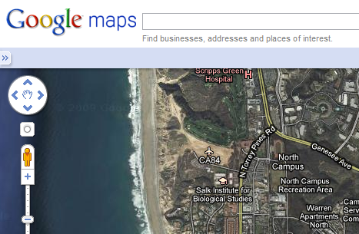
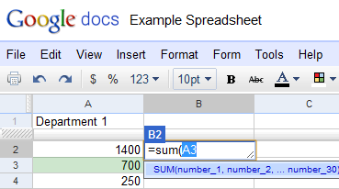
2005: Enter Ajax: A desktop feel to cloud-based applications
Asynchronous partial update of the page
Fancy JavaScript/Ajax components maps, calendars, tabbed windows

Slide 7
Ajax: Mundane data coordination between page state and server state (app server + database)
JavaScript/Java code
tuned to incrementally update HTML DOM & JavaScript components
HTML
DOM
JavaScript
Components
JavaScript components have different programmatic interfaces
JavaScript/Java code reflects page data & request parameters to the server
JavaScript
collect_args();
response_handler = function(){
partial_renderer(); }
send_request();
Diffs
Browser
Application Server
Action
Page Computation
Request
Parameters
Java
Java
Delta
Queries
INSERT INTO reviews …
SELECT *
FROM proposals…
SELECT *
FROM reviews …
Session
Objects
Session
Objects
Database Server
Database
7

Slide 8
For each action, yet another incremental page computation code and partial renderer
Pure Server-side Model
Ajax Model
Partial update requires different logic and imperative programming for each user action
Partial Renderer 1
Partial Renderer 2
Partial Renderer 3
Browser
Application Server
Action 1
Page Computation
Action 1
Page Computation 1
INSERT …
INSERT …
Action 2
Action 2
Page Computation 2
UPDATE …
UPDATE …
Action 3
Action 3
Page Computation 3
DELETE …
DELETE …
8

Slide 9
Goal of the FORWARD Web Application Programming Framework
Remove the architectural frictions
Plumbing code addressing language heterogeneities
Data coordination code between Ajax page and server state (app server main memory + database)
Make easy things easy while difficult things possible
Novelty: SQL-based declarative programming
“Unified application state” virtual database, comprising
entire application state
accessible via SQL++ distributed queries
Ajax page as a rendered SQL++ view that is automatically and incrementally maintained
Actions and pages use just SQL++, no Java or JavaScript
Automatic optimizations enabled

Slide 10
FORWARD Application: Set of declarative configurations, interpreted in a location-transparent way
Browser-side FORWARD JavaScript libraries
HTML
DOM
JavaScript
Components
FORWARD Interpreter (e.g., http://forward.ucsd.edu )
FORWARD Application nsf_reviewing
Action Configuration
Page Configuration
Action Configuration save_review
Page Configuration
review
Source Configurations & SQL++ Schema Definitions
Unified SQL++ Application State

Slide 11
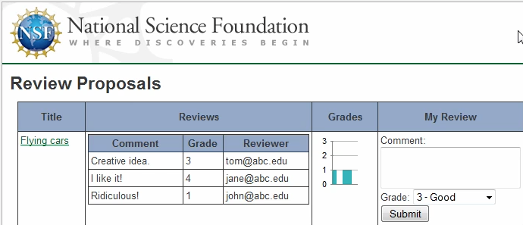
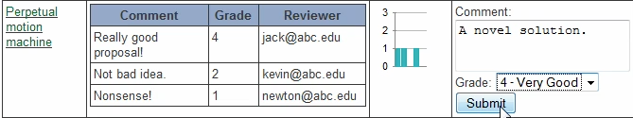
FORWARD Application: Operation
Browser-side FORWARD JavaScript libraries
HTML
DOM
JavaScript
Components
FORWARD Interpreter (e.g., http://forward.ucsd.edu )
FORWARD Application nsf_reviewing
Action Configuration
Page Configuration
Action Configuration save_review
Page Configuration
review
Source Configurations & SQL++ Schema Definitions
Unified SQL++ Application State

Slide 12
Actions Access Unified Application State via SQL++
Browser-side FORWARD JavaScript libraries
HTML
DOM
JavaScript
Components
SQL++ includes:
Nesting
Variability
Identity
Ordering
FORWARD Interpreter (e.g., http://forward.ucsd.edu )
Core page &
request parameters: Abstraction of relevant part of browser state
FORWARD Application nsf_reviewing
Action Configuration
Page Configuration
Action Configuration save_review
Page Configuration
review
Source Configurations & SQL++ Schema Definitions
Unified SQL++ Application State
Core Page
Database
Session
Objects
Action
Outputs
Request Parameters

Slide 13
Actions as Compositions of Services
no
Java
// Insert submitted review into reviews table of the hosted database
INSERT INTO hosted.reviews(proposalId, comment, rating)
VALUES (request.pid, request.myComment, request.myRating)
// Has the reviewer reviewed all assigned proposals
NOT EXISTS( SELECT * FROM … )
Action Configuration save_review
SQL++
update
failure
success
email
SQL++
condition
sent
yes
default
goto page:
error
goto page:
home
goto page:
review

Slide 14
Pages as Rendered SQL++ Views, with User Input Attributes
Browser-side FORWARD JavaScript libraries
HTML
DOM
JavaScript
Components
FORWARD Interpreter (e.g., http://forward.ucsd.edu )
FORWARD Application nsf_reviewing
Action Configuration
Page Configuration
Action Configuration save_review
Page Configuration
review
Source Configurations & SQL++ Schema Definitions
Unified SQL++ Application State

Slide 15
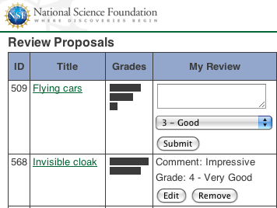
Page Configuration Follows Popular Frameworks: HTML + FORWARD statements & expressions, using SQL++
<fstmt:for query="
// proposals assigned to
// currently logged-in reviewer
SELECT p.id AS pid, p.title
FROM hosted.proposals AS p
WHERE EXISTS(
SELECT *
FROM hosted.assignments AS a
WHERE a.proposal = p.id
AND a.reviewer = session.user">
<tr>
...
<td>{pid}</td>
...
</tr>
</fstmt:for>
Overall structure reminiscent of XQuery and SQL/XML
15

Slide 16
Page Configuration: Ajax/JavaScript Components Simply by FORWARD Unit Tags
<fstmt:for query="
SELECT ...">
<tr>
...
<td>
<funit:bar_chart>
<bars>
<fstmt:for query="SELECT …">
<bar>
<id> {gid} </id>
<value> {score} </value>
</bar>
</fstmt:for>
</bars>
</funit:bar_chart>
</td>
...
After each action, the FORWARD interpreter automatically & incrementally updates
HTML and JavaScript components
16

Slide 17
Core Page and Request Parameters: Mirror of named page data
<fstmt:for name="proposals" query="
SELECT p.id AS pid, p.title
FROM hosted.proposals AS p
WHERE ...">
<tr>
...
<funit:editor name="myReview">
...
</funit:editor>
...
<funit:select name="myRating">
...
</funit:select>
...
<funit:button
onclick="save_review"/>
</tr>
</fstmt:for>
Core Page
proposals
pid | my_review | rating
Automatically inferred

Slide 18
Implementation Issues Summary
Incremental page maintenance:
Data: Deferred incremental SQL++ view maintenance
Visual units: Efficient wrapping of components from Dojo, Yahoo UI, Google Visualization, Stanford Protovis
Query optimization for distributed queries over small main memory sources and a large persistent database
Internal mappings, resolving heterogeneities
query results to visual state
visual state to core and request schemas

Slide 19
Related Work on Removing Cross-Layer Frictions
HTML
DOM
JavaScript
Components
Browser
ASP.NET,
GWT
Application server
?
Java (C#)
Browser Mirror Java (C#) Objects
Database Mirror Java (C#) Objects
App Server
Objects
Hibernate,
Entity Framework
Database server
SQL Data

Slide 20
Future work
Client side computation optimizations
enabled by declarativeness, location transparency
deliver efficiency, disconnected operation
Optimizations for updating a myriad views
leveraging pub-sub works
Visual Do-It-Yourself development

Slide 21
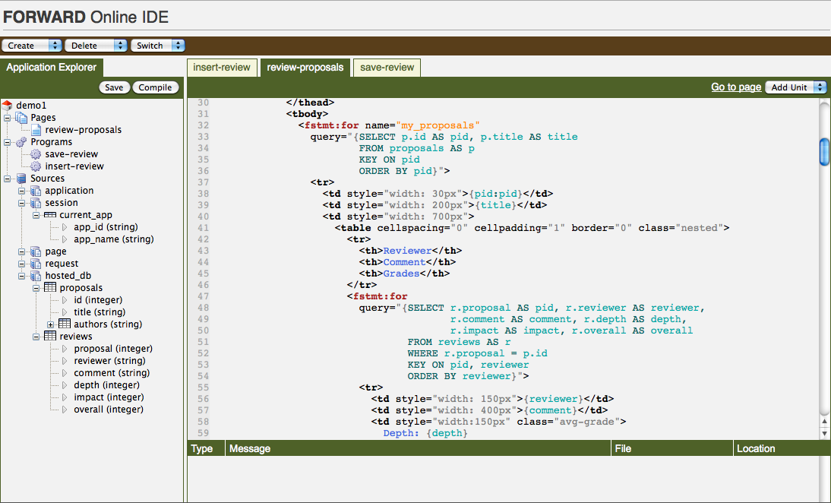
FORWARD Demo

