Slide 1
Answering Queries using Humans, Algorithms & Databases
Aditya Parameswaran
Stanford University
(Joint work with Alkis Polyzotis, UC Santa Cruz)
1/11/11

Slide 2
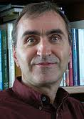
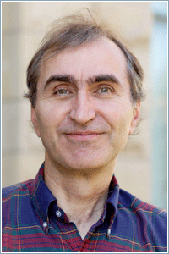
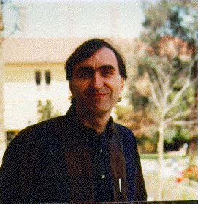
Why Crowd-source?
Many tasks are done better by humans
Understanding speech, images and language
Many people are online and willing to work
Several commercial marketplaces
Amazon’s Mechanical Turk, Odesk, LiveOps, …
Several programming libraries
TurKit, HPROC, …
Label/Tag
Identify
Description
Compare
Sort
Rank

Slide 3
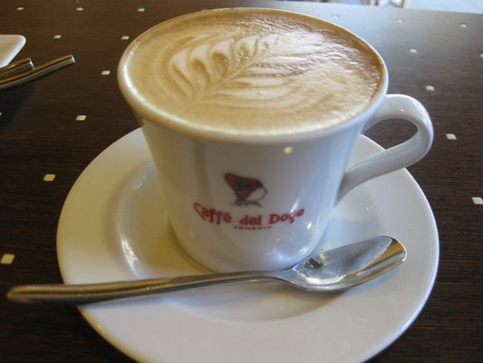

Example
Select top-k images for a restaurant from a user-submitted image DB
Must display food served in restaurant OR
Must display restaurant name
Not dark
Not copyrighted
Need to ask humans
Can use image processing algorithms for some cases
Can look up database containing meta-data

Slide 4
Example: Current Solution
Programmer does all the work
Implements calls to:
Crowd libraries, hand-coding:
Which tasks to run
On which items
In what order
For what price
Algorithms, since crowd latency may be high, specifying:
For which tasks, on which items and in what order
Relational data
Write code to :
Integrate obtained information
Deal with inconsistencies and incorrect answers from the crowd

Slide 5
Our Vision
Declarative Query Processing Engine
Query
Result
Data
Humans
Algorithms
Nothing out-of-the-ordinary for DB people!
Application only provides the UI to ask questions to humans
Remainder handled “under the covers” by the query optimizer
Application development becomes much simpler.

Slide 6
Outline for the Talk
Declarative Query Processing Engine
Query
Result
Data
Humans
Algorithms
Example Declarative Queries
Need for Redesign
Research Challenges + Initial ideas
Query Semantics
Physical Query Processing
Handling Uncertainty
Other Important Issues

Slide 7
Example Query
Find all jpg travel pictures: either large pictures of a clean beach, or pictures of a clean and safe city
4 types of predicates
r – relational predicates
a – algorithmic predicates
h – human predicates
UI for question is provided by the application.
ha – mixed (human / algorithmic) predicates
Can ask humans or can use algorithms
travel(I):= rJpeg(I), hClean(I), hBeach(I), aLarge(I)
travel(I):= rJpeg(I), hClean(I), haCity(I,C), rSafe(C)
Is this an image of a clean location?

Slide 8

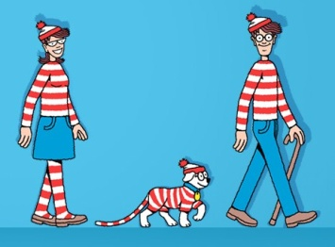
Other Examples
Find all images of people at the scene of the crime who also have a criminal record
suspects(N, I):=rCriminal(N, P), rScene(I), haSim(I,P)
rCriminal : database of known criminals, with images
haSim : evaluates presence of P in I
Then the results may be used for an aggregation: Find the best image for every criminal
topImg(N, hBest(<I>)):= suspects(N, I)
hBest : the top image
Do these images contain the same person?

Slide 9
Need for a New Architecture
uncertainty
Tradeoffs between
Performance,
Monetary cost, and
Uncertainty in query result
Unknown
Selectivities
Latency for both algorithms and humans
Uncertainty in answers
This combination of “evils” has never appeared before!
Plus, some other aspects that will become clear later
Uncertain databases
time
cost
Adaptive Query Optimization
User Defined Functions

Slide 10
Semantics of Query Model
uncertainty
We want “correct answers”
What is a correct answer?
Notion not clear:
Correlations and Inconsistencies
Mistakes and Lack of knowledge
We use a threshold on confidence to define correctness (later)
Three semantics:
Find all correct answers, minimizing cost and time
Find k correct answers, minimizing cost and time
Find as many as possible, and minimize time for fixed cost
time
cost

Slide 11
Query Proc. without Uncertainty
travel(I):= rJpeg(I), hClean(I), hBeach(I), aLarge(I)
travel(I):= rJpeg(I), hClean(I), haCity(I,C), rSafe(C)
Two-criteria optimization , e.g., cost & time
Selectivities are not known
Adaptive query optimization
Latency not known
Asynchronous execution
It is critical to reason about the Information gain of a question

Slide 12
Asking the right questions
travel(I):= rJpeg(I), hClean(I), hBeach(I), aLarge(I)
travel(I):= rJpeg(I), hClean(I), haCity(I,C), rSafe(C)
Prefer questions affecting more tuples “downstream”
If all correct answers needed :
Prefer selective questions
If k correct answers needed :
Prefer non-selective questions leading to answers
For complex tasks
Need to subdivide into questions that maximize information gain
e.g., Classify, Cluster, Categorize
We studied this problem carefully for graph search
Human-assisted graph search: It’s okay to ask questions, VLDB ‘11

Slide 13
Query Proc. without Uncertainty
Intra and inter-stage optimization
Stage 1
Stage 2
Perform computations on relational data
Issue a set of asynchronous questions to
Crowd
Algorithms
Collect results from previous stages
Prefer algorithmic and relational questions
Stage 3
……
Stage n

Slide 14
Uncertainty
Sources:
Intra-predicate correlation
Inter-predicate correlation
Subjective views, random mistakes
Lack of knowledge
Only want correct answers (confidence > τ)
Standard techniques are insufficient!
travel(I):= rJpeg(I), hClean(I), hBeach(I), aLarge(I)
travel(I):= rJpeg(I), hClean(I), haCity(I,C), rSafe(C)
answers to two images I for hClean
answer to I for hBeach is YES → NO for haCity

Slide 15
How do we compute confidence?
Scheme 1: Majority voting
Each question attempted by c humans
Majority answer taken as the correct answer
Scheme 2: Homogeneous worker population
Per question, each worker is IID from a distribution
No cross-correlations
Infer distribution based on answers of workers
Scheme 3: Item Response Theory

Slide 16
Other Important Aspects
Pricing
Must price tasks so that they complete
“Important”, “harder” tasks priced higher
Spam
Test questions or a Gold standard
Reputation systems for workers
Choosing UI questions for predicates

Slide 17
From Tasks to UI Questions
suspects(N, I):= rCriminal(N, P), rScene(I), haSim(I,P)
topImg(N, hBest(<I>)):= suspects(N, I)
The choice of the UI affects:
The number of UI questions (thus, the cost)
The overall uncertainty of the answer
Latency
Complex tasks:
Sort, Top-k, Max
Compare
Sort
Are the two images alike?
Match similar images from the two sets
I₁
I₂
I₃
I₁
I₂
I₁
I₂
I₃
J₁
J₂
J₃
I₁
J₁

Slide 18
Conclusions
Using human computation within the database
Important and challenging new research area for DB people
Requires a careful redesign of the DBMS
More parameters/tradeoff that we need to keep track of
Vision of the sCOOP project
(System for COmputing with and Optimizing People)
Look out for our paper at VLDB in Seattle!
Human-assisted Graph Seach: It’s okay to ask questions!
By: A. Parameswaran, A. Das Sarma, H. Garcia-Molina,
N. Polyzotis and J. Widom

