Slide 1
IQ: Iterative Querying for Knowledge
Yosi Mass IBM-Haifa and The Hebrew University, Israel
Maya Ramanath Max-Planck Institute for Informatics, Germany
Yehoshua Sagiv The Hebrew University, Israel
Gerhard Weikum Max-Planck Institute for Informatics, Germany

Slide 2
Querying for Knowledge
The Web is the largest repository of information
Tell me something about classical music composers who have composed music for films.

Slide 3
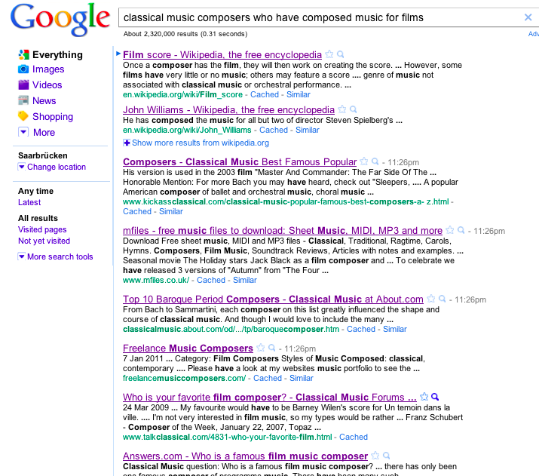
Information is not easily useable
Extract and organize entities, relationships, classes
Keywords are not enough
Advanced queries
What do I do next ?

Slide 4
Knowledge-base in RDF
Subject | Predicate | Object
Ennio_Morricone | hasType | Composer
Ennio_Morricone | hasType | Classical_Composer
Ennio_Morricone | composedFor | A_Fistful_of_Dollars
A_Fistful_of_Dollars | directedBy | Sergio_Leone
A_Fistful_of_Dollars | hasGenre | Western
Clint_Eastwood | actedIn | A_Fistful_of_Dollars
Nino_Rota | hasType | Classical_Composer
Nino_Rota | composedFor | The_Godfather
Nino_Rota | bornIn | Milan
Nino_Rota | wonAward | Academy_Award
The_Godfather | hasGenre | Drama

Slide 5
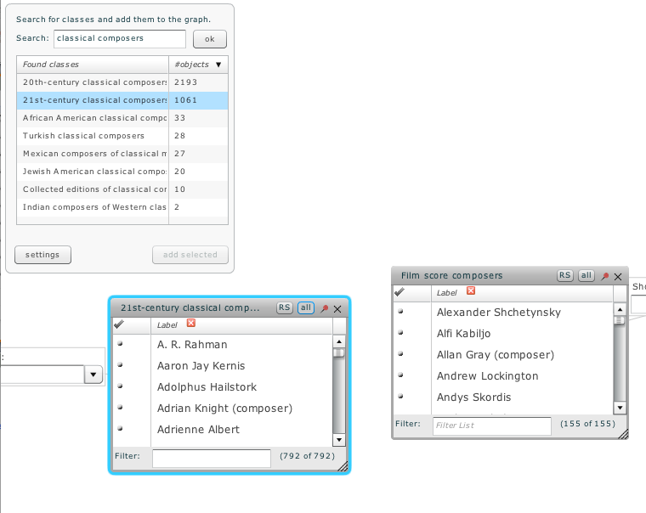

1 billion triples
3.4 million entities
What can I do next?
Keywords still not enough
Lacks textual information

Slide 6
What we want…
Data | Query | System
Text-only, structure-only are inadequate | Text queries are good, but inadequate | Users cannot find answers in one shot
Structure+text is ideal | Keep interface, but have API | Support iterative querying

Slide 7
Data and Query, Iterative Querying

Slide 8
Knowledge-base in RDF
Subject | Predicate | Object
Ennio_Morricone | hasType | Composer
Ennio_Morricone | hasType | Classical_Composer
Ennio_Morricone | composedFor | A_Fistful_of_Dollars
A_Fistful_of_Dollars | directedBy | Sergio_Leone
A_Fistful_of_Dollars | hasGenre | Western
Clint_Eastwood | actedIn | A_Fistful_of_Dollars
Nino_Rota | hasType | Classical_Composer
Nino_Rota | composedFor | The_Godfather
Nino_Rota | bornIn | Milan
Nino_Rota | wonAward | Academy_Award
The_Godfather | hasGenre | Drama
SPARQL queries
SELECT ?s WHERE {
?s hasType ?o }
SELECT ?s, ?o WHERE {
?s ?p Milan .
?o wonAward AcademyAward .
?s ?composedFor ?o }

Slide 9
Knowledge-base with Context
Subject | Predicate | Object | Context
Ennio_Morricone | hasType | Composer | …
Ennio_Morricone | hasType | Classical_Composer | …
Ennio_Morricone | composedFor | A_Fistful_of_Dollars | …
A_Fistful_of_Dollars | directedBy | Sergio_Leone | Fistful of Dollars (Italian: Per un pugno di dollari) is a 1964 Italian-Spanish Spaghetti Western film directed by…
A_Fistful_of_Dollars | hasGenre | Western
Clint_Eastwood | actedIn | A_Fistful_of_Dollars | …
Nino_Rota | hasType | Classical_Composer | Nino Rota (December 3, 1911, Milan – April 10, 1979, Rome) was an Italian composer and academic who is best known for his film scores, notably for the films of Federico Fellini and Luchino Visconti. He also composed the music for two of Franco Zeffirelli's Shakespeare films, and for the first two films of Francis Ford Coppola's Godfather trilogy, receiving for the latter the Academy Award…
Nino_Rota | composedFor | The_Godfather
Nino_Rota | bornIn | Milan
Nino_Rota | wonAward | Academy_Award
The_Godfather | hasGenre | Drama | …

Slide 10
Extending SPARQL
Subject | Predicate | Object | Context
Ennio_Morricone | hasType | Composer | …
Ennio_Morricone | hasType | Classical_Composer | …
Ennio_Morricone | composedFor | A_Fistful_of_Dollars | …
A_Fistful_of_Dollars | directedBy | Sergio_Leone | Fistful of Dollars (Italian: Per un pugno di dollari) is a 1964 Italian-Spanish Spaghetti Western film directed by…
A_Fistful_of_Dollars | hasGenre | Western
Clint_Eastwood | actedIn | A_Fistful_of_Dollars | …
Nino_Rota | hasType | Classical_Composer | Nino Rota (December 3, 1911, Milan – April 10, 1979, Rome) was an Italian composer and academic who is best known for his film scores, notably for the films of Federico Fellini and Luchino Visconti. He also composed the music for two of Franco Zeffirelli's Shakespeare films, and for the first two films of Francis Ford Coppola's Godfather trilogy, receiving for the latter the Academy Award…
Nino_Rota | composedFor | The_Godfather
Nino_Rota | bornIn | Milan
Nino_Rota | wonAward | Academy_Award
The_Godfather | hasGenre | Drama | …
SELECT ?c WHERE {
?c hasType Composer {“Italian”}
}

Slide 11
Iterative Querying
Exploration
Understand and express query intent precisely
Filtering and refinement
Choose interesting subsets of results
Refine query if needed
Aggregation
Organizing result set

Slide 12
Exploration with SPARQL (CIKM ’09, TechReport ‘10)
composers who have composed music for films
SELECT ?c, ?f WHERE {
?c hasType composer .
?f hasType film .
?c composedMusicFor ?f }
SELECT ?c, ?f WHERE {
?c hasType composer .
?f hasType film .
?c ?prop ?f }
SELECT ?c, ?f WHERE {
?c hasType composer .
?f hasType film .
?c directedMusicFor ?f }
SELECT ?c, ?f WHERE {
?c hasType composer .
?f hasType movie.
?c ?prop ?f }

Slide 13
Filter and Refine – context (DEB ‘10)
classical music composers who have composed music for westerns.
SELECT ?c, ?f WHERE {
?c hasType composer .
?f hasType film .
?c composedMusicFor ?f }
SELECT ?c, ?f WHERE {
?c hasType composer .
?f hasType film .
?c ?prop ?f }
SELECT ?c, ?f WHERE {
?c hasType composer {“classical music”} .
?f hasType film .
?c composedFor ?f }
SELECT ?c, ?f WHERE {
?c hasType composer {“classical music”} .
?f hasType film {“gun fight”, “wild west”} .
?c composedMusicFor ?f }
SELECT ?c, ?f WHERE {
?c hasType composer {“classical music”} .
?f hasType film {“westerns”,“gun fight”,“wild west”} .
?c ?prop ?f {“compose”} }

Slide 14
Exploration with keywords
User prefers keywords
No good translation from user‘s query
composers who have composed music for films
Query consists of keywords: “compose, music, film”
hasType
hasType
Ennio_Morricone
composer
Mozart
Classical_composer
A_Fistful_of_Dollars
hasMusicFrom
composedMusicFor
Alien
film
hasType
Sci-fi
hasGenre
?x hasType composer
?x composedMusicFor ?y
?y hasType film
hasType
Film_genre
Notes:
Ennio_Morricone hasType composer
Ennio_Morricone composedMusicFor A_Fistful_of_Dollars
A_FistfulA_Fistful_of_Dollars hasType film
Beethoven hasType Classical_Composer
Xxxx hasMusicFrom Beethoven
Xxxx hasGenre Romance
Romance isa Film_Genre
BritneySpears hasType Singer
Singer subClassOf Musician
Yyy hasType Film
BritneySpears composedFor yyy

Slide 15
Filtering and Refinement (SIGMOD ‘10)
More from the same schematic
More from the same schematic, but…
hasType
hasType
Ennio_Morricone
composer
Ennio_Morricone
composer
composedMusicFor
A_Fistful_of_Dollars
composedMusicFor
A_Fistful_of_Dollars
film
hasType
film
hasType
Results from this schematic too, but…
hasType
Classical_composer
Mozart
hasMusicFrom
Alien
“Western”,
“gun fight”,
“wild west”
Sci-fi
hasGenre
hasType
Film_genre
Notes:
No chance for serendipitous discovery – “award-winning composers only”

Slide 16
Aggregating Results – Ranking (CIKM ‘09)
Setting
Data: Structure+text
Query: Structure+text
Notion of importance
“Popularity” (knowledge-base is incomplete)
Confidence in facts (where did the facts come from and how)
Personalization
Multiple queries to consider
Exploratory queries could contain many variants
Composers X and Y compose for Westerns
Composer X is famous, not Y
Composer Y has context classical composer
Composers X directed music for Westerns, Y composed music for them
Composer X is famous, not Y

Slide 17
Conclusion
Knowledge-bases have the potential to answer advanced user queries
The data should have both structured as well as textual components, so does the query
Many queries cannot be answered one-shot. We need iterative querying
Exploration
Filter and Refine
Aggregate

