Slide 1







Insert name
Data Consistency Properties and the Trade-offs in Commercial Cloud Storages: the Consumers’ Perspective
H. Wada, A. Fekete, L. Zhao, K. Lee and A. Liu
NICTA (National ICT Australia)
U. of New South Wales
U. of Sydney
Insert Title

Slide 2

NoSQL is Winning Acceptance
NoSQL (Not Only SQL)
  Emerged to complement traditional database systems
  SimpleDB, Google Datastore, Azure Storage, Cassandra, …
  Some are private use, others provided as data store service
Designed to achieve high scalability and high availability for essential functionalities, trading off for some features of traditional DBMS
  No relational data model, no joins, limited or no transaction
May offer weaker data consistency such as Eventual Consistency
  This design choice is often explained by the CAP theorem: Pick partition-tolerance and availability
<number> / 20

Slide 3
Eventual Consistency
A model originally proposed for disconnected operation (e.g., mobile computing)
Different nodes keep replicas and each update is “eventually” propagated to each replica
  And eventually, there is agreement on which update is the latest
  DNS is the most well-known system implementing eventual consistency
Usual definition is counterfactual:
“once updating ceases, and the system stabilizes, then after a long enough period, all replicas will have the same value”
<number> / 20

Slide 4
Extra Properties of Eventual Consistency
Programming an application is much harder if storage supports only eventual consistency
  What to do until everything settles down??
  Handling inconsistency in the sequence of reads
  Cf Hellerstein et al PODS’10/CIDR’11: eventual consistency data model supports monotonic programs (a very limited class)
A range of extra properties, which (if the storage provides this) can make programming not quite so hard
  e.g., read-your-own-writes, monotonic reads, …
<number> / 20

Slide 5
Our Research Objective: Consistency from the Consumer’s Perspective
Investigate consistency models provided by commercial NoSQLs in cloud
  If weak, which extra properties supported? How often and in what circumstances is inconsistency (stale values) observed?
  Any differences between what is observed and what is announced from the vendor?
Investigate the benefits for consumer of accepting weaker consistency models
  Are the benefits significant to justify consumers’ effort?
  When vendor offers choice of consistency model, how do they compare in practice?
<number> / 20

Slide 6
Platforms we observed
A variety of commercial cloud NoSQLs that are offered as storage service
  Amazon S3
    Two options: Regular and Reduced redundancy (durability)
  Amazon SimpleDB
    Two options: Consistent Reads and Eventual Consistent Reads
  Google App Engine datastore
    Two options: Strong and Eventual Consistent Reads
  Windows Azure Table and Blob
    No option available in data consistency
<number> / 20

Slide 7
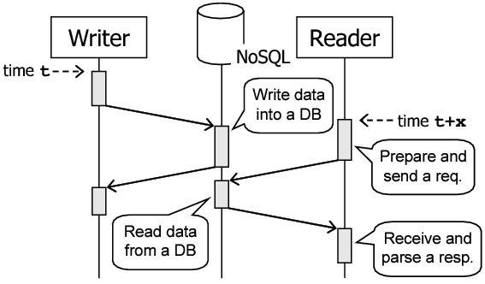
Frequency of Observing Stale Data
Experimental Setup
  A writer updates data once each 3 secs, for 5 mins
    On GAE, it runs for 27 seconds
  A reader(s) reads it 100 times/sec
    Check if the data is stale by comparing value seen to the most recent value written
    Plot against time since most recent write occurred
  Execute the above once every hour
    On GAE, every 10 min
    For at least 10 days
    Done in Oct and Nov, 2010
<number> / 20

Slide 8
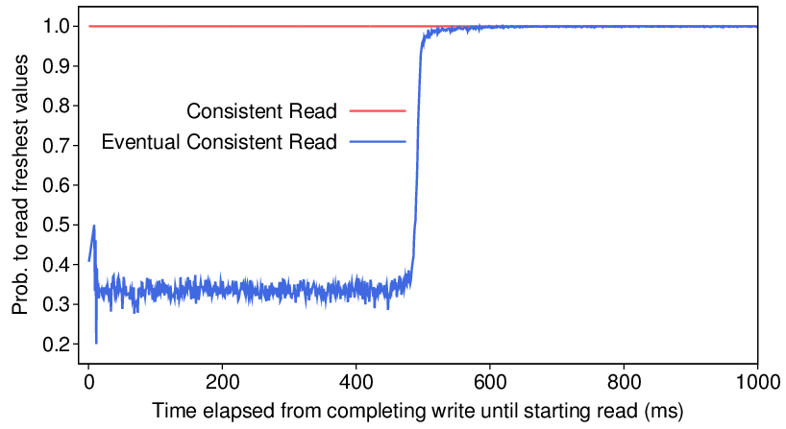
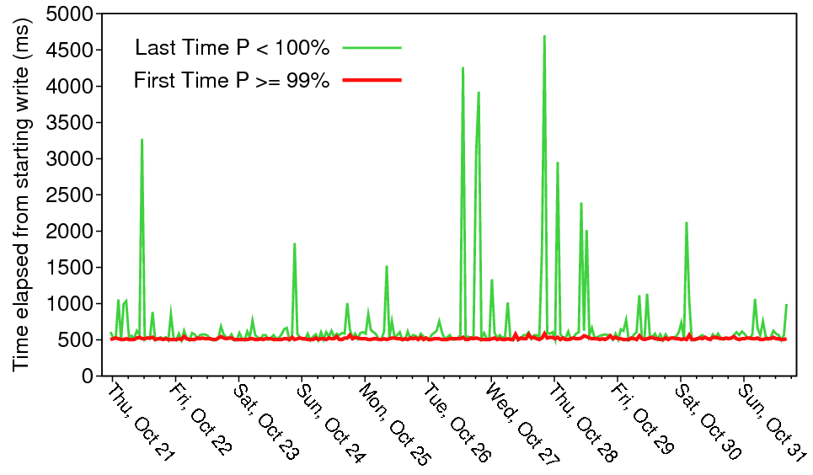
SimpleDB: Read and Write from a Single Thread
With eventual consistent read, 33% of chance to read freshest values within 500ms
  Perhaps one master and two other replicas. Read takes value randomly from one of these?
First time for eventual consistent read to reach 99% “fresh” is stable 500ms
Outlier cases of stale read after 500ms, but no regular daily or weekly variation observed
<number> / 20

Slide 9
Stale Data in Other Cloud NoSQLs
Cloud NoSQL and Accessing Source | What Observed
SimpleDB (access from one thread, two threads, two processes, two VMs or two regions) | Accessing source has no affect on the observable consistency. Eventual consistent reads have 33% chance to see stale value, till 500ms after write.
S3 (with five access configurations) | No stale data was observed in ~4M reads/config. Providing better consistency than SLA describes.
GAE datastore (access from a single app or two apps) | Eventual consistent reads from different apps have very low (3.3E⁻⁴ %) chance to observe values older than previous reads. Other reads never saw stale data.
Azure Storages (with five access configurations) | No stale data observed. Matches SLA described by the vendor (all reads are consistent).

Slide 10
Additional Properties:
Read-Your-Writes?
Read-your-writes: a read always sees a value at least as fresh as the latest write from the same thread/session
Our experiment: When reader and writer share 1 thread, all reads should be fresh
SimpleDB with eventual consistent read: does not have this property
GAE with eventual consistent read: may have this property
  No counterexample observed in ~3.7M reads over two weeks
<number> / 20

Slide 11
Additional Properties:
Monotonic Reads?
Monotonic Reads: Each read sees a value at least as fresh as that seen in any previous read from the same thread/session
Our experiment: check for a fresh read followed by a stale one
SimpleDB: Monotonic read consistency is not supported
  In staleness, two successive
  eventual consistent reads are
  almost independent
  The correlation between staleness
  in two successive reads (up to 450ms
  after write) is 0.0218, which is very low
GAE with eventual consistent read: not supported
  3.3E⁻⁴ % chance to read values older than previous reads
 | 2nd Stale | 2nd Fresh
1st Stale | 39.94% (~1.9M) | 21.08% (~1.0M)
1st Fresh | 23.36% (~1.1M) | 15.63% (~0.7M)
<number> / 20

Slide 12
Additional Properties:
Monotonic Writes?
Monotonic Writes: Each write is completed in a replica after previous writes have been completed
Programming is “notoriously hard” if monotonic write consistency is missing
  W. Vogels. Eventually consistent. Commun. ACM, 52(1), 2009.
This is an implementation property, not directly visible to consumer. But we explore what happens when we do successive writes, and try to read the data
<number> / 20

Slide 13
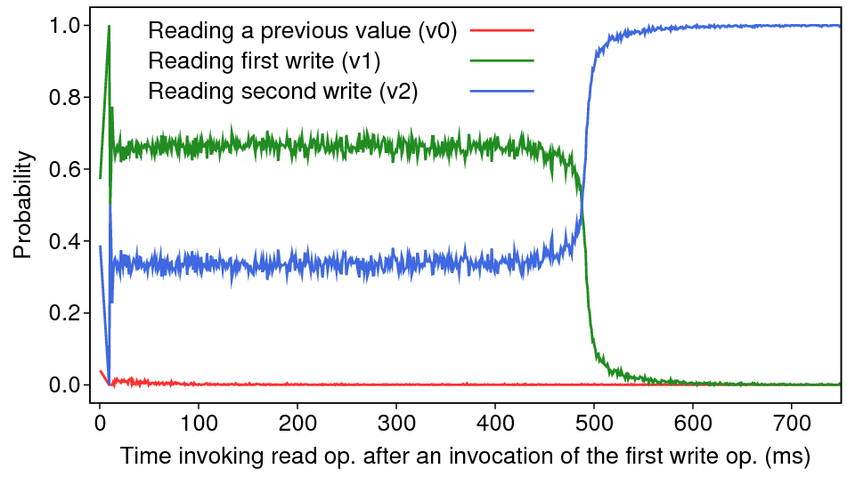
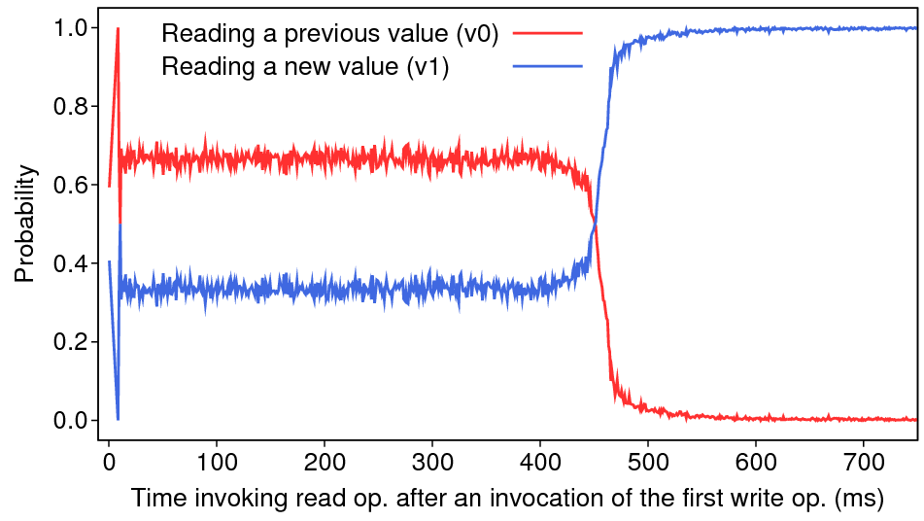
SimpleDB’s Eventual Consistent Read:
Monotonic Write
A data has value v0 before each run. Writing value v1 and then v2 there, then read it repeatedly
v1 != v2
v1 = v2
When v1 != v2, writing v2 “pushes” v1 to replicas immediately (previous value v0 is not observed)
  Very different from the “only writing one value” case
When v1 = v2, second write does not push (v0 is observed)
  Same as the “only writing one value” case
<number> / 20

Slide 14
SimpleDB’s Eventual Consistent Read:
Further exploration -- Inter-Element Consistency
SimpleDB’s Data Model
SimpleDB’s API
Domain
Write a value
Write multiple values in an item
Write multiple values across items in a domain
Item
Attribute | Value
Read a value
Read multiple values in an item
Read multiple values across items in a domain
Consistency between two values when writing and reading them through various combinations of APIs
Reading two values independently | Each read has 33% chance of freshness. Each read operation is independent
Writing two at once and reading two at once | Both are stale or both are fresh. Seems “batch write” and “batch read” access to one replica
Writing two in the same domain independently | The second write “pushes” the value of the first write (but only if two values are different)
<number> / 20

Slide 15
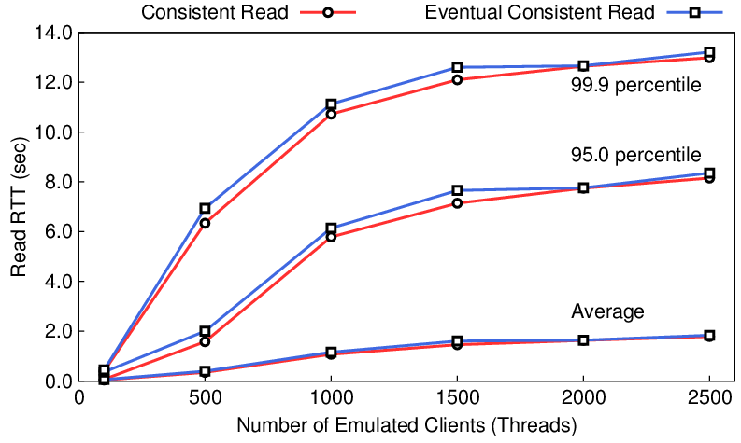
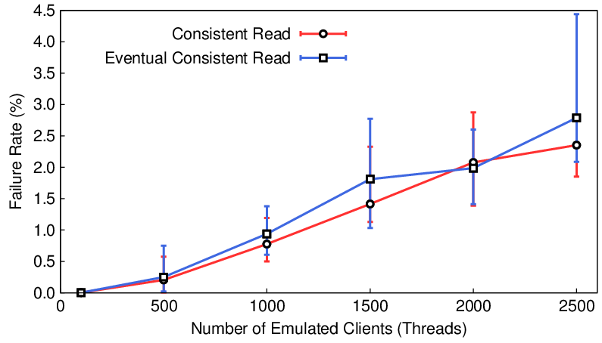
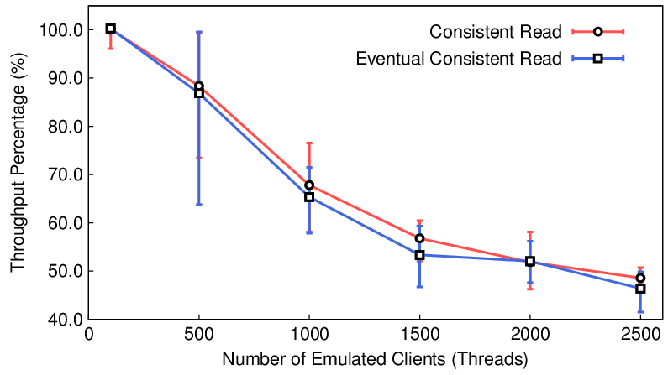
Trade-Off Analysis of SimpleDB: A Benefit for Consumer from Weak Consistency?
No significant difference was observed in RTT, throughput, failure rate under various read-write ratios
  If anything, it favors consistent read!
Financial cost is exactly same
* Each client sends 1 rps. All obtained under 99:1 read-write ratio
<number> / 20

Slide 16
What Consumers Can Observe (From Our Experiments) I
SimpleDB platform showed frequent inconsistency
It offers option for consistent read. No extra costs for the consumer were observed from our experiments
  At least under the scale of our experiments (few KB stored in a domain and ~2,500 rps)
?? Maybe the consumer should always program SimpleDB with consistent reads?
<number> / 20

Slide 17
What Consumers Can Observe (From Our Experiments) II
Some platforms gave (mostly) better consistency than they promise
  Consistency almost always (5-nines or better)
  Perhaps consistency violated only when network or node failure occurs during execution of the operation
?? Maybe the chance of seeing stale data is so rare on these platforms that it need not be considered in programming?
  There are other, more frequent, sources of data corruption such as data entry errors
  The manual processes that fix these may also be used for rare errors from stale data
<number> / 20

Slide 18
Eventual consistency is too general a label
Different algorithms/system designs that all give eventual consistency differ so widely in other properties, that matter to the consumer
Consumer needs to know more
  Rate of inconsistent reads
  Time to convergence
  Extra properties that would be important for programming
  Performance under variety of workloads
  Availability
  Costs
Just as non-functional requirements are as crucial as functional ones in SDLC
<number> / 20

Slide 19
Implications of Our Experiments for Consumers?
Can a consumer rely on our findings in decision-making? NO!
  Vendors might change any aspect of implementation (including presence of properties) without notice to consumers.
    e.g., Shift from replication in a data center to geographical distribution
  Vendors might find a way to pass on to consumers the savings from eventual consistent reads (compared to consistent ones)
The lesson is that clear SLAs are needed, that clarify the properties that consumers can expect
<number> / 20

Slide 20
On-going Work
More detailed investigation of properties
  Longer time period
  With more data and under heavier load
  Look at the distribution of rare inconsistency cases on GAE, S3
Improved metrics for SLAs of cloud-based data storage
Monitoring tools for a range of consumer-visible properties of a cloud-based data store
Consistency-aware middleware to integrate across data-stores
<number> / 20

