Slide 1


Bits
Eugene Wu, Carlo Curino, Sam Madden
CSAIL@MIT
Notes:
US government funded project called..

Slide 2
Memory Hierarchy
Registers .3ns
Cache 10ns
RAM 100ns
Disk 10⁷ns
Notes:
All well aware of hierarchy and that access times lower levels take orders of mag more time

Slide 3
Ideal Memory Hierarchy
Hottest
Coldest
Registers .3ns
Cache 10ns
RAM 100ns
Disk 10⁷ns
Notes:
to maximize system performance, the goal is to keep the data in each level as hot as possible, so accesses are restricted to higher faster levels
If we look at it bit by bit (is every bit being used as hot as possible), then….
Fast levels are really small, and they get polluted when bits without data, or with unuseful data are read into them.

Slide 4
The Hierarchy is Lukewarm
Registers .3ns
Cache 10ns
RAM 100ns
Disk 10⁷ns
Notes:
Unfortunately, the hierarchy is luke warm and cold data is pervasive throughout the hierarchy

Slide 5
Why so cold?
Notes:
What is causing these chills? Before CIDR, we spent a solid week before the submission searching high and low, we believe this problem is due to copious amounts of

Slide 6
Why So Cold?
Cache misses
Inefficient data structures
Replacement policies
Picking wrong data structures
Poor locality
On and on…..
Notes:
We looked at these and realized that they are all types of ….

Slide 7
Waste.
dfn: Bits not useful to the application right now
Notes:
… are invading our memory hierarchy.
We’ve categorized them into 3 groups

Slide 8
Unused Space
Locality Waste
Encoding Waste
Bits that don’t contain any data

Slide 9
Unused Space
Locality Waste
Encoding Waste
Bits of data that’s not useful now
Notes:
This covers a huge spectrum of causes
- unclustered data
- poor prefetching algorithms
- poor cache/page replacement policies
- Poor storage layout

Slide 10
Unused Space
Locality Waste
Encoding Waste
Bits of inefficiently represented data
Notes:
Explain granularity. The other 2 are ok
As we will mention later on, because the data is semantically richer than the application’s needs

Slide 11
Unused Space
Locality Waste
Encoding Waste
Fundamental to system design

Slide 12
Unused Space
Locality Waste
Encoding Waste
Result of poorly defined schemas
Notes:
Which are an unfortunate fact of life, so

Slide 13
Unused Space
Locality Waste
Encoding Waste
Can we find ways to
reduce or reuse the waste?
Notes:
So in this talk I will be focusing on each of these three nefarious groups
And ask the question

Slide 14
Standing On Tall Shoulders
Vertical Partitioning
Database cracking
Clustering
Indexes
Self tuning databases
Optimal database parameters
Compression
Horizontal Partitioning
Index selection
LRU
2Q
Column Stores
Notes:
I’m standing on incredibly tall shoulders.
Vertial partitioning, database cracking, clustering, selftuning databases are all awesome pieces of work.
Many of esteemed researchers here have worked on
Our main contribution is
Think about system optimization as a waste minimization problem
Convince you that there a huge amount of cool work done

Slide 15
But The Clouds Are Higher
Vertical Partitioning
Database cracking
Clustering
Indexes
Self tuning databases
Optimal database parameters
Compression
Horizontal Partitioning
Index selection
LRU
2Q
Column Stores
Huge amount of room for
interesting work
Notes:
Outrageous
Results

Slide 16
Outrageous
ly
Awesome
Results
(Preliminary!)

Slide 17
Unused Space
Allocated bits that do not contain any data
Notes:
I’ll first discussi Unused space which is…. Using the example of B-Tree indexes

Slide 18
B-Tree Indexes
Notes:
Which is free space in b trees

Slide 19
B-Tree Indexes
Why?
Notes:
Explain why b-indexes on each of the points

Slide 20
1. Lots of Unused Space
In an insert workload
32% of unused space*
42% in Cartel centroidlocations index
Waste is designed into the data structure
Amortize insert costs
* A. C.-C. Yao. On random 2-3 trees
Notes:
In an insert workload, due to page splitting, Yao has theoretical results (bolstered by real world instances) that show page utilization converges to 68%, or 32% of unused space
We found in the cartel database, which stores sensor information of boston taxis, that its as high as 55%

Slide 21
2. Indexes are Large
Wikipedia’s revision table
Data 33 GB
Indexes 27 GB
Cartel’s centroidlocations table
Data 13 GB
Indexes 8.24 GB
Notes:
Second, these indexes are large, often nearly the size of the data itself
Wikipedia’s revision table contains metadata about each article revision. It contains 33 GB of data and nearly the same amount for indexes.
If we used yao’s results, there would be 8.5 GB of unused space in the indexes
Similar situation for Cartel’s centroidlocations gps table
This may be frightening, but As researchers This empty space is really a huge opportunity!
Motivate our solution by walking through the life of a common wikipedia query
Wikipedia’s revision table, which contains metadata for every article revision (not including the text)
11M articles 1.1G data .9G index
198M revisions 33G 27G
Centroidlocations table is a table that stores gps locations of tens of taxis around boston. 1 point per taxi per second
180M tuples

Slide 22
Life Of A Wikipedia Query
SELECT page_id FROM page WHERE title = “Donkey”
Leaf Pages
Buffer Pool
17 | “Donkey” | 1/10/2009 | true
Disk
17 | “Donkey” | 1/10/2009 | true
Notes:
That looks up the page id given the article’s title
, fetched data page then tuple, then returned to the operator that requested the lookup.
White space in the leaf pages is the 32% of unused space
It is allocated for future inserts,
so until inserts happen, why not use it for data?

Slide 23
Life Of A Wikipedia Query
SELECT page_id FROM page WHERE title = “Donkey”
Leaf Pages
17
Buffer Pool
17 | “Donkey” | 1/10/2009 | true
Disk
17 | “Donkey” | 1/10/2009 | true
Notes:
So that before returning the result, cache the accessed fields

Slide 24
Life Of A Wikipedia Query
SELECT page_id FROM page WHERE title = “Donkey”
Leaf Pages
17
Buffer Pool
Disk
17 | “Donkey” | 1/10/2009 | true
Notes:
So that when the next Donkey query comes, we can answer it from the index directly

Slide 25
Index Caching
Free space in secondary index leaf pages to cache hot data on access path
Improve locality
Save memory for other queries
Guarantee:
Never increase Disk IO
Minimal overhead
Consistency
Notes:
Both improves locality for queries that use the cache and …
Minimal overhead using best effort operations
To explain the cache’s design, lets take a look at a common way index pages are structured

Slide 26
Anatomy of an Index Page
Fixed Size Header
Index Keys
Free Space
Directory Entries
Fixed Size Footer
Notes:
Index keys and dir entries (index in the page) start on opposite sides and grow inward
A very common way of implementing index pages MYSQL POSTGRES

Slide 27
Anatomy of an Index Page
Fixed Size Header
Index Keys
Cache Slot
Coldest Data
Cache Slot
Cache Slot
Hottest Data
Cache Slot
Cache Slot
Coldest Data
Directory Entries
Fixed Size Footer
Notes:
Split the free space into fixed size cache slots
Observation that the slots near center least likely to be overwritten
Here is the NEED of placing the hottest in the center

Slide 28
Cache Replacement Policy
Hotter entries move to stable locations
New data replace coldest entries
On cache hit, swap entry into hotter slot
Notes:
Here is the mechanism for doing that.
In addition, to guarantee consistency, the paper describes efficient techniques to invalidate an index’s entire cache, as well as fine grained page level cache invalidation

Slide 29
What? Does This Work!?
44% of Wikipedia queries
Use name_title index
Read ≤ 4 out of 11 fields
name_title can store data for 70% of tuples
Using above workload (zipf α=0.5)
98% hit rate on read-only workload
95% hit rate on insert/read mix
Notes:
Analyzed wikipedia’s workload. Found that 44% … use same name_title index and read 4 out of 11 fields.
Even if each cache entry stores all 4 fields, the index could store entries for 70% of the tuples
Using the above storage capacity and the name_title queries
Inserts increase the number of index keys and reduce cache size. We found that even shrinking the cache size by 50% over course of ep still nets

Slide 30
Up To Order-of-magnitude Wins
Notes:
Microexperiment
constructed two large blocks of memory to simulate bufferpool and index (cache), and simulated queries that access data through index with varying hit rates.
that computes tuple lookup costs as the bufferpool and index cache hit rates vary. Effectively, the cost/query
EXPLAIN EXPERIMENT
Each line represents buffer pool hit rate, so green means 98% of data is in ram so 2% must go to disk.

Slide 31
Up To Order-of-magnitude Wins
Notes:
Without index caching is HERE (0)
With index caching, we move along the x axis
We saw that the lookups in the name_title can have 98% hit rate

Slide 32
Up To Order-of-magnitude Wins
Notes:
Which is here.

Slide 33
Up To Order-of-magnitude Wins
100x
Notes:
For wikipedia mixed workload, assuming insert 95% hit rate, The difference is over 100X
Now we zoom in on the blue line, which is when the data completely fits in memory

Slide 34
2X Win Even If Data Is In Memory
Notes:
!!!!!!! Overhead is 0.3us
Crossover point at 32%
Outperforms by 2.7X

Slide 35
2X Win Even If Data Is In Memory
Notes:
!!!!!!! Overhead is 0.3us
Crossover point at 32%
Outperforms by 2.7X
Can avoid additional memory lookup because data already in cpu cache
Next, thing start to get a little wacky when I discuss locality waste…

Slide 36
Locality Waste
When cold data pollutes higher level of memory hierarchy due to ineffective placement

Slide 37
SELECT * FROM T WHERE id = 4
0 | 1 | 2
3 | 4 | 5
6 | 7 | 8
Notes:
One reason is because data is moved at the .page granularity
For example this query only reads one of the tuples on the data page, so rest of bits on page considered cold
When this page is read, The cold data that comes along for the ride, effectively reduces the usable memory size

Slide 38
Locality Waste In Wikipedia
99.9% queries access latest revision of article
5% of revision tuples
As low as 2% utilized
Can’t optimize based on data values alone
Traditional clustering/partitioning doesn’t work
Notes:
Unfortunately clustered by insertion, so many of the pages have utilization as low

Slide 39
Workload-Specific Data Placement

Slide 40
Access Frequency Clustering
Cluster accessed tuples at end of table
Insert new copy of tuple
Invalidate old copy
Update pointers to new copy
Notes:
One general approach we believe is useful is Access frequency based clustering,
We knew wikipedia’s revision table’s access freq, so we explicitly exploited it.
Ran transactions that inserted copies of latest revisions …

Slide 41
Access Frequency Clustering
Cluster accessed tuples at end of table
Insert new copy of tuple
Invalidate old copy
Update pointers to new copy

Slide 42
Access Frequency Clustering
Cluster accessed tuples at end of table
Insert new copy of tuple
Invalidate old copy
Update pointers to new copy
Notes:
After these insertions Dense cluster of hot tuples at end of the tabel
An additional optimization is

Slide 43
Access Frequency Clustering
Cluster accessed tuples at end of table
Insert new copy of tuple
Invalidate old copy
Update pointers to new copy
Hot Partition
Notes:
Deletes and reclaiming old space. Assume that disk is cheap and since that is cold data, it will never pollute higher memory levels.

Slide 44
revision table experiments
Clustering
2.2X query performance win
Partitioning
8X query performance win
Reduces effective index size from 27GB to 1.4GB
Smaller index size fits in memory
Notes:
Ran an experiment on Wikipedia’s full 2008 revision table, using revision table queries derived from a sample of wikipedia’s request patterns. 800K queries
Clustering = 2x faster to run the trace queries
Partitioning lets us separately index the hot and cold partitions. Since only the hot partition is accessed, it reduces the effective index size from full table’s 27 to
Now, here really is where the wacky of the wacky and outrageous ideas comes from…

Slide 45
Encoding Waste
Data that is inefficiently represented or at higher granularity than the application needs
Notes:
This is particularly important because it lets us fit more data into the higher levels of memory hierarchy

Slide 46
Poorly Defined Schema
CREATE TABLE taxi_pings{
mac varchar(17), “02:22:28:E0..”
tstamp varchar(14), “12-09-2011…”
flags int, 0,1,2,3
year int 2011
}
Schemas must be defined upfront
Little knowledge about data
Notes:
Taxis in boston ping every second. Store pings in taxi_pings
representative of fields found in Cartel and wikipedia database tables
Mac field stores mac address in 17 byte string. This causes a lot of redundancy since there are a small number of taxis. Dictionary encoding would reduce the size to a 4 byte id field
Year as 2 bytes
Year could not store the data and calculate it from tstamp at query time
Found that one of the tables in Cartel can save up to 80% 11GB, the average was 30%

Slide 47
Poorly Defined Schema
CREATE TABLE taxi_pings{
mac varchar(17), “02:22:28:E0..”
tstamp varchar(14), “12-09-2011…”
flags int, 0,1,2,3
year int 2011
}
Schemas must be defined upfront
Little knowledge about data
Design to be conservative and overallocated
Notes:
In existing systems, the developer will have to manually tune her schema parameters, evolving her schema over several iterations
What we really need are good tools to deal with these bad schemas!
In short term…

Slide 48
Tools We Need Now
Automatically detect the waste
Field’s true value range
Field’s true data type
Surface waste information to developer
Impact on performance

Slide 49
Physical Independence to the MAX
Interpret schemas as hints
DB should..
Detect field storage sizes
Replace bits with CPU Cycles
Store fields based on semantic property
Flexible field storage
Notes:
app designers shouldn’t have to manage their Schemas, it lets use schemas as hints
automatically detect the best storage allocation for fields -- compression
Recognize redundant or computable field and replace them with query time functions
Exploit semantics of how fields are used. For instance, ID fields only used… like c-store, substitute its storage with physical location
Enable all of this, storage manager flexible enough to vary how fields are stored
Stopping back…

Slide 50
Research Opportunities
Tools that detect waste
Amount of memory my workload really needs?
How inefficient is my schema?
Workload specific data structures & policies
Index caching algorithms
Storage layout techniques
Automatic optimization as workload changes
Can this field be dropped?
Runtime repartitioning
Notes:
Discussed research opportunities in the exciting field of waste management
In conclusion, there’s a HUGE amount of waste weighing down our speedy databases

Slide 51
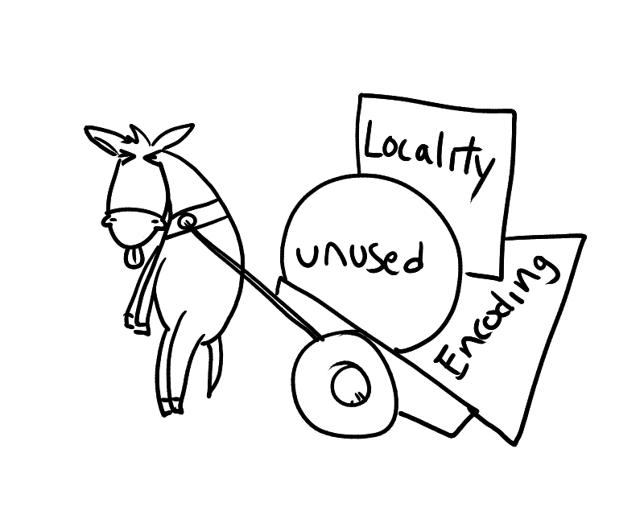

Slide 52
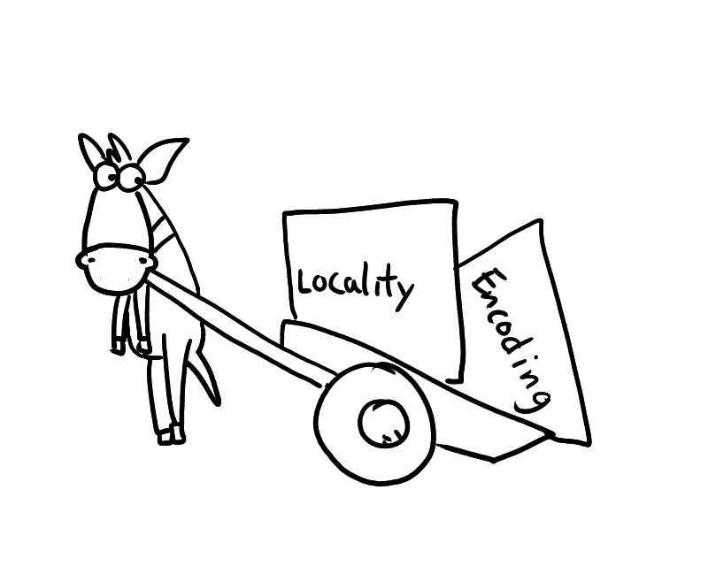

Slide 53
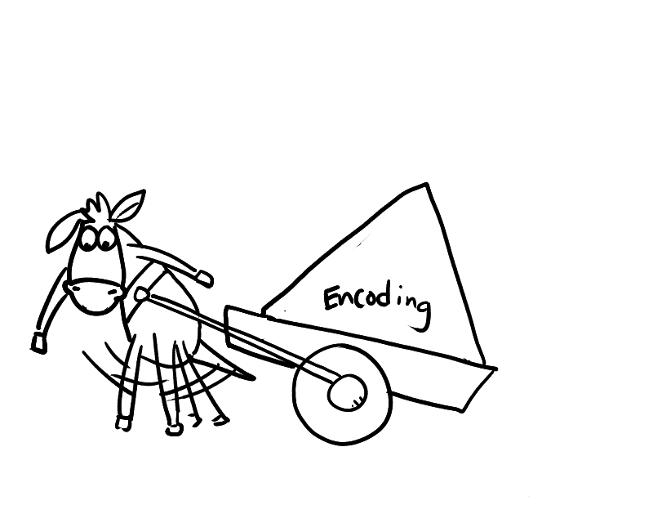

Slide 54
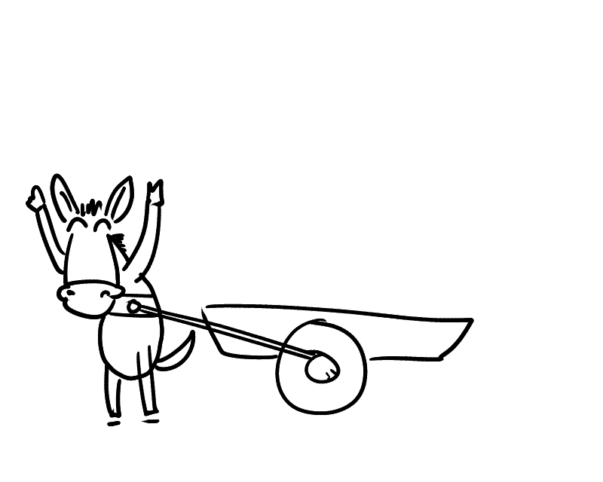

Slide 55

Thanks!
Locality waste
Encoding waste
Unused space
Notes:
What’s the message?
I’ve talked about waste, and I’d love questions about your waste or if you thought this was a big waste of time

Slide 56
Additional Slides

Slide 57
How Can You Just Re-insert Tuples?
Experiments specific to Wikipedia
ID fields are opaque to the application
App looks up ID by article name
Update foreign key references
Lookup Table
old ID → new ID
Query rewrites

Slide 58
Index Caching Assumptions
Fixed size cache entries
Set of fields is fixed over the index
Secondary index
We know what fields to cache ahead of time
Notes:
Use as backup slide
In general, want to cache “stable” fields – fields that are not updated often (managing consistency has costs, though low)
For the purposes of this talk, we assume that cache entries are fixed size, and the cache entries for a particular index contains the same set of fields

Slide 59
Index Cache Consistency
Page Cache-LSN (PCLSN) in each index page
Global Cache-LSN (GCLSN)
An index page’s cache is valid IFF:
PCLSN == GCLSN
GCLSN++ invalidates entire cache
Finer grained invalidation in paper

Slide 60
Alternative: Fillfactor = 100%
Specify the amount of free space in index pages on creation
Problems
Trade read speed + waste for insert performance
Fillfactor is only initial setting
Notes:
Here is a possible approach to this problem
There are number of immediate approaches to reduce the utilization, or improve the performance of B-trees.
Can imagine setting the splitting policy, but <look into this>

Slide 61
Alternative: Covering Indexes
Store all the queried fields in the index
Queries will be index-only
Problems
Utilization is still 68%
Creates more waste because index is larger!

Slide 62
Cache Replacement Experiments
Notes:
Backup slide
Swap is the vanilla swapping based caching replacement algorithm
Shrink runs the same algorithm, but reduces the cache size linearly by 50% over the course of the experiment
simulate continuous inserts
5% drop in quality

Slide 63
Cache Replacement - Occasional

Slide 64
Index Caching Performance

Slide 65
Clustering Experiment Setup
revision table queries
Derived from sample of wikipedia’s http requests
800K accesses of 5.2M
10% of 2 hours

Slide 66
Access Frequency Clustering

Slide 67
Overhead of Clustering

Slide 68
Benefit of Clustering Over Time
Notes:
Original experiment was 10% of 2 hours of wikipedia’s revision table workload

