Slide 1
Querying Encrypted Data using Fully Homomorphic Encryption
Murali Mani, UMFlint
Talk given at CIDR, Jan 7, 2013

Slide 2





Scenario
Hand over data
Content-Owner
(Client)
Request content (Query)
Limited resources (cannot host data)
Cloud Service Provider (Content Host)
(Has lot of resources)
Content (Query Results)
Content-Requester (has permission) (could be the content-owner)

Slide 3
Who could be malicious?
Content-Owner
(Client) (Trusted)
Cloud Service Provider (Content Host)
Potentially Malicious Client (no permission to view content) (uses the same host)
(Could be intentionally or unintentionally malicious)
Reference: Hey, You, Get Off of My Cloud: Exploring Information Leakage in Third-Party Compute Clouds, CCS 2009

Slide 4
Approach
Can the cloud service provider see only encrypted data and still answer queries?
What capabilities are provided by the somewhat recent breakthroughs by the crypto community in Fully Homomorphic Encryption (FHE)?

Slide 5
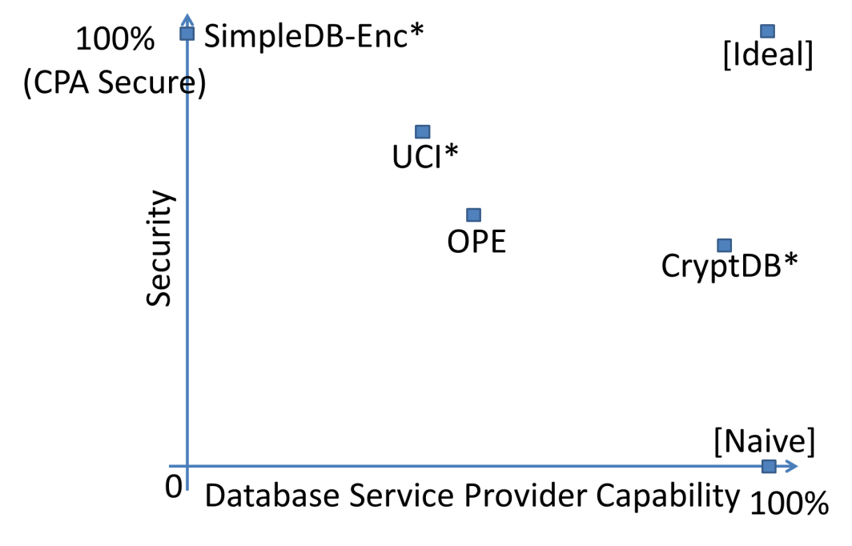
Comparing some of the state-of-the-art approaches
SimpleDB-Enc* -- Amazon SimpleDB where all data is encrypted
UCI* -- Approach from UCI where a few distinct values fall into a bucket
H. Hacigumus, B. R. Iyer, C. Li, and S. Mehrotra. Executing sql over encrypted data in the database-service-provider model. In SIGMOD, 2002.
OPE (Order Preserving Encryption)
R. Agrawal, J. Kiernan, R. Srikant, and Y. Xu. Order-preserving encryption for numeric data. In ACM SIGMOD, 2004.
A. Boldyreva, N. Chenette, Y. Lee, and A. O'Neill. Order-preserving symmetric encryption. In EUROCRYPT, 2009.
CryptDB – (Adjustable security)
R. A. Popa, H. Balakrishnan, S. Madden et al. Cryptdb: Protecting condentiality with encrypted query processing. In SOSP 2011.

Slide 6
Fully Homomorphic Encryption: An Overview (Craig Gentry et al, 2009+)
Any number of additions and multiplications (think bit-wise XOR and AND) can be performed on encrypted data.
All computer programs can be written in terms of these operations.
Idea:
Every addition/multiplication adds some “error”
When error becomes large, re-encrypt with a second public key, while removing the previous encryption – “bootstrapping”
Bootstrapping done in such a way as to decrease the error and more operations can be done on this re-encrypted data

Slide 7
About FHE
Cryptographic Security guarantees:
C. Gentry. Fully homomorphic encryption using ideal lattices. In STOC, 2009.
FHE is secure given approximate-GCD is hard
Bootstrapping makes assumption that sparse subset sum problem is hard
“Better” security guarantees have been provided since 2009.
Practicality of FHE
Bootstrapping is an extremely time-consuming operation
Improvements have been made since original 2009 construction
V. Vaikuntanathan. Computing blindfolded: New developments in fully homomorphic encryption. In FOCS, 2011.
C. Gentry, S. Halevi, and N. P. Smart. Better bootstrapping in fully homomorphic encryption. In PKC, 2012.

Slide 8
FHE for Databases
FHE as is “can be” used for answering queries
Translate a query into a circuit (that uses XOR and AND operations)
However, translating a query in its entirety into a circuit could be cumbersome
We would lose out on algebraic operator-by-operator processing used typically in DB systems.
Qn: How do we support algebraic query processing of encrypted data?

Slide 9
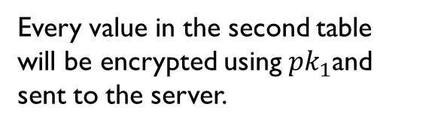
Algebraic Processing using FHE: Data Model
Every table is appended with a presence bit column. All algebraic operators operate on tables represented in this model.
PC
PC
model | speed | ram | hd | price
1001 | 2.66 | 1024 | 250 | 2114
1002 | 2.10 | 512 | 250 | 995
1003 | 1.42 | 512 | 80 | 478
1004 | 2.80 | 1024 | 250 | 649
1005 | 3.20 | 512 | 250 | 630
model | speed | ram | hd | price | p
1001 | 2.66 | 1024 | 250 | 2114 | 1
1002 | 2.10 | 512 | 250 | 995 | 1
1003 | 1.42 | 512 | 80 | 478 | 1
1004 | 2.80 | 1024 | 250 | 649 | 1
1005 | 3.20 | 512 | 250 | 630 | 1
1006 | 2.5 | 512 | 250 | 600 | 0
Every value in the second table will be encrypted using ${pk}_{1}$and sent to the server.

Slide 10
Algebraic Processing using FHE: Computational Model
What programming language constructs can be supported on encrypted data?
Example: suppose a, b are encrypted
if (a > b)
x = a;
else x = b;
flag = a > b;
x = (flag * a) + (!flag * b)

Slide 11
Algebraic Processing using FHE: Example Operator Algorithm (SELECT)
For illustration, we will use a single equality comparison . Algorithm for (SELECT * FROM R WHERE col = val) using our computational model:
for every row (a, p) in R
match = (col(a) == val)
produce a row in result as (a, p (AND) match)
To check x == y, we can use a fixed, combinational circuit (supported by FHE). One simple circuit for x == y, given bits of x are x1, x2, …, xn and bits of y are y1, y2, …, yn is:
(1 XOR x1 XOR y1) AND (1 XOR x2 XOR y2) AND … AND (1 XOR xn XOR yn)

Slide 12
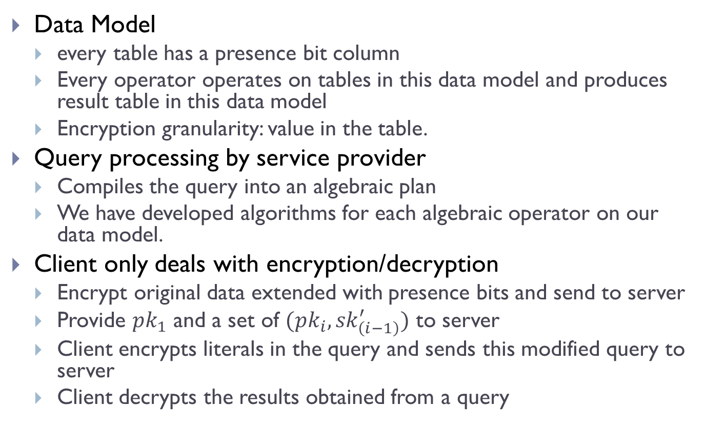
Algebraic Processing using FHE: Summary
Data Model
every table has a presence bit column
Every operator operates on tables in this data model and produces result table in this data model
Encryption granularity: value in the table.
Query processing by service provider
Compiles the query into an algebraic plan
We have developed algorithms for each algebraic operator on our data model.
Client only deals with encryption/decryption
Encrypt original data extended with presence bits and send to server
Provide ${pk}_{1}$ and a set of $({pk}_{i},{sk}_{\left(i−1\right)}^{′})$ to server
Client encrypts literals in the query and sends this modified query to server
Client decrypts the results obtained from a query

Slide 13
Conclusions
We have developed an approach to “perform” algebraic query processing of encrypted data using FHE
Gives us strongest security guarantees as yet, and the server does all query processing.
Issues
Practicality of FHE is a concern, though crypto community has made substantial progress since 2009
Database style optimization needs investigation
Utilizing indexes
Cost-based optimization
Alternate algorithms for operators
…

Slide 14
Thank you !!! Questions??

