Slide 1
Solid-state storage & DBMS
CIDR 2013
Manos Athanassoulis

Slide 2
Flash is replacing disks
But, random writes on flash
Instability in performance
Shorter device lifetime
And flash capacity is expensive
Is flash ready/suitable for secondary storage?
Reverse: How can DBMS exploit flash?
Flash not a drop-in replacement for disks
Notes:
The last few years flash disks have gained a big part of the storage market.
Flash, however, compared with traditional disks shows higher instability in performance and generally shorter device lifetime, while flash capacity is – also – more expensive.
So, a lot of research has been conducted answering the question whether flash is really suitable for secondary storage.
Or to reverse the question: How systems, like database systems, can exploit flash? ..
particularly, having in mind that flash is not a drop-in replacement for disks.

Slide 3
Disks all over the place
DBMS modules assumes disks
Storage
Buffer management
Indexing
Logging
Lower-level:
Block APIs
Storage software stack
Buffers
Re-architect DBMS needed for solid-state storage
Notes:
Almost every layer of a traditional database system assumes the presence of disks:
The storage layer, the buffer management, the indexing and the logging subsystems all do.
Moreover, the block APIs themselves and the software stack regarding secondary storage manipulation assume disks as the underlying storage medium.
Re-architecting database systems for solid state is important!

Slide 4
How to use flash in a “disk-world”?
Buffers
Notes:
So – in a disk-world - how can we use flash?

Slide 5
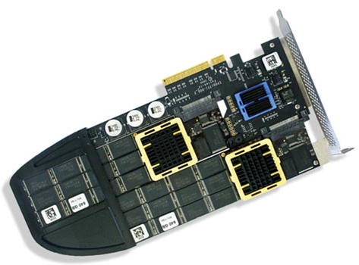
How to use flash in a “disk-world”?
As a specialized write cache
Hides update overhead
Buffers
Updates
Notes:
We can use flash as a specialized write cache to hide the update overhead, …

Slide 6
How to use flash in a “disk-world”?
As a specialized write cache
Hides update overhead
As secondary storage
Offers efficient random access
Buffers
Notes:
… as the sole secondary storage, something that requires altering the access patterns in a flash-friendly way, …

Slide 7
How to use flash in a “disk-world”?
As a specialized write cache
Hides update overhead
As secondary storage
Offers efficient random access
As a “regular” cache level
Buffers
SSD Buffer
Notes:
… or as a regular cache level between the traditional storage and the memory management layers.

Slide 8
Flash, solid-state, DBMS: The challenges are far from done …
Notes:
But, the challenges are far from done!

Slide 9

Flash Wall
Capacity: Density will plateau (soon)
Endurance (already)
Notes:
Flash storage will soon hit the wall of capacity, and is already hitting the wall of endurance.

Slide 10
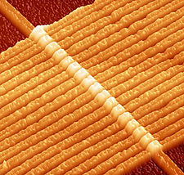
PCM, memristor and co
More than flash:
How to use persistent main memory?
Notes:
A wealth of technologies – like PCM and memristor - are around the corner and a new fundamental question is posed: How can we use persistent main memory?

Slide 11
Software stack is too slow
Notes:
Last but not least, the software stack for managing storage devices is becoming too slow.
As technology progresses the hardware latency for accessing data decreases exponentially, while the software latency (in OS and FS) remains the same, hence, being a major performance bottleneck.
As the technologies progress (from hard disks, to flash and lately to other solid-state technologies like PCM) the cost of accessing data on the hardware level decreases exponentially, while the software cost (in OS and FS) remains the same, hence, being a major performance bottleneck.

Slide 12
Flash Wall(s)
Persistent main memory
OS & FS too slow
Thank you!
Manos Athanassoulis

