Slide 1
Reliable Prostate Cancer Grading
Patch-Level Gleason Pattern Classification with Uncertainty Quantification using SICAPv2
Hermes Hui • Owen Reid • Mike Reynolds

Slide 2

The Problem
Prostate cancer is the most common cancer among men in Canada
  Over 25,000 diagnoses annually
  Gleason grading critical for treatment decisions
  Manual grading is time-intensive and subjective
Current Challenges
  AI models lack confidence estimates
  Risk of over-reliance without uncertainty

Slide 3
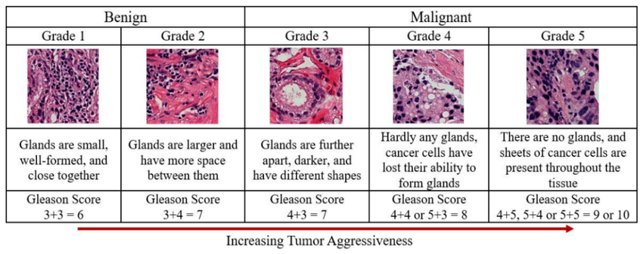
Gleason Grading System
Pathologists classify prostate tissue into patterns based on cellular architecture:
  NC - Non-Cancerous (Normal tissue structures)
  G3 - Grade 3 (Well differentiated)
  G4 - Grade 4 (Moderately differentiated)
  G5 - Grade 5 (Poorly differentiated - Most aggressive)

Slide 4
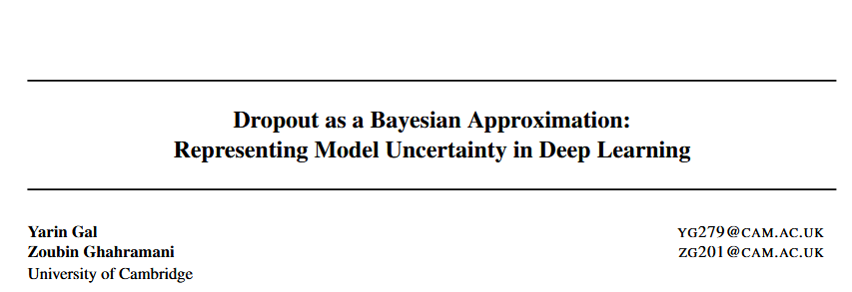
Our Solution
Two-Part Approach
1. Classification Model - ResNet18 Architecture
  11.2M parameters
  Patch-level classification (4 classes: NC, G3, G4, G5)
  Trained on SICAPv2 dataset
2. Uncertainty Quantification - Monte Carlo Dropout
  Bayesian approximation for confidence estimates
  Identifies ambiguous cases
  Enables selective prediction strategy

Slide 5
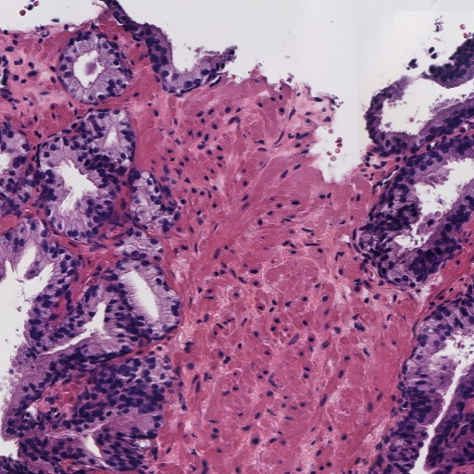
SICAPv2 Dataset
Dataset Overview
  182 Whole Slide Images of prostate histopathology
  10,340 total patches (512×512 pixels at 10× magnification)
  Expert pathologist annotations
  4 classification categories
Our Data Split
  8,215 Training Patches
  1,744 Validation Patches

Slide 6
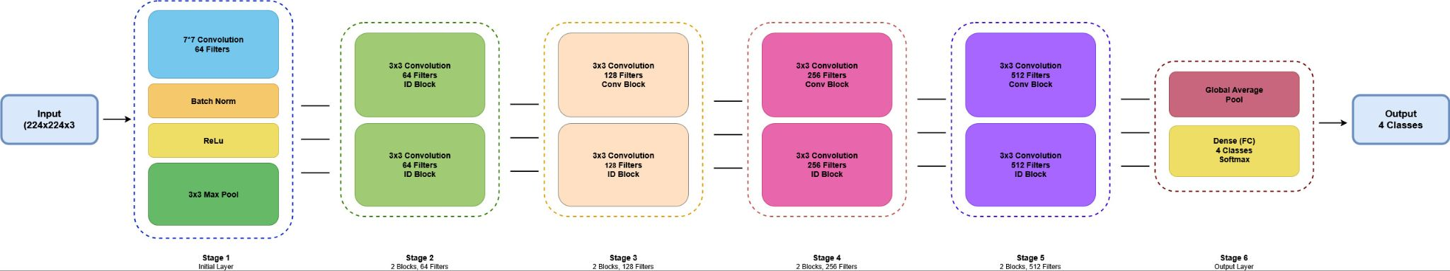
ResNet18 Architecture
Progressive Feature Learning: Low-level edges → High-level tissue patterns
  Stage 1: Initial 7×7 conv + pooling → Extract edges and basic shapes
  Stage 2: 64 filters → Learn basic cell and tissue patterns
  Stage 3: 128 filters → Gland formations and cellular clustering
  Stage 4: 256 filters → Larger-scale tissue patterns
  Stage 5: 512 filters → Most abstract features for classification
  Output: Global average pooling → Dense layer → 4-class softmax
Key Feature: Residual connections (skip connections) enable stable training

Slide 7
Training Methodology
Data Augmentation
  Random horizontal/vertical flips
  Random 90° rotations
  Brightness/contrast adjustment
  ImageNet normalization
Training Strategy
  Adam optimizer (lr=1e-4), Batch size: 32
  Early stopping, Learning rate reduction, Model checkpointing

Slide 8
Monte Carlo Dropout
Uncertainty Quantification Method
Key Concept: Treat dropout as approximate Bayesian inference (Gal & Ghahramani, 2016)
How It Works:
  1. Training: Dropout layers randomly deactivate neurons
  2. Inference: Keep dropout active, perform 20 forward passes
  3. Aggregation: Collect predictions from all passes
    Mean prediction → Final classification
    Standard deviation → Uncertainty/confidence measure
Clinical Value: High uncertainty identifies cases needing pathologist review

Slide 9
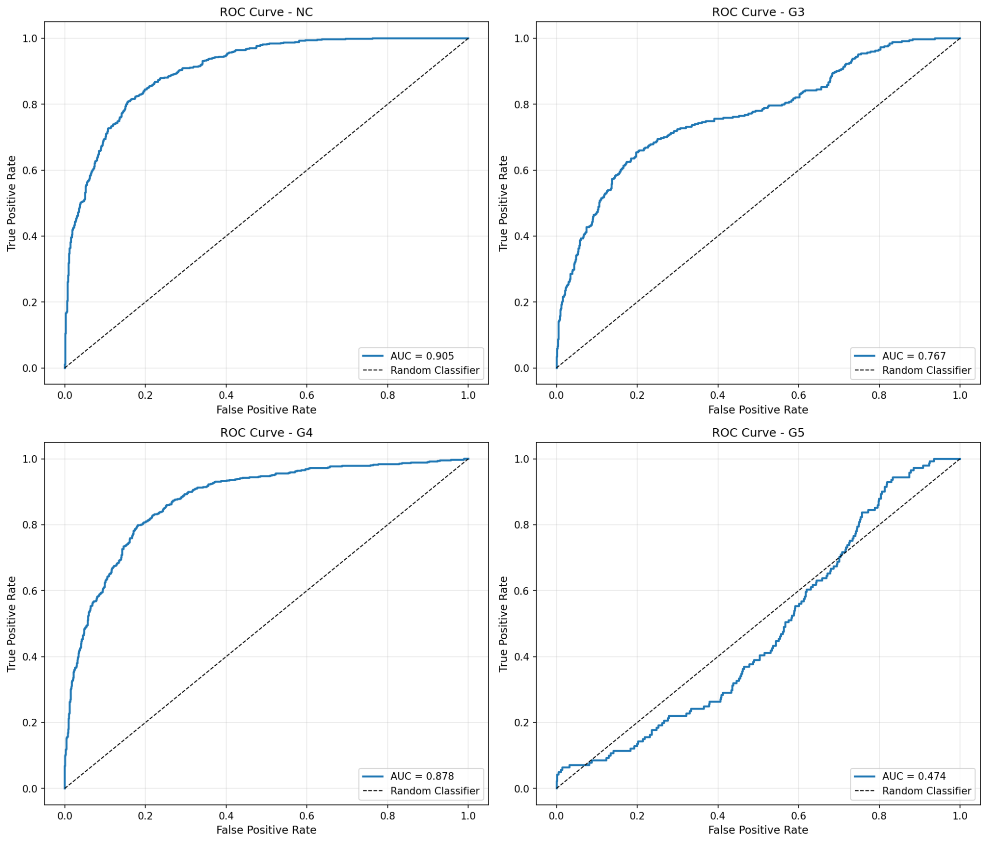
Baseline Model Performance
Overall Accuracy: 64.62%
Class-Specific AUC (Area Under ROC Curve)
  NC: 0.905
  G3: 0.767
  G4: 0.878
  G5: 0.474
Key Observations
  Strong discrimination for NC and G4
  G5 classification is challenging (rare patterns)
Macro-Average AUC: 0.756

Slide 10
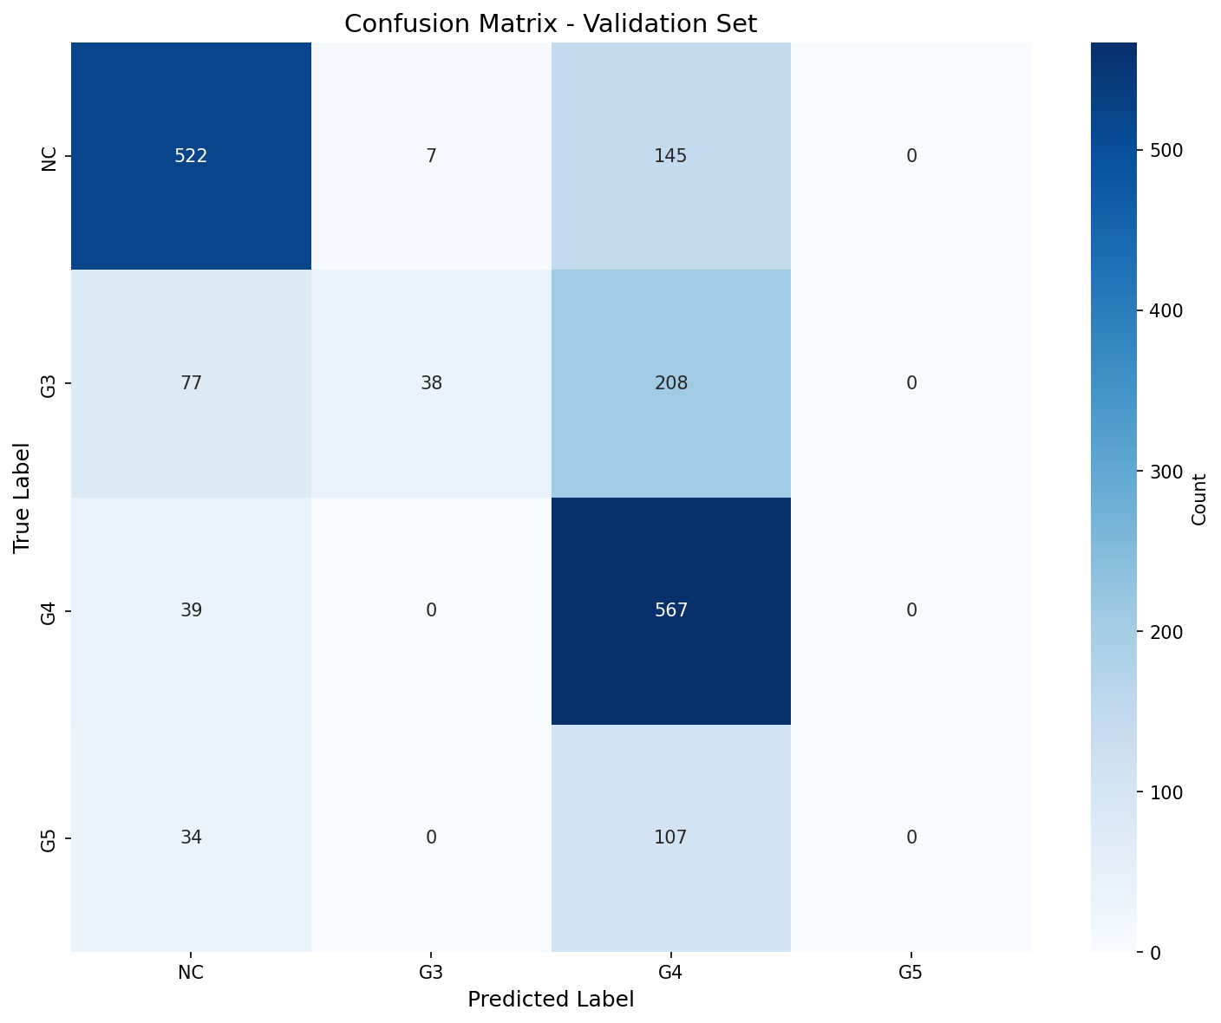
Classification Patterns
Confusion Matrix Insights
Strong Performance:
  NC: 522/674 correct (77%)
  G4: 567/902 correct (63%)
Challenges:
  G5: 0/74 correct (0%) - Model never predicts G5
Common Misclassifications:
  G4 → G5 (most frequent)
  G3 → NC (adjacent grades)
Clinical Note: G4/G5 distinction difficult even for pathologists

Slide 11
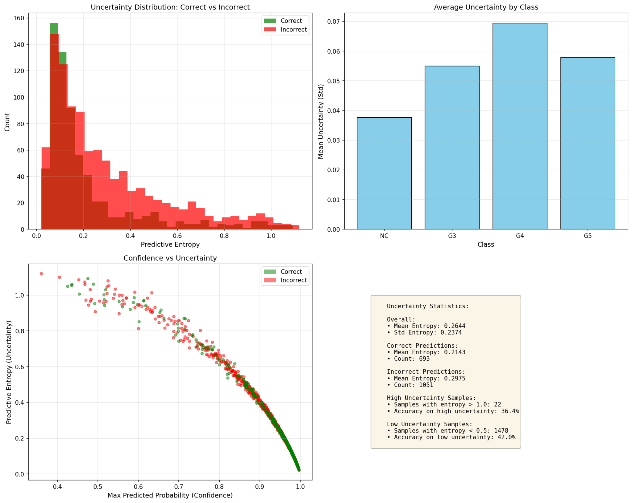
Uncertainty Quantification Results
MC Dropout Accuracy: 38.9% (30 samples per prediction)
Prediction Entropy Analysis
  Low entropy = High confidence
  Higher error count at low entropy levels
  Indicates need for additional training
Average Uncertainty by Class
  Similar standard deviation across all grades (~0.045-0.056)
  G4 shows highest uncertainty (0.056)
    Correlates with largest training set

Slide 12
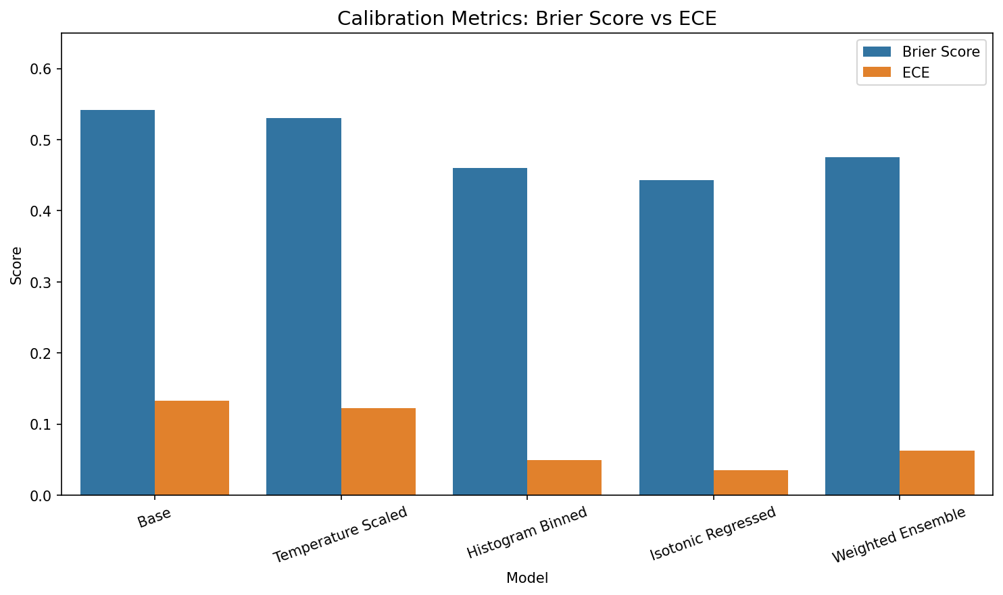
Model Calibration
Explored multiple calibration methods to improve prediction reliability
Methods Tested:
  Temperature Scaling
  Histogram Binning
  Isotonic Regression
  Weighted Ensemble
Best Results (Isotonic Regression):
  Brier Score: 0.443 (lower is better)
  ECE: 0.035 (lower is better)
  Macro-Average AUC: 0.756 → 0.848

Slide 13
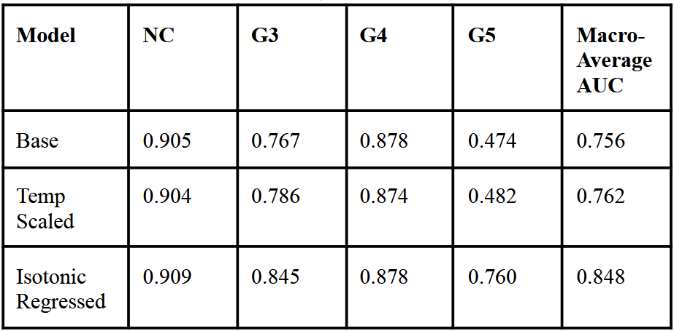
Key Findings
  ResNet18 achieves reasonable baseline performance (64.62% accuracy)
  Model excels at NC and G4 identification (AUC > 0.87)
  Struggles with rare G5 patterns
  Monte Carlo Dropout successfully quantifies uncertainty
  Enables identification of ambiguous cases
  Calibration methods significantly improve reliability
    Isotonic Regression best for minimizing ECE and Brier score
  Uncertainty correlates with model struggles
    Highest for G4 (largest class with most confusion)

Slide 14
Future Work & Improvements
Model Improvements
  Deeper architectures (ResNet50, EfficientNet)
  Address class imbalance with weighted loss
  Expanded hardware resources for training
Calibration Methods
  Deep ensembles
Clinical Deployment
  Test with practicing pathologists
  Measure impact on workflow

Slide 15

Conclusion
Developed uncertainty-aware deep learning system for Gleason grade classification
Baseline ResNet18 model
Monte Carlo (MC) dropout for uncertainty quantification
Model calibration
Works towards making deep learning usage in clinical settings more trustworthy and useful

Slide 16
Acknowledgments
Dataset
  Silva-Rodríguez et al. for providing the usage of the SICAPv2 dataset
Tools & Resources
  Google Colab for GPU computing resources
  TensorFlow, Keras, scikit-learn, matplotlib developers
Course
  Dr. Sadeghian and TAs for teaching and guidance

