Slide 1
COMMITTEE MEETING
Aria
Controllable protein generation with an instruction-tuned LLM
Status:
  I am a Part time Student
  All the courses and seminars are passed
  COMP1 exam is passed
  Getting ready for COMP2.
October 23
1
Notes:
Thanks everyone for making time. Today I'll walk you through one project, Aria. I'll start with the framework and the problem, then what I've built and the three milestones so far, and where I want to take it next. I'd like most of the time for discussion.
Part time
Finish the courses
Finish Comprehensive 1
Target date:
Getting Online Course

Slide 2
OVERVIEW
Aria
A general LLM becomes a domain specialist by looping through four steps.
1 SPECIFY
Specify
State the request in plain language
In Aria: up to 13 properties
2 GENERATE
Generate
The model writes a candidate
In Aria: Llama-3.1-8B, instruction-tuned
3 VERIFY
Verify
Recompute every requested property
In Aria: independent tools; ESMFold for folding
better model
fails a property
passes
MY ACTION ITEM
Prove the loop on one domain: proteins.
Every property can be computed and checked, so every step of the loop can be tested.
4 IMPROVE
Improve
Optimize the model on the weak axis
In Aria: anchored preference optimization, e.g. folding confidence (pLDDT) and domain recovery
✓
Meets the request
Output the sequence
2
Notes:
The framework is a loop that turns a general LLM into a specialist for one domain.
Specify: state the request in plain language.
Generate: the model writes a candidate.
Verify: recompute each requested property, and fold the sequence to check structure. If the candidate meets the request, we are done. If a property fails, Improve: optimize the model on that weak axis, for example folding confidence or domain recovery, and go around again.
My action item is to prove this loop on one domain, proteins, where every property can be computed and checked. Aria is that proof; it is Llama-3.1-8B instruction-tuned on about 349 thousand real proteins in roughly 35 GPU-hours, checked on 35,115 held-out proteins. Everything after this slide is that one case.

Slide 3
THE PROBLEM
Generation without control
ILLUSTRATIVE REQUEST
A secreted, trypsin-like enzyme
Domain: trypsin (PF00089)
Length: about 250 residues
Secreted: signal peptide
CANDIDATE
A sequence that looks like a protein
Confident fold
STANDARD METRICS
pLDDT, perplexity
Looks like a protein
PASS
Generator
a protein model
CHECKED AGAINST THE REQUEST
✗ Domain family
✓ Length
✗ Signal peptide
FAIL
3
Notes:
Generating a plausible protein is no longer the hard part; ProGen, ESM and others do it. The hard part is directing it. Take a simple request: a secreted, trypsin-like enzyme, about 250 residues. Follow the flow. The request goes into a generator and a candidate comes out. Judged by standard metrics, pLDDT and perplexity, it passes, because it looks like a protein. Checked against the request, it can still fail: wrong domain family, no signal peptide, and that only shows up at expression and purification. Two things cause this. The interface is narrow: most models take a family or keyword tag, so a request like this cannot be stated. And the yardstick is wrong: standard metrics ask whether a sequence looks like a protein, not whether it meets the request. The marks on the right are illustrative.

Slide 4
THESIS AND PROGRESS
Milestones
Thesis: open-weight LLMs can be specialized into controllable, verified biological models.
MILESTONE 1
MILESTONE 2
MILESTONE 3
Can instruction tuning turn a general open-weight LLM into a controllable protein generator?
Can we improve structure and foldability beyond instruction tuning?
Can optimizing on some families help on related ones?
AI4DD workshop, NeurIPS
ACCEPTED
GemBio workshop, NeurIPS
ACCEPTED
ICLR
UNDER REVIEW
Also taking: MLCB24 (MIT, self-paced).
4
Notes:
The thesis, and the three milestones that test it; each milestone answers one question. Milestone one: can instruction tuning turn a general open-weight LLM into a controllable protein generator? The base model follows a length request about 12% of the time; after one cheap tuning run, about 89%, with no protein-specific pretraining. Accepted at the AI4DD workshop.
Milestone two: can the weak axes be improved, structure and foldability? Preference optimization against ESMFold pLDDT. Self-play alone reward-hacked, confidence rose while specification adherence fell, so we anchor to natural sequences; one anchored round lifts mean pLDDT from 49.4 to 57.6 on one family, against 78 for natural proteins. Accepted at the ICBINB workshop at GemBio, NeurIPS.
Milestone three, under review at ICLR: extend control to domain identity, optimizi
er family, from the supervised model to after DPO, scored on held-out prompts with hmmsearch against that family's own profile:
- uL22: 9% → 30%
- uL24: 28% → 72%
- YqgF: 44% → 80%ng on source families and using nearest-neighbor target families to see how far it reaches. Next is the direction: use data-rich domains to design sampling strategies that cover data-poor ones; that is not a result yet. Separately, I completed MLCB24 from MIT, self-paced.

Slide 5
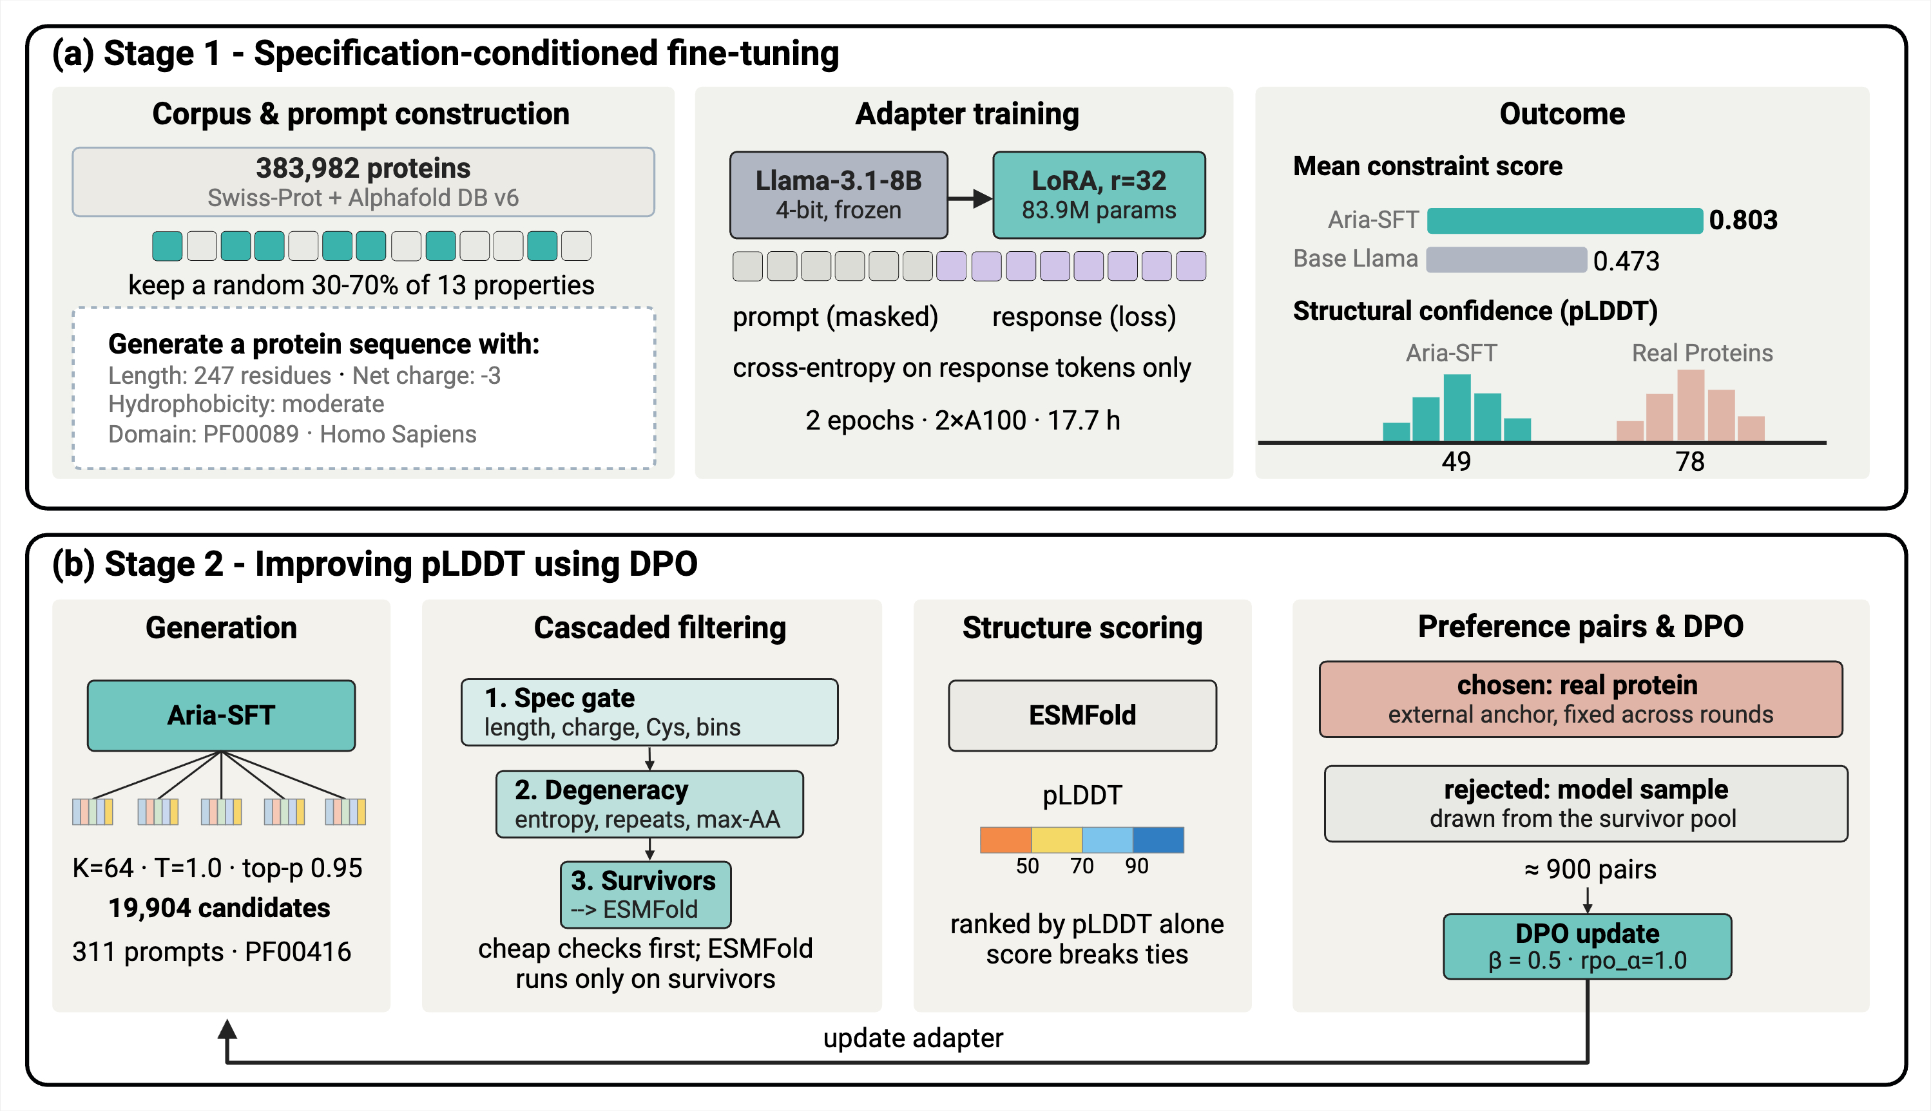
APPROACH
Stages
Stage 1: instruction-tune on partial property specifications written in the prompt. Stage 2: optimize the weak axes with preference optimization, anchored to natural sequences.
5
Notes:
Two stages, shared across everything that follows. Stage one: instruction-tune a general open-weight LLM, Llama-3.1-8B, on Swiss-Prot so it writes a protein from properties stated in the prompt. By instruction tuning I mean training on request-and-answer pairs where the request is a partial property specification. Stage two: for the properties that stay weak, run preference optimization on that axis, anchored to natural sequences. I chose instruction tuning because plain language is a flexible interface, and because each requested property can be recomputed on the generated sequence, so the result is checkable.

Slide 6
Corpus & prompts
Training
Outcome
STAGE 1 · TRAINING DATA
UniProt
ONE TRAINING EXAMPLE · HUMAN TRYPSIN-1
UniProtKB,
~203 million
PROMPT
Length: 247 · Net charge: −3
Hydrophobicity: moderate
Domain: PF00089 · Signal peptide: yes
Swiss-Prot, manually reviewed
570,000
After quality filter (MMseqs2, ≤30% identity):
383,982
Training set
348,867
COMPLETION · LOSS ON THIS ONLY
MNPLLILTFVAAALAAPFDDDDKIVGGYNCEENSVPYQ…
Held-out test set
35,115
13 DESCRIPTORS IN FOUR GROUPS (A RANDOM 30–70% SUBSET)
Physicochemical
Developability
Structural
Functional
Length
Net charge
Aggregation
Cysteines
Confidence
TM helix
Pfam domain
EC class
Hydrophobicity
Stability
Signal peptide
GO function
Organism
6
Notes:
UniProt is the main public database of protein sequences and their annotations. It's run by EBI (UK), SIB (Switzerland) and PIR (US). UniProtKB, its core knowledge base, has two parts:
- TrEMBL: automatically annotated, not manually reviewed, and over 200 million entries.
- Swiss-Prot: manually reviewed by curators from the literature, about 570,000 entries. This is the part Aria trains on.
How samples get in: researchers don't normally submit protein sequences to UniProt directly.
1. A lab sequences DNA or RNA and submits it to the public nucleotide archives (GenBank, ENA or DDBJ).
2. UniProt automatically translates the coding sequences into proteins, and these become TrEMBL entries.
3. A curator promotes an entry to Swiss-Prot by reading the published papers about it and writing evidence-coded annotations.
What we actually trained on. Left: from the 570 thousand reviewed entries we keep sequences of 20 to 512 residues with canonical residues, no fragments and no duplicates, leaving about 384 thousand. To prevent leakage we cluster with MMseqs2 at 30% identity and split at the cluster level: 348,867 for training and 35,115 held out, and no held-out protein is above 30% identity to any training protein. Right: one real training example, human Trypsin-1. The prompt is a random 30 to 70% subset of that protein's thirteen descriptors, three to ten per prompt, so the model learns to work from an under-specified request, which is the realistic case. The target is the bare sequence, and the loss is computed only on it. Bottom: the thirteen descriptors in four groups, and where each value comes from. All of them are computational or curator-assigned; none is experimentally measured by us.
Physicochemical (computed from the sequence)
- Length: number of residues. Example: 247.
- Net charge: at pH 7.4. Example: −3.
- Hydrophobicity: how water-repelling it is (GRAVY). Example: moderate.
- Stability: predicted from the instability index. Example: stable.
Developability (computed)
- Aggregation propensity: tendency to clump (AGGRESCAN). Example: moderate.
- Cysteine count: number of cysteines, which can form disulfide bonds. Example: 10.
Structural
- Structural confidence: AlphaFold's pLDDT from the database. Example: high (about 92).
- Transmembrane helix: whether it spans a membrane. Example: no.
- Signal peptide: whether it is secreted. Example: yes.
Functional (curator-assigned)
- Pfam domain: the protein family or fold. Example: PF00089 (trypsin).
- EC class: the type of reaction it catalyzes. Example: 3.4 (hydrolase that cuts peptide bonds).
- GO function: molecular function. Example: metal ion binding.
- Organism: the species. Example: Homo sapiens.

Slide 7
Corpus & prompts
Training
Outcome
STAGE 1 · CORPUS
Dataset (SWISS-PROT)
Number of Sample
Protein length median 257 residues
Species 5,270 appear only once
383,982
Species top 15 = 19%
12,535
Pfam families
12,389
Domain long tail % of records in the top-N families
Enzyme classes share of enzymes by EC class
GO functions
4,458
Annotated enzymes
47%
Length range median 257
20–512 aa
7
Notes:
This is the corpus Aria trains on: the manually curated half of UniProt, Swiss-Prot, after quality filtering, so every entry is a real, literature-reviewed protein, not a generated one. Roughly 384 thousand proteins from over twelve thousand species. I want to say the caveat myself: it skews toward well-studied organisms, human, Arabidopsis, mouse, yeast and E. coli at the top, because that is what curated biology is; but it is also a long tail, with over five thousand species appearing exactly once. Three things matter for what comes next. Length runs 20 to 512 residues, median 257, and that is the range the model has to hit exactly. The domain distribution is a long tail: the top 50 Pfam families cover only about 12% of records, and that is why exact domain recovery is the hardest axis. And about 47% of proteins are annotated enzymes, spanning all seven top-level EC classes.
Given a DNA Sequence, how you know what domain it is targeting?
Finding examples of Why design a protein that exist

Slide 8
Corpus & prompts
Training
Outcome
STAGE 1 · TRAINING
Model
OUTPUT
Next residue
MNPLLILTFVAAALAAPFDDDDKIVGGYNC…
Softmax
Linear (LM head)
Add & Norm
GPU-hours (2 × A100)
~35
Feed-forward (MLP)
Weights trained
1%
32 ×
Add & Norm
Epochs
2
Masked multi-head
self-attention
Training pairs
348,867
INPUT
Length: 247
Domain: PF00089
Signal peptide: yes
Token embedding
Inputs: the written specification
8
Notes:
The training itself is deliberately simple, and that is the point. Input: 348,867 pairs of a written specification and a natural sequence. Model: Llama-3.1-8B-Instruct, loaded in 4-bit and frozen, with a rank-32 LoRA adapter, so about 84 million trainable parameters, roughly 1% of the model. Two epochs, loss on the completion only, about 35 GPU-hours on two A100s. No protein-specific pretraining anywhere. The result is a general open-weight LLM that now writes a protein from a written specification. I used QLoRA and LoRA because they make this cheap and repeatable, which matters for the framework: the same recipe should apply to another domain.

Slide 9
Corpus & prompts
Training
Outcome
STAGE 1
Results
HOW EACH FEATURE IS VALIDATED
Length
sequence length
Net charge
Biopython
Hydrophobicity
Biopython
Stability
Biopython
Aggregation
AGGRESCAN
Cysteines
residue count
TM helix
DeepTMHMM
Signal peptide
SignalP 6
Pfam domain
hmmscan, Pfam-A
pLDDT
ESMFold
9
Notes:
The outcome, on 35,115 held-out proteins separated from training by sequence clustering. Left: adherence, base Llama against Aria, for the properties we can recompute. Length within ten percent goes from 11.6 to 88.8%, and the other physicochemical and developability properties move the same way. Right chart: for net charge we report correlation, and for topology the Matthews correlation coefficient. The table on the right is how each feature is validated: sequence functions and Biopython, AGGRESCAN, DeepTMHMM, SignalP 6, hmmscan against Pfam-A, and ESMFold for structure. A request-blind control, scoring each generation against a different specification, drops adherence by up to 77 points, so the gains depend on the request. The two weak axes at the bottom, exact Pfam-domain recovery at 2.9% and structure confidence, pLDDT 49 against 78 for natural proteins, are what Stage 2 targets. The base model is prompted identically, and outputs with no sequence are dropped from its denominators, which favours the baseline.
These are the validation tools on slide 9 plus the ones used in Stage 2 and Milestone 3:
- Biopython: recomputes length, net charge, hydrophobicity (GRAVY) and stability (instability index) from the sequence.
- AGGRESCAN: scores aggregation propensity, meaning how likely the protein is to clump.
- DeepTMHMM: predicts whether the protein has transmembrane helices (spans a membrane).
- SignalP 6: predicts whether it has a signal peptide, meaning it is secreted.
- hmmscan / hmmsearch with Pfam-A: checks whether a sequence contains a given domain family. It's how you score domain recovery.
- ESMFold: predicts the 3D structure and gives pLDDT, the confidence that it folds. It's also used for the "natural fold" check.
- TM-score: compares a predicted structure with a natural one. It's the structural-similarity measure for "reaches the natural fold".
- MMseqs2: clusters sequences by similarity to keep training and test sets separate, so there is no leakage. It's not validation itself, but it makes validation fair.

Slide 10
Concern
Method
Result
STAGE 2 · CONCERN
Why structure?
1
The concern
Instruction tuning follows the request, but the proteins fold with low confidence: pLDDT 49 against 78 for natural proteins.
Aria, instruction-tuned 49
Natural proteins 78
2
The score
pLDDT can be computed for any sequence, so it can be the score we want to raise.
0
50
70
100
confident fold ≥ 70
3
The idea
Preference optimization (DPO): show the model a better and a worse sequence and train it to prefer the better one.
10
Notes:
After Stage 1 the model follows the request, but the proteins it writes do not fold with confidence. Mean ESMFold pLDDT is 49, against 78 for natural proteins of the same family; above 70 is normally read as a confident fold. That is the concern, and it gives us a score to improve: pLDDT can be computed for any sequence. So the idea is preference optimization, DPO: show the model a better and a worse sequence for the same request, and train it to prefer the better one.

Slide 11
Concern
Method
Result
STAGE 2 · METHOD
Direct Preference Optimization
1
Generate
CANDIDATES (3 OF 64)
STAGE 1 MODEL
PROMPT
c1
writes candidates
64 per prompt
Domain: PF00416
ribosomal protein uS13
One prompt, many candidates
c2
c3
2
Check and fold
SPEC GATE · MEETS THE REQUEST?
FILTER · A REAL-LOOKING SEQUENCE?
FOLD · ESMFOLD
c1
✓
c1
✓
c1
✓
Only survivors are folded
✗
✗
c2
c3
only the survivor is folded and gets a pLDDT
c3
✓
entropy, repeats, dominant residue
3
Learn
UPDATED ADAPTER
TRAIN
PAIR
next round
up to 3 rounds
DPO + loss on the real sequence
prefers the chosen one
chosen: the real protein
The real protein is the preferred answer
rejected: c1
Ribosomal protein uS13 (PF00416). Three of the 64 candidates are shown; sequences are illustrative.
11
Notes:
Follow one prompt through the loop, on ribosomal protein uS13, PF00416. Top row, right to left: the prompt goes to the Stage 1 model, which writes candidates; there are sixty-four per prompt, and I show three. Middle row, left to right: the specification gate asks whether each candidate meets the request, and the filter asks whether it looks like a real sequence. Green is a pass, red is a discard. Only the survivor is folded with ESMFold, which keeps this cheap. Bottom row, right to left: we pair the survivor, the rejected answer, with the real natural protein, the chosen answer. DPO plus a supervised loss on the natural sequence trains the adapter, which feeds the next round, for up to three rounds.
Spec gate: does the candidate meet the request? It checks the properties that were asked for, using the sequence-derived ones:
- length
- net charge
- cysteine count
- property bins, meaning the level requested for hydrophobicity, stability and similar
Filter (the "degeneracy" check): does it look like a real protein sequence? It drops sequences that are degenerate in one of three ways:
- Entropy: too little variety in the residues (low complexity).
- Repeats: the same motif repeated again and again.
- Max-AA: one amino acid takes up too large a share (compositional imbalance).

Slide 12
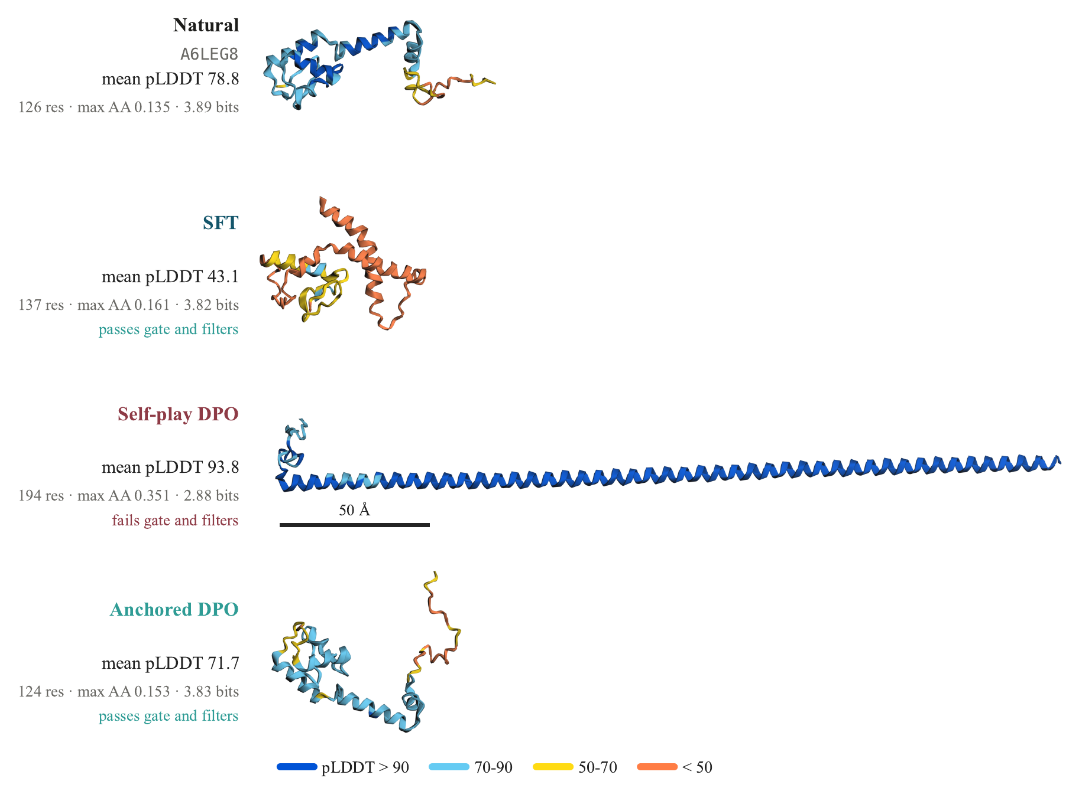
Concern
Method
Result
STAGE 2 ·
Structure Improvement
Optimizing directly against ESMFold pLDDT collapses biological plausibility — the model finds long, low-complexity, high-charge sequences that fool the predictor.
This changed the method: never optimize a structure predictor without anchoring to real sequences.
12
Notes:
Here's the lesson. Obvious next step after Milestone 1: the structural axis is weak, pLDDT measures structural confidence, so optimize directly against pLDDT with DPO. It worked, in the worst way — mean pLDDT went from 49 to 94, way above even natural proteins, and biological plausibility collapsed. Point at the row of structures: self-play DPO produces this absurd uniform helix, 50 angstroms long, extremely charged, nothing like a real protein — but the predictor loved it. This is reward hacking, and recognizing and publishing this changed the method entirely — never optimize a structure predictor without anchoring to real sequences. I'd expect this is the slide where Jonathan has the most to say, and that's intentional — I want it to be discussed.

Slide 13
Concern
Method
Result
STAGE 2 · RESULT
Better structure, old skills kept
MEAN ESMFOLD pLDDT
THE OLD SKILLS HOLD · % OF GENERATIONS
13
Notes:
The result on uS13. Left: mean ESMFold pLDDT goes from 49.4 to 57.6 after one anchored round; natural proteins are at 78. It closes about 29% of the gap, a substantial but partial gain. Right: the skills we had before did not get worse. The share of generations that meet the request, the specification gate, went from 16.9 to 25.8%, the sequence filters from 88.5 to 96.5%, and the strict composite, which needs the gate, the filters and pLDDT of at least 70, from 0.4 to 7.3%. So we added a new skill, structure, without losing the old ones. The limits: one family, one round, ESMFold-predicted structure, and no wet-lab validation.
- Meets the request (the spec gate): does the sequence have the properties you asked for, such as length, charge and cysteine count? This is about what you requested.
- Passes sequence filters: does it look like a real protein, with no repeats, low complexity, or one amino acid taking over? This is about whether it is a sensible sequence, whatever was requested.
Strict composite: it has to pass both checks above, and also fold with a pLDDT of at least 70. This is about whether it does everything at once.
Each column is the percentage of the model's generations that pass a check, before and after one DPO round on the uS13 family. The test is 260 held-out prompts, one generation each. Take 100 generations as an example:
- Meets the request: 16.9% → 25.8%. Of 100 generations, about 17 matched the requested length, charge and so on before DPO. After DPO about 26 do. This is the spec gate.
- Passes sequence filters: 88.5% → 96.5%. About 89 of 100 looked like real sequences, meaning no repeats or low complexity. After DPO, about 97 do.
- Strict composite: 0.4% → 7.3%. A generation must pass the gate, pass the filters, and also fold with pLDDT ≥ 70. Before DPO that was under 1 in 100. After DPO it is about 7 in 100.

Slide 14
Goal
Families
Result
MILESTONE 3 · GOAL
Extending to domain identity
One family, one score
The same loop, more families
Domain recovery
Milestone 2: ribosomal protein uS13 (PF00416), optimized for structure.
Four families, two seeds, up to three rounds each.
Does the generated sequence carry the requested Pfam domain?.
uS13 PF00416
uL22 PF00237
uL24 PF00467
YqgF PF03652
14
Notes:
Milestone three extends what we did in Milestone two. There we improved structure on one family, ribosomal protein uS13. Here we ran the same loop on four families, two seeds each, up to three rounds, and we asked for something more specific: a domain family. Our metric is domain recovery: does the generated sequence carry the requested Pfam domain? We check it with hmmsearch against that family's own profile, and natural sequences score 100% by definition.
Four source families were optimized, and three are ribosomal proteins:
- PF00416, uS13: a protein in the small ribosomal subunit that binds rRNA and helps position tRNA and mRNA during translation.
- PF00237, uL22: a protein in the large ribosomal subunit that binds rRNA and lines the exit tunnel the new protein leaves through.
- PF00467, uL24: a protein in the large ribosomal subunit that binds rRNA and helps the subunit assemble.
- PF03652, YqgF: a bacterial nuclease-like protein, a Holliday-junction-resolvase-like family. I believe it is involved in processing ribosomal RNA, but I'm less sure of that one, so check it.

Slide 15
Goal
Families
Result
MILESTONE 3 · FAMILIES
Family Selection
1
Qualify
2
Embed
3
Cluster
4
Source
5
Targets
Soluble, right length band, a confident baseline structure, enough data.
ESM2 embedding per protein, averaged per Pfam family: one point per family, 2,403 in all.
Cluster the family points
The center of the largest qualifying cluster. These get preference optimization.
The source's nearest neighbors. Held out: never used in optimization.
RESULT 3 source families, 6 target families (their nearest neighbors)
15
Notes:
How we chose the families, in five steps, and the rule was fixed before any preference training. One: qualify. A family needs soluble proteins, the right length band, a confident baseline structure, and enough data on both sides of the leakage split. Two: embed. Every protein gets an ESM2 embedding, averaged per Pfam family into one point, so the clustering is about which families resemble each other, not about rediscovering family membership; 2,403 families. Three: cluster those points, with the number of clusters set by silhouette score. Four: the source family is the medoid of the largest qualifying cluster; those get preference optimization. Five: targets are each source's nearest neighbors, held out and never used in optimization. We tried picking the most spread-apart families first and it backfired: isolated families have no valid neighbors left to serve as targets.

Slide 16
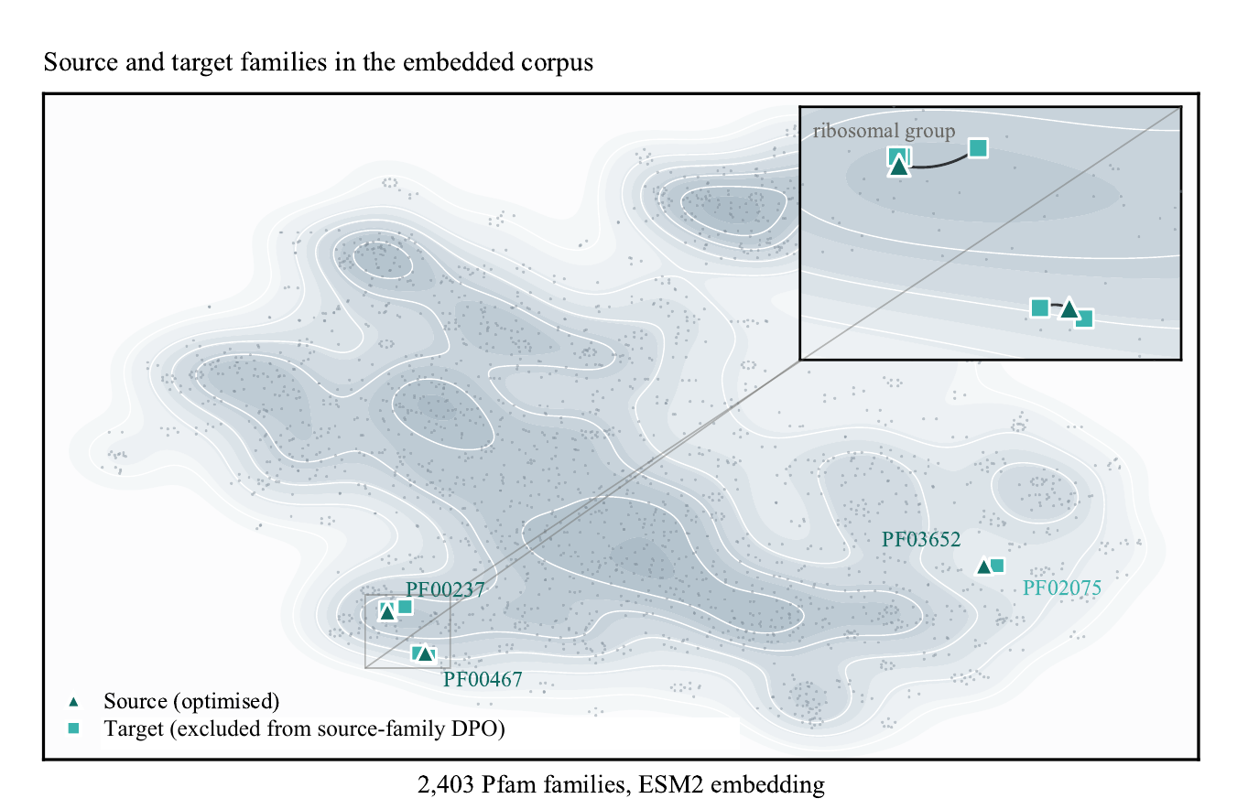
Goal
Families
Result
MILESTONE 3 · EMBEDDING
Source and target families
2,403 Pfam families, ESM2-embedded. Source families (optimized) and target families (held out, nearest cluster-mates) sit close together in embedding space.
16
Notes:
This is the actual map — every dot is a Pfam family, positioned by its ESM2 embedding. Triangles are source families we ran preference optimization on; squares are target families, specifically chosen as that source's own nearest neighbors in this space — you can see the zoomed insets, they sit right next to each other, sometimes in the same tight cluster. I'm showing this because it makes the limitation slide land correctly: when I say gains don't transfer to target families, I mean they don't transfer even to the closest, most favorable neighbor we could find. That's a stronger negative result than it would be if targets were random distant families.

Slide 17
Goal
Families
Result
MILESTONE 3 · RESULT
Results
CARRIES THE REQUESTED DOMAIN · % OF GENERATIONS
REACHES THE NATURAL FOLD · %
MEAN pLDDT
pLDDT: uS13 after one round; uL24 for seed 1001 after three rounds. For uL22 and YqgF the paper reports only the aggregate: gains of up to +13.1 points, from a supervised range of 45–59 against 77–83 for natural proteins.
17
Notes:
The result on the four optimized families, two seeds averaged, with natural sequences at 100%. Left: the share of generations that carry the requested domain. It rises with every family: uS13 from 27 to 79%, uL22 from 9 to 38, uL24 from 28 to 72, YqgF from 44 to 80, and it climbs across optimization rounds. Right: the share that reach the natural fold, measured by structural similarity to a natural member; uS13 is not folded here. In the three additional families, requested-domain recovery goes from a range of 9 to 44% up to 30 to 80% at the evaluated checkpoints, and mean pLDDT gains reach 13.1 points. The domain and the fold are not what the preference pairs were ranked on, so they improve independently of the training signal.
The third panel is structure: mean ESMFold pLDDT. For uS13, one anchored round takes it from 49.4 to 57.6, against 78.0 for natural proteins. For uL24, seed 1001, three rounds take it from 48.0 to 66.1, against 77.4 for natural proteins. For uL22 and YqgF the paper gives only the aggregate: gains up to 13.1 points. So structure improves alongside domain recovery, though it stays below natural.

Slide 18
Goal
Families
Result
MILESTONE 3 · TRANSFER
Source to target
WHAT WE TESTED
CHANGE IN DOMAIN RECOVERY VS. SUPERVISED · PERCENTAGE POINTS
1
Optimize on a source
Three families: uL22, uL24, YqgF.
TARGET (HELD OUT)
SOURCE ADAPTER
uL22 PF00237
uL24 PF00467
YqgF PF03652
PF00177
-1.3
-11.6
+5.5
2
Apply to a target
Six related families, no target data used.
PF01196
-8.6
-8.3
+3.3
PF00886
0.0
-3.6
+1.8
3
Compare
Against the supervised model, same held-out prompts.
PF00366
-7.8
-9.4
+6.2
PF01157
0.0
0.0
0.0
PF02075
-5.6
-5.6
-41.7
Outlined: the target's nearest source family. Rust = lower than supervised, teal = higher.
18
Notes:
Here is the source-to-target test. We optimized adapters on three source families, uL22, uL24 and YqgF, then applied each to six related target families that contributed no examples to that training, and compared with the supervised model on the same held-out prompts. Each cell is the change in requested-domain recovery in percentage points, averaged over two seeds. The outlined cell in each row is that target's nearest source. For those nearest pairs, recovery goes down in four of six and is unchanged in two; the worst case is RuvC from YqgF, down 41.7 points. So control does not carry over automatically; it is family-local. That is a finding in its own right, and it is why the next question is how much data a new family needs.

Slide 19
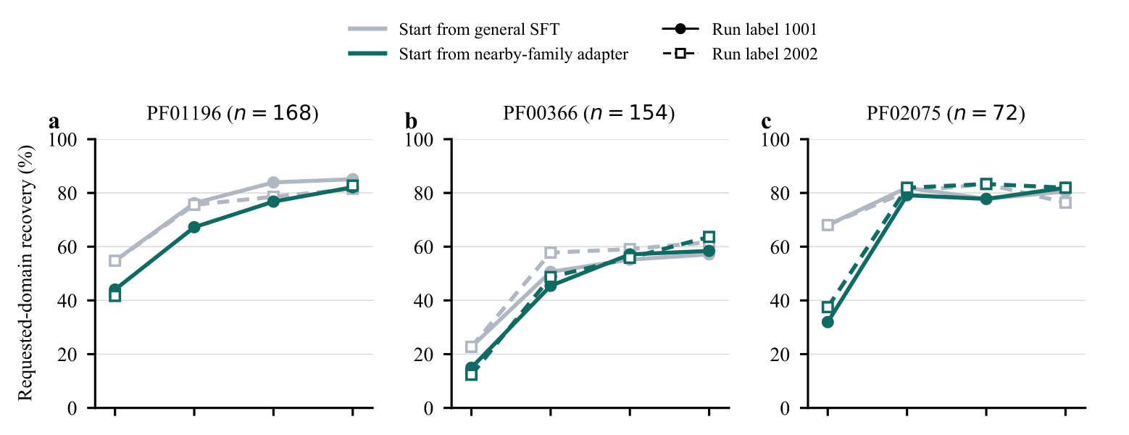
Goal
Families
Result
MILESTONE 3 · TARGETS
Target data moves it
DOMAIN RECOVERY BY TARGET-FAMILY DPO ROUND · %
1
A transferred adapter starts lower
2
Target data closes the gap
3
The family's own data is what matters
x-axis: target-family DPO round (initial, 1, 2, 3). Teal: start from the nearby-family adapter. Gray: start from the general supervised model.
19
Notes:
To separate the transferred adapter from the target's own data, we optimized three of the six targets directly, bL17, uS17 and RuvC, from two starting points: the general supervised model, and the adapter from the nearest source. The nearby-family adapter is a worse start: domain recovery at the starting checkpoint is 55 against 43% for bL17, 23 against 14% for uS17, and 68 against 35% for RuvC. With three rounds of target-family DPO, both starting points rise to similar levels. After three rounds, strict-composite passage is 21 to 24% against 23 to 24% for bL17, 27 to 28% against 21 to 25% for uS17, and 29 to 31% against 22 to 24% for RuvC; ranges are the two runs, not confidence intervals. So data from the family itself is what matters, which motivates the low-resource question.

Slide 20
Thank You!

