Slide 1

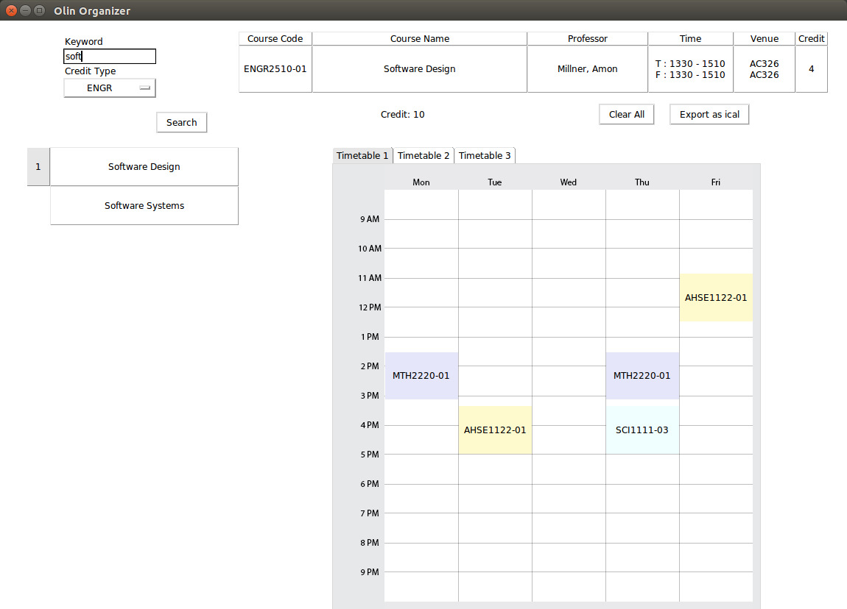
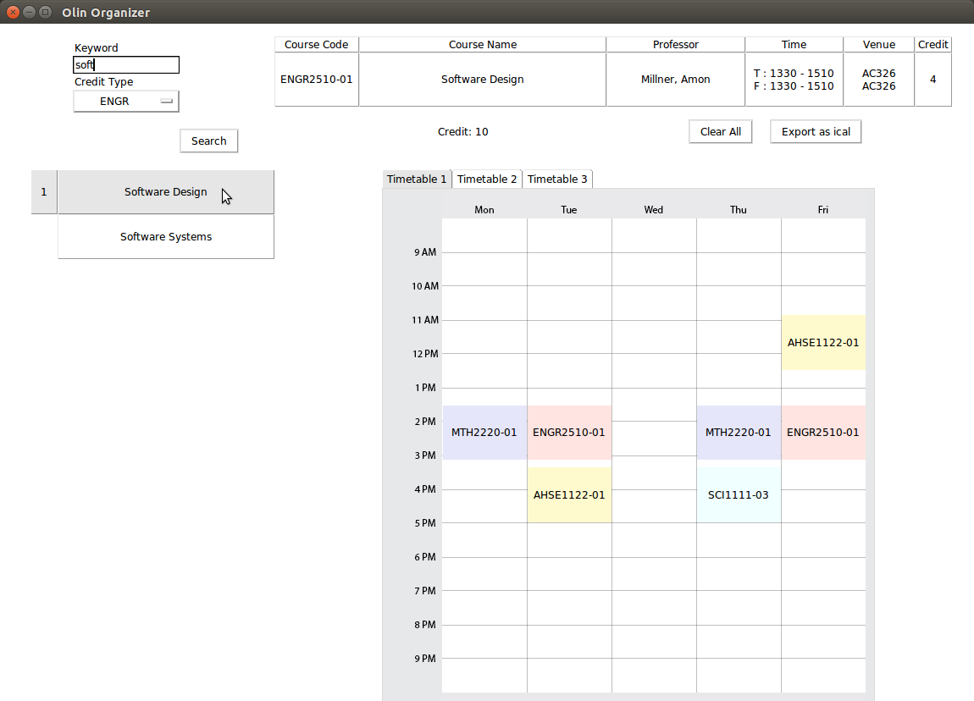


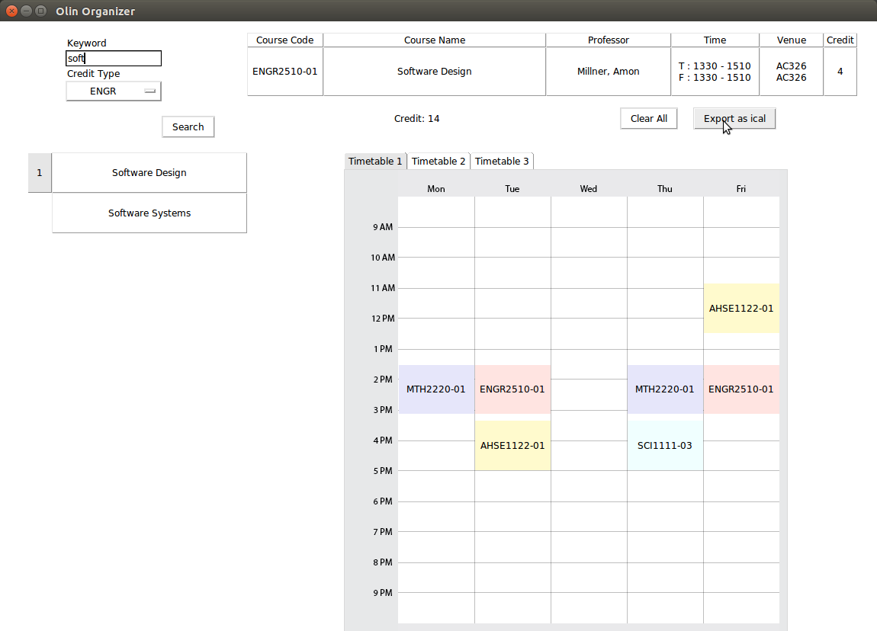

The revolutionized planner
Olin
Organizer
Jee Hyun Kim
Junhyun Nam
Zi Liang Ong
About O2 Olin Organizer can potentially modernize how students plan their schedule. This idea was sparked by exchange students who came from universities that offer a wide variety of courses. The program is extremely beneficial for Oliners to choose the best choice of classes and plan for alternative schedules. Students can effortlessly export timetable as iCAL and synchronize it with their smartphones.
Getting Started 3 easy steps.
Users can search for a particular class and
information with regards to the class will be displayed.
Add all the intended courses into the timetable.
Export as iCAL.
1
Features Olin Organizer provides all the information on a course such as credit, day and time, professor and venue. The search function makes course finding straightforward and alternate timetable planning helps student to be prepared if a certain course is full or unavailable. The iCAL function will add all the classes into the user’s calendar in one click.
2
Coding Platform Olin Organizer is a python based program that uses TkInter library for design interface. TkInter is a user-friendly and well documented Graphic User Interface (GUI) package. The program uses Comma Separated Values (CSV) library to import information about courses in Olin and iCalender library to support iCAL function.
iCAL
3
Code Structure Olin Organizer requires a firm coding structure to handle user
interaction as well as vast amount
Of information. Model View
Controller (MVC) is an organized
coding structure so debugging
is much simpler and less time
consuming.
iCAL files will be saved at a folder of user’s preference.

Slide 2


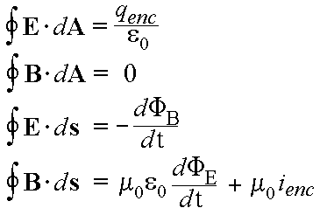

$$E=mc^{2}$$

