Slide 1

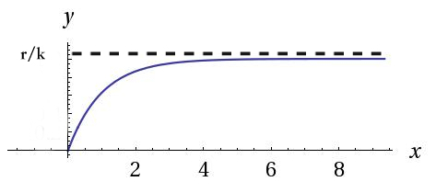
MATH 308 Differential Equations
Ciel Wu, Jacob Paradise
Washington & Jefferson College
60 S Lincoln Street
Washington, PA 150301
Drug Dissemination into Bloodstream
Theory
First we need to find the solution of this DE. (*)
(*) is separable. So we rewrite it as
.
Then we get a general solution,
And when t approaches to infinity, we have,
Which gives a limiting value r/k as result.
Given x(0)=0, then we have
So that we know, and ,
Therefore, .
And the graph of this function will be like this,
The value of r/k will be the limiting value, as t increases,
x will be getting closer and closer to this ceiling, with a decreasing speed.
When it reaches one-half of the limiting value, we have
Therefore, and . .The half-life period is dependent on the rate of drug
absorbed.
Application
Conclusion
Introduction
As a drug is administered into a person’s blood stream, it becomes more spread apart throughout the body until the concentration of the drug within the body will become zero.
By solving this DE model, we know that for any drug problem, we could use this model to figure out the concentration of it at a specific time, the maximum concentration of the drug in the blood, and also find out the half-life period from the rate of absorbing.
Model set-up
A mathematical model for the rate at which a drug disseminations into the bloodstream is given by
References
Dennis G.Zill. 2013. A first course in Differential Equations with Modeling Applications, 10th Edition. Manual for General Biology. 93.
Jerald Hertzog, Zachary Marsh, Victoria Smith and Leah Vaughan, Modeling drug dissemination with differential equations Poster.
r= Constant rate of the drug disseminates into the bloodstream
k= Constant rate of the drug absorbed in the bloodstream
t= Time
x(t)= Concentration of the drug in the bloodstream at time t.
With an initial condition,
x(0)=0.
We believed that as t increases, the concentration of the drug will ultimately approach a limiting value r/k (but never reach it). So we called this value Xs which means the concentration of the drug in bloodstream in stable condition.
There is a patient whose weight is 50kg, and the drug disseminates into the bloodstream with a speed of 20mg/min. What is the value of Xs? And find out the concentration of drug in bloodstream after being injecting this drug for 10 hours. (The half-life period of the drug is known to be 3.5 h and the volume is known to be 2L/kg.)
We know, the model of the drug dissemination is
and since Xs= r/k, so we have,
Ciel Wu: wux@jay.washjeff.edu
Jacob Paradise: paradisejl@washjeff.edu
For Further Information
r
X
k

