Slide 2
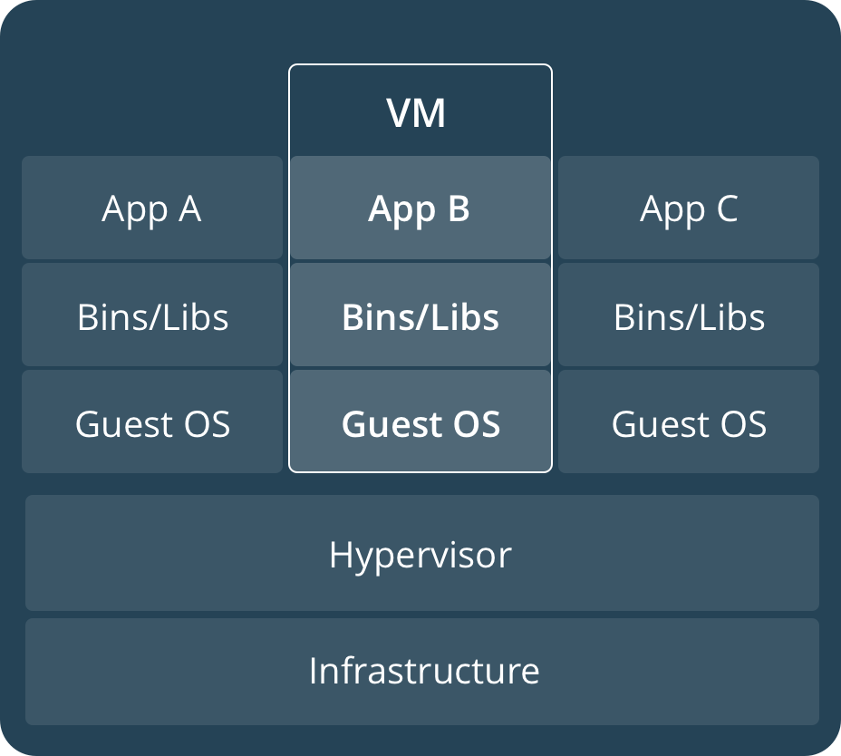
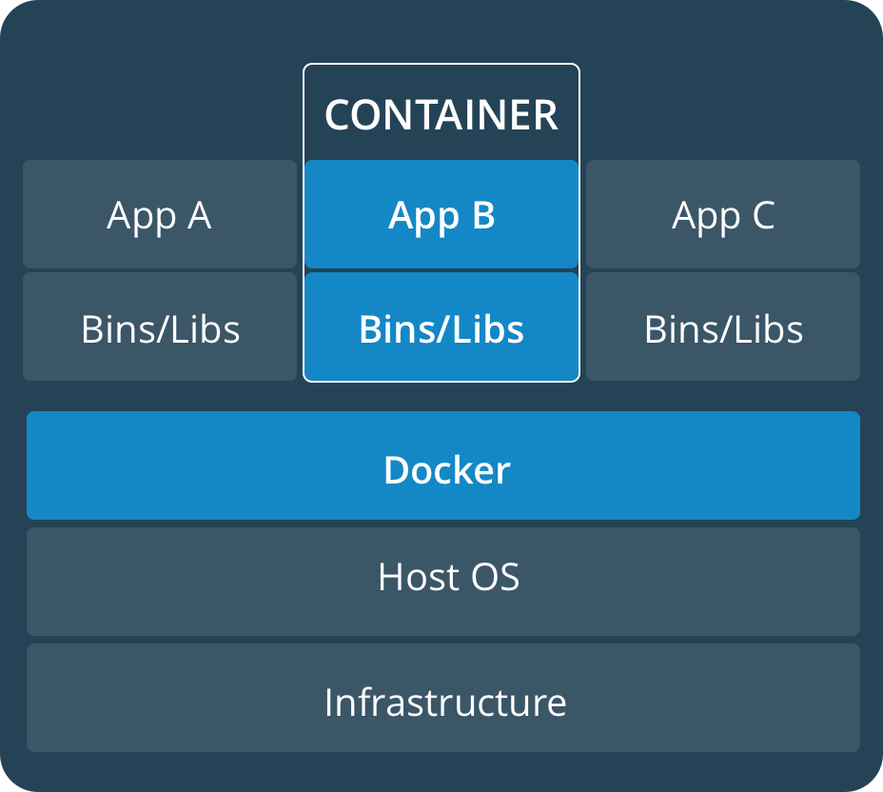

Slide 4
Container
Container
Container
Container
Container
Container
Image
(i.e. Spark)
Image
(i.e. SQL+pHp)
Image
(i.e. Tensorflow)
Docker daemon

