Slide 1
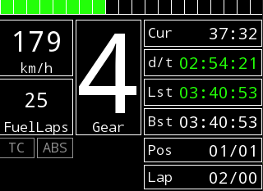
RPMS (SHMEM)
0 50 55 60 65 70 75 80 85 9091 92 93 94 95 96 97 98 99
Speed (SHMEM)
Laptime (SHMEM)
Delta Time (API)
Laps to go with fuel. Calculation by me.(SHMEM)
Last Lap (SHMEM)
Best Lap (SHMEM)
Gray=Disabled; Yellow=Active
(UDP)
Position (SHMEM)
Lap (SHMEM)
Delta Time: Green=Faster, Red=Slower
Last Lap: Green=Fastet, White=Within One second of fastet, Yellow=More than 1 second slower

