Slide 1
Cloudify Assignment
Cards Web API

Slide 2
Knowledge background and preparation
Review and improve competence in HTTP, REST API and Flask areas
Richardson Maturity Model, REST – PUT vs. POST, Idempotence, etc.
Install Flask and other necessary modules

Slide 3
Requirements analysis
Cloudify Assignment for Developer - Cards API.pdf
Clearly defined
Time spent summary
Knowledge gaining 2-3 hrs
Implementation 1 hr
Refactorization and tests 2 hrs

Slide 4
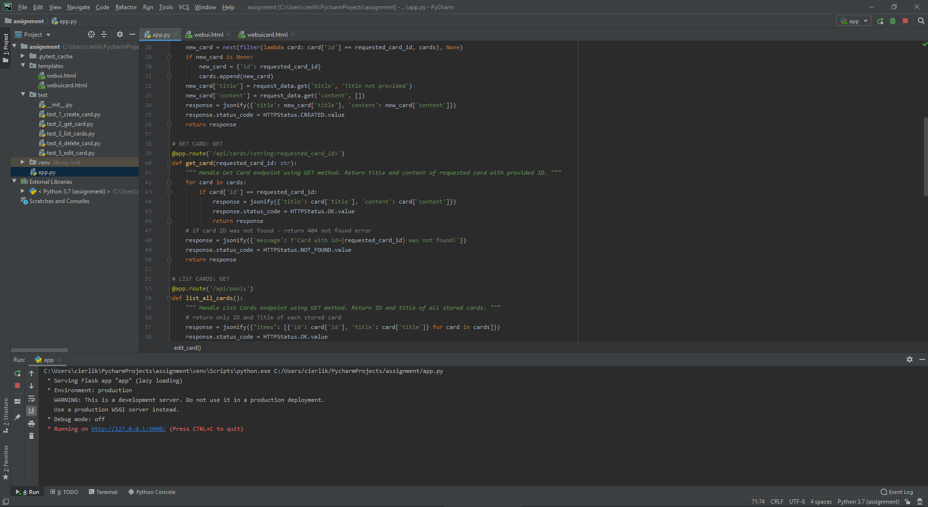
Source code

Slide 5
Web UI
Used Jinja2 module
HTML pages generated from provided templates
Customizable content, page built using variable values
Bootstrap 4.3
Used additionally for quick visual improvement of UI webpages

Slide 6
Documentation
Pydoc
Documentation based on docstrings of all methods and modules
Can be accessible in terminal or via HTML page

Slide 7
Verification
Postman
Manual functional and unit tests during logic implementation
Pytest
Automated testing of completed project modules

