Slide 1
Small Minds
Cierra Roper, Destiny Watson

Slide 2
Purpose
To create a fun but educational interactive site for children in grades K-3rd grade.

Slide 3
Technologies Used
Javascript
PHP
HTML
Bootstrap
CSS
Google Font API
Sketch.js (jQuery Plugin)

Slide 4
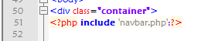
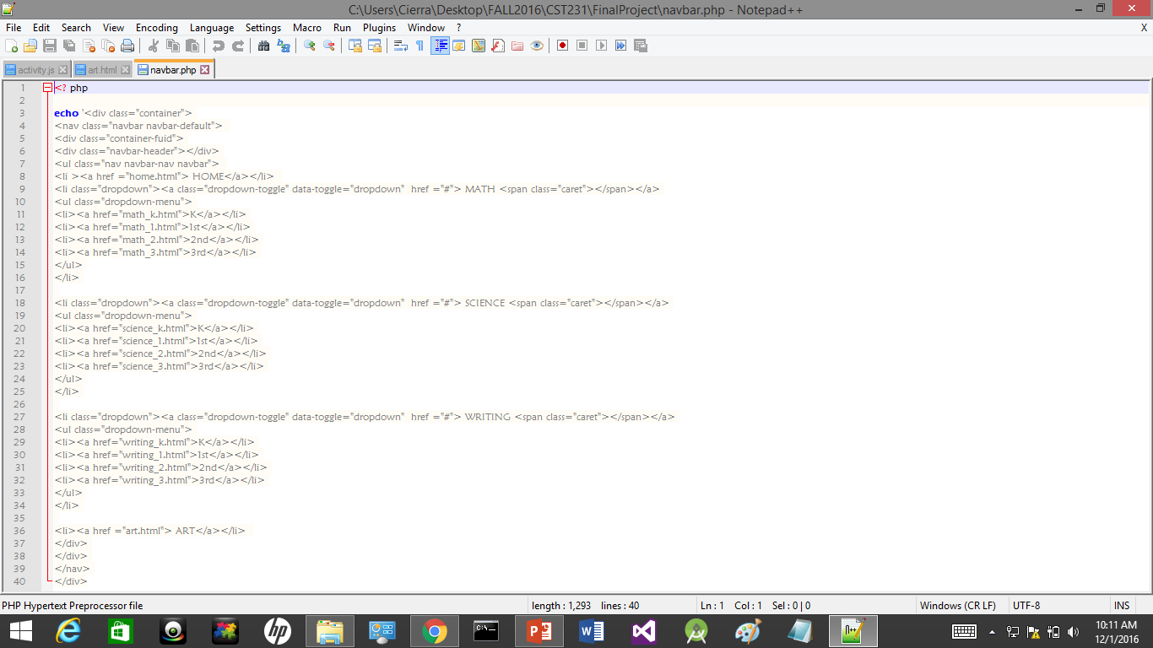

Navigation Bar
Created with bootstrap
Added to each page with php method include()
Dropdown menu for each subject
K-3 has there own section to choose from

Slide 5
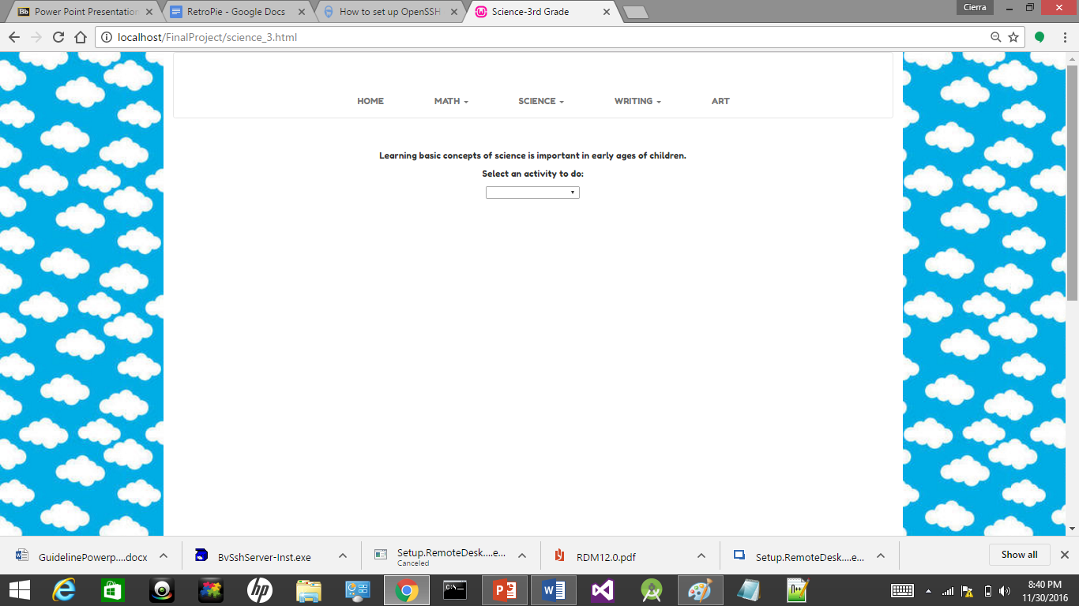
Layout
Simple Layout
Every activity easily accessible
Every grade level follows same consistent page layout
Greeting
Activity Options(Select activity from menu
Activity loads on the page

Slide 6
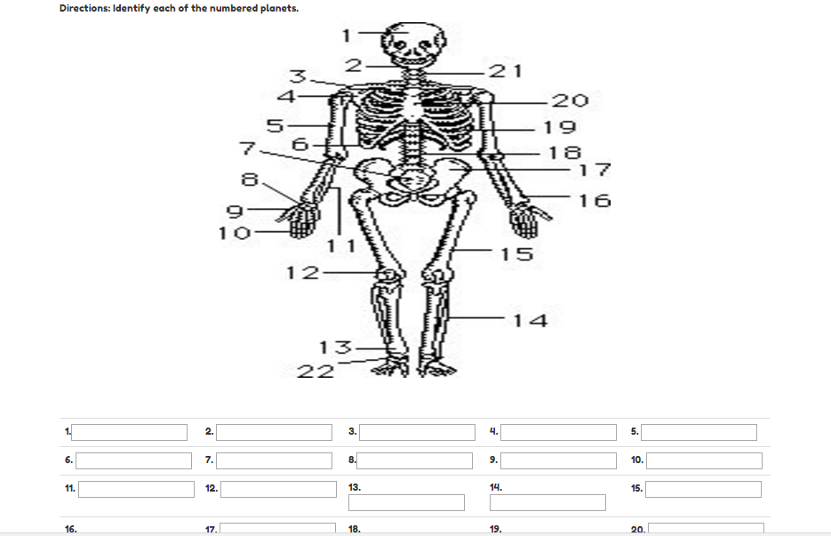
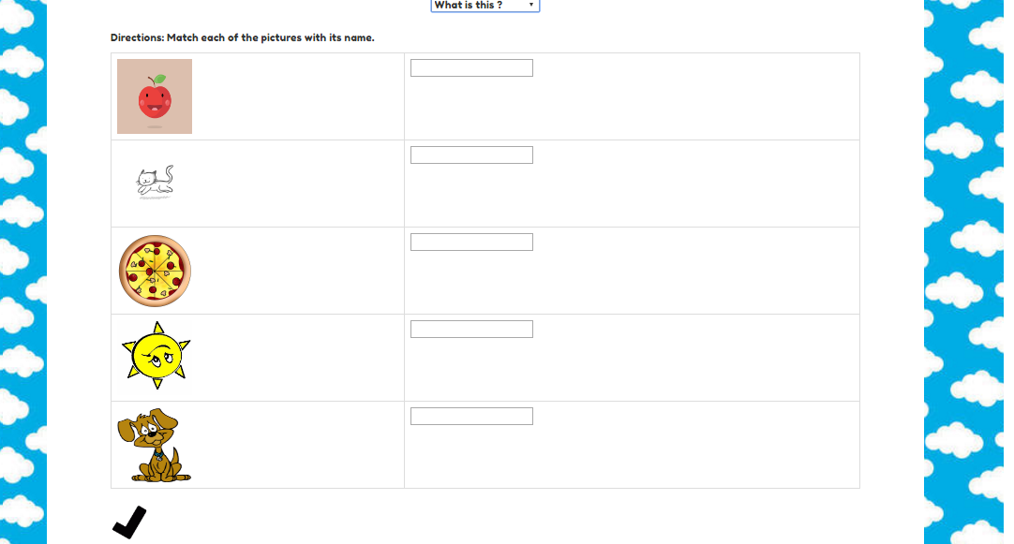
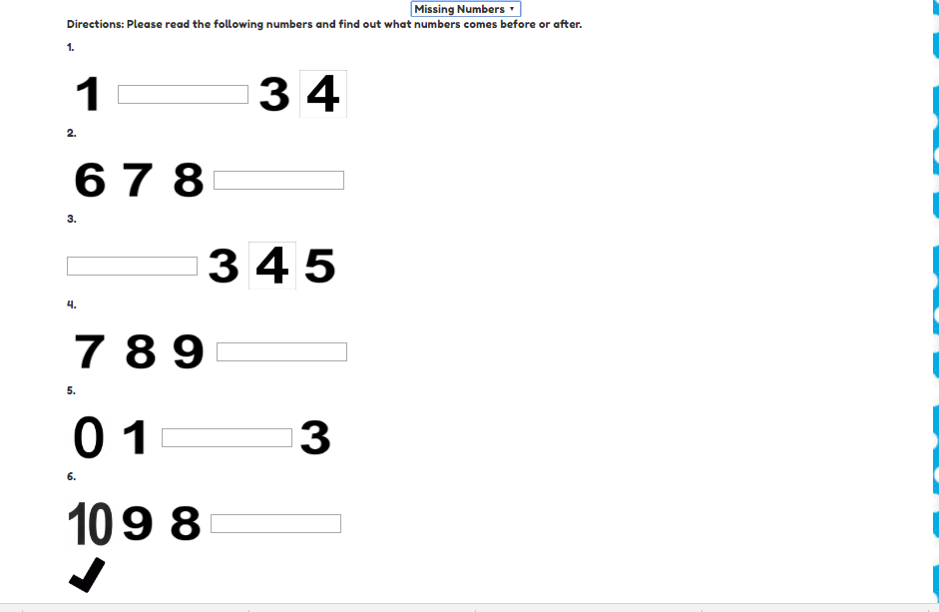
Activities
Personalized to each grade level
Fill in the blank and check

Slide 7

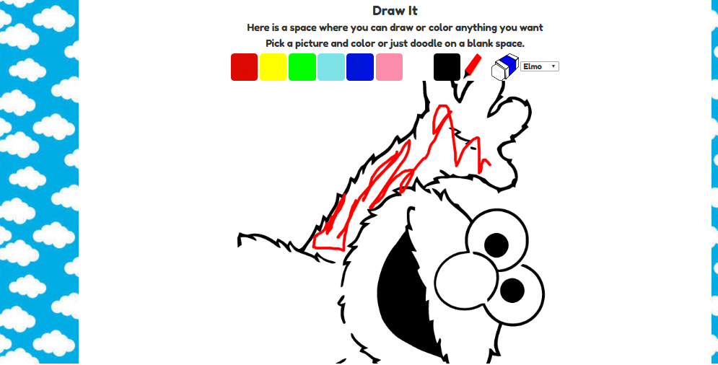
Art
Can be used by all grades
Accessed through jQuery plugin Sketch.js
Can draw on a blank canvas or color on a picture

Slide 8
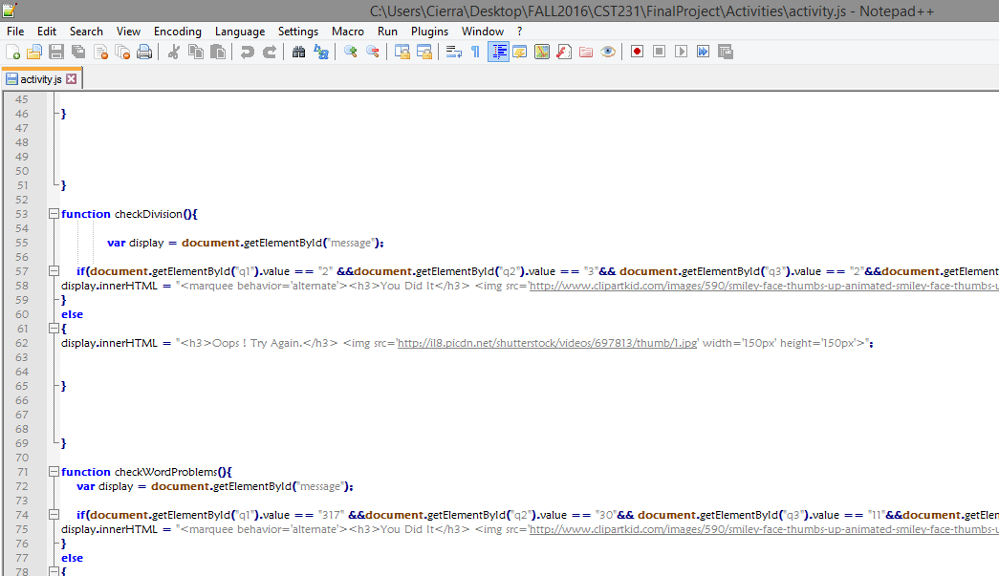
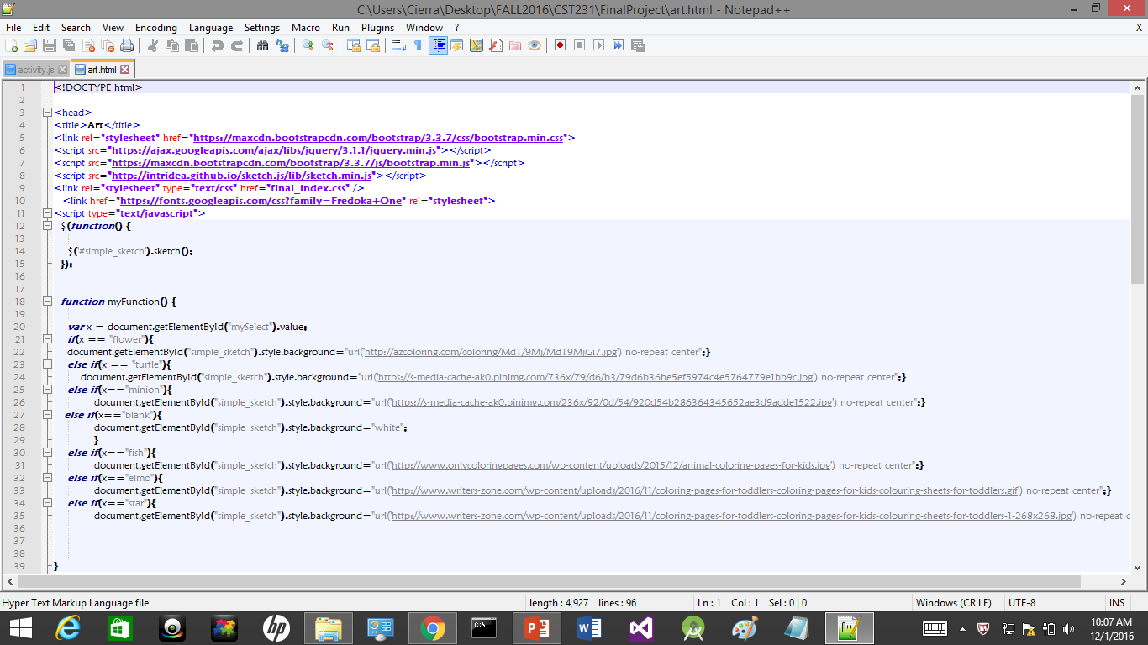
Activity functionality
Most of the functionality is done with Javascript
Selection menu
Answer validation
the draw it functions

Slide 9
In the Future
Add more activities
More variety
Different versions of certain activities will be loaded each time that activity is chosen

