Slide 1
Exploratory Data Analysis on Facebook Utilization Data
Tanya walia

Slide 2
introduction
Domain: Social Media Analysis
Topic: Facebook data analysis
Project Introduction: The objective of the proposed framework is to study and analyse the differences in the way users are using Facebook based on their gender, age-group, etc. and Identify a pattern out of it.
Source: https://docs.google.com/spreadsheets/d/1PHNL0qC1qCvVsN9vZMKEPo1cg5CmNB4JmYoCQcfVR3g/edit?usp=sharing

Slide 3
objective
1. Analysis based on gender of the users
2. Analysis based on least active users on Facebook
3. Analysis based on the user accessibility (Mobile Devices vs. Web Devices)
4. Deal with missing values
5. Perform EDA

Slide 4
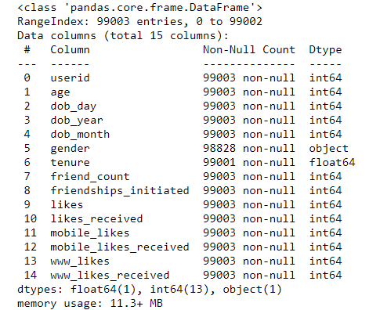
Dataset description

Slide 5
Analysis based on gender of the users

Slide 6
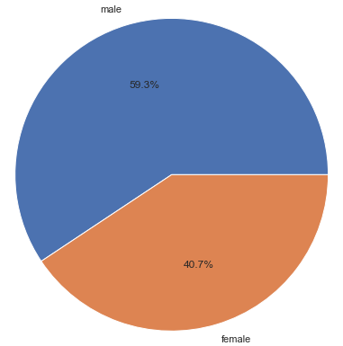
What is composition of male and female users?

Slide 7
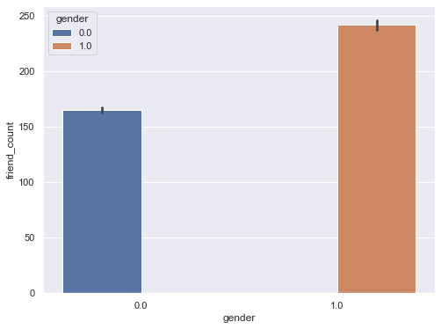
Which category of gender has more friends?

Slide 8
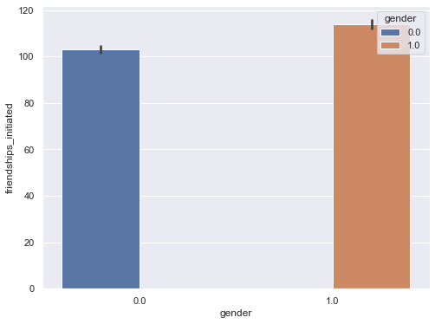
Which category of gender initiated more friendships?

Slide 9
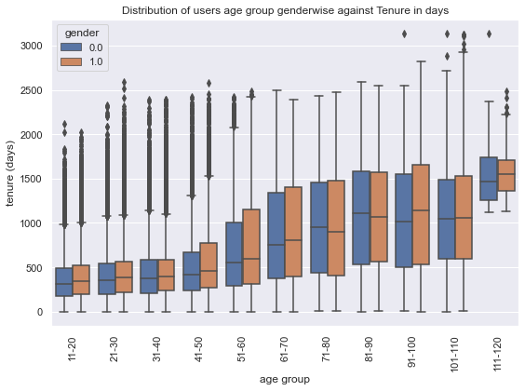
What is the distribution of tenure across different categories of gender?

Slide 10
Analysis based on the least active users on Facebook

Slide 11
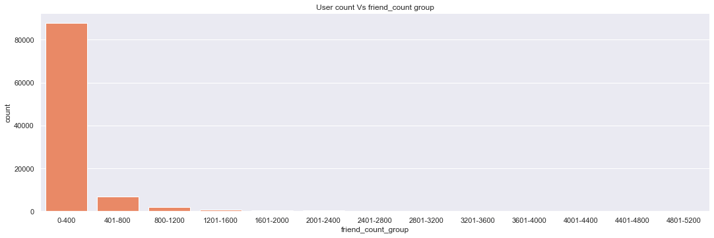
How many users have no friends?

Slide 12
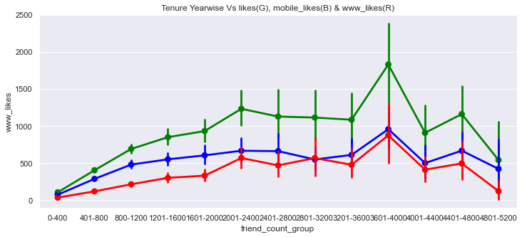
How many users did not like any posts?

Slide 13
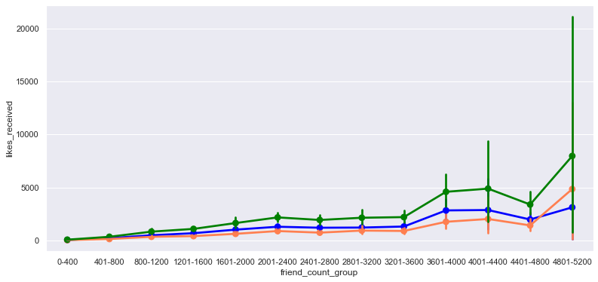
How many users did not receive any likes?

Slide 14
Analysis based on the user accessibility (Mobile Devices vs. Web Devices)

Slide 15
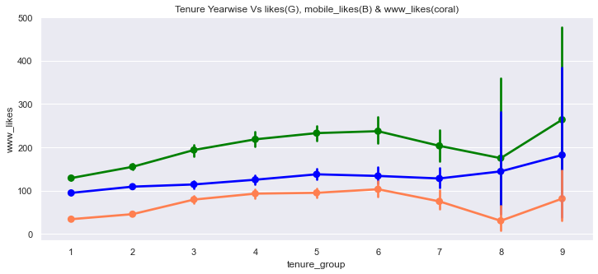
What is the average number of posts liked by users (based on gender) through web vs. mobile devices?

Slide 16
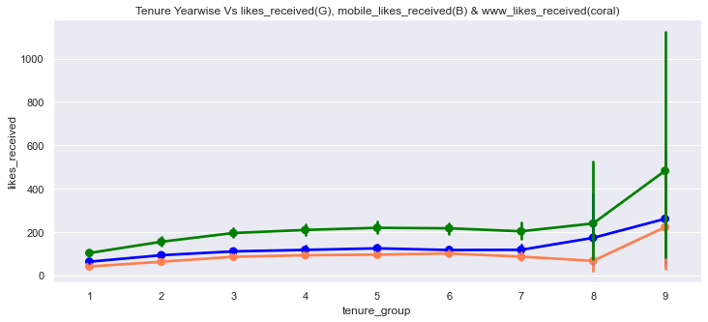
What is the average number of likes received by users (based on gender) through web vs. mobile devices?

Slide 17
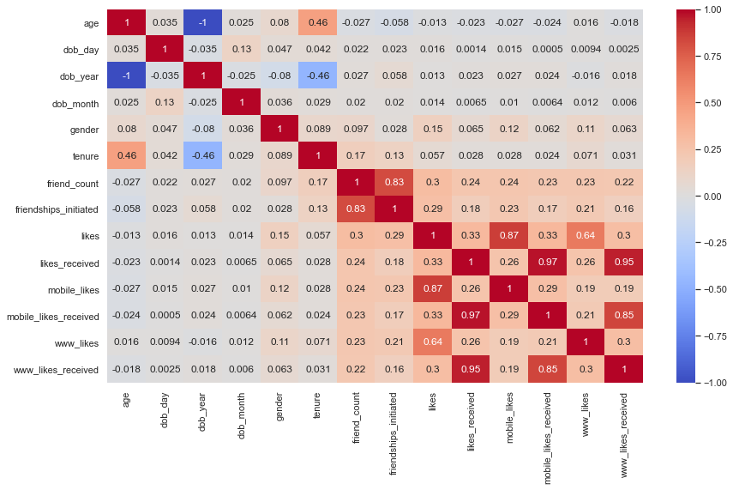
Correlation matrix

Slide 18
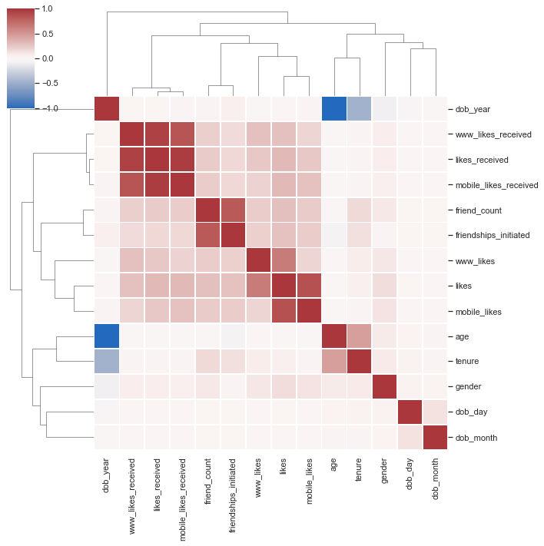
Cluster map

Slide 19
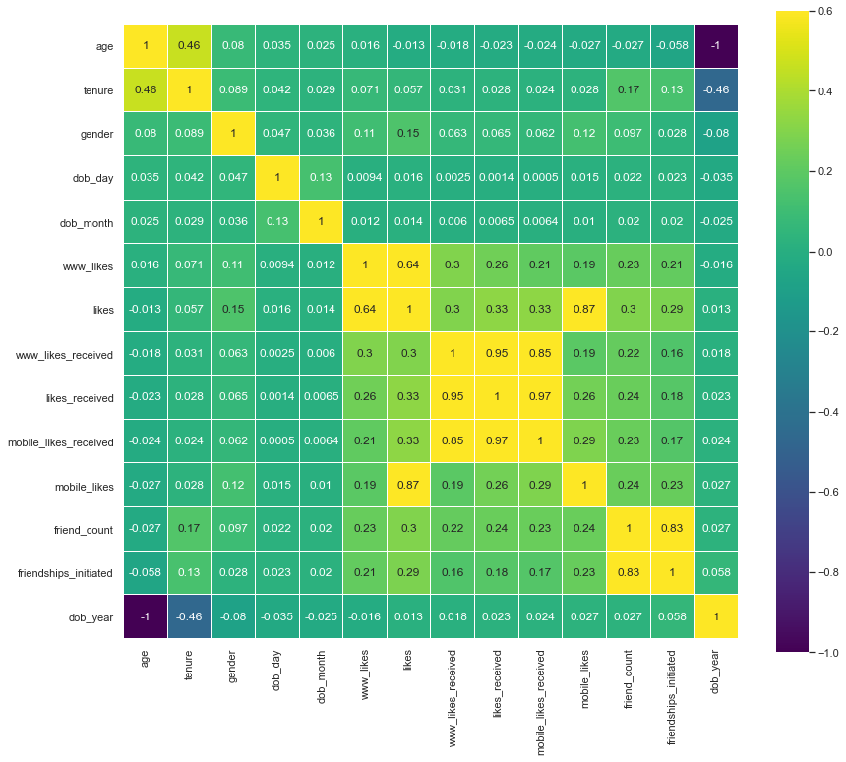
Heatmap

Slide 20
Thank you!

