Slide 1
Objects and Classes 黃世強 (Sai-Keung Wong)

Slide 2
Content
Classes vs objects
State, behaviours
Unified Modeling Language
Constructors
Constant object names
Anonymous objects
Class is a data type
Class definition and implementation
Preventing multiple Inclusions
Scopes
Attribute modifiers: public, protected, private

Slide 3
Object-Oriented Programming (OOP) Concepts
We use objects in implementing programs.
An object represents an entity in the real world.
An object has a unique identity, state, and a set of behaviors (implemented as methods).
Objects can be distinctly identified.
The state of an object consists of a set of data fields (or properties) with their current values.
The behavior of an object is defined by a set of functions.

Slide 4
Objects
class ClassName {
Data Fields
Constructors
Functions
};
class Circle {
double radius; //Data Fields
Circle( ); //Constructor
double getArea( ) const; //Function
};
Circle Object1
Data field:
radius = 13.0
Circle Object2
Data field:
radius = 12.0
Circle Object3
Data field:
radius = 15.0
In this example, an object has a state and a behavior.
The state defines what the object’s values are and what the object can do next.
The behaviors define what the object can do.

Slide 5
Classes
Classes are constructs that define objects of the same type.
Data fields: variables
Behaviors: functions
Constructors: they are invoked to construct objects from the class.

Slide 6
class Circle {
double radius; //Data Fields
Circle( ) { //Constructor
radius = 1.0;
}
Circle( double newRadius ) { //Constructor
radius = newRadius;
}
double getArea( ) const { // function
return radius*radius*3.141592654;
}
};
Circle a, b(12.5), c(21);

Slide 7
UML Class Diagram
Circle
+radius: double
+Circle()
+Circle(newRadius: double)
+getArea( ) const: double
Class name
Data fields
Constructors and
Functions
The + symbol means public
a: Circle
radius = 1.0
b: Circle
radius = 12.5
c: Circle
radius = 21.0
UML: Unified Modeling Language

Slide 8
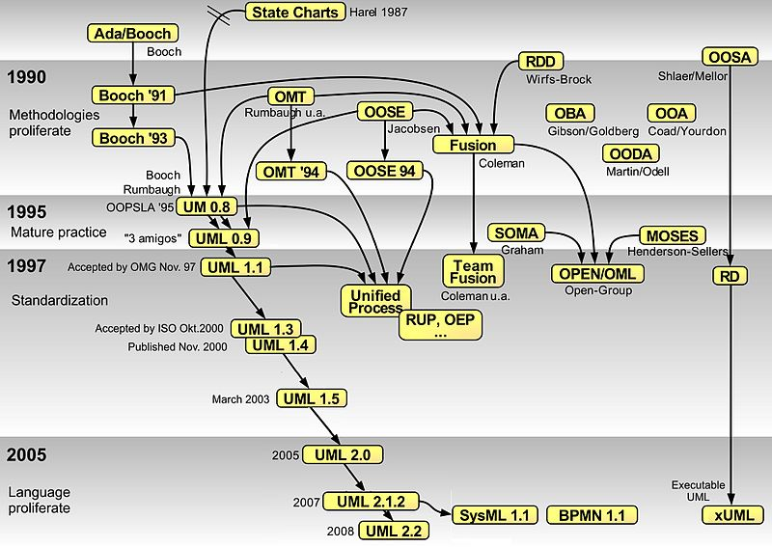
https://en.wikipedia.org/wiki/Unified_Modeling_Language#/media/File:OO_Modeling_languages_history.jpg

Slide 9
Constructors
The constructor has the same name as the class name.
Constructors can be overloaded. They have the same name but with different signatures. They initialize data members. They do not return a value (no void).
A no-arg or no-argument constructor does not have any arguments
If a class does not have any constructors, a default constructor is implicitly declared . It is a no-arg constructor with an empty body.
class MyClass {
public:
MyClass( ); // no-arg constructor
MyClass( int b);
MyClass( int d, float e);
};
class MyClass {
protected:
int a;
};

Slide 10
Object Names
Assign a name when we create an object.
A constructor is invoked when an object is created.
ClassName objectName; // Create an object using the no-arg constructor
For example,
SQUARE sq;

Slide 11
Constructing an object with arguments
// Declare an object using a constructor with arguments
ClassName objectName(arguments);
For example,
SQUARE sq(3.2);
TRIANGLE triangle( 1.2, 1. , .8 );

Slide 12
Access Operator
The access operator: the dot operator (.)
We can use this operator to access data members and methods.
objectName.dataField : reference a data field in the object.
objectName.function(arguments): invoke a function on the object.

Slide 13
Naming Objects and Classes
Capitalize the first letter of each word in a class name;
Examples: Circle, Square

Slide 14
Class
Use class names to declare object names.
A class is a data type.
Use primitive data types to declare variables.

Slide 15
Memberwise Copy (shallow copy)
Copy the content of one object to another
Square x, y;
x = y; // use the assignment copy
The data members of y are copied to their counterparts in object x.
class Square {
public:
double side;
double area;
};
x.side = y.side;
x.area = y.area;

Slide 16
Constant Object Name
Square mySquare;
Once an object name is declared, it represents an object.
It cannot be reassigned to represent another object.
An object name is a constant.
The contents of the object may change.

Slide 17
Anonymous Object
When we create an object and use it once, we do not need to name it.
// create an anonymous object using the no-arg constructor
ClassName( );
// create an anonymous object using the constructor with argument
ClassName(arguments);

Slide 18
Anonymous Object? When to use it?
void f( A *x ); // forward declaration
void g( ) {
f( new A );
f( new A( ) );
}
// may have the memory leak problem
Use it once.
Do not refer to it later.
void f( A x );
void g( ) {
f( A( ) );
}

Slide 19
Anonymous Object? When to use it?
class FUNC_PROFILE {
private:
clock_t start;
double duration;
public:
FUNC_PROFILE() {
start = clock();
}
~FUNC_PROFILE() {
duration = (clock()-start)/(double) CLOCKS_PER_SEC;
cout << "duration:" << duration << endl;
}
};
//include ctime

Slide 20
Anonymous Object? When to use it?
class FUNC_PROFILE {
private:
clock_t start;
double duration;
public:
FUNC_PROFILE() {
start = clock();
}
~FUNC_PROFILE() {
duration = (clock()-start)/(double) CLOCKS_PER_SEC;
cout << "duration:" << duration << endl;
}
};
//include ctime
void f( ) {
FUNC_PROFILE( );
…
…
}

Slide 21
Anonymous Object? When to use it?
class FUNC_PROFILE {
private:
clock_t start;
double duration;
public:
FUNC_PROFILE() {
…….
}
~FUNC_PROFILE() {
…….
}
};
//include ctime
void foo() {
// create and
// destroy at the end of
// the function call.
FUNC_PROFILE a;
……
}
void foo() {
//create and destroy at once
FUNC_PROFILE();
……
}
foo ( A(), B(n) ); //pass objects

Slide 22
Class and Structure
A structure and a class defines data members.
A class has methods.
A structure does not have any methods.
struct Record {
char id[16];
char phoneNumber[16];
int age;
};
class Record {
public:
char id[16];
char phoneNumber[16];
int age;
public:
void printf() const;
};

Slide 23
Separating Definition from Implementation
Class definition: describe the contract of the class.
Class implementation: implement the contract, including constructors and functions.
Class declaration: simply list all the data fields, constructor prototypes, and the function prototypes.
The class declaration and implementation are in two separate files.
Both files should have the same name, but with different extension names.
Class declaration file: the extension name is .h
Class implementation file: the extension name is .cpp

Slide 24
Inline Declaration in a class
class A {
……
// foo is defined inside the class body of A
int foo( int a, int b) { return a + b; } // inline method
}

Slide 25
Inline method
class A {
……
// foo is defined inside the class body of A
int foo( int a, int b) { return a + b; } // inline function
int g ( );
}
inline A::g( ) { // inline method
….
}

Slide 26
inline functions
The binary code of the function is copied to the position that the function is invoked.
inline void g( int a, int b ) { ……}
void foo( ) {
g( 1, 4);
g( 3, 6);
}
cache

Slide 27
Data Field Encapsulation
Non-hidden data members
Clients can access them directly.
There are potential problems.
They can be modified directly from outside.
Potential problems
Data may be tampered.
It makes the class difficult to maintain.
It is vulnerable to bugs.
Clients may modify the data members. Subsequently, the state of an object can be wrong.

Slide 28
Accessor and Mutator
A get function: a getter (or accessor)
A set function: a setter (or mutator)
The signature of a get function:
returnType getPropertyName()
The get function returns a bool data type
bool isPropertyName()
The signature of a set function:
public void setPropertyName(dataType propertyValue)
Notes:
When the clients want to access the data members, they use accessors and mutators.

Slide 29
When we decide to implement accessors and mutators for data members with different attributes, we need to think carefully. The modifications of data members do not lead to a mistake. Use the right attribute modifiers for declaring the data members: private, protected, public
Accessor and Mutator

Slide 30
Rectangle Class
Rectangle
side1 : double side2: double area : double perimeter: double
+Rectangle( ) +Rectangle( double len1, double len2 ) +getSide1( ) +getSide2( ) +setSide1(side1: double): void +setSide2(side2: double): void +getArea( ) +getPerimeter( ) +computeArea( ) …

Slide 31
Scope
double r;
void foo ( int a ) {
int r;
r = 12.0;
for ( int i = 0; i < 10; ++I ) {
double r = 0.0;
r += i;
}
}
void main( ) {
double r;
foo( 10 );
}
The (lexical) scope of a binding: visibility of an entity
void foo ( int a ) {
int r;
r = 12.0;
}
void main( ) {
int r;
foo( 10 );
}
double r;
void foo ( int a ) {
int r;
r = 12.0;
}
void main( ) {
double r;
foo( 10 );
}

Slide 32
The Scope of Variables
Global variables
they are declared outside all functions
they are accessible to all functions in its scope
The scope of a global variable: from its declaration and to the end of the program.
Local variables
They are defined inside functions
The scope of a local variable: from its declaration and continues to the end of the block containing the variable.

Slide 33
The Scope of Data Members (Data Fields)
Data fields can be accessible by all methods, constructors, and the destructor.
Data fields and functions can be declared in any order in a class.
class Rectangle {
private:
double side1, side2;
public:
Rectangle( );
double getSide1( ) const;
};
class Rectangle {
public:
Rectangle( );
double getSide1( ) const;
private:
double side1, side2;
};

Slide 34
The Scope of Variables
class A {
private:
int a; // data member( data field)
public:
void foo( ) { int a; // local variable has the same name as a data field
a = 5; // 5 is assigned to the local variable. Higher precedence
}
};

Slide 35
Class Abstraction and Encapsulation
Class abstraction: separate
class implementation from the use of the class.
The creator of the class provides a description of the class.
Let the user know how the class can be used.
The user of the class does not need to know how the class is implemented.
The detail of implementation is encapsulated and hidden from the user.

Slide 36
Data Encapsulation
Data hiding
class Circle {
private:
double radius; // the client needs not to know what it is.
…
};
Circle c;
c.radius = 10.1; // not allowed

Slide 37
Example
class MONTE_CARLO_SYSTEM {
protected:
double mRadius;
int mNumSamples; // range = [2, 1,000,000]
vector<float> mX;
vector<float> mY;
void generateUniformSamples( );
public:
MONTE_CARLO_SYSTEM( );
void askForInput( );
void reset();
double computePI() const;
double getRadius( ) const;
int getNumSamples( ) const;
bool getSample(int sampleIndex, float &x, float &y) const;
};
The client does not need to know how the sample points are stored.

