Slide 1
Graph System
Data Structure and Object Oriented Programming
Sai Keung Wong (黃世強)
National Chiao Tung University, Taiwan

Slide 2
Marking Scheme
Use the mouse to create a node to connect two selected nodes.
Use the mouse to select a node. Then press DELETE to delete the node. Also delete all the edges attached at the node.
Press ‘d’ to activate or deactivate the process of node deletion. In the process of node deletion, the nodes are automatically deleted one by one.
Options ‘1’, ‘2’, ‘3’, ‘4’, and ‘5’ are handled correctly.
The key events ‘<‘ and ‘>’ are handled correctly in option ‘5’.
Press ‘e’ to export the graph to a file. (TAs, check the file content for correctness)

Slide 4
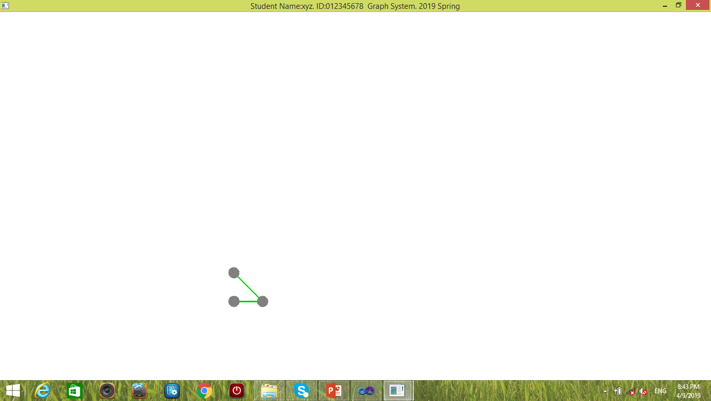
Graph
A graph G = (V, E) consists of a set of nodes (V) and a set of edges (E).
An edge is attached at two nodes.
A gray dot is a node.
A green line segment is an edge.

Slide 5
Assumptions
There are at most 1000 nodes and 1000 edges.
The degree of a node is at most 1000. That is that there are at most 1000 edges attached at a node.
We do not handle parallel edges.

Slide 6
Major task
Design a data structure to manipulate a graph. You should use the given data structure GRAPH_NODE and GRAPH_EDGE. The position of a node is on the x-z plane. Keep the y-coordinate of a node as zero.
Add a node (GRAPH_NODE)
Add an edge (GRAPH_EDGE)
Delete a node and all the edges attached at it

Slide 7
Modify the GRAPH_NODE and GRAPH_EDGE in graph_basics.h
Add extra data members and functions if you want to do so.

Slide 8
Tasks
int addNode( float x, float y, float z, float r = 1.0 ); Add a node and return the id of the node
int addEdge( int nodeID_0, int nodeID_1 ); Add an edge and return the id of an edge,
where nodeID_0 and nodeID_1 are the node IDs of the two nodes of the edge.
void createDefaultGraph( ) Create the default graph
void createNet_Circular( int n, int num_layers ); create nodes arranged in circles
void createNet_Square( int n, int num_layers ); create nodes arranged in squares. Some nodes at the center are removed.
void createNet_RadialCircular( int n ); create nodes arranged in a circle and one node at center.
void createRandomGraph_DoubleCircles(int n); create nodes arranged in two circles. The edges are randomly created for nodes in the inner and outer circle.

Slide 9
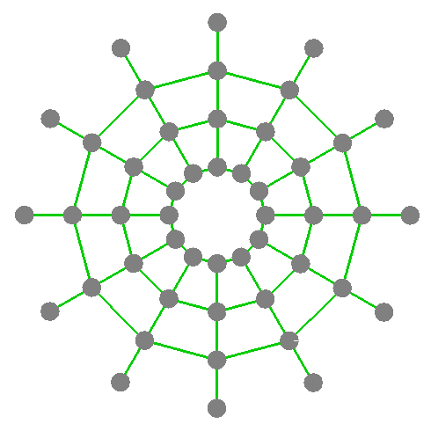
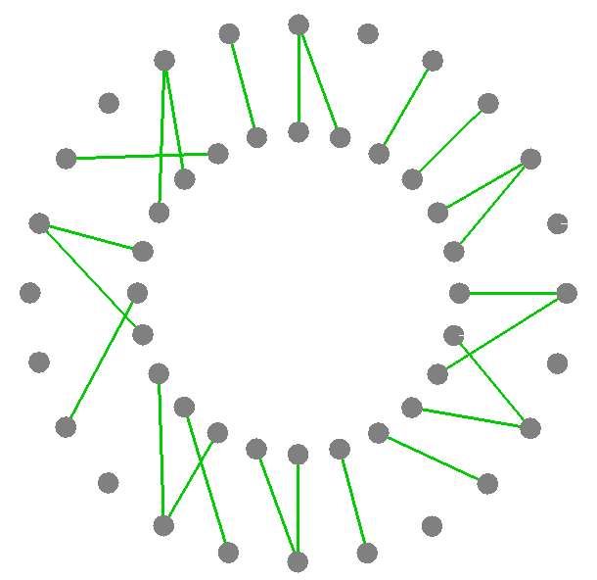
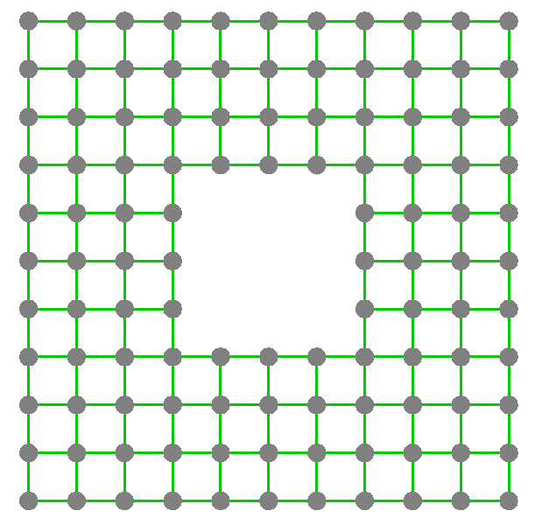
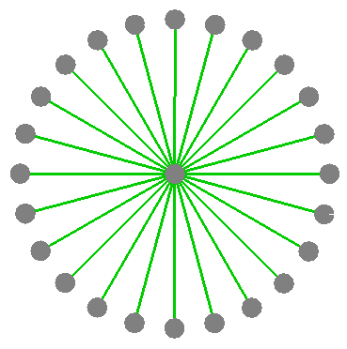
Graphs There are five options.
createDefaultGraph
createNet_Circular
createNet_Square
createNet_RadialCircular
createRandomGraph_DoubleCircles

Slide 10
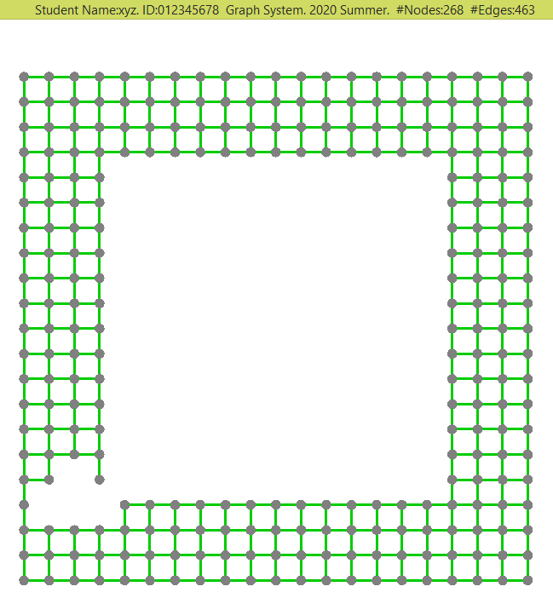
The top bar shows the student information, number of nodes, and number of edges.

Slide 11
createDefaultGraph. Press ‘1’

Slide 12
void createNet_Circular( int n, int num_layers ); Press ‘2’
createNet_Circular(12, 3);
There are 12 nodes arranged in each circle.
There are three inner layers and one outer layer.
There are edges connecting adjacent nodes between the inner layers. And also edges connect adjacent nodes in the same layer.
In the outer layer, there are no edges connecting the nodes in the outer layer.

Slide 13
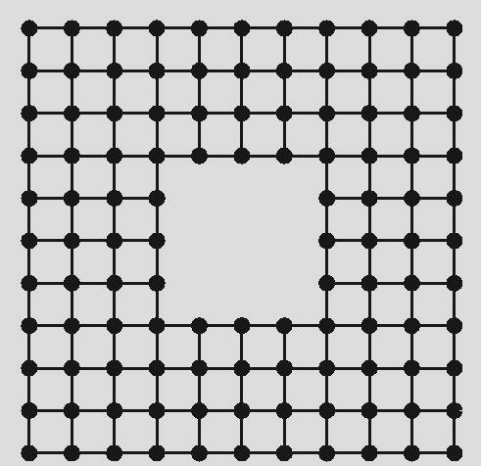
void createNet_Square( int n, int num_layers ); Press ‘3’
createNet_Square(3, 11)
n is the width of the inner square.
num_layers is the number of layers of the net.
Based on your own design, you can set your own parameters.
} 3
} 4
Number of layers = 11.

Slide 14
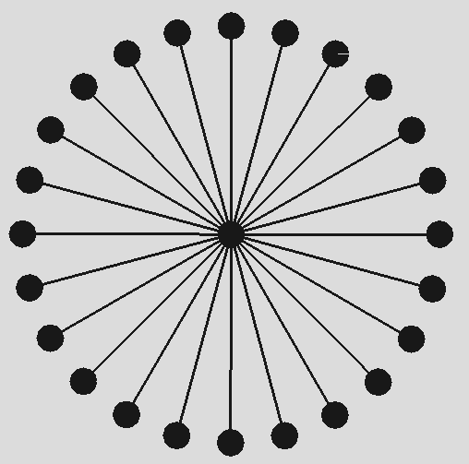
void createNet_RadialCircular( int n ); Press ‘4’
createNet_RadialCircular(24)
See the figure and do the same☺

Slide 15
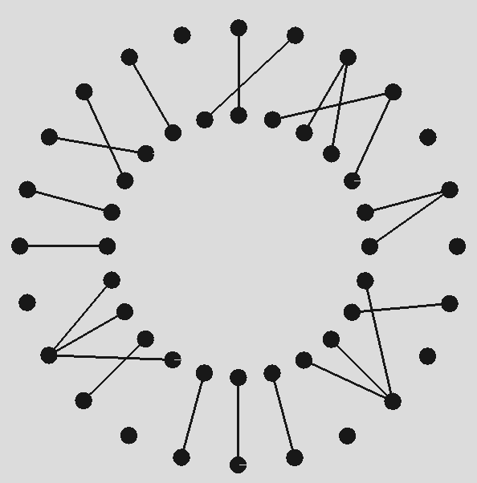
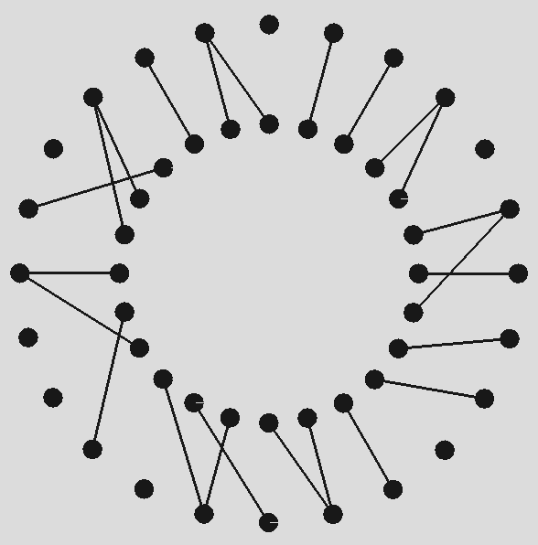
void createRandomGraph_DoubleCircles(int n); Press ‘5’
createRandomGraph_DoubleCircles(24)
There are two circles.
There are n nodes in each circle.
For each node of the inner circle, it connects to a close node in the outer circle.
A node of the outer circle is close to a node in the inner circle if the edge formed by these two nodes do not intersect the inner circle.
Different graphs can be created by pressing ‘5’.

Slide 16
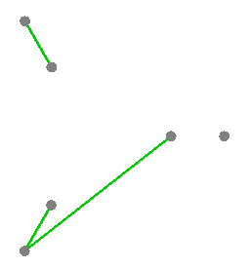
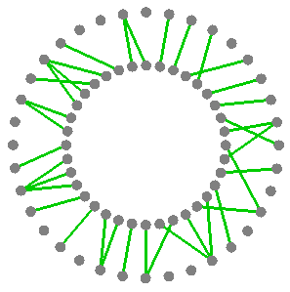
Key usage for createRandomGraph_DoubleCircles
createRandomGraph_DoubleCircles(
mNumPoints_DoubleCircles
)
Press ‘<’ to decrease the number of nodes.
The smallest number of nodes of a circle is 3.
Press ‘>’ to increase the number of nodes.
The largest number of nodes of a circle is 36.

Slide 17
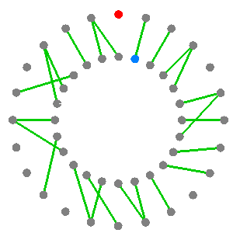
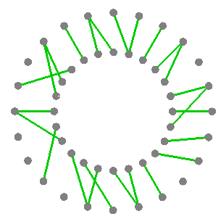
Tasks
Use the mouse to select two nodes and create an edge.
Click the left mouse button to select a node.
If the same node is selected, the node is unselected.

Slide 18
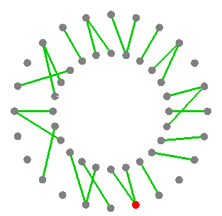

Tasks
Use the mouse to select a node.
Press DELETE to delete the node and all the edges attached at the node

Slide 19
Tasks
int getNumOfNodes( ) const; get the number of nodes N
void getNodeInfo( int nodeIndex, double &r, vector3 &p ) const;
Return the node position (p) and radius of the node (r) with nodeindex.
The nodeIndex starts from 0 to (N-1).
int getNumOfEdges( ) const; get the number of edges
vector3 getNodePositionOfEdge( int edgeIndex, int nodeIndex ) const;
return the node position of the node with nodeIndex of an edge with edgeIndex.
nodeIndex 0 for the first node of the edge
nodeIndex 1 for the second node of the edge

Slide 20
GRAPH_NODE *findNearestNode( double x, double z, double &cur_distance2 ) const
Find the nearest node to the given position (x, y, z). The y-coordinate is ignored in the parameter list.
Note that we work in x-z plane only. y should be set to 0.
The squared distance between the node and the given position should be stored in cur_distance2.

Slide 21
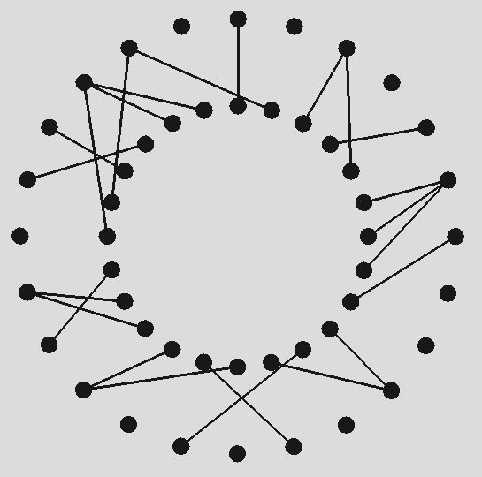
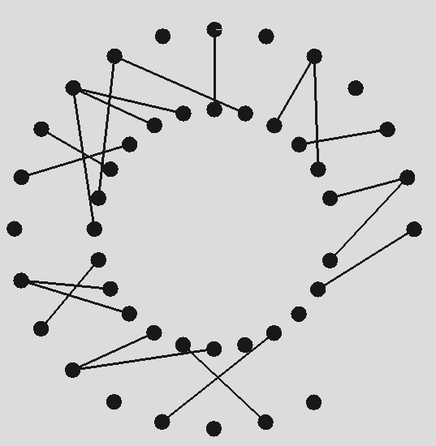
Press ‘d’ to toggle automatic deletion process for nodes. Delay with 250 msec.

Slide 22
Press ‘e’ to export the graph to a file Implement exportGraph
Save the graph as text format
The file name is graph.txt
File format
#Nodes // Let n = #Nodes
#Edges // Let m = #Edges
Node_ID x y z // There are n lines
…. // Each line contains one node
….
Edge_ID Node0_ID Node1_ID // There are m lines
…. // Each line contains one edge
….

Slide 23
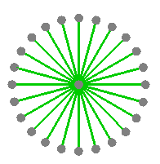
graph.txt
0 0 1
1 0 2
2 0 3
3 0 4
4 0 5
5 0 6
6 0 7
7 0 8
8 0 9
9 0 10
10 0 11
11 0 12
12 0 13
13 0 14
14 0 15
15 0 16
16 0 17
17 0 18
18 0 19
19 0 20
20 0 21
21 0 22
22 0 23
23 0 24
25
24
0 15 0 15
1 30 0 15
2 29.4894 0 18.8804
3 27.9924 0 22.4966
4 25.6108 0 25.6024
5 22.5069 0 27.9864
6 18.8919 0 29.4863
7 15.0119 0 30
8 11.1312 0 29.4925
9 7.5138 0 27.9983
10 4.40608 0 25.6193
11 2.01959 0 22.5172
12 0.516795 0 18.9034
13 1.90735e-005 0 15.0239
14 0.504436 0 11.1427
15 1.99571 0 7.52415
16 4.3723 0 4.41454
17 7.47243 0 2.02558
18 11.085 0 0.51991
19 14.9642 0 4.29153e-005
20 18.8457 0 0.501369
21 22.4655 0 1.98975
22 25.577 0 4.36388
23 27.9684 0 7.4621
24 29.477 0 11.0735

Slide 24
Task: Modify the message if necessary
void GRAPH_SYSTEM::askForInput( )
{
cout << "GRAPH_SYSTEM" << endl;
cout << "Key usage:" << endl;
cout << "1: create a default graph" << endl;
cout << "2: create a graph with 10x10 nodes. Connect the consecutive nodes horizontally" << endl;
cout << "3: create a graph with 10x10 nodes. Connect the consecutive nodes vertically" << endl;
cout << "4: create a graph with 10x10 nodes. Create 10 randomly generated edges" << endl;
cout << "5: create a graph with 10x10 nodes. Create 10 randomly generated edges attached at a random node" << endl;
cout << "Delete: delete a node and all the edges attached at it" << endl;
cout << "Spacebar: unselect the selected node" << endl;
cout << " " << endl;
cout << "Use the mouse to select nodes and add edges" << endl;
cout << "Click the left button to select/unselect or create an edge" << endl;
cout << " " << endl;
cout << "A selected node is highlighted as red." << endl;
}

Slide 25
Enjoy programming!

