Slide 1
File Input and Output
黃世強 (Sai-Keung Wong)

Slide 2
Writing Data to a File
#include <iostream>
#include <fstream>
using namespace std;
int main() {
ofstream output; // Create a file object
output.open("scores.txt"); // Open or create a file for writing
output << "Mary" << " " << "L" << " " << "Smith" << " " << 99 << endl;
output << "John" << " " << "P" << " " << "Jones" << " " << 59 << endl;
output.close();
cout << "Finished..." << endl;
return 0;
}

Slide 3
ofstream class
We can use it to write the following items to a text file:
primitive data type values,
arrays
strings
objects
ofstream output; // Create a file object
output.open("scores.txt"); // Open or create a file for writing
output << "Mary" << " " << "L" << " " << "Smith" << " " << 99 << endl;
output << "John" << " " << "P" << " " << "Jones" << " " << 59 << endl;
output.close();

Slide 4
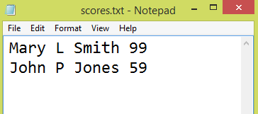
ofstream class
ofstream output; // Create a file object
output.open("scores.txt"); // Open or create a file for writing
output << "Mary" << " " << "L" << " " << "Smith" << " " << 99 << endl;
output << "John" << " " << "P" << " " << "Jones" << " " << 59 << endl;
output.close();

Slide 5
ofstream class
ofstream output; // Create a file object
output.open("scores.txt"); // Open or create a file for writing
output << "Mary" << " " << "L" << " " << "Smith" << " " << 99 << endl;
output << "John" << " " << "P" << " " << "Jones" << " " << 59 << endl;
output.close();
Could you figure out how the bytes of data are ordered in the file?
A datum or data are represented as a series of bytes.

Slide 6
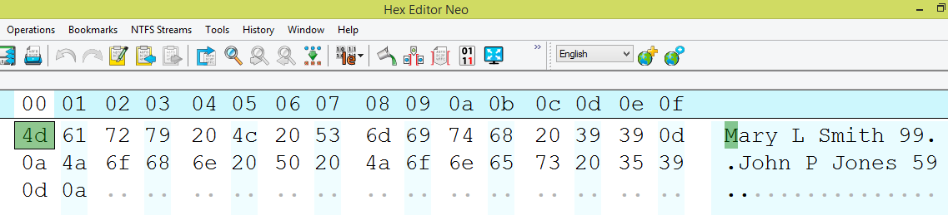
ofstream class
ofstream output; // Create a file object
output.open("scores.txt"); // Open or create a file for writing
output << "Mary" << " " << "L" << " " << "Smith" << " " << 99 << endl;
output << "John" << " " << "P" << " " << "Jones" << " " << 59 << endl;
output.close();
Could you figure out how the bytes of data are ordered?
View the file content in Hex Editor Neo

Slide 7
ofstream class
ofstream output; // Create a file object
output.open("scores.txt"); // Open or create a file for writing
output << "Mary" << " " << "L" << " " << "Smith" << " " << 99 << endl;
output << "John" << " " << "P" << " " << "Jones" << " " << 59 << endl;
output.close();
We can read the content of the file directly because the data are stored as text (ASCII code).

Slide 8
Close file
We must use the close() function to close the stream for the object.
If we do not invoke the close function, the data may not be saved in the file.
ofstream output; // Create a file object
output.open("scores.txt"); // Open or create a file for writing
output << "Mary" << " " << "L" << " " << "Smith" << " " << 99 << endl;
output << "John" << " " << "P" << " " << "Jones" << " " << 59 << endl;
output.close();

Slide 9
output.open("scores.txt");
When we use open to open a file, we must be careful.
If the file already exists, its contents will be destroyed without warning.
ofstream output; // Create a file object
output.open("scores.txt"); // Open or create a file for writing
output << "Mary" << " " << "L" << " " << "Smith" << " " << 99 << endl;
output << "John" << " " << "P" << " " << "Jones" << " " << 59 << endl;
output.close();

Slide 10
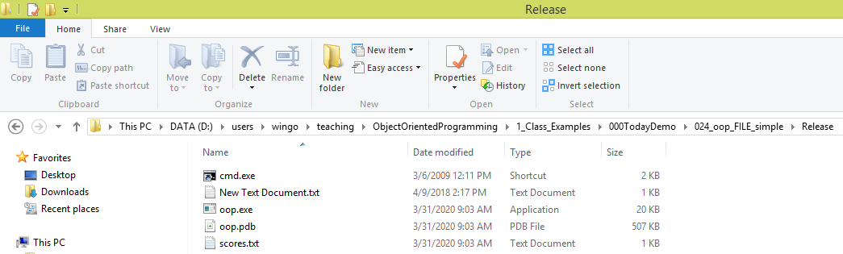
Absolute filename
In a file system, a file is placed in a directory.
An absolute file name contains a file name with its path and drive letter.
For example, the exe file is placed in D:\teaching\OOP\1_Class_Examples\024_oop_FILE_simple\Release.
D: is the drive letter. Absolute file names are machine-dependent (Platform dependent).

Slide 11
Including \ in file names
The backslash (\) is the directory separator for Windows.
To output the backslash character, we must write \\.
For example:
output.open("d:\\OOP_test\\student_scores.txt");

Slide 12
Relative filename
We can use relative file name without drive letters.
→ platform free
The directory of the relative filename can be specified as follows:
./ ; the current directory
../ ; the parent directory of the current directory
./../filename

Slide 13
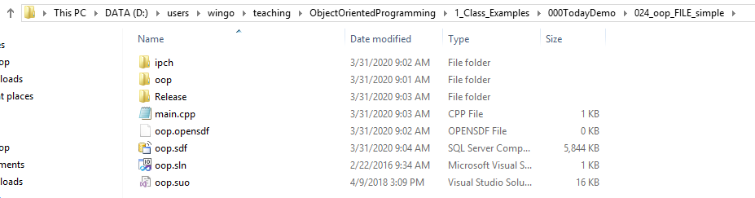
Relative filename
./ ; the current directory, i.e., 024_oop_FILE_simple
../ ; we will go to the folder: 000TodayDemo
./Release/opp.exe ; the opp.exe file in the Release folder

Slide 14
Examples for Relative file paths
./oop.sln
./main.cpp
./Release/scores.txt
../../Example2/Release/oop2.exe // climb up and down the directory
// hierarchy to get oop2.exe

Slide 15
Reading Data from a File
We use the ifstream class to read data from a text file.
void printf_info( ) {
cout << firstName << " " << mi << " "
<< lastName << " " << score << endl;
}
ifstream input("scores.txt"); // open a file to read data
char mi; string firstName, lastName; int score;
int flg = input.fail( );
if ( flg ) { return; //cannot open }
input >> firstName >> mi >> lastName >> score;
printf_info( );
input >> firstName >> mi >> lastName >> score;
printf_info( );
input.close();
File content:
Mary L Smith 99
John P Jones 59

Slide 16
Testing File Existence
We should check whether a file exists before performing operations on it.
We can invoke the fail() function after invoking the open function.
If the return value of fail() is true, it indicates that the file does not exist.
ifstream input("student_scores.txt");
If ( input.fail()) { //cannot open file }

Slide 17
Testing File Existence
ifstream input("myscores.txt"); // Read data
char mi; string lastName; int score;
try {
int flg = input.fail( );
if ( flg ) { throw flg; }
……
input.close();
} catch( int flg ) {
cout << "Error. Cannot open file. Flag:" << flg << endl;
}

Slide 18
Known data format
To read data correctly, you need to know exactly how data is stored. For example, the program would not work if the score is a double value with a decimal point.
ifstream input("scores.txt"); // Read data
char mi; string lastName; int score;
try {
int flg = input.fail( );
if ( flg ) { return; //cannot open}
input >> firstName >> mi >> lastName >> score;
……
input.close();
}
File content:
John T Smith 90
Eric K Jones 14

Slide 19
eof
We invoke the eof() function on the input object to detect the end of file.
double sum = 0; double number;
while (input >> number) // read to the end of file
{
cout << number << " ";
sum += number;
}
Note: bool flg = input >> number
flg is true if input reads a number successfully

Slide 20
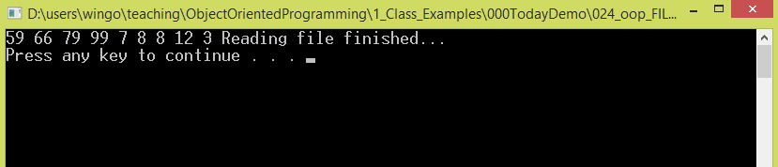
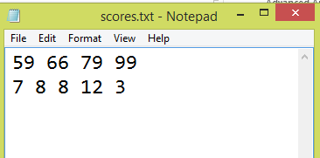
eof
We invoke the eof() function on the input object to detect the end of file.
double sum = 0; double number;
while (input >> number) // read to the end of file
{
cout << number << " ";
sum += number;
}

Slide 21
Functions for reading and writing data
The stream extraction operator (>>) can read a text that does not contain a whitespace character.
To read a text that has whitespace characters, we can use getline.
getline(ifstream& input, string &s, char delimiter)

Slide 22
getline with delimiter: ' '
File content:
Mary L Smith 99
John P Jones 59
ifstream input;
input.open("scores.txt");
while(!input.eof()) {
string str;
getline(input, str, ' ');
cout << "str:" << str << endl;
}
str:Mary
str:L
str:Smith
str:99
John
str:P
str:Jones
str:59
;a newline

Slide 23
getline with delimiter: ' '
File content:
Mary L Smith 99
John P Jones 59
ifstream input;
input.open("scores.txt");
while(!input.eof()) {
string str;
getline(input, str, '\n');
cout << "str:" << str << endl;
}
str:Mary L Smith 99
str:John P Jones 59
str:
problem!

Slide 24
getline with delimiter: '\n'
File content:
Mary L Smith 99
John P Jones 59
ifstream input;
char delimiter = '\n';
input.open("scores.txt");
while(true) {
string str;
getline(input, str, delimiter);
if ( input.eof() ) break;
cout << "str:" << str << endl;
}
str:Mary L Smith 99
str:John P Jones 59

Slide 25
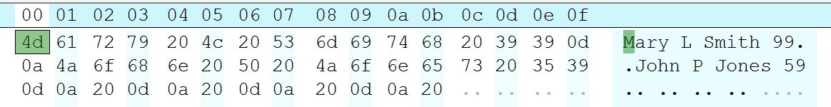
getline with delimiter: '\n'
File content:
Mary L Smith 99
John P Jones 59
ifstream input;
char delimiter = '\n';
input.open("scores.txt");
while(true) {
string str;
getline(input, str, delimiter);
if ( input.eof() ) break;
cout << "str:" << str << endl;
}
Three lines with a whitespace character
str:Mary L Smith 99
str:John P Jones 59
str:
str:
str:
0x20: whitespace character in ASCII code

Slide 26
get and put
Invoke the get function on an input object to read a character.
Invoke the put function on an output object to write a character.

Slide 27
The get function
Invoke the get function on an input object to read a character.
void readFile_UsingGet( ) {
ifstream input; // Create a file object
input.open("use_put.txt"); // Open or create a file for writing
string msg;
int c = 0;
char ch;
while (true) {
input.get(ch);
if (input.eof()) break;
msg += ch; // append ch to the end of the string in msg
}
cout << "str size:" << msg.size() << endl;
cout << "str:" << msg << endl;
input.close();
}
str size:23
str:Using the put function.

Slide 28

The get function
void readFile_UsingGet( ) {
ifstream input; // Create a file object
input.open("use_put.txt"); // Open or create a file for writing
string msg;
int c = 0;
char ch;
while (input.get(ch)) {
//input.get(ch);
//if (input.eof()) break;
msg += ch; // append ch to the end of the string in msg
}
......
input.close();
}
str size:23
str:Using the put function.
while (true) {
input.get(ch);
if (input.eof()) break;
msg += ch;
}

Slide 29
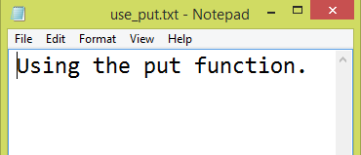
The put function
void saveFile_UsingPut( ) {
ofstream output;
output.open("use_put.txt");
string msg("Using the put function.");
int c = 0;
char ch;
while ( ch = msg[ c++ ] ) {
output.put(ch); // write one character
}
output.close(); // close the file
cout << "file saved..." << endl;
}

Slide 30
get and put
Read a sequence of characters from a file and save them to another file.
char ch = input.get(); // Read a character
while ( !input.eof( ) ) // Check if end of file
{
output.put( ch ); // Save the character
ch = input.get( ); // Read next character
}

Slide 31
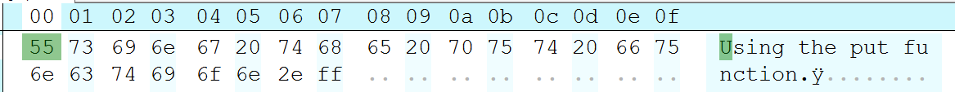
get and put
Read a sequence of characters from a file and save them to another file.
char ch = input.get(); // Read a character
while ( !input.eof( ) ) // Check if end of file
{
char ch = input.get( ); // Read next character
output.put( ch ); // Save the character
}
Wrong Approach
The last character is an extra character.

Slide 32
The fstream class
We can use the fstream class to create an input stream or output stream.
To open an fstream file, we specify a file mode to tell how the file will be used.
Please read the file modes.
| :This is a bitwise inclusive OR operator.
For example,
stream.open("city.txt", ios::out | ios::app);

Slide 33
File Open Modes
Mode | Description
ios::in
ios::out
ios::app
ios:ate
ios::truct
ios:binary

Slide 34
Combining Modes
We use the | operator to obtain a combination of modes.
For example, to open an output file named city.txt for appending data, you can use the following statement:
stream.open("city.txt", ios::out | ios::app);

Slide 35
Stream States & Stream State Bit Values
Each stream object contains a set of bits that are treated as flags.
Each bit value (0 or 1) indicates the state of a stream.
Bit | Description
ios::eofbit | Set when the end of an input stream is reached
ios::failbit | Set when an operation failed
ios::hardfail | Set when an unrecoverable error occurred
ios::badbit | Set when an invalid operation has been attempted
ios::goodbit | Set when an operation is successful

Slide 36
Stream State Functions
Function | Description
eof( ) | true if the eofbit flag is set
fail( ) | true if the failbit or hardfail flags is set
bad( ) | true if the badbit is set
good( ) | true if the goodbit is set
clear( ) | clears all flags

Slide 37
Binary I/O
A text file consists of a sequence of characters (ASCII code).
A binary file as consisting of a sequence of bytes.
Example.
199 (decimal integer) is stored as the sequence of three characters, '1', '9', ‘7', in a text file.
A byte-type value C5 is stored in a binary file.
Decimal 197 = Hex C5 (199 = 12 * 16 + 5).

Slide 38
Text vs. Binary I/O
All files are stored as a sequence of bytes.
They are stored in binary format.
We build the text I/O upon binary I/O to provide a level of abstraction for character encoding and decoding.
Text view
Binary format

Slide 39
Using the ios::binary mode
Binary I/O does not require conversions.
If we write a numeric value to a file, the exact value is saved to the file.
fstream output; // Create a file object
output.open("scores.txt", ios::out|ios::binary );
Syntax for the write/read function of the stream object.
streamObject.write(char* bytes, int size);
streamObject.read(char* bytes, int size);

Slide 40
reinterpret_cast
We can use it to cast the address of a primitive type value or an object to a character array pointer for binary I/O.
Syntax:
reinterpret_cast<dataType>(address)
address: The starting address of the data (primitive, array, or object).

Slide 41
class A { public: A() { x = 0x1234; z = 1.234; }
int x; double z;
};
A a;
void write_file( ) { fstream output; // Create a file object
output.open("scores.txt", ios::out|ios::binary );
output.write(reinterpret_cast<char*>(&a.x), sizeof(a.x));
output.write(reinterpret_cast<char*>(&a.z), sizeof(a.z));
output.close(); }
void read_file( ) { fstream input; // Create a file object
input.open("scores.txt", ios::in|ios::binary );
input.read(reinterpret_cast<char*>(&a.x), sizeof(a.x));
input.read(reinterpret_cast<char*>(&a.z), sizeof(a.z));
cout << "a.x:" << a.x << endl;
cout << "a.z:" << a.z << endl;
input.close( ); }

Slide 42
Random Access
A file consists of a sequence of bytes.
A file pointer points to a byte that is to be read.
It points to the beginning of a file when the file is opened.
When data are read/write to the file, the file pointer moves forward to the next data item.
Example: When we put a character using the put( ) function, the file pointer moves one byte ahead of the previous location.
file pointer
file
byte
byte
byte
byte
byte
byte
……
byte
byte
byte
Before put
file
byte
byte
byte
byte
byte
byte
……
byte
byte
byte
After put

Slide 43
seekp, seekg (note: get and put pointers are the same???)
seekg: for controlling the get pointer
seekp: for controlling the put pointer
tellg: return the position of the getpointer
tellp: return the position of the put pointer
Statement | Purpose
seekg(128, ios:beg); | Move the get file pointer to 128th byte from the beginning of the file
seekg(-32, ios:cur); | Move the get file pointer to the 32th byte backward from the current get pointer position
seekp(-128, ios:end); | Move the put file pointer to the 128th byte backward from the end of the file
seekp(32); | Move the get file pointer to 128th byte in the file

Slide 44
seekp, seekg, tellp, tellg
ios::beg | Offset from the beginning of the file
ios::end | Offset from the end of the file
ios::cur | Offset from the current file pointer
file pointer
file
byte
byte
byte
byte
byte
byte

Slide 45
How to output in hex format
fstream input; // Create a file object
input.open("scores.txt", ios::in|ios::binary );
input.seekg(0, ios::beg); //get file pointer
while (true) {
char c;
c = input.get();
if (input.eof()) break;
cout << c << endl; // in ASCII code
}

Slide 46
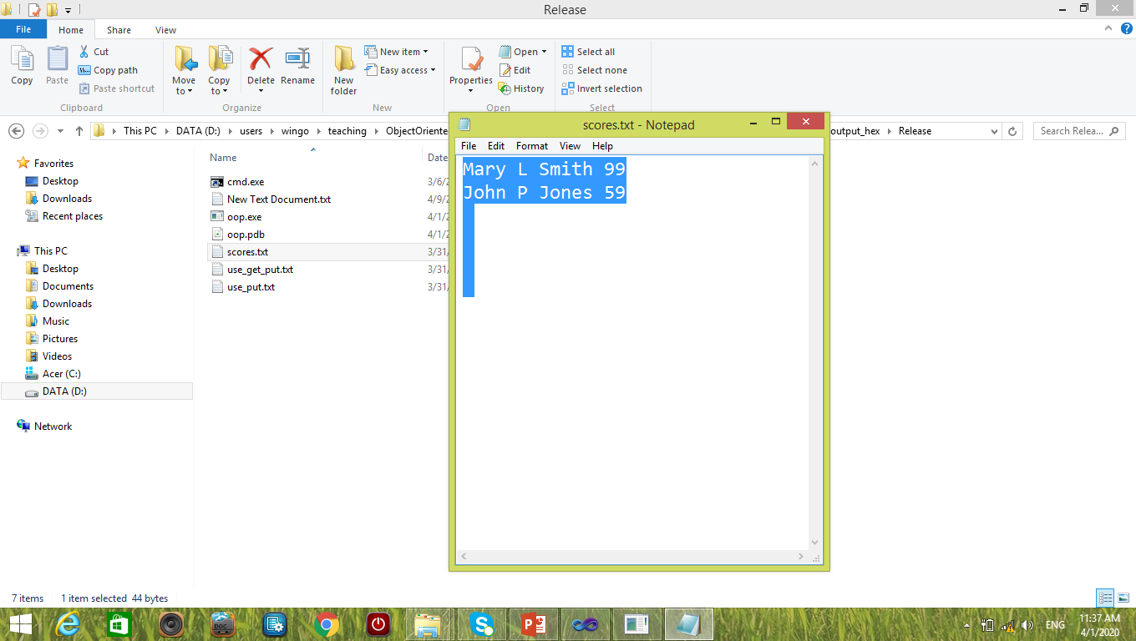
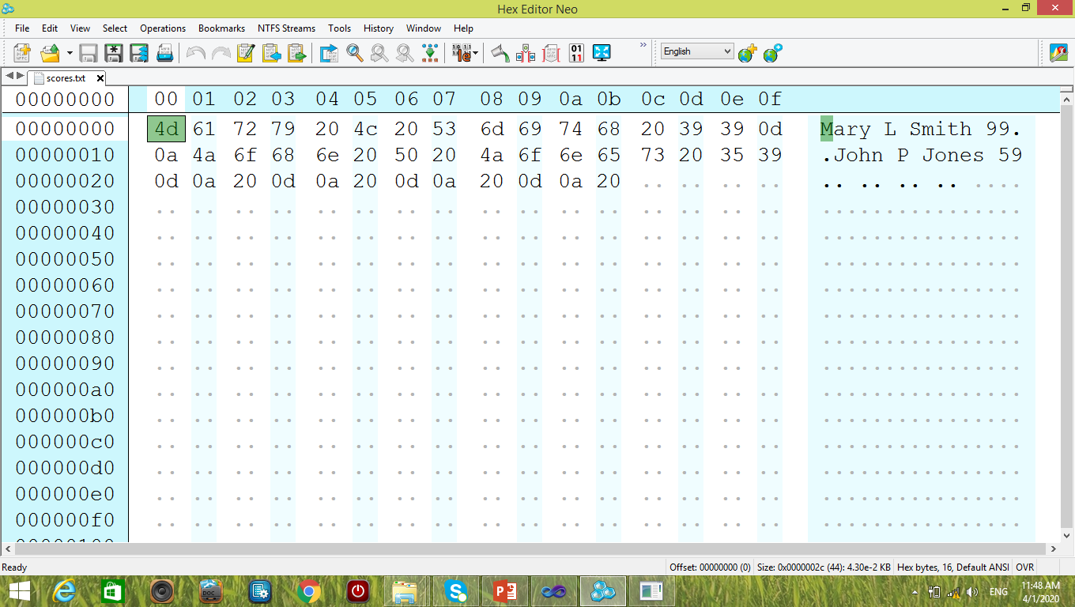
How to output in hex format
fstream input;
input.open("scores.txt",
ios::in|ios::binary );
input.seekg(0, ios::beg);
while (true) {
char c = input.get();
if (input.eof()) break;
cout << c << " ";
}
a r y L S m i t h 9 9
J o h n P J o n e s 5 9
M is missing!

Slide 47
How to output in hex format
fstream input;
input.open("scores.txt",
ios::in|ios::binary );
input.seekg(0, ios::beg);
while (true) {
char c = input.get();
if (input.eof()) break;
cout << std::hex << c << " ";
}
a r y L S m i t h 9 9
J o h n P J o n e s 5 9
c is a char!

Slide 48
How to output in hex format
fstream input;
input.open("scores.txt",
ios::in|ios::binary );
input.seekg(0, ios::beg);
while (true) {
char c = input.get();
if (input.eof()) break;
cout << std::hex << (int) c << " ";
}
4d 61 72 79 20 4c 20 53 6d 69 74 68 20 39 39 d a 4a 6f 68 6e 20 50 20 4a 6f 6e 65 73 20 35 39 d a 20 d a 20 d a 20 d a 20
The ASCII code of M appears!

Slide 49
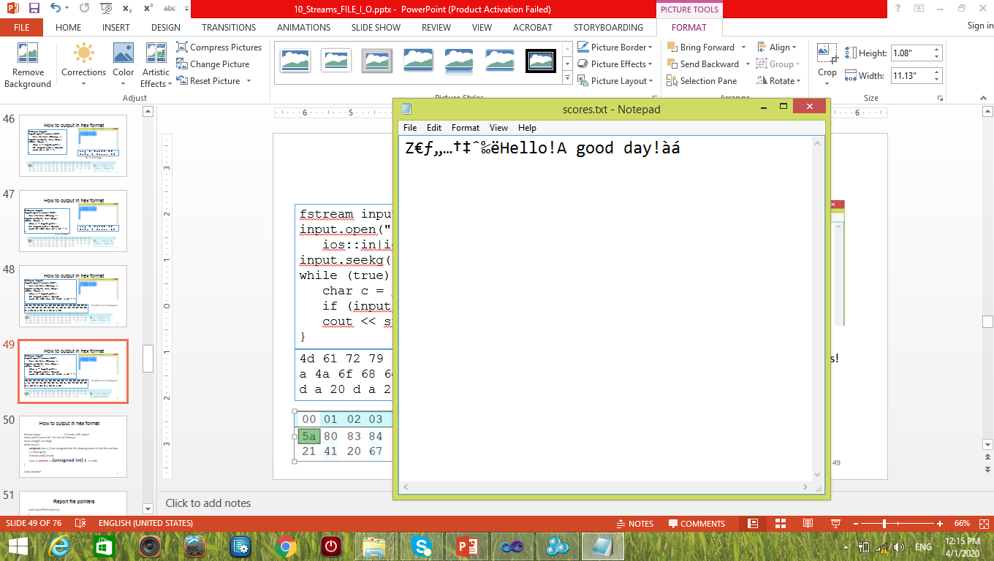
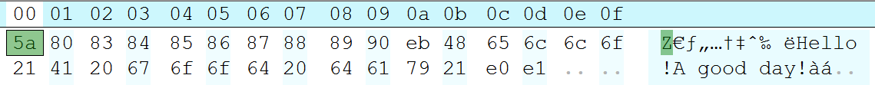
How to output in hex format
fstream input;
input.open("scores.txt",
ios::in|ios::binary );
input.seekg(0, ios::beg);
while (true) {
char c = input.get();
if (input.eof()) break;
cout << std::hex << (int) c << " ";
}
5a ffffff80 ffffff83 ffffff84 ffffff85 ffffff86 ffffff87 ffffff88 ffffff89 ffffff90 ffffffeb 48 65 6c 6c 6f 21 41 20 67 6f 6f 64 20 64 61 79 21 ffffffe0 ffffffe1

Slide 50
How to output in hex format
fstream input;
input.open("scores.txt",
ios::in|ios::binary );
input.seekg(0, ios::beg);
while (true) {
unsigned char c = input.get();
if (input.eof()) break;
cout << std::hex << (unsigned int) c << " ";
}
5a 80 83 84 85 86 87 88 89 90 eb 48 65 6c 6c 6f 21 41 20 67 6f 6f 64 20 64 61 79 21 e0 e1

Slide 51
Report file pointers
void reportFilePointers()
{
cout << "tellp:" << input.tellp() << endl;
cout << "tellg:" << input.tellg() << endl;
}

Slide 52
Report Data
void reportData(
unsigned char &a1,
unsigned char &b1,
unsigned char &c1,
unsigned char &d1
)
{
cout << "a1:" << hex << (unsigned short) a1 << endl;
cout << "b1:" << hex << (unsigned short) b1 << endl;
cout << "c1:" << hex << (unsigned short) c1 << endl;
cout << "d1:" << hex << (unsigned short) d1 << endl;
}

Slide 53
Read a file backward
unsigned char a1, b1, c1, d1;
fstream input; // Create a file object
input.open(cn_fileName, ios::in|ios::binary );
input.seekg(-1, ios::end);
//
input.read(reinterpret_cast<char*>(&a1), sizeof(a1));
input.seekp(-2, ios::cur);
input.read(reinterpret_cast<char*>(&b1), sizeof(b1));
input.seekp(-2, ios::cur);
input.read(reinterpret_cast<char*>(&c1), sizeof(c1));
input.seekp(-2, ios::cur);
input.read(reinterpret_cast<char*>(&d1), sizeof(d1));

Slide 54
Read a file backward
The file content in hexadecimal format:
34 12 21 12 58 39 b4 c8 00 be f3 3f
0 1 2 3 4 5 6 7 8 9 10 11 (address)
unsigned char a1, b1, c1, d1;
fstream input; // Create a file object
input.open(cn_fileName, ios::in|ios::binary );
reportfilePointers(input);
input.seekg(-1, ios::end);
reportfilePointers(input);
input.read(reinterpret_cast<char*>(&a1), sizeof(a1));
reportfilePointers(input);
input.seekg(-2, ios::cur);
reportfilePointers(input);
input.read(reinterpret_cast<char*>(&b1), sizeof(b1));
input.seekg(-2, ios::cur);
input.read(reinterpret_cast<char*>(&c1), sizeof(c1));
input.seekg(-2, ios::cur);
input.read(reinterpret_cast<char*>(&d1), sizeof(d1));
reportData(a1, b1, c1, d1)
tellp:0
tellg:0
tellp:11
tellg:11
tellp:12
tellg:12
tellp:10
tellg:10
a1:3f
b1:f3
c1:be
d1:0

Slide 55
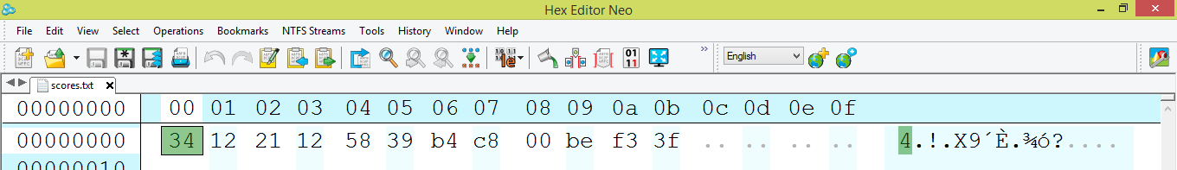
Memory address increasing direction
The file content in hexadecimal format:
34 12 21 12 58 39 b4 c8 00 be f3 3f

Slide 56
What happens if we make a mistake?
The file content in hexadecimal format:
34 12 21 12 58 39 b4 c8 00 be f3 3f
0 1 2 3 4 5 6 7 8 9 10 11 (address)
unsigned char a1, b1, c1, d1;
fstream input; // Create a file object
input.open(cn_fileName, ios::in|ios::binary );
reportfilePointers(input);
input.seekg(1, ios::end); // wrong, out of bound
reportfilePointers(input);
input.read(reinterpret_cast<char*>(&a1), sizeof(a1));
reportfilePointers(input);
input.seekg(-2, ios::cur);
reportfilePointers(input);
input.read(reinterpret_cast<char*>(&b1), sizeof(b1));
input.seekg(-2, ios::cur);
input.read(reinterpret_cast<char*>(&c1), sizeof(c1));
input.seekg(-2, ios::cur);
input.read(reinterpret_cast<char*>(&d1), sizeof(d1));
reportData(a1, b1, c1, d1)
a1:bf
b1:0
c1:2d
d1:6
These numbers cannot be found in the file, except for 0.

Slide 57
What happens if we make a mistake?
The file content in hexadecimal format:
34 12 21 12 58 39 b4 c8 00 be f3 3f
0 1 2 3 4 5 6 7 8 9 10 11 (address)
unsigned char a1, b1, c1, d1;
fstream input; // Create a file object
input.open(cn_fileName, ios::in|ios::binary );
reportfilePointers(input);
input.seekg(1, ios::end); // wrong, out of bound
reportfilePointers(input);
input.read(reinterpret_cast<char*>(&a1), sizeof(a1));
reportfilePointers(input);
input.seekg(-2, ios::cur);
reportfilePointers(input);
input.read(reinterpret_cast<char*>(&b1), sizeof(b1));
input.seekg(-2, ios::cur);
input.read(reinterpret_cast<char*>(&c1), sizeof(c1));
input.seekg(-2, ios::cur);
input.read(reinterpret_cast<char*>(&d1), sizeof(d1));
reportData(a1, b1, c1, d1)
tellp:0
tellg:0
tellp:13
tellg:13
tellp:-1
tellg:-1
tellp:-1
tellg:-1
a1:bf
b1:0
c1:2d
d1:6

Slide 58
Binary numbers
Digits: 1 (true) or 0 (false)
MSB: most significant bit
LSB: least significant bit
Bit numbering:
Position value.
MSB
LSB
0
1
0
0
0
0
0
1
7
6
5
4
3
2
1
0
2¹⁰
MSB
LSB
1
0
0
0
0
0
0
0
0
1
0
0
0
0
0
0
15
14
13
12
11
10
9
8
7
6
5
4
3
2
1
0

Slide 59
Hexadecimal digits
Decimal Hex Decimal Hex
0 10 A
1 11 B
2 12 C
3 13 D
4 14 E
5 15 F
6
7
8
9
Examples:
21 (Dec) = 15 (Hex)
16 (Dec) = 10 (Hex)
32 (Dec) = 20 (Hex)
257 (Dec) = 101 (Hex)
Position value: 256

Slide 60
Hexadecimal digits
Decimal Hex Decimal Hex
0 10 A
1 11 B
2 12 C
3 13 D
4 14 E
5 15 F
6
7
8
9
1001 1010 (Bin)
= 9 A (Hex)
1111 0011 1101 0001 (Bin)
= F 3 D 1 (Hex)
F3D1 (Hex)
It has two bytes, F3 and D1.

Slide 61
Hexadecimal digits
Decimal Hex Decimal Hex
0 10 A
1 11 B
2 12 C
3 13 D
4 14 E
5 15 F
6
7
8
9
1D2B4A5F (Hex)
Most significant byte: 1D
Least significant byte:5F

Slide 62
Endianness
Endianness: is the sequential order in which bytes are arranged into larger numerical values when stored in memory or when transmitted over digital links.
Big endian: whenever addressing memory, or sending or storing words bytewise, the most significant byte is stored first.
Big endian: whenever addressing memory, or sending or storing words bytewise, the least significant byte is stored first.
Source: wiki

Slide 63
Endianness
Big endian: whenever addressing memory, or sending or storing words bytewise, the most significant byte is stored first (has the lowest address). Example:
0x12345678 (in C++)
Store to memory: 12 34 56 78
Little endian: whenever addressing memory, or sending or storing words bytewise, the least significant byte is stored first (the lowest address). Example:
0x12345678 (in C++)
Store to memory: 78 56 34 12
Source: wiki
Memory address
Memory address

Slide 64
Endianness
1D2B4A5F (Hex) : 1D has the highest position value
: 5F has the lowest position value
Most significant byte: 1D
Least significant byte:5F
In memory, memory increasing from left to right
Big Endian: 1D 2B 4A 5F (LSB has the highest address)
Little Endian: 5F 4A 2B 1D (MSB has the highest address)

Slide 65
Two’s complement for unsigned integers
10 (Dec)
= 0A (Hex)
= 0000 1010 (Bin)
-10 (Dec)
= -0A (Hex) ?
= -0000 1010 (Bin)?

Slide 66
Two’s complement for unsigned integers
10 (Dec)
= 0A (Hex)
= 0000 1010 (Bin)
-10 (Dec)
= -0A (Hex) ?
= -0000 1010 (Bin)?
10 (Dec)
= 0A (Hex)
= 0000 1010 (Bin)
Invert the bits =>
1111 0101
Add 1 to the result =>
1111 0110

Slide 67
Two’s complement for unsigned integers
-10 (Dec)
= -0A (Hex) ?
= -0000 1010 (Bin)?
10 (Dec)
= 0A (Hex)
= 0000 1010 (Bin)
Invert the bits =>
1111 0101
Add 1 to the result =>
1111 0110
MSB:
Sign bit

Slide 68
Two’s complement for unsigned integers
If MSByte >7,
the number is negative.
10 (Dec)
= 0A (Hex)
= 0000 1010 (Bin)
Invert the bits =>
1111 0101
Add 1 to the result =>
1111 0110
MSB:
Sign bit

Slide 69
Example
7 (Dec)
0000 0111 (Bin)
0000 0000 0000 0111
Invert bits
1111 1111 1111 1000
Add 1
1111 1111 1111 1001
=>
f f f 9
2 bytes
short int a = 7;
short int b = -7;
cout << "a:" << a << endl;
cout << "a(hex):" << hex << a << endl;
cout << "b:" << dec << b << endl;
cout << "b(hex):" << hex << b << endl;
Output:
a:7
a(hex):7
b:-7
b(hex):fff9

Slide 70
Example
7 (Dec)
0000 0111 (Bin)
0000 0000 0000 0000
0000 0000 0000 0111
Invert bits
1111 1111 1111 1111
1111 1111 1111 1000
Add 1
1111 1111 1111 1111
1111 1111 1111 1001
=>
f f f f f f f 9
Four bytes
int a = 7;
int b = -7;
cout << "a:" << a << endl;
cout << "a(hex):" << hex << a << endl;
cout << "b:" << dec << b << endl;
cout << "b(hex):" << hex << b << endl;
Output:
a:7
a(hex):7
b:-7
b(hex):fffffff9

Slide 71
Exercise One What are the output?
The file content in hexadecimal format:
34 12 21 12 58 39 b4 c8 00 be f3 3f
0 1 2 3 4 5 6 7 8 9 10 11 (address)
unsigned char a1, b1, c1, d1;
fstream input; // Create a file object
input.open(cn_fileName, ios::in|ios::binary );
reportfilePointers(input);
input.seekg(-5, ios::end);
reportfilePointers(input);
input.read(reinterpret_cast<char*>(&a1), sizeof(a1));
reportfilePointers(input);
input.seekg(-2, ios::cur);
reportfilePointers(input);
input.read(reinterpret_cast<char*>(&b1), sizeof(b1));
input.seekg(-2, ios::cur);
input.read(reinterpret_cast<char*>(&c1), sizeof(c1));
input.seekg(-2, ios::cur);
input.read(reinterpret_cast<char*>(&d1), sizeof(d1));
reportData(a1, b1, c1, d1)
tellp:0
tellg:0
tellp:?
tellg:?
tellp:?
tellg:?
tellp:?
tellg:?
a1:?
b1:?
c1:?
d1:?

Slide 72
Report Data
void reportData(
unsigned char &a1,
unsigned char &b1,
unsigned char &c1,
unsigned char &d1
)
{
cout << "a1:" << hex << (unsigned short) a1 << endl;
cout << "b1:" << hex << (unsigned short) b1 << endl;
cout << "c1:" << hex << (unsigned short) c1 << endl;
cout << "d1:" << hex << (unsigned short) d1 << endl;
}

Slide 73
Exercise One What are the output?
The file content in hexadecimal format:
34 12 21 12 58 39 b4 c8 00 be f3 3f
0 1 2 3 4 5 6 7 8 9 10 11 (address)
unsigned char a1, b1, c1, d1;
fstream input; // Create a file object
input.open(cn_fileName, ios::in|ios::binary );
reportfilePointers(input);
input.seekg(-5, ios::end);
reportfilePointers(input);
input.read(reinterpret_cast<char*>(&a1), sizeof(a1));
reportfilePointers(input);
input.seekg(-4, ios::cur);
reportfilePointers(input);
input.read(reinterpret_cast<char*>(&b1), sizeof(b1));
input.seekg(2, ios::cur);
input.read(reinterpret_cast<char*>(&c1), sizeof(c1));
input.seekg(3, ios::cur);
input.read(reinterpret_cast<char*>(&d1), sizeof(d1));
reportData(a1, b1, c1, d1)
tellp:0
tellg:0
tellp:7
tellg:7
tellp:8
tellg:8
tellp:4
tellg:4
a1:c8
b1:58
c1:c8
d1:3f

Slide 74
Exercise Two What are the output?
The file content in hexadecimal format:
34 12 21 12 58 39 b4 c8 00 be f3 3f
0 1 2 3 4 5 6 7 8 9 10 11 (address)
char a1, b1, c1, d1;
fstream input; // Create a file object
input.open(cn_fileName, ios::in|ios::binary );
reportfilePointers(input);
input.seekg(-5, ios::end);
reportfilePointers(input);
input.read(reinterpret_cast<char*>(&a1), sizeof(a1));
reportfilePointers(input);
input.seekg(-2, ios::cur);
reportfilePointers(input);
input.read(reinterpret_cast<char*>(&b1), sizeof(b1));
input.seekg(-2, ios::cur);
input.read(reinterpret_cast<char*>(&c1), sizeof(c1));
input.seekg(-2, ios::cur);
input.read(reinterpret_cast<char*>(&d1), sizeof(d1));
reportData_signed_char(a1, b1, c1, d1)
tellp:0
tellg:0
tellp:?
tellg:?
tellp:?
tellg:?
tellp:?
tellg:?
a1:?
b1:?
c1:?
d1:?

Slide 75
Report Data
void reportData_signed_char (
char &a1,
char &b1,
char &c1,
char &d1
)
{
cout << "a1:" << hex << (short) a1 << endl;
cout << "b1:" << hex << (short) b1 << endl;
cout << "c1:" << hex << (short) c1 << endl;
cout << "d1:" << hex << (short) d1 << endl;
}

Slide 76
Exercise Two What are the output?
The file content in hexadecimal format:
34 12 21 12 58 39 b4 c8 00 be f3 3f
0 1 2 3 4 5 6 7 8 9 10 11 (address)
char a1, b1, c1, d1;
fstream input; // Create a file object
input.open(cn_fileName, ios::in|ios::binary );
reportfilePointers(input);
input.seekg(-5, ios::end);
reportfilePointers(input);
input.read(reinterpret_cast<char*>(&a1), sizeof(a1));
reportfilePointers(input);
input.seekg(-4, ios::cur);
reportfilePointers(input);
input.read(reinterpret_cast<char*>(&b1), sizeof(b1));
input.seekg(2, ios::cur);
input.read(reinterpret_cast<char*>(&c1), sizeof(c1));
input.seekg(3, ios::cur);
input.read(reinterpret_cast<char*>(&d1), sizeof(d1));
reportData_signed_char(a1, b1, c1, d1)
tellp:0
tellg:0
tellp:7
tellg:7
tellp:8
tellg:8
tellp:4
tellg:4
a1:ffc8
b1:58
c1:ffc8
d1:3f

