Slide 1


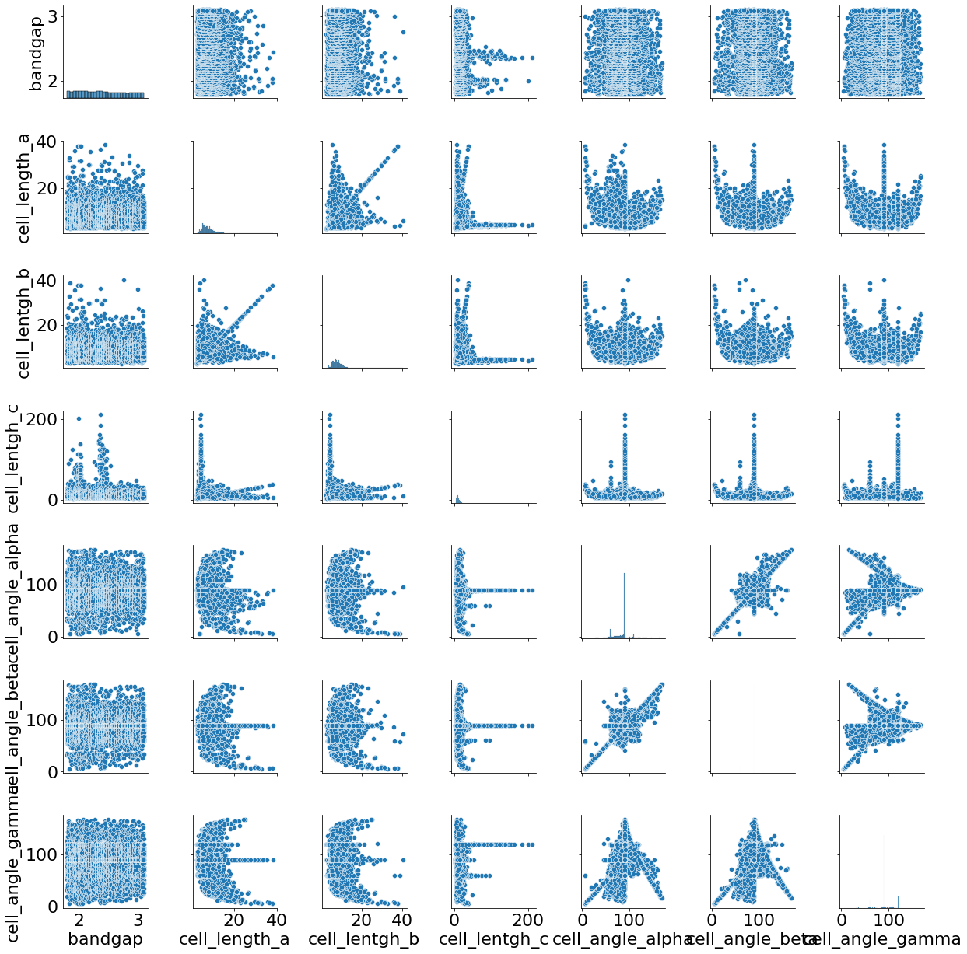
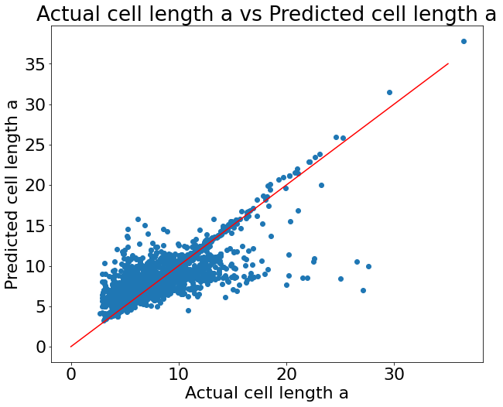
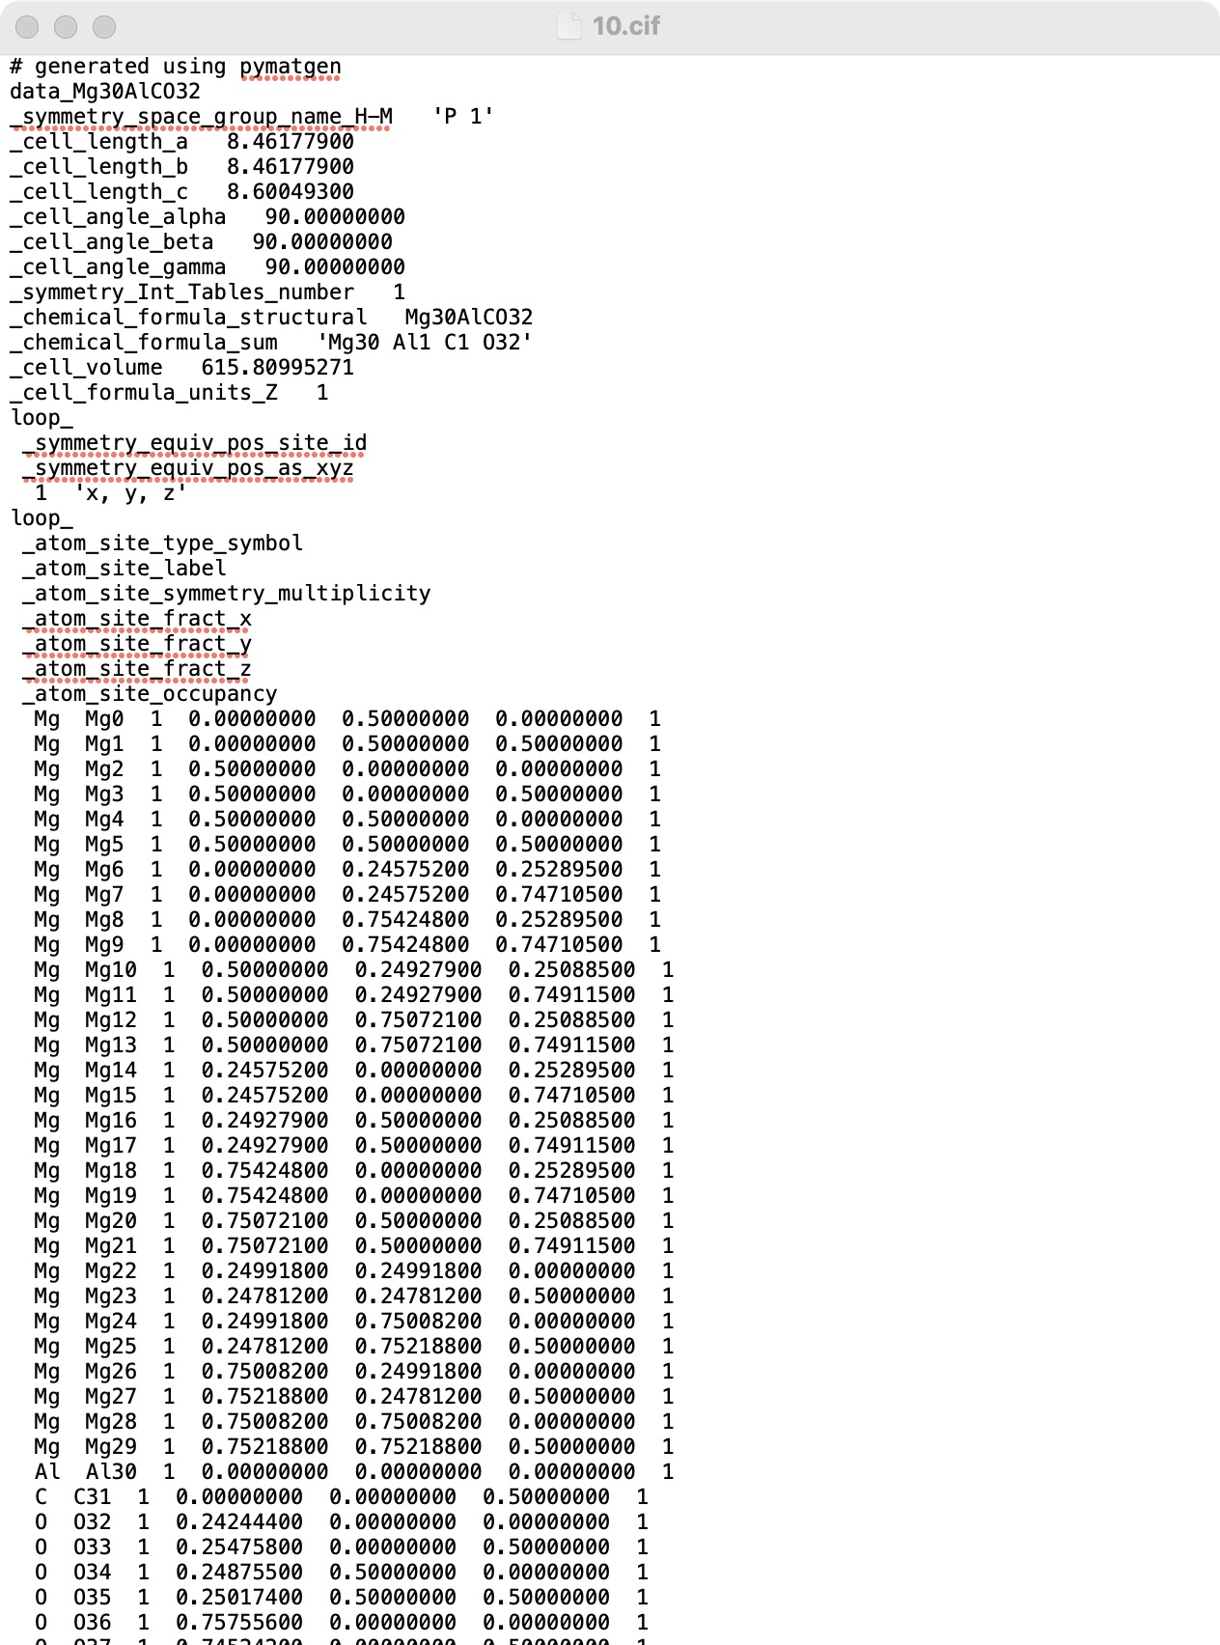
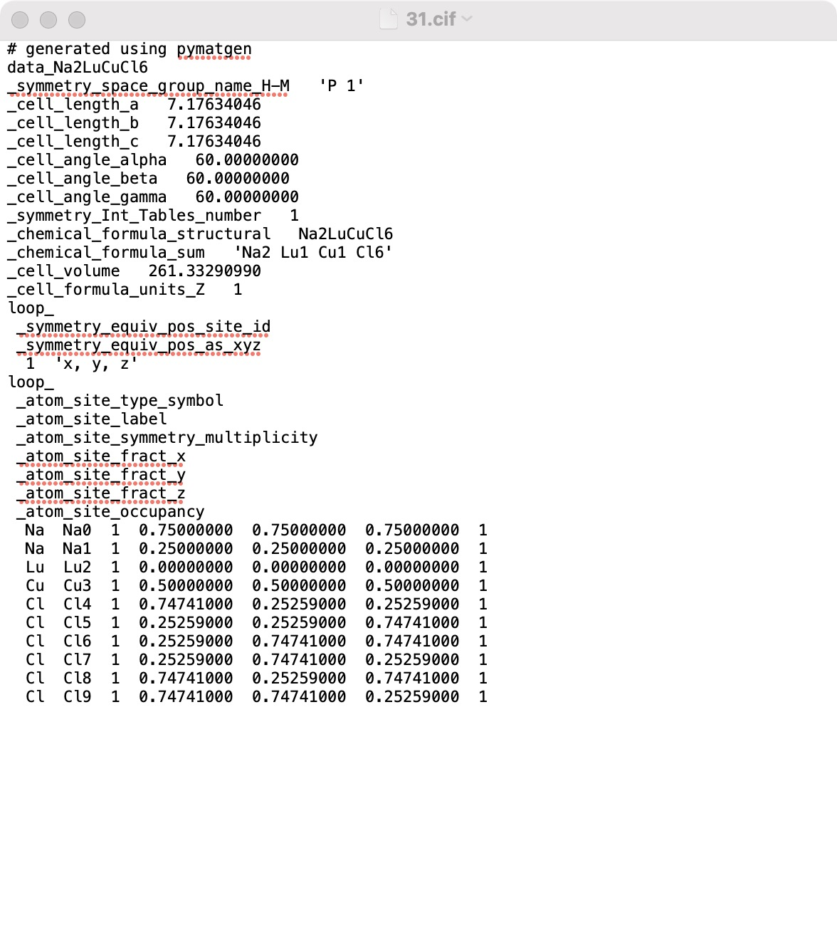
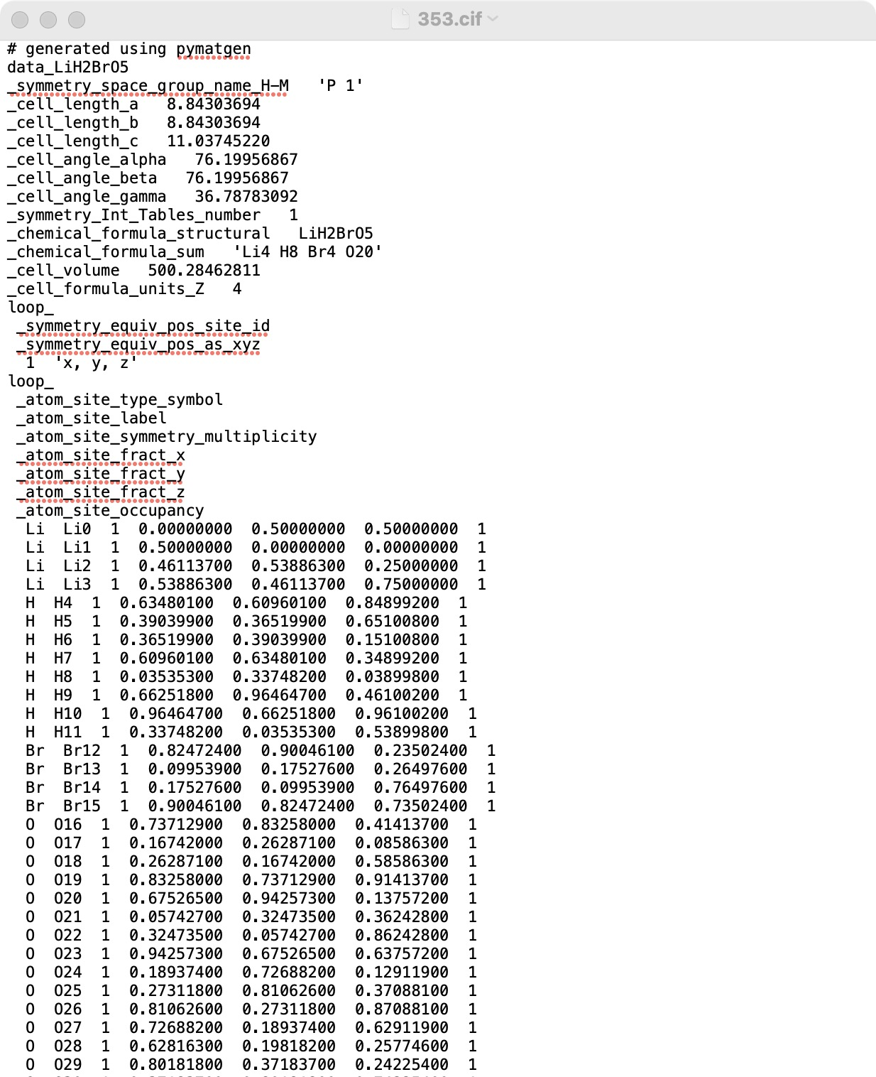
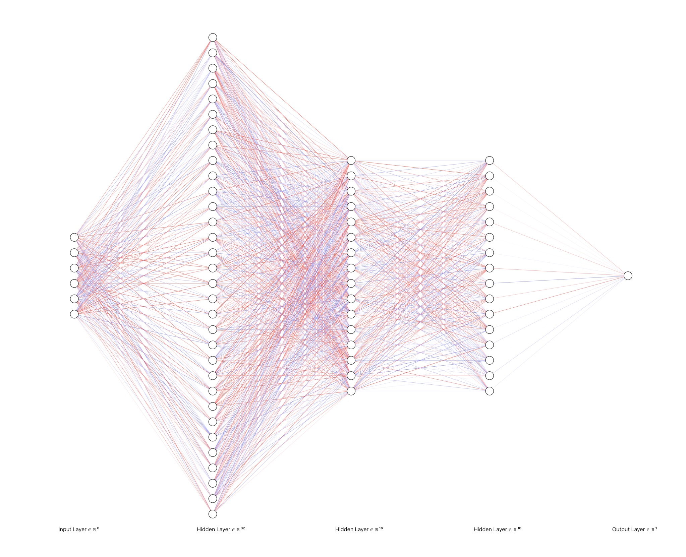
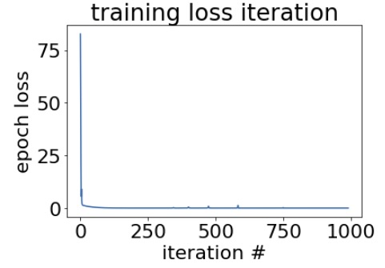
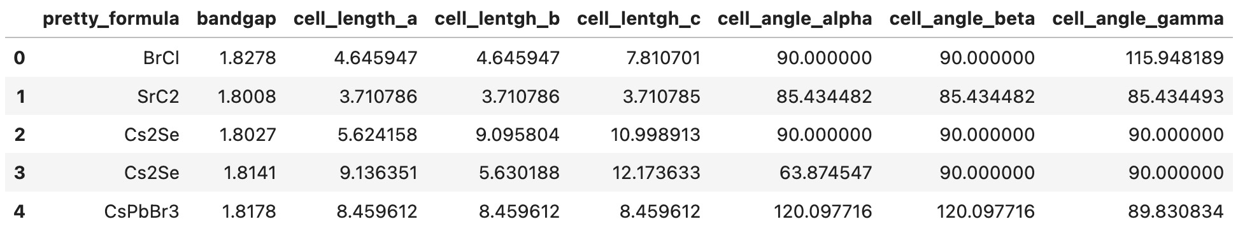
A Practical CIF Process Program And Its Application In Structure-Property Relationship Study
Yanyao Han, Yifei He, Jiayi Li, Ruofan Liu
https://github.com/cif-data-concentration
Motivation & Terminology
I. CIF Preprocess
II. Band Gap Prediction
III. Cell Parameter Prediction
.CIF is a type of tile format that stores the structural information of individual compounds. It is widely applied in the field of materials, structural biology, physics, etc., where people are interested in the relationship between the fundamental molecular structure and the properties.
With the rise of computational tools and big data analysis, massive process of raw .cif files becomes an interest. Automatic extraction of structural information would facilitate the statistical and computational analysis
CIFdownload(api, filepath, lower_bound, higher_bound):
input: api key and a saving directory
Output: a list of dictionaries storing crystal structure information of individual compounds and individual .cif files written from the downloaded library data.
CIFconvert(filepath):
Input: a directory where all the cif files are stored together.
Output: a dataframe containing chemical formula, crystal structure, and user selected properties (e.g. band gaps)
Features:
Automatic extraction and compiling of structural information from multiple cif files in the same directory.
Separate functional modules for independent application.
Sequential input prompt to ease the customization process of API download
With the pair plot of all the features in the extracted dataframe, the correlation within the cell parameters is strong. We thus revised our hypothesis based on this discovery.
Hypothesis: For the band gap of a substance to fall in the visible light spectrum, there is a specific relationship for the cell parameters to satisfy, hence confining the size of the unit cell.
Method: Neural Network
Results:
Hypothesis: the structure of substances is strongly correlated with the band gap values.
Method: For the prediction of the band gap from the structural information, the following 6 parameters extracted from the cif datafram are involved:
Length of the edges in x, y, and z directions
Angle between the edge and the three cartesian axis
A couple of neural network models have been adapted to train the model.
Results:
Deep learning for regression task – MSE of 0.14
K-means clustering (with 3 clusters) – 10.8% accuracy
Deep learning classification with one-hot encoding – 36.7% accuracy
Interpretation:
Despite decent training curve (training cost goes down and converges over the epochs), the classification tasks (both supervised and unsupervised) produce very low accuracy for classification tasks. And regression task’s evaluation metric requires further assessment.
The relatively negative results suggest weak correlation between the structural information and the band gap in the current database. The hypothesis requires further refinement , since the given data set has only band gap as criteria, without controlling other factors in the substances (such as type of atoms ). Therefore, it is very likely that the database contains lots of noise.
Band gap is the energy gap between the valance band and the conduction band of a molecule. It could be interpreted as the energy threshold to ”activate” the conductivity of a material. Tuning the band gap has a great significance on the energy application such as photovoltaic electronics, battery, etc.
One of the factors that associates with this property is the size of the crystalline unit cell. [1]
IV. Future Work
Materials Project is an open-source library that contains common properties and structural information of crystalline inorganics. [2] It accompanies with pymatgen, a python based package, that vividly extracts data and information with customizable components for the users via API access.
However, the learning curve for mastering pymatgen API is relatively sharp. Moreover, pymatgen only provides the methods to access very structured, organized to Materials Project and doesn’t provide revenues for RAW data preprocessing.
CIF Preprocess:
More flexibility and customizability in the chosen information for dataframe conversion by including more input prompts for users.
UI design to replace the input prompts
Band Gap and Cell Parameter Prediction:
Better confinement of the hypothesis with the control of other non-structural factors that impacts the band gap values.
Commitment:
Yanyao Han – Model training, environment setup, UI design.
Yifei He – CIF Preprocess
Jiayi Li – Model training,
Ruofan Liu – Model training, environment setup
[1] Rohrer, G. S. Structure and Bonding in Crystalline Materials, Cambridge University Press, 2001.
[2] Jain, A., et al., The Materials Project: A materials genome approach to accelerating materials innovation, APL Materials, 2013, 1(1), 011002.
Notes:
r square in III
validation loss in II

